Slide 1

SYNOPTIC METEOROLOGY
of a North Atlantic–European Cyclone
Synoptic Analysis of a North Atlantic–European Cyclone
Sasi Varun Ramachandran
Global Software Development · 26.02.2026

Slide 2
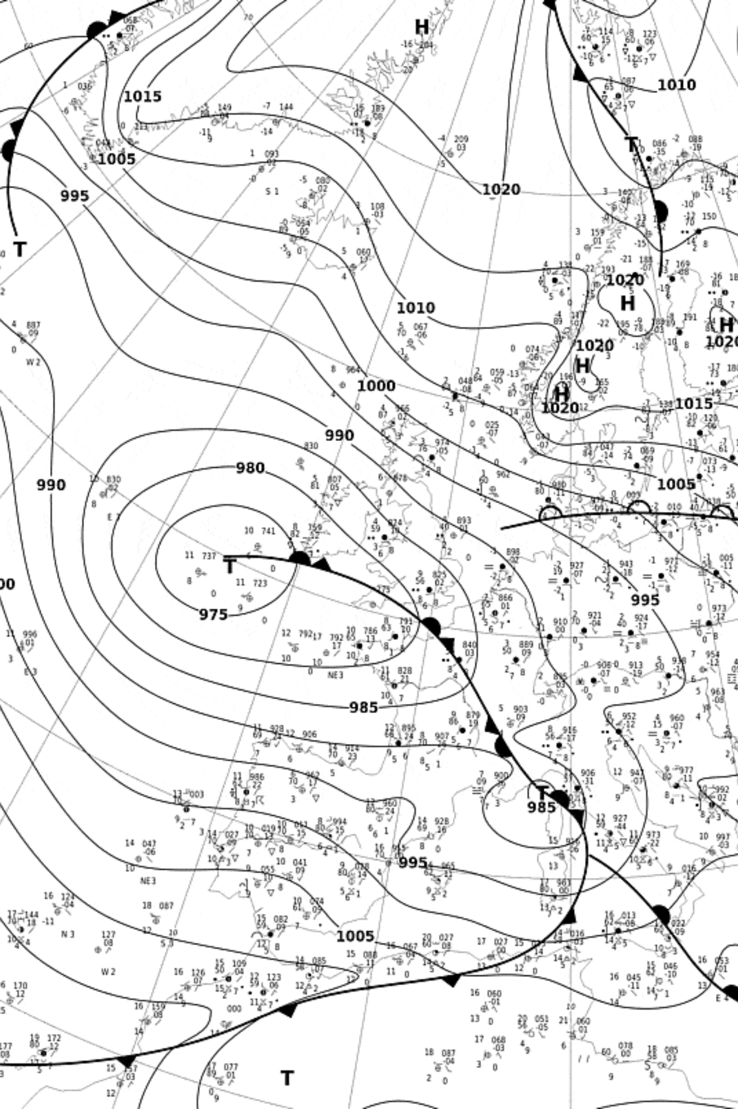
INTRODUCTION
Case Overview
Analysis Time
06 February 2026 – 12:00 UTC
Region of Interest
North Atlantic & Europe
Data Sources
DWD Surface Analysis
Radar Observations (DWD / KNMI)
EUMETSAT Water Vapour Satellite
ICON Model Visualized in Met.3D

Slide 3
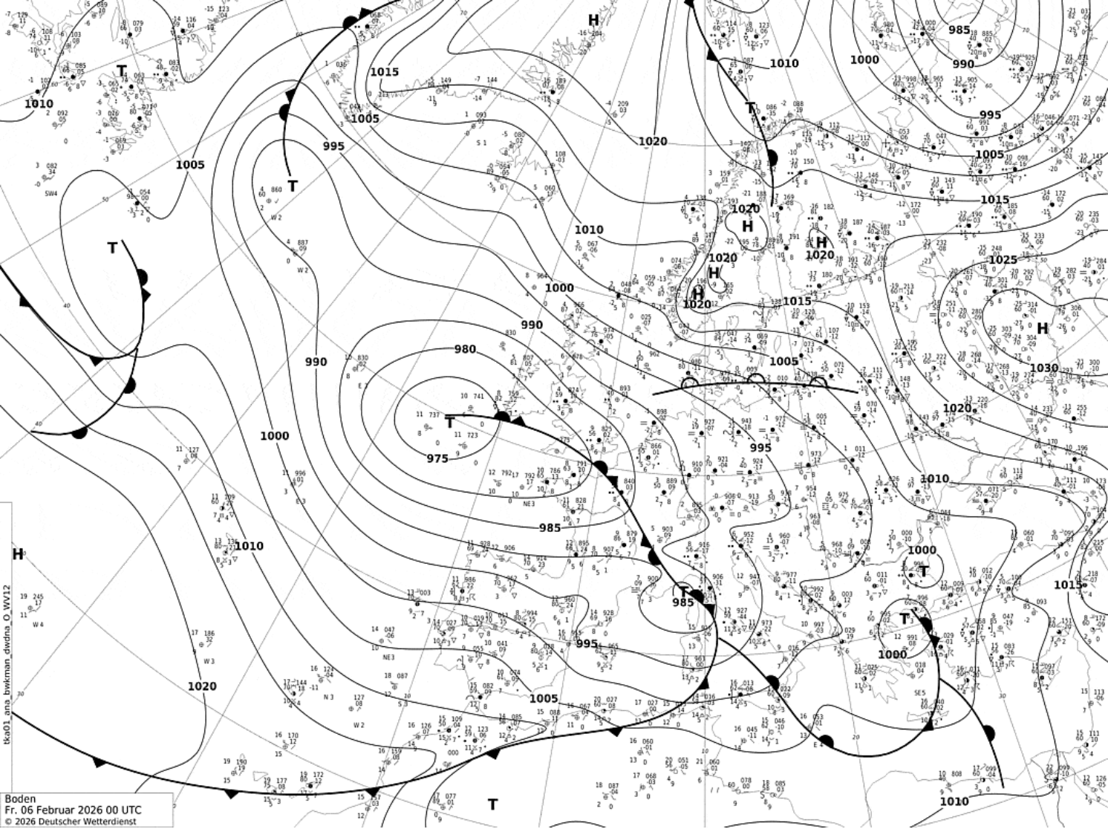
SURFACE ANALYSIS
Synoptic Situation at the Surface
Deep Atlantic Low
Frontal System
~975 hPa low-pressure center located west of Europe, indicating a mature and intense cyclone at the synoptic scale
Well-developed frontal system present, with a cold front extending southeastward from the low-pressure center
Pressure Gradient
High-Pressure Ridge
Strong pressure gradient around the cyclone, with a secondary weaker low identifiable over Central Europe
A high-pressure ridge over Eastern Europe contrasts with the active low-pressure system dominating the western domain

Slide 4
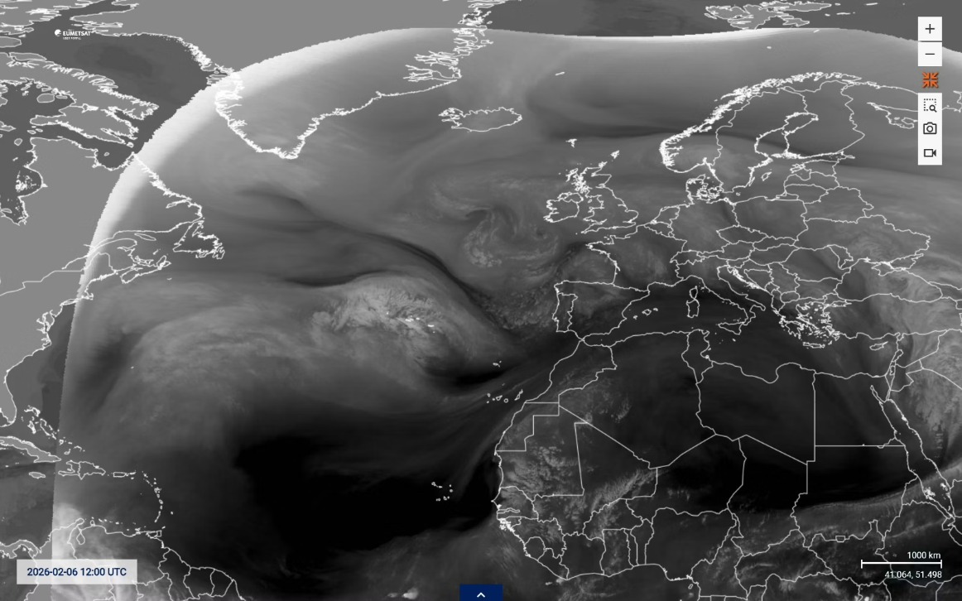
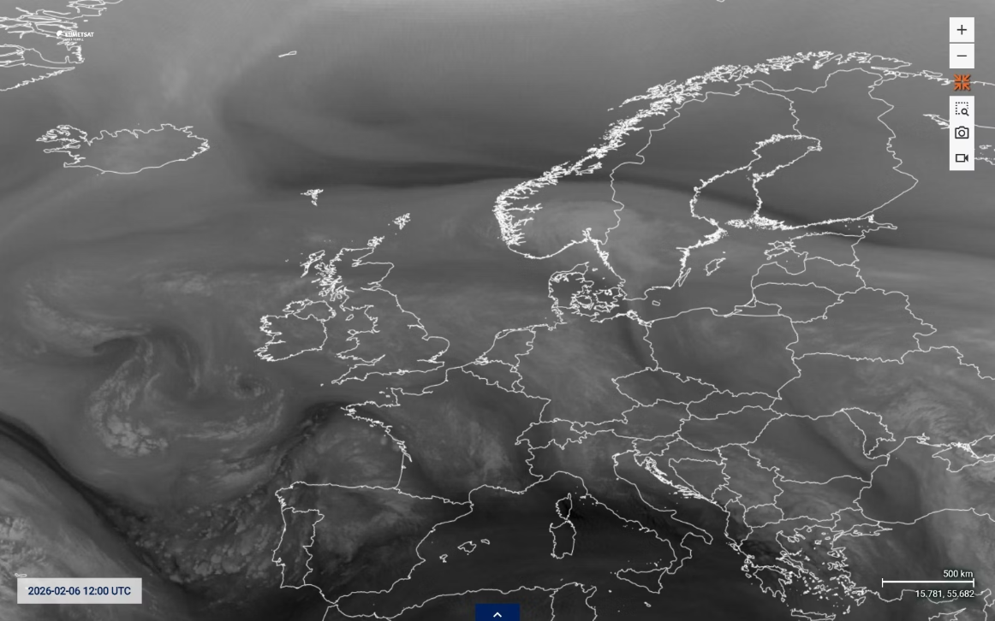
SATELLITE
Satellite Analysis – 06 February 2026, 12 UTC
Water Vapour Imagery
The satellite image at 12 UTC shows a well-developed spiral cloud structure over the North Atlantic, confirming the mature stage of the cyclone.
Key Features
Pronounced cloud band extending southeastward along the frontal zone
Contrast between bright and darker regions reflects differences in moisture content
Dry intrusion wrapping in from the southwest — characteristic of dynamically active mid-latitude cyclones
Strong interaction between upper-level and surface processes confirmed

Slide 5
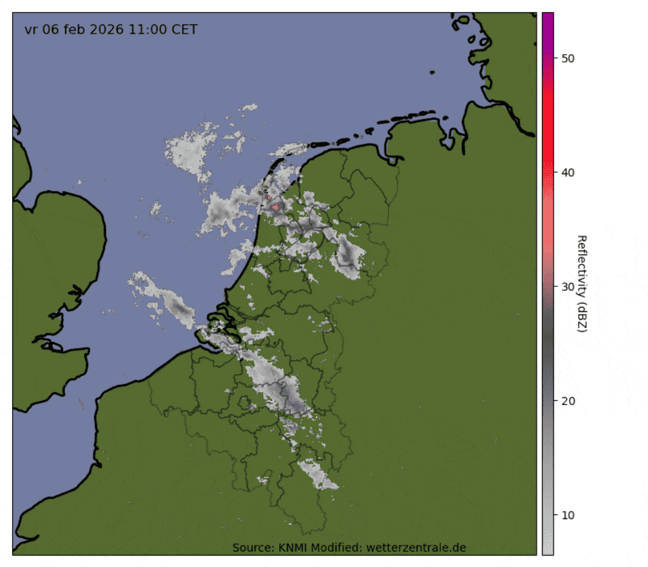
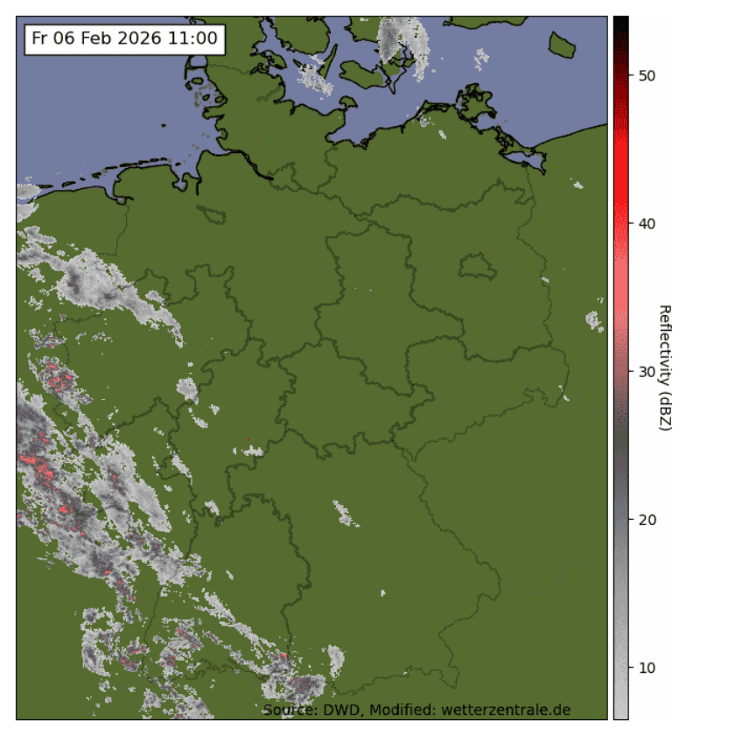
RADAR
Radar Observations – Frontal Precipitation Structure
Precipitation Band Structure
Radar observations at 12 UTC reveal a well-defined precipitation band aligned SW–NE across parts of Western and Central Europe, corresponding to the cold frontal zone.
Key Observations
Strongest reflectivity values concentrated along the frontal boundary
Embedded areas of higher intensity suggest locally stronger convective elements
Precipitation primarily organized along the frontal zone
Consistent with both surface analysis and satellite frontal position

Slide 6
MET.3D
Met.3D – Mean Sea Level Pressure
Model Fidelity
Deep Atlantic low clearly represented at similar position and intensity
Pressure gradient well defined, especially south of the low center
Tightly packed isobars indicate strong surface winds
Frontal structure inferred from pressure field consistent with observational analysis
The Met.3D visualization reproduces the main synoptic features observed in the DWD surface analysis with good agreement in position and intensity.

Slide 7
MET.3D
Met.3D – Surface Wind Field & Precipitation
Wind Distribution
Geostrophic Adjustment
Strongest winds south and southwest of the cyclone center, where the pressure gradient is most pronounced. Wind field follows isobars with clear cyclonic circulation.
Consistent with geostrophic theory — tighter pressure gradients produce stronger winds, confirming the physical relationship between pressure gradient and surface wind intensity.
Precipitation Structure
Model vs. Observations
Well-defined frontal precipitation band associated with the Atlantic cyclone. Strongest areas coincide with regions of enhanced frontal lifting.
Model reproduces the overall structure and position of the precipitation band well. Minor differences in small-scale intensity expected due to model resolution effects.

Slide 8
DISCUSSION
Discussion & Model Evaluation
Observations vs. Model
Satellite Insight
Strong consistency between DWD surface analysis, EUMETSAT satellite imagery, KNMI/DWD radar, and ICON model output across all analysed fields
Dry intrusion and spiral cloud structure confirm dynamically active cyclone stage, supporting the surface-based frontal analysis
Radar Confirmation
Model Limitations
Frontal precipitation band structure in radar aligns well with model-predicted precipitation, validating ICON's frontal positioning
Minor discrepancies in small-scale precipitation intensity are attributable to parameterization effects and resolution constraints inherent to the ICON model

Slide 9



CONCLUSION
Summary & Conclusions
Surface Analysis
Satellite & Radar
Model Validation
Deep North Atlantic low (~975 hPa) with tight pressure gradient and well-developed cold front identified
Spiral cloud structure, dry intrusion, and organized frontal precipitation band confirmed observationally
ICON via Met.3D successfully reproduces large-scale pressure, wind, and precipitation structure
Key Takeaways
Thank You
Strong consistency between observations and ICON model representation at 12 UTC on 06 February 2026
Questions & Discussion
Satellite imagery and radar confirm the mature cyclone stage and dynamically active frontal system
Met.3D demonstrates reliable simulation of synoptic-scale features including pressure, winds, and precipitation

