Slide 1
Crowdsourced Civic Issue Reporting And Resolution
System
CSE7101- Capstone Project Review-1
Batch Number : CSE_139
Under the Supervision of,
Ms. Saiqa Khan N
Professor / Associate Professor / Assistant Professor School of Computer Science and Engineering Presidency University
Name of the Program: B.Tech(Computer Science And Engineering) Name of the HoD: Dr. Blessed Prince
Name of the Program Project Coordinator: Dr. Muthuraj
Name of the School Project Coordinators: Dr. Sampath A K , Dr. Geetha A
Roll Number | Student Name
20221CSE0281 | M Sidhardha
20221CSE0259 | P Sasi Kumar
20221CSE0282 | T Sree Vardhan

Slide 2
Problem Statement Number: SIH25031
Organization :Government Of Jharkhand
Category: Software
Problem Description :Clean and Green Technology

Slide 3
Objectives :
To provide a user-friendly platform for citizens to report civic issues easily
To enable quick identification and documentation of local problems
To improve communication between citizens and municipal authorities
To ensure transparency by allowing users to track the status of reported issues
To prioritize issues based on urgency and public impact
To encourage community participation in civic development
To support faster and more efficient resolution of civic problems
To improve overall quality of public services and urban living

Slide 4
Background and Related work for title Selection
Rapid urban growth has increased the number of civic issues such as potholes, garbage accumulation, water leakage, and malfunctioning streetlights. Traditional methods of reporting these problems are mostly manual, slow, and lack transparency, which often leads to delays in resolution and reduced public trust. With the widespread use of smartphones and internet connectivity, digital platforms offer a better way for citizens to report and monitor civic issues. Crowdsourcing enables multiple users to contribute real-time information, helping authorities identify and prioritize problems efficiently.
Several existing systems and studies focus on e-governance and smart city solutions. Government grievance portals allow complaint registration but provide limited tracking and engagement. Mobile-based civic reporting applications support image and location-based reporting but are often region-specific. Smart city technologies use sensors and analytics but require high costs. The proposed system integrates crowdsourcing, transparency, and real-time updates to improve civic issue resolution and citizen participation.

Slide 5
Analysis of Problem Statement
Technical Challenges:
Scalability: Handling a large number of users and simultaneous issue reports without performance degradation.
Data Accuracy: Ensuring the correctness of reported issues, locations, and images while avoiding duplicate or false reports.
Real-time Processing: Managing real-time updates for issue status, notifications, and authority responses.
Location Mapping: Accurate GPS integration and map visualization for precise issue identification.
Security & Privacy: Protecting user data, images, and location details from unauthorized access.
System Integration: Integrating the platform with existing municipal databases and workflows.
User Engagement: Encouraging continuous citizen participation and preventing misuse of the system.

Slide 6
Analysis of Problem Statement
Needs:
Cloud-based Infrastructure for scalability and high availability.
Secure Authentication mechanisms for citizens and authorities.
Database Management System to store reports, images, and status logs efficiently.
GIS & Mapping APIs for location-based issue reporting.
Notification Services (SMS/Email/App) for real-time updates.
Admin Dashboard for authorities to monitor, prioritize, and resolve issues effectively

Slide 7
Innovation or Novel Contributions
Introduces a crowdsourced approach that allows multiple citizens to report and validate civic issues in real time.
Provides location-based reporting with images, improving accuracy and faster identification of problems.
Enables transparent issue tracking, allowing citizens to view status updates and authority actions.
Supports priority-based resolution using public feedback and issue severity.
Offers a single unified platform connecting citizens and civic authorities for efficient coordination.

Slide 8
Technology Stack Components:
Frontend: HTML, CSS, JavaScript, React (for user-friendly web interface)
Backend: Node.js with Express / Java Spring Boot (API and business logic)
Database: MySQL / PostgreSQL / MongoDB (issue and user data storage)
Cloud & Hosting: AWS / Firebase / Azure (scalability and availability)
Maps & Location: Google Maps API / OpenStreetMap (GPS-based reporting)
Authentication: JWT / OAuth (secure login)
Notifications: Email, SMS, Push Notifications
Version Control: Git & GitHub

Slide 9
Analysis of Problem Statement (contd...)
Software Requirements:
Operating System: Windows / Linux / macOS
Frontend Technologies: HTML, CSS, JavaScript, React
Backend Technologies: Node.js with Express / Java Spring Boot
Database: MySQL / PostgreSQL / MongoDB
Web Browser: Google Chrome / Firefox
Tools: VS Code, Git, GitHub
APIs: Maps API, Notification Services
Hardware Requirements:
Processor: Intel i3 or above
RAM: Minimum 8 GB
Storage: 256 GB SSD or higher
Server (Cloud): AWS / Firebase / Azure
User Devices: Smartphone or PC with Internet

Slide 10
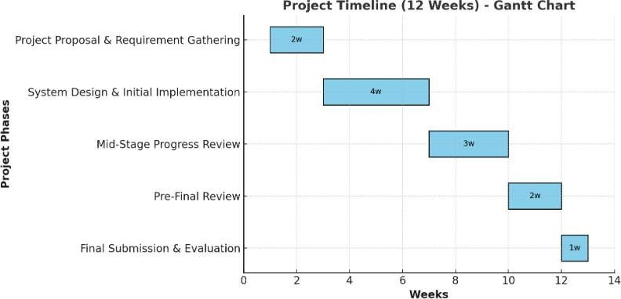
Timeline of the Project (Gantt Chart)

Slide 11
References (IEEE Paper format)
[ 1 ] Brabham, D. C., Crowdsourcing in the Public Sector, Georgetown University Press, 2015.
[ 2 ] Open311 Consortium, Open311 Service Request Platform, https://www.open311.org
[ 3 ] Nam, T., & Pardo, T. A., “Smart City as Urban Innovation: Focusing on Management, Policy, and Context,” Proceedings of the 5th International Conference on Theory and Practice of Electronic Governance, 2011.
[ 4 ] Batty, M. et al., “Smart Cities of the Future,” European Physical Journal Special
Topics, Vol. 214, No. 1, 2012.
[ 5 ]Government of India, National e-Governance Plan and Smart City Mission,
https://www.data.gov.in

Slide 12
Github Link
https://github.com/Msidhu07/CivicConnect

Slide 13


