Slide 1
CSE7302- University Project Review-4
Crowdsourced Civic Issue Reporting And Resolution
System
Batch Number : CSE_139 Roll Number | Student Name
20221CSE0281 | M Sidhardha
20221CSE0259 | P Sasi Kumar
20221CSE0282 | T Sree Vardhan
Under the Supervision of,
Ms. Saiqa Khan N
Professor / Associate Professor / Assistant Professor School of Computer Science and Engineering Presidency University
Name of the Program: B.Tech(Computer Science And Engineering)
Name of the HoD: Dr. Blessed Prince
Name of the Program Project Coordinator: Dr. Muthuraj
Nameof the School Project Coordinators: Dr. Sampath A K , Dr. Geetha A

Slide 2
Content
• Abstract
• Literature Survey
• Objectives
• Existing Methods & Drawbacks
• Proposed Method & Feasibility Study
• Architecture Diagram
• Modules
• Hardware & Software Details
• Timeline Of The Project
• Github Link
• Web Applications
• References

Slide 3
Problem Statement Number: SIH25031
Organization :Government Of Jharkhand Category: Software
Problem Description : Rapid urbanization and industrial growth have led to serious environmental issues such as air and water pollution, improper waste management, and excessive energy consumption. Traditional technologies depend heavily on fossil fuels and inefficient processes that harm natural resources and human health. The lack of eco-friendly systems and limited use of renewable energy further worsen environmental degradation. There is a strong need for Clean and Green Technology solutions that are sustainable, cost-effective, and energy-efficient. Such technologies should reduce pollution, conserve resources, and promote the use of renewable energy. Implementing clean and green solutions will help protect the environment while supporting long-term economic and social development for future generations.

Slide 4
Abstract:
• Urban civic issues often remain unresolved due to slow and inefficient reporting systems.
• Lack of transparency and coordination reduces accountability of authorities.
• The project aims to provide a simple and reliable platform for reporting civic problems.
• Citizens can submit issues with images, location details, and descriptions.
• Reported issues are automatically categorized and assigned to concerned departments.
• Authorities can track, update, and manage complaints in real time.
• The system improves response time, transparency, and overall civic service efficiency.

Slide 5
Literature Survey:
Traditional civic complaint systems are often slow, manual, and lack transparency.Research shows that crowdsourced digital platforms improve citizen participation and faster issue reporting.Applications like FixMyStreet and SeeClickFix use mobile and location-based reporting for civic issues.Smart city studies highlight the use of GIS and cloud technologies for efficient issue management.However, challenges such as data validation, user engagement, and authority integration still remain.

Slide 6
Literature Survey:
Key Observations From The Literature Include:
• Traditional civic issue reporting systems are time-consuming and lack transparency.
• Crowdsourced platforms improve citizen participation and real-time issue reporting.
• Use of geolocation, images, and mobile apps enhances accuracy and accountability.
• Smart city technologies (GIS, cloud systems) support efficient issue management.
• Challenges remain in data validation, user engagement, and integration with authorities.

Slide 7
Literature Survey:
Research Gap:
• Existing civic issue reporting systems lack seamless integration with government workflows.
• Limited use of intelligent validation mechanisms leads to false or duplicate reports.
• Most platforms do not provide predictive analytics for issue prioritization.
• User engagement and long-term participation remain low due to poor feedback mechanisms.
• There is a need for a scalable, secure, and user-friendly system with real-time transparency and accountability

Slide 8
Objectives :
The Main Objective Of The Proposed System Are:
• To provide a user-friendly platform for citizens to report civic issues easily
• To enable quick identification and documentation of local problems
• To improve communication between citizens and municipal authorities
• To ensure transparency by allowing users to track the status of reported issues
• To prioritize issues based on urgency and public impact
• To encourage community participation in civic development
• To support faster and more efficient resolution of civic problems
• To improve overall quality of public services and urban living

Slide 9
Exisiting method & Drawbacks:
Existing Methods:
• Complaints submitted through phone calls, written forms, or municipal office visits.
• Basic online portals or mobile apps with manual processing.
• Limited use of images, geolocation, and real-time tracking.
Drawbacks:
• Time-consuming and inconvenient for citizens.
• Lack of transparency in complaint status and resolution.
• Delays due to manual verification and processing.
• Poor coordination between departments.
• Low citizen engagement and accountability.

Slide 10
Proposed Method & Feasibility Study:
Proposed Method:
• Develop a crowdsourced digital platform (web/mobile) for reporting civic issues.
• Citizens can submit issues with images, location data, and descriptions in real time.
• Issues are automatically categorized and assigned to relevant departments.
• Authorities can update status, manage tasks, and resolve complaints through a dashboard.
• Real-time tracking and notifications ensure transparency and citizen engagement.
Feasibility Study:
• Technical Feasibility: Uses existing technologies like mobile apps, GPS, cloud databases, and web frameworks.
• Economic Feasibility: Low-cost implementation using open-source tools and scalable cloud infrastructure.
• Operational Feasibility: Easy to use for both citizens and authorities with minimal training.
• Social Feasibility: Encourages public participation and improves trust in civic administration.

Slide 11
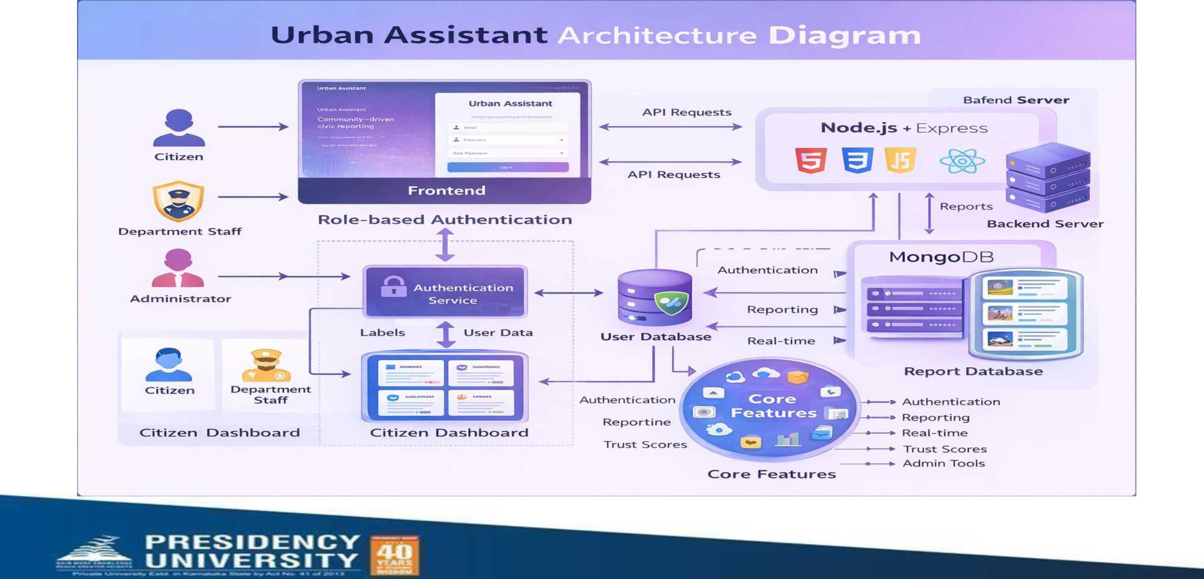
Architecture Diagram

Slide 12
Modules:
• User Registration & Authentication Module:
Allows citizens and authorities to register, log in, and securely access the system.
• Issue Reporting Module:
Enables users to report civic issues by uploading images, adding descriptions, and capturing GPS location.
• Issue Categorization & Validation Module:
Automatically classifies issues and checks for duplicate or false reports.
• Backend Processing & Workflow Module:
Assigns reported issues to the appropriate municipal departments and manages resolution flow.
• Authority Dashboard Module:
Allows officials to view, update, prioritize, and close reported complaints.
• Status Tracking & Notification Module:
Sends real-time updates and notifications to users about complaint progress.
• Feedback & Analytics Module:
Collects citizen feedback and generates reports for performance analysis and decision-making.

Slide 13
Software and Hardware:
Software Requirements:
• Operating System: Windows / Linux / macOS
• Frontend Technologies: HTML, CSS, JavaScript, React
• Backend Technologies: Node.js with Express / Java Spring Boot
• Database: MySQL / PostgreSQL / MongoDB
• Web Browser: Google Chrome / Firefox
• Tools: VS Code, Git, GitHub
• APIs: Maps API, Notification Services
Hardware Requirements:
• Processor: Intel i3 or above
• RAM: Minimum 8 GB
• Storage: 256 GB SSD or higher
• Server (Cloud): AWS / Firebase / Azure
• User Devices: Smartphone or PC with Internet

Slide 14
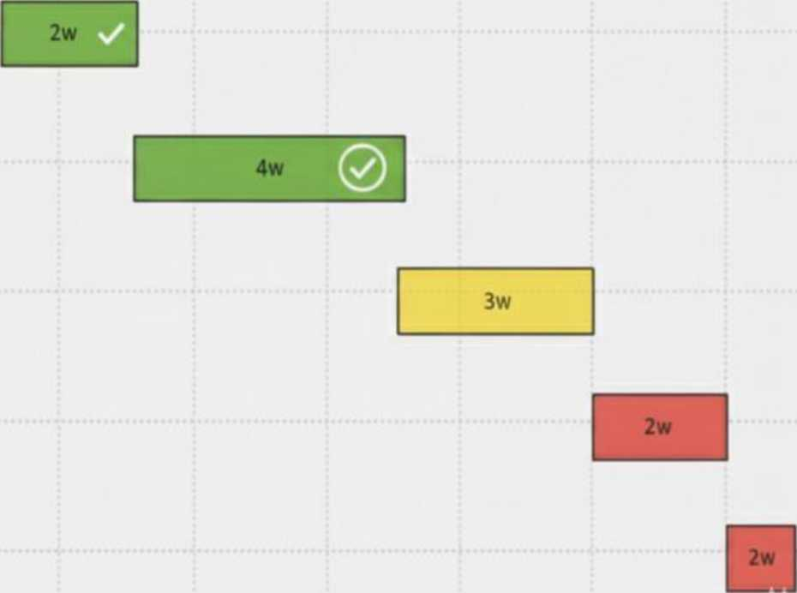

Timeline of the Project (Gantt Chart)
Krwjeci umeime weeKs; - vaami unarx
Project Proposal & Requirement Gathering
System Design & Initial Implementation
Mid-Stage Progress Review
Pre-Final Review
Final Submission & Evaluation
J_» ■_I_L

Slide 15
Github Link
https://github.com/Msidhu07/CivicConnect

Slide 16


Login Page
ConnectCivic
About Us Contact Us
SMART CIVIC REPORTING
MH8M
/no o
um&
^©DDD³ @00^7 « ^©DDD³ W®0®@ ^ ^7®QOF (fe
®DQ G0Q® gj®
Report local issues, support your neighbors, track progress with your city, and let verified departments respond with accountability.

Slide 17
Web Application (Sign In Page)
Urban Assistant
Community-driven civic reporting
you@example gov
Enter your password
Sign In
Don't have an account? Sign Up

Slide 18
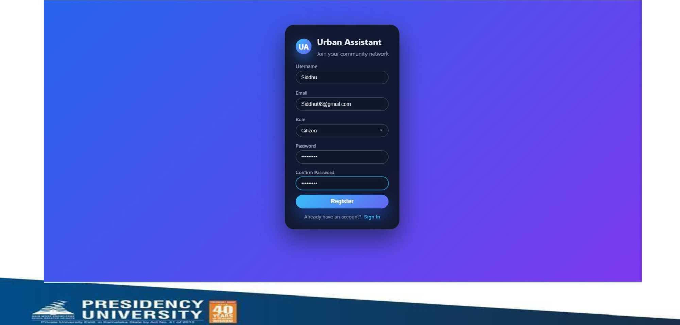
Sign Up Page

Slide 19
Citizen Dashboard(Report Issue Page)
UA
Citizen Dashboard
Community Feed Report Issue • Trust score: 50 Sign Out
Report an Issue
Share location, details and media with your city Report Title
( e g Pothole on 5th Avenue ) I
Roads J
Priority
Low - ) I
Description
Describe what you see and how it affects the community
/■
Street
( 123 Mam St ) I
Gty
( Your city ) I
State
[ State ) I
ZIP
¹ ZIP code I
Nearby landmark
¹ Park, building, or intersection I
Upload photo / video
No fie chosen
Auto detect location
Submit Report

Slide 20
Administrator Dashboard(Admin panel)
Admin Panel
Administrator • siddhu09@gmail.com
Network Health
Track incident flow and resolution across the city
Reports & Users
Search, filter, and assign reports to depart Search reports
( Search by title or description Any status Any category Any priority
Total Reports | Pending | Resolved
2 | 1 | 1
All statuses | Awaiting triage | Closed this month
streetlights HIGH PENDING
Electricity From siddhu • 2/19/2026, 10:0423 PM Change sfc ^ Assign dep ~
"pothole near
. ... LOW RESOLVED
school
From siddhu • 2/19/2026, 9:09:45 PM Change sfc Assign dep ^
siddhu09@gmaii.com • admin • Joined 3/1/2026
Siddhu TRUST so
siddhu08@gmail.com • citizen • Joined 3/1/2026

Slide 21
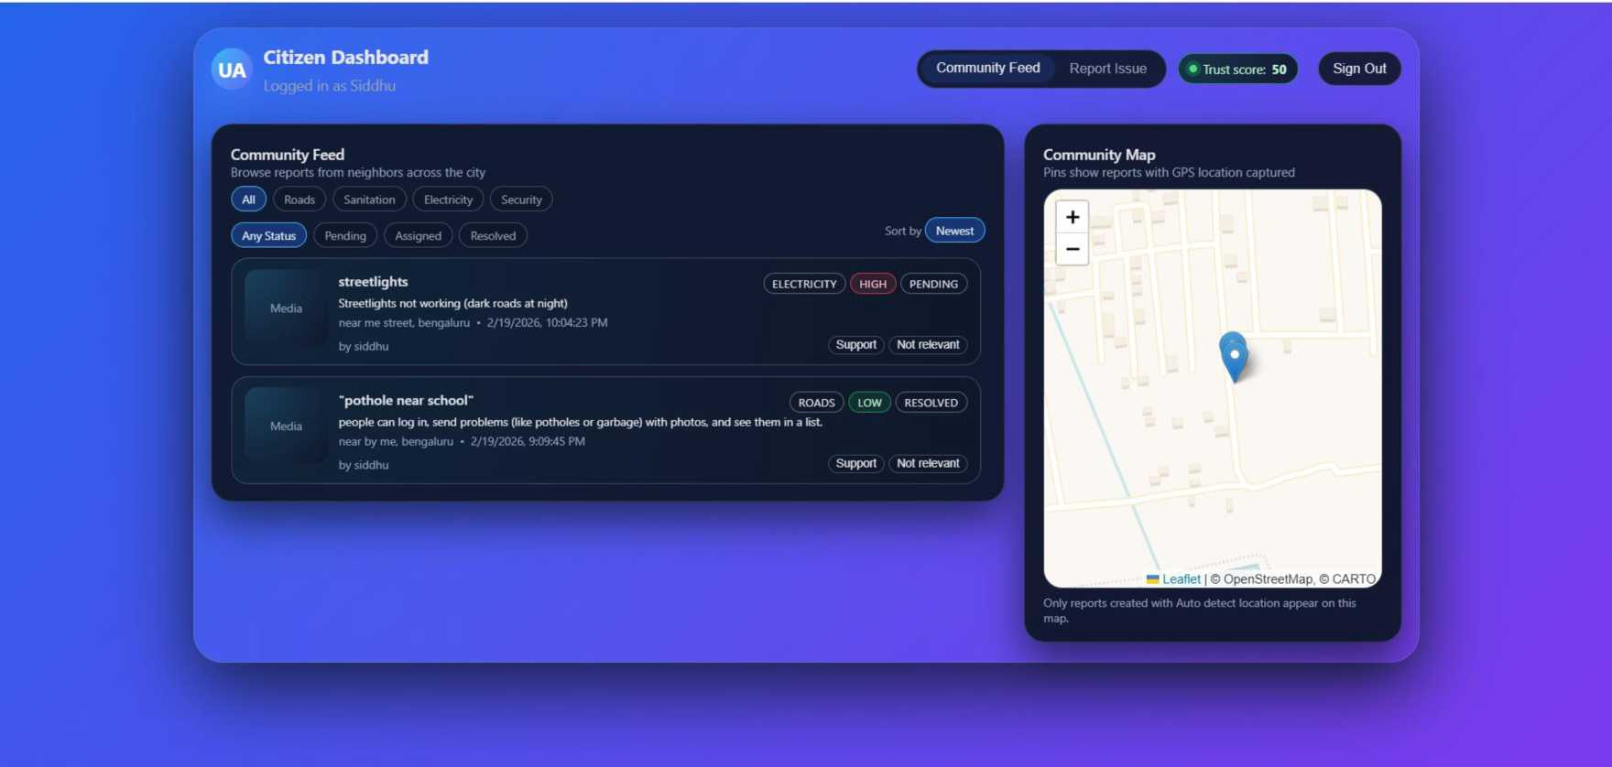
Citizen Dashboard(Community Feed)
4
I

Slide 22
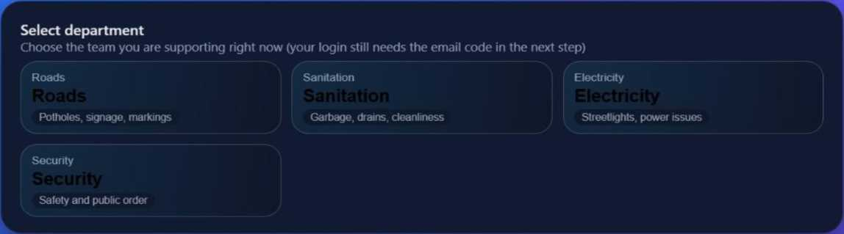
Department Portal
^ Department Portal
Sign Out

Slide 23
One Time Pad(Department Portal)
Department Portal
Check your email
We have sent a one-time code to the same address you used when you signed in. Please copy it from your inbox and type it here so we know it is really you.
Please wait 40s before requesting another code.
The six-digit code from your email
801528
Verify and open queue
Send the code again

Slide 24
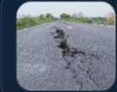
UA
Department Portal
Issue queue
Here is the work waiting for the Electricity team right now.
streetlights broken
tygh • 4/21/2026,11:24:11 AM
Filed by Siddhu Validate
streetlights
near me street ■ 2/19/2026,10:04:23 PM Filed by siddhu
Validate

Slide 25
Sign Out
RESOLVED In Progress Resolved
PENDING In Progress Resolved

Slide 26
References (IEEE Paper format)
[ 1 ] Brabham, D. C., Crowdsourcing in the Public Sector, Georgetown University Press, 2015.
[ 2 ] Open311 Consortium, Open311 Service Request Platform, https://www.open311.org
[ 3 ] Nam, T., & Pardo, T. A., “Smart City as Urban Innovation: Focusing on Management, Policy, and Context,” Proceedings of the 5th International Conference on Theory and Practice of Electronic Governance, 2011.
[ 4 ] Batty, M. et al., “Smart Cities of the Future,” European Physical Journal Special Topics, Vol. 214, No. 1,2012.
[ 5 ]Government of India, National e-Governance Plan and Smart City Mission, https://www.data.gov.in

Slide 27
References(IEEE Paper Format)
[ 6 ] Ushahidi, “Ushahidi: Crowdsourcing and Crisis Mapping Platform,” [Online]. Available: https://www.ushahidi.com
[ 7 ] Data.gov, “The Home of the U.S. Government’s Open Data,” [Online]. Available: https://www.data.gov [ 8 ] UN-Habitat, “Urban Innovation and Citizen Participation,” [Online]. Available: https://unhabitat.org
[ 9 ] Organisation for Economic Co-operation and Development (OECD), “Digital Government and Civic Engagement,” [Online]. Available: https://www.oecd.org
[ 10 ] Google, “Google Maps Platform Documentation,” [Online]. Available: https://developers.qooqle.com/maps
[ 11 ] IEEE, “Smart Cities and Civic Engagement Technologies,” IEEEXplore Digital Library, [Online].
Available: https://ieeexplore.ieee.org
[ 12 ] Open311, “Open311: Standard for Civic Issue Reporting,” [Online]. Available: https://www.open311 .org [ 13 ] MyGov, “MyGov—Citizen Engagement Platform,” Government of India, [Online]. Available:

Slide 28
f
TUawU
You*.

