Slide 1
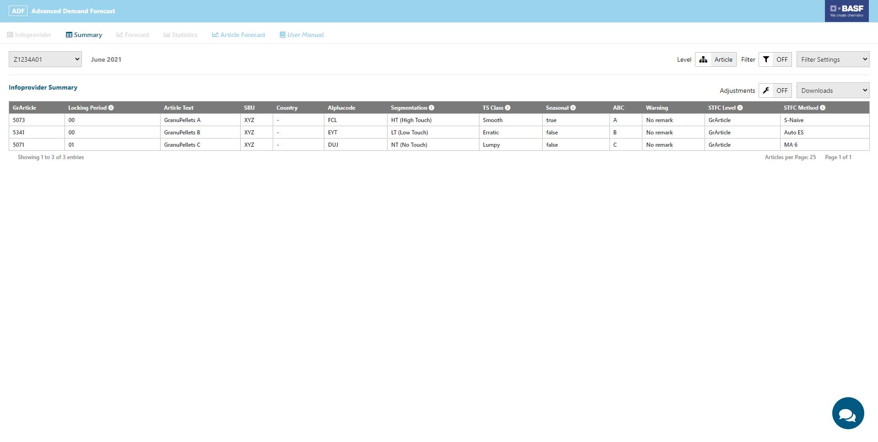
This filters and settings usually help you to filter and search for articles in the table below. However, in this version these buttons are disabled.
This is the main navigation of the ADF Inspector. Some menu items are disabled in this simplified version of the Inspector. Usually, you can find there even more statistics about your article forecasts
Click on the row of this table to inspect the results of the forecast run in the Article Forecast section of the main navigation. In this version you can only click on the article that you are supposed to plan according to your task instructions.
By hovering over the info-icons you can see tooltips that explain the related term.
Infoprovider Selection
The Infoprovider section shows an overview table that contains all Infoproviders to which you have access and for which the forecasting run for the selected forecast version has been created

Slide 2
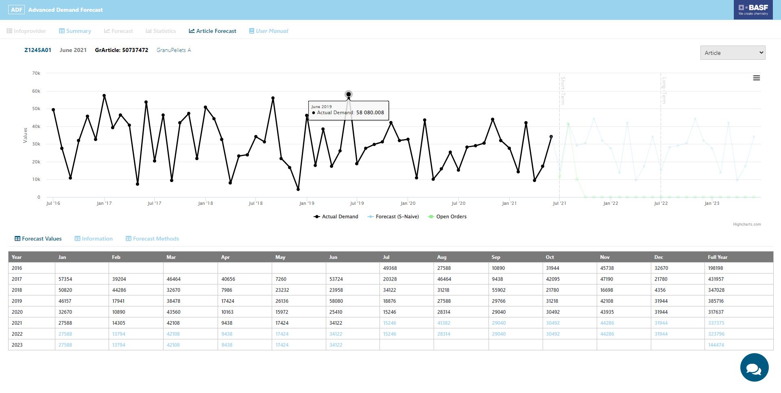
Hover over the graph to see the exact numbers.
Mark a time frame with your mouse to zoom in on this specific time frame. To reset the zoom click on the “Reset zoom” botton in the upper right corner of the graph.
Click here to disable and enable the plot lines in the graph.
Article Forecast
In the Article Forecast section the results of the forecast run are displayed for the selected article. Additional subsections with further information can be selected below the plot
The Forecast Values subsection shows a table of the historical data and forecast of the selected article

Slide 3
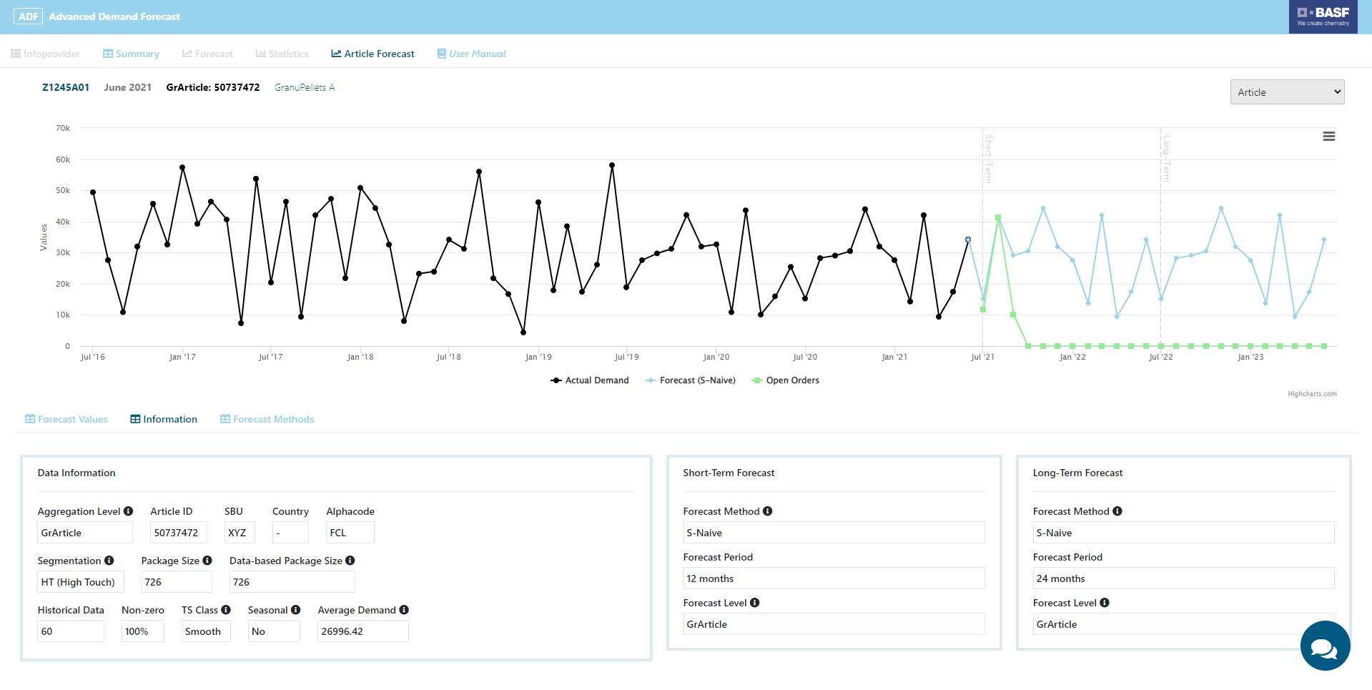
Information
The Information subsection shows the attributes of the selected article as well as the best-fitting methods for short-term and long-term forecasts

Slide 4
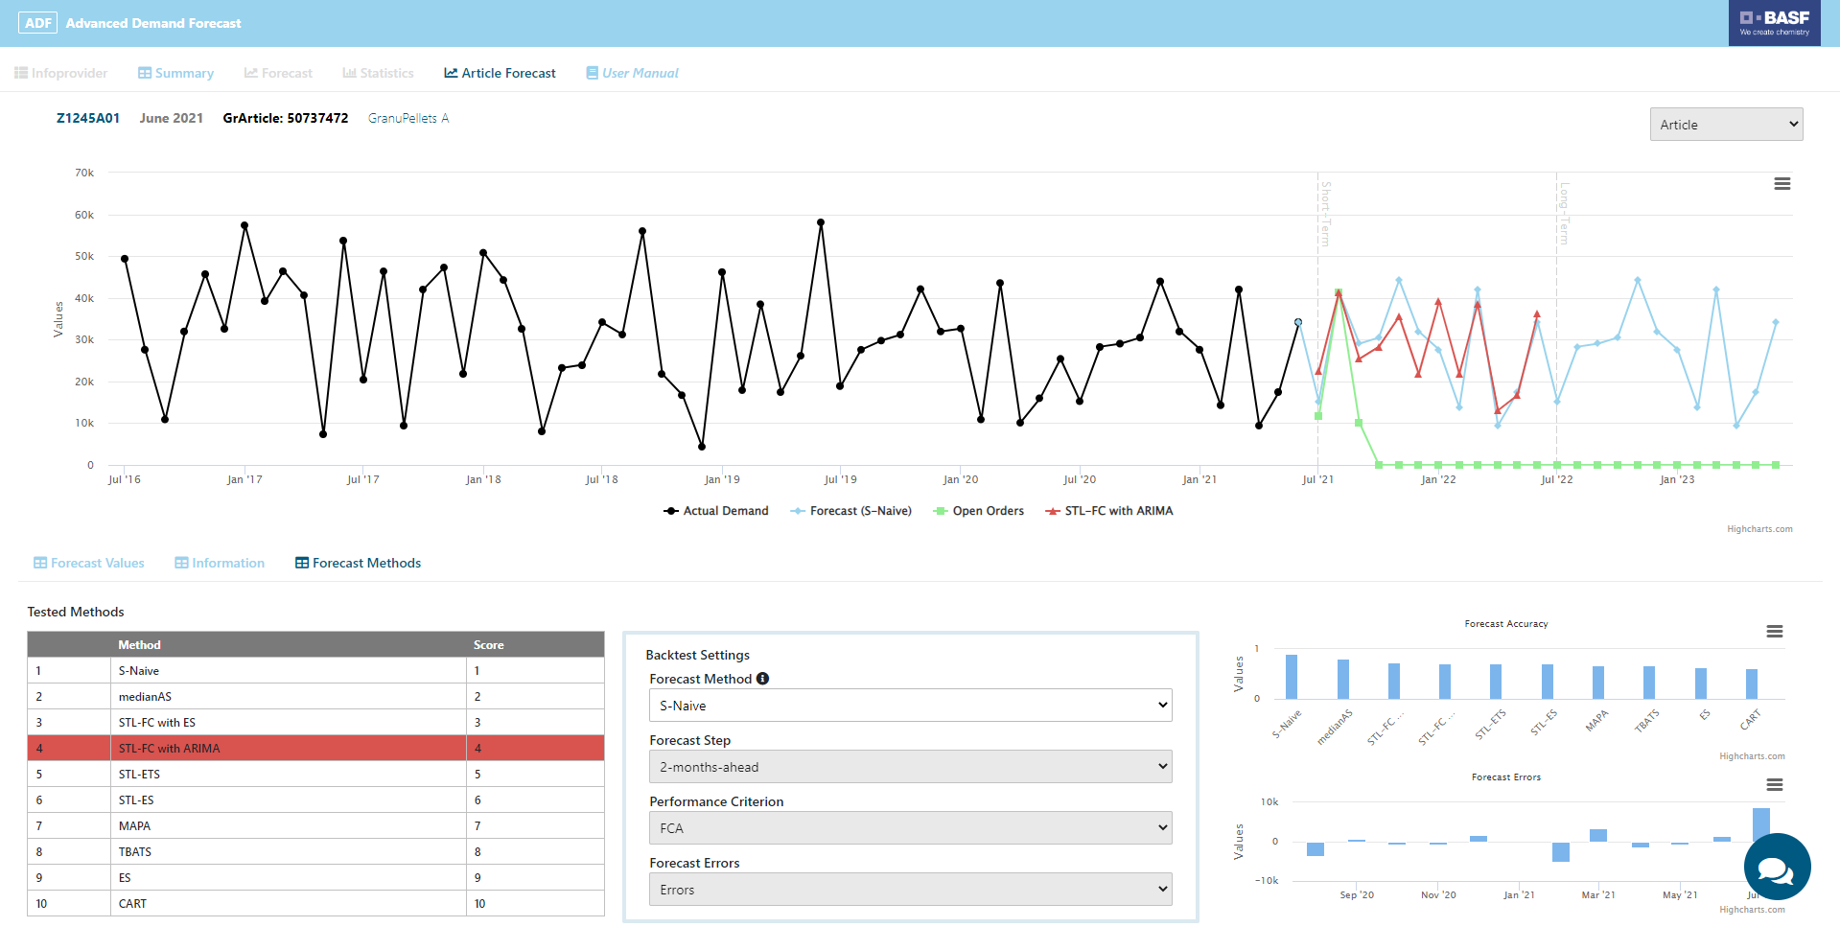
Forecast Methods
The Forecast Methods shows the best-fitting and alternative forecast methods and their respective accuracy and error
Select a forecast method to explore the forecast errors in the graph on the right
Select a forecast method to show its performance and plot the backtesting results and forecast

