Slide 1
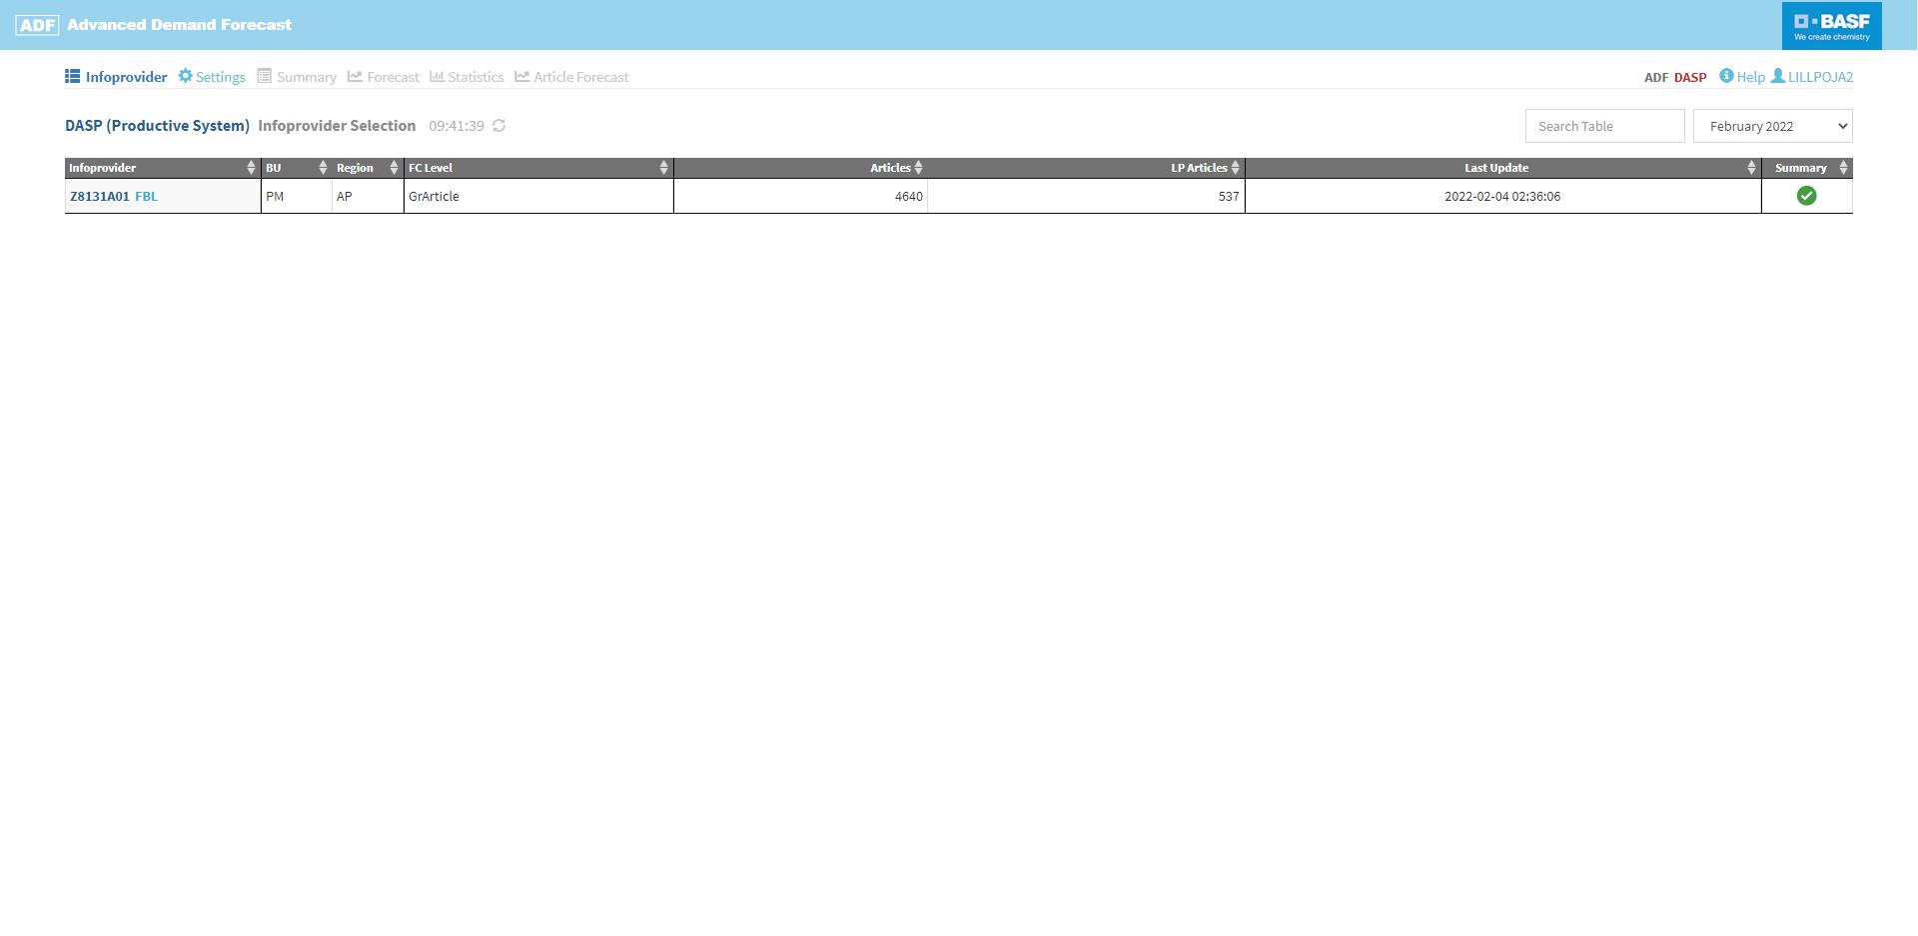
Search for a specific Infoprovider (if you have access to more than one)
Click on the row of an Infoprovider to inspect the results of the forecast run in the Summary, Forecast and Statistics sections of the main navigation
Select the forecast version of a specific month. By default, this shows the most recent version
The main navigation will be activated once an Infoprovider has been selected for inspection
Click on your username to change your password or log out
Infoprovider Selection
The Infoprovider section shows an overview table that contains all Infoproviders to which you have access and for which the forecasting run for the selected forecast version has been created

Slide 2
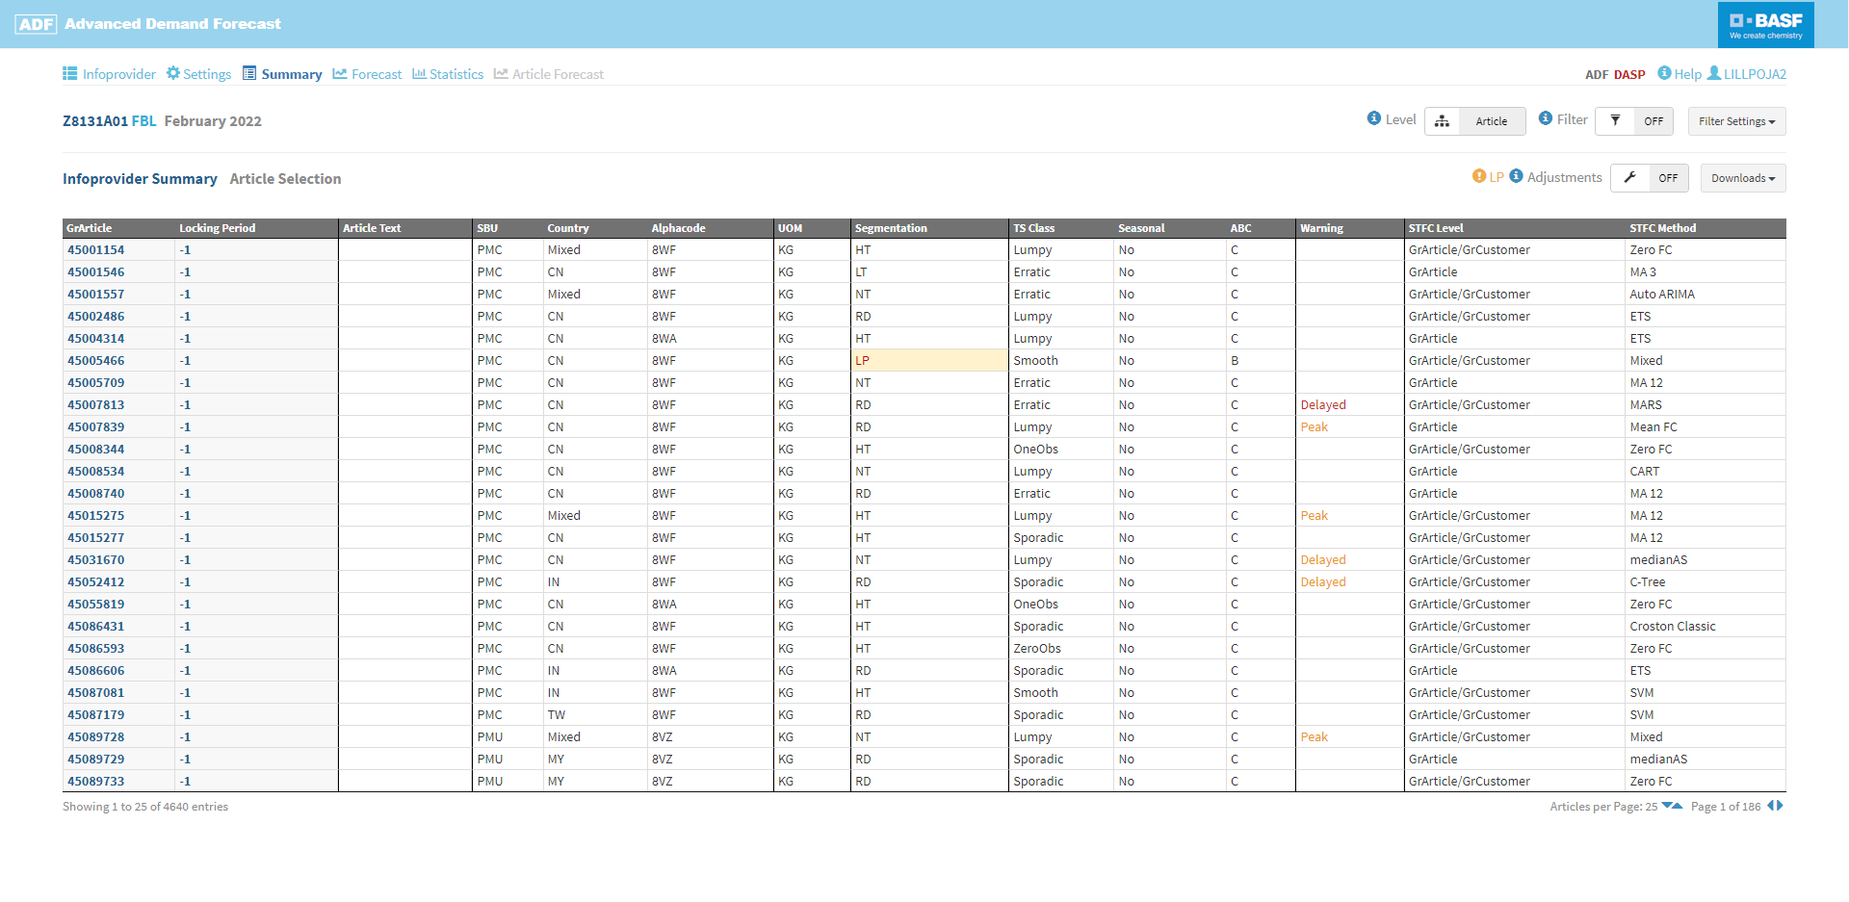
Switch between article and article customer level
Click on the row of the article or article customer combination you want to see the details of
Filter the table of articles e. g. by article number / text, customer, SBU, seasonality, ABC or warning type
Infoprovider Summary
In the Summary section all articles of an Infoprovider are displayed together with their individual attributes

Slide 3
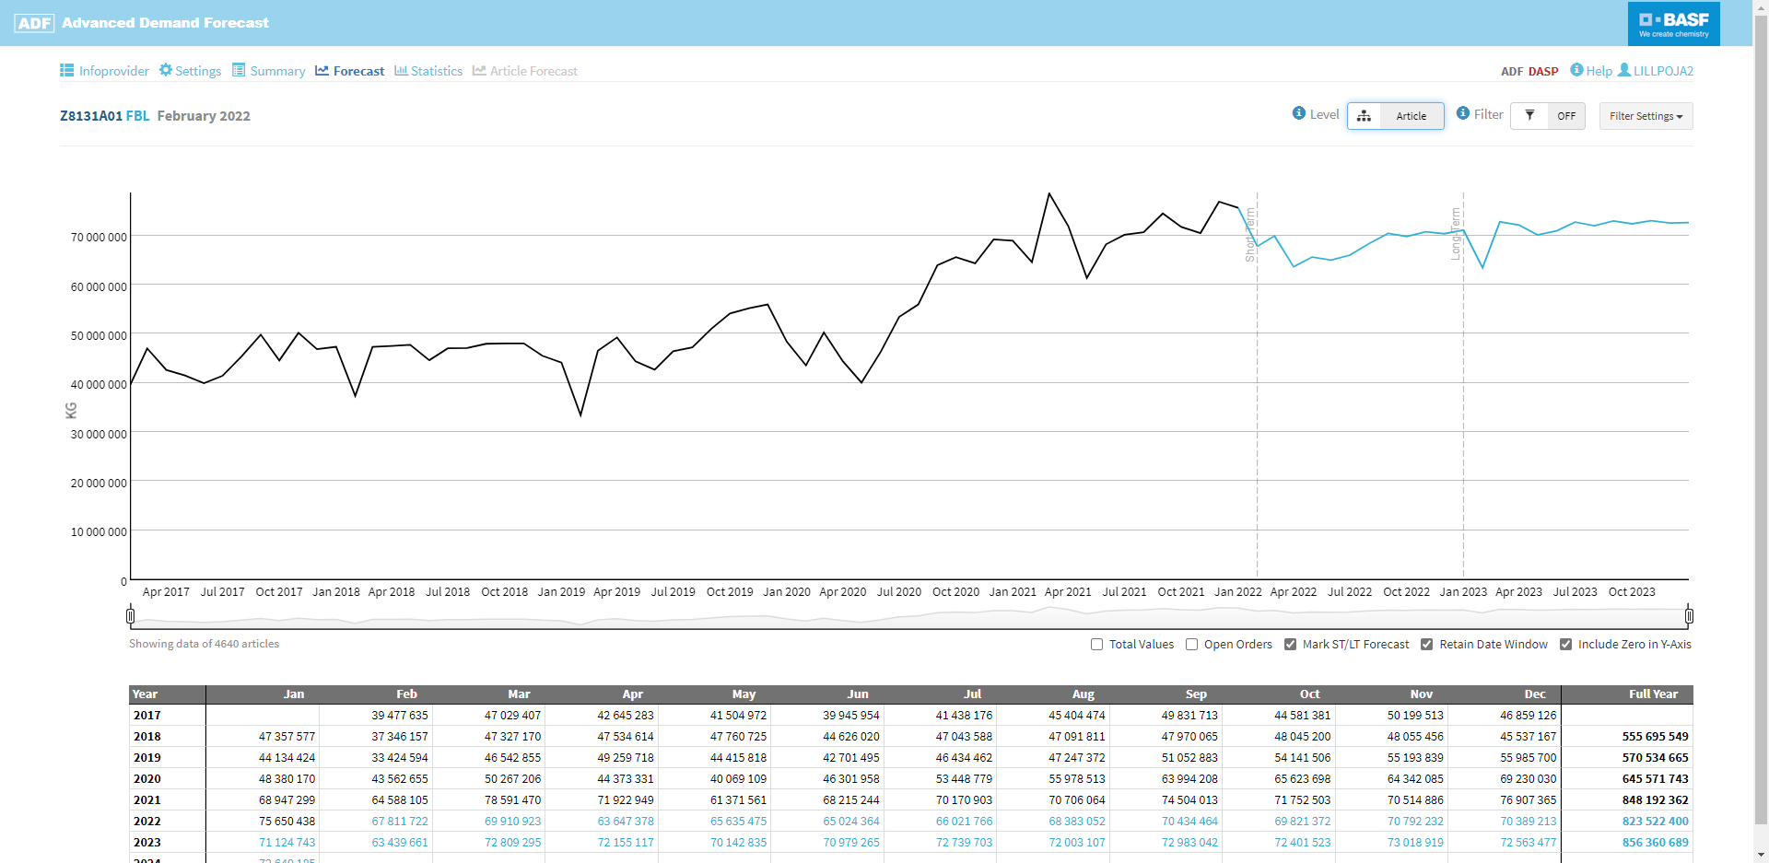
Filter the articles which are shown aggregated in the plot e. g. by article number / text, customer, SBU, seasonality, ABC or warning type
Show / hide additional information in the plot, e. g. future open orders
Use the sliders to zoom in on a specific time frame
Data and Forecast Plot
The Forecast section displays an interactive plot as well as a table of the historical data and forecast of the selected Infoprovider aggregated over all articles
Use the filter to plot any subset of articles

Slide 4
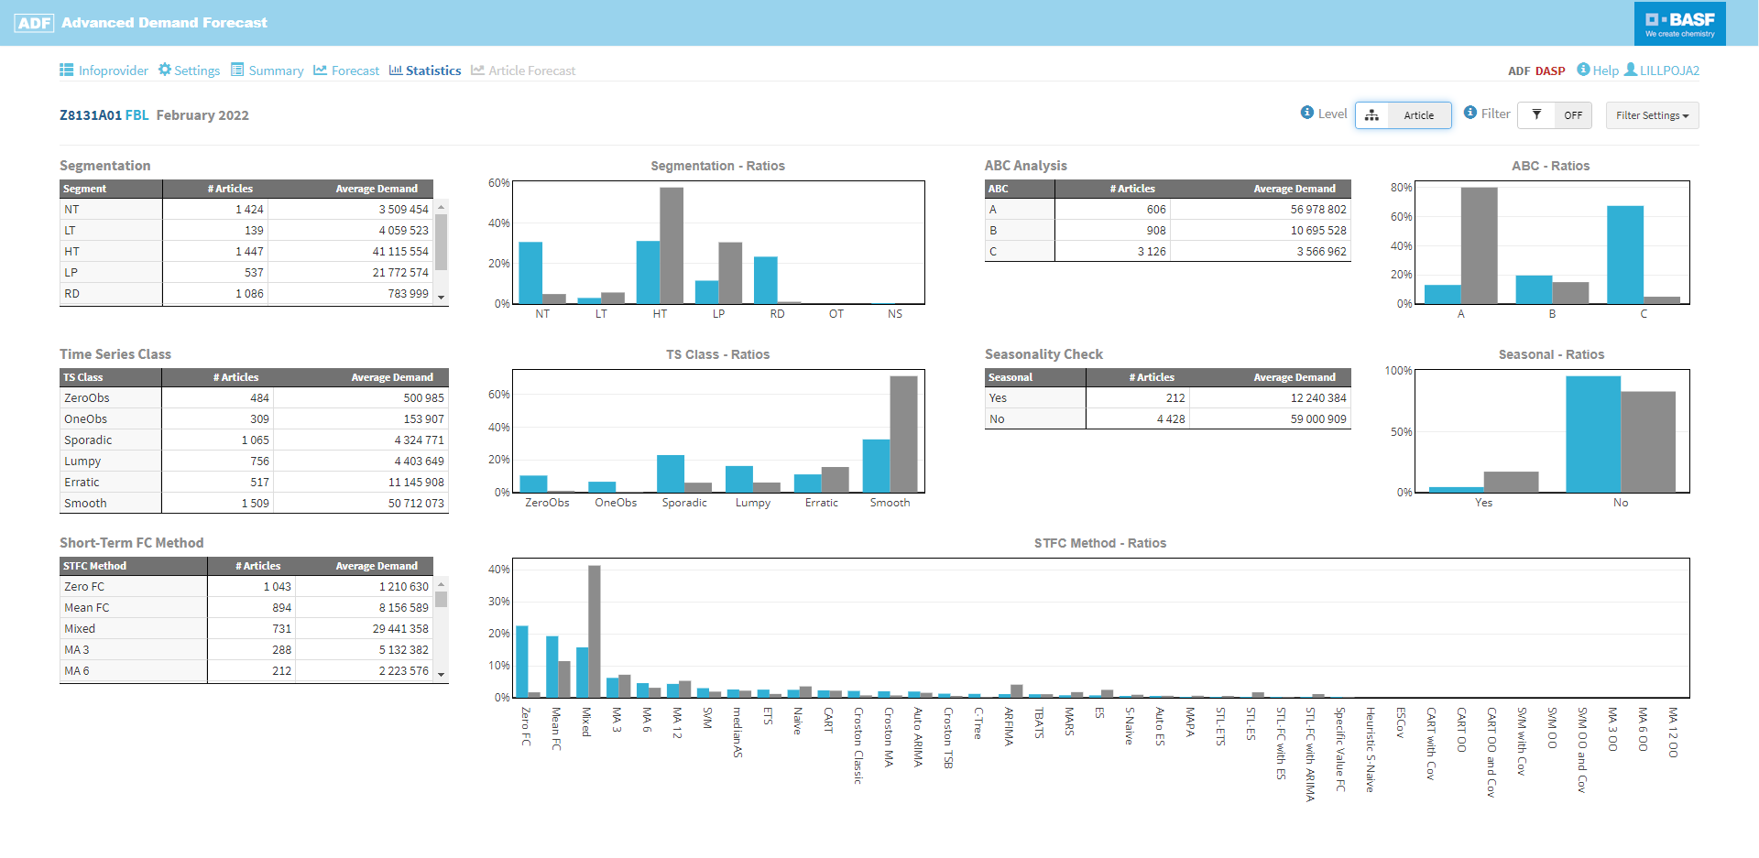
Filter the articles which are included in the analysis e. g. by article number / text, customer, SBU, seasonality, ABC or warning type
Statistics
The Statistics section features tables and bar charts which show the ratios of different attributes of the selected Infoprovider aggregated over all articles
For each attribute two different ratios are calculated. One with respect to the number of articles and one weighted with the average demand of the last 12 months.

Slide 5
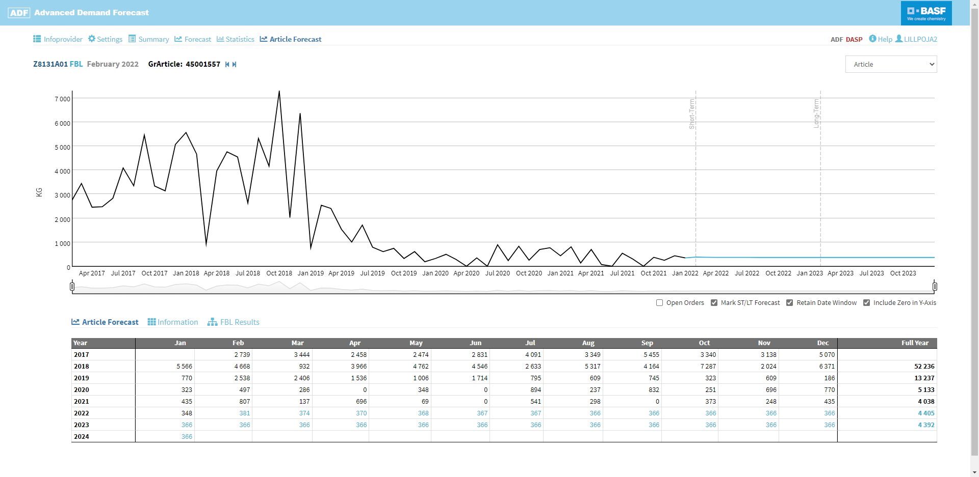
Chose between showing the plot on article level or for a specific customer of this article
Show / hide additional information in the plot, e. g. future open orders
Use the sliders to zoom in on a specific time frame
Article Forecast
In the Article Forecast section the results of the forecast run are displayed for the selected article. Additional subsections with further information can be selected below the plot
The Article Forecast subsection shows a table of the historical data and forecast of the selected article or article customer combination

Slide 6
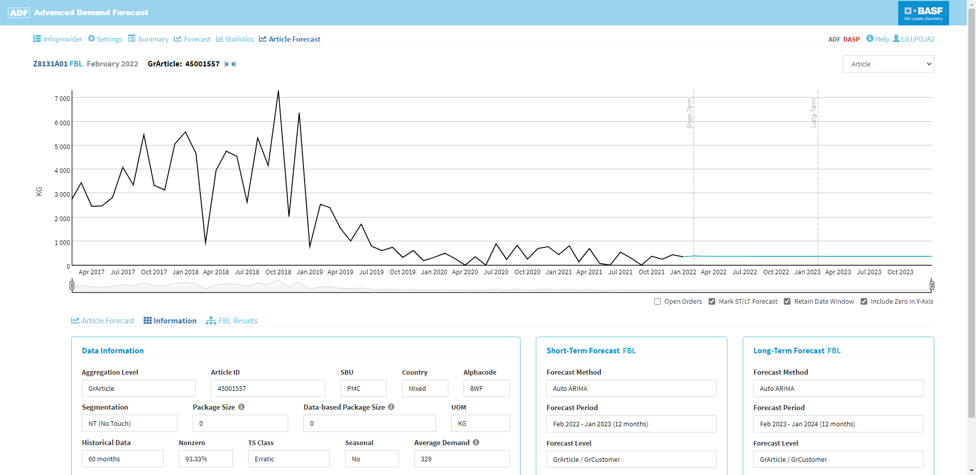
Article Forecast
In the Article Forecast section the results of the forecast run are displayed for the selected article. Additional subsections with further information can be selected below the plot
The Information subsection shows the attributes of the selected article as well as the best-fitting methods for short-term and long-term forecasts

Slide 7
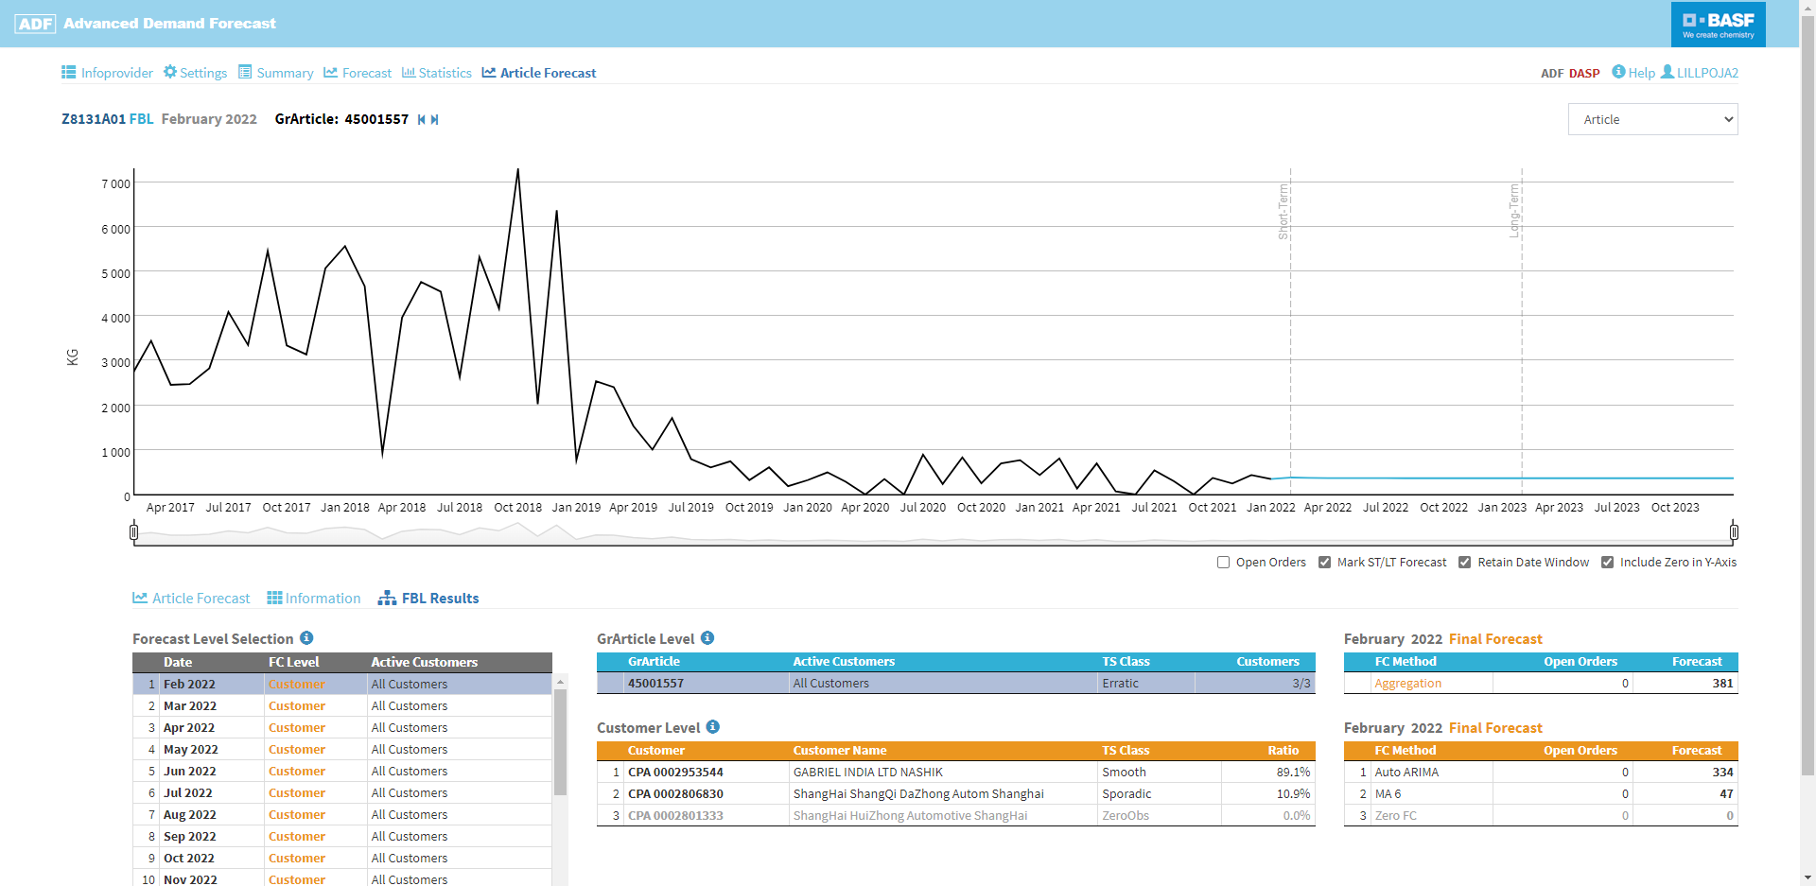
Article Forecast
In the Article Forecast section the results of the forecast run are displayed for the selected article. Additional subsections with further information can be selected below the plot
The FBL Results subsection (only available when the Feedback Loop has been activated) shows the best-fitting forecast level (article / article and customer) and forecast method (aggregation / disaggregation) as well as the best-fitting forecast method per chosen forecast level
Select a customer to show the best-fitting and alternative forecasts and plot the historical data and forecast
Select a forecast version to show the details on article customer level

Slide 8
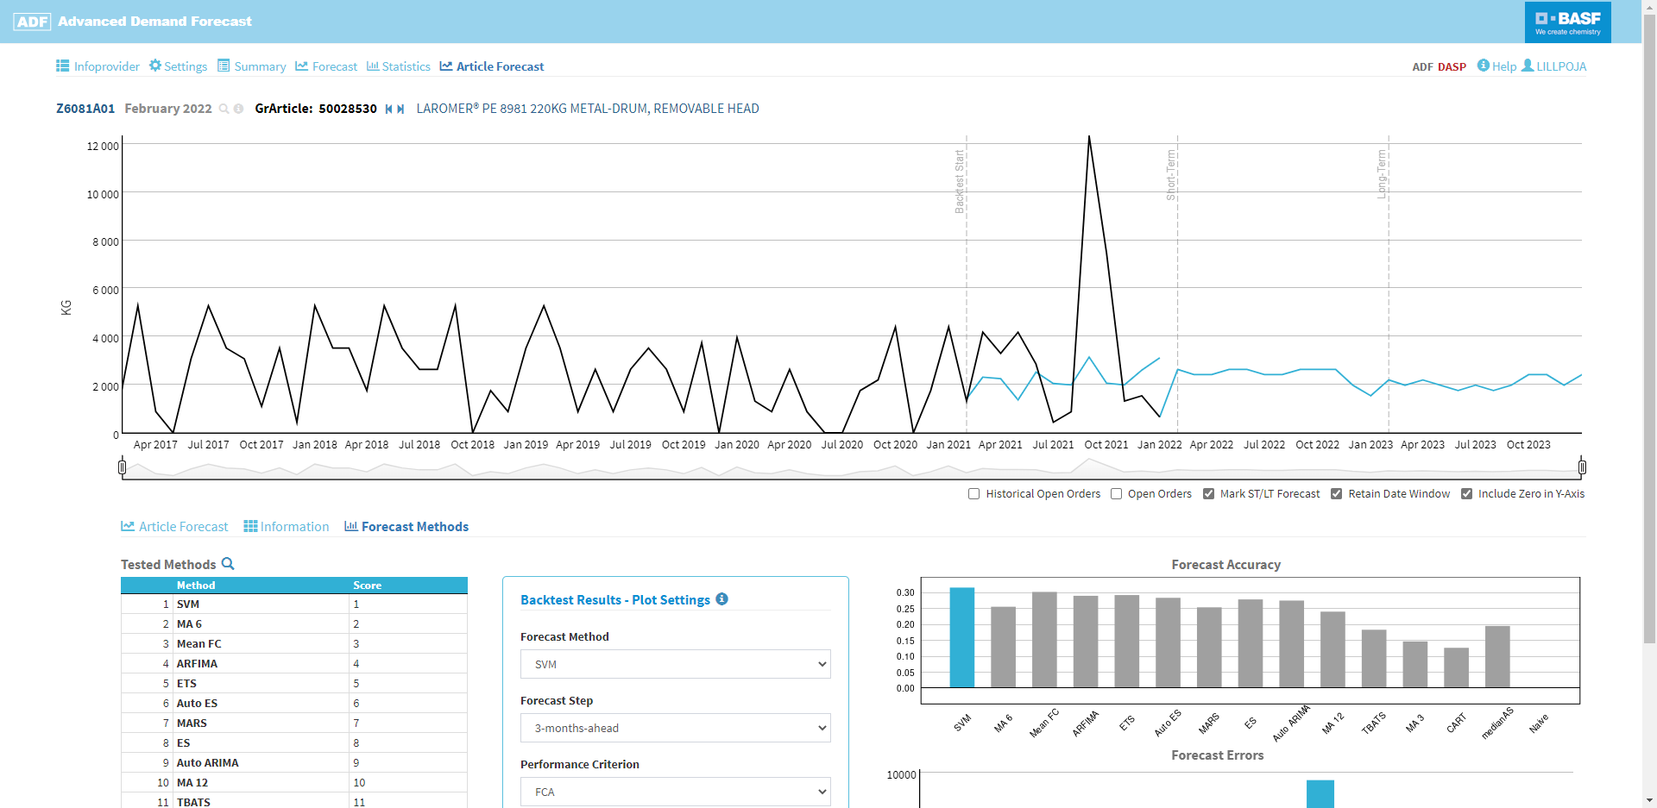
Article Forecast
In the Article Forecast section the results of the forecast run are displayed for the selected article. Additional subsections with further information can be selected below the plot
The Forecast Methods subsection (only available when the Feedback Loop has not been activated) shows the best-fitting and alternative forecast methods and their respective accuracy and error
Select a forecast method to show its performance and plot the backtest results and forecast

