Slide 1

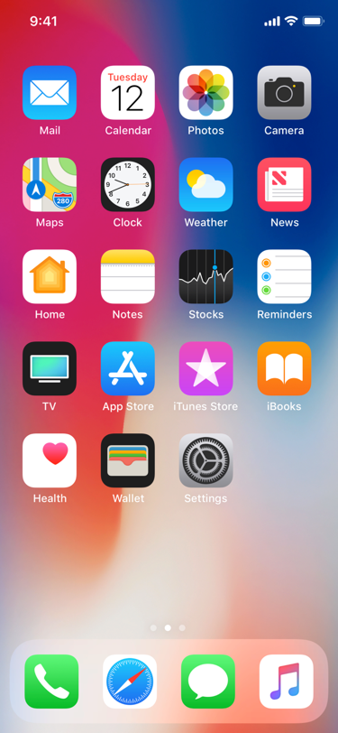
FI
FarmIn

Slide 2








FarmIn
Profile
Topic
Practices
Search
Agroforestry
Crop rotation
Composting
No tillage
Location
Chat
FarmIn News
Marketplace

Slide 3
FarmIn
Profile
Topic
Search
Location
Chat
FarmIn News
Marketplace

Slide 4






FarmIn
Profile
Topic
Seasons
Search
Monsoon
Summer
Autumn
Spring
Winter
All year round
Location
Chat
FarmIn News
Marketplace

Slide 5


FarmIn
Profile
Topic
Search
X
Advertisements
Click here to know about local equipment sharing!
We Have What YOU Need!
Location
Chat
FarmIn News
Marketplace

