Slide 1

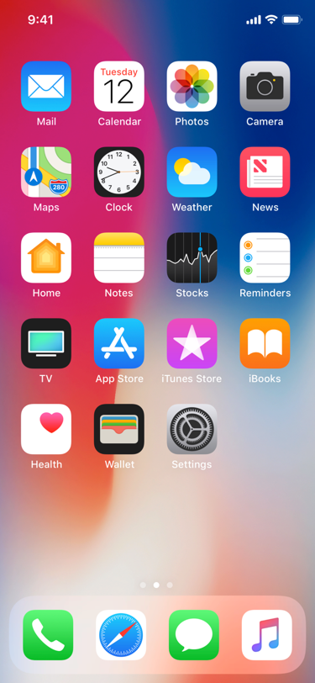
FI
FarmIn

Slide 2











FarmIn
Profile
Topic
Seasons
Search
Monsoon
Summer
Autumn
Spring
Winter
All year round
Location
Chat
FarmIn News
Marketplace

Slide 3


FarmIn
Profile
Topic
Search
X
Advertisements
Click here to know about local equipment sharing!
We Have What YOU Need!
Location
Chat
FarmIn News
Marketplace

