Slide 1
COLOR TO GRAY METHODS
Sisinty Sasmita Patra

Slide 2
Problem:
Converting Color Image to Gray Image

Slide 3
Color To Gray methods
Averaging
XYZ Luminance
YUV Luminance
L*a*b Luminance
L*a*b Luminance Enhancement
Color2Gray
Notes:
http://en.wikipedia.org/wiki/Luminance_(relative)

Slide 4
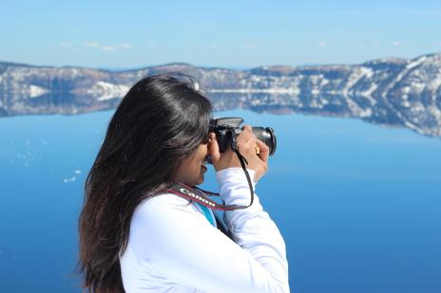
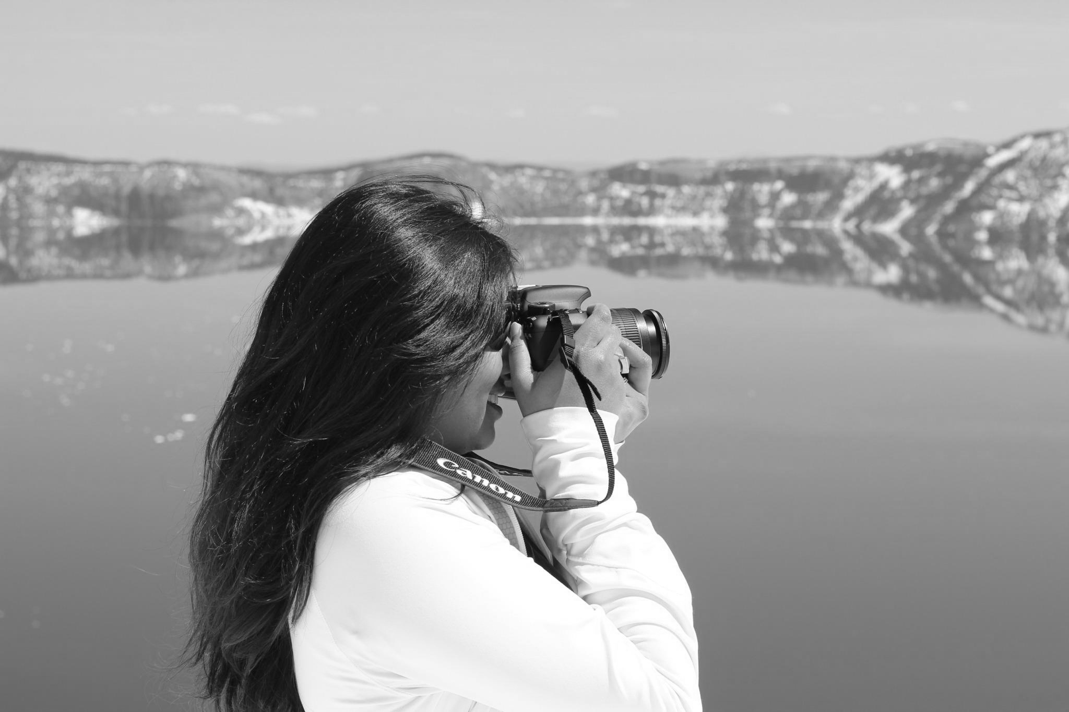
Averaging method
Computed (R+G+B)/3 for every pixel

Slide 5

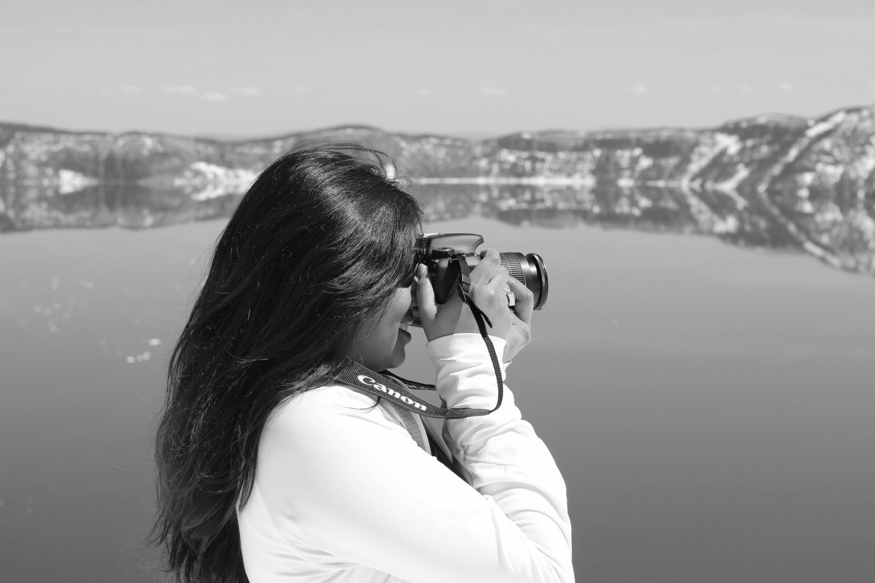
XYZ Luminance
Luminance = (0.2126 * R + 0.7152 * G + 0.0722 * B)

Slide 6
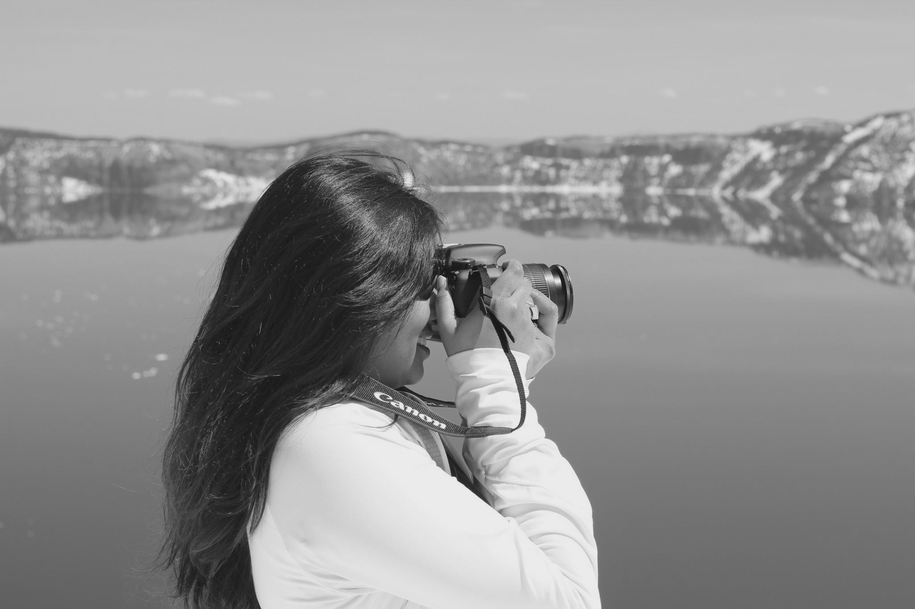
YUV Luminance
Luminance = (0.257 * R) + (0.504 * G) + (0.098 * B) + 16

Slide 7
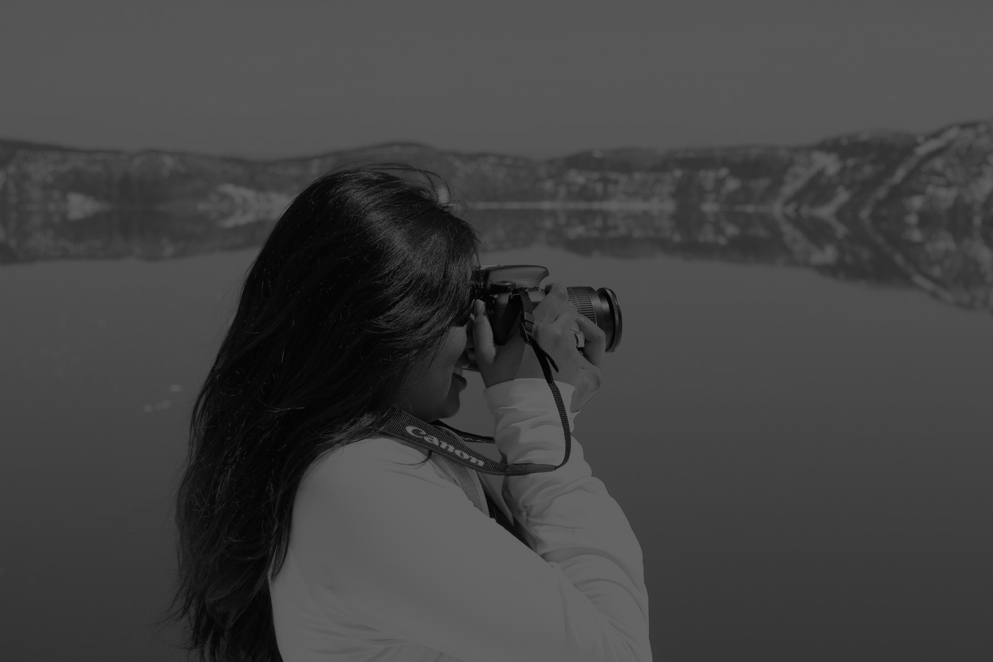
Lab Luminance
lab = color.rgb2lab(rgb)

Slide 8
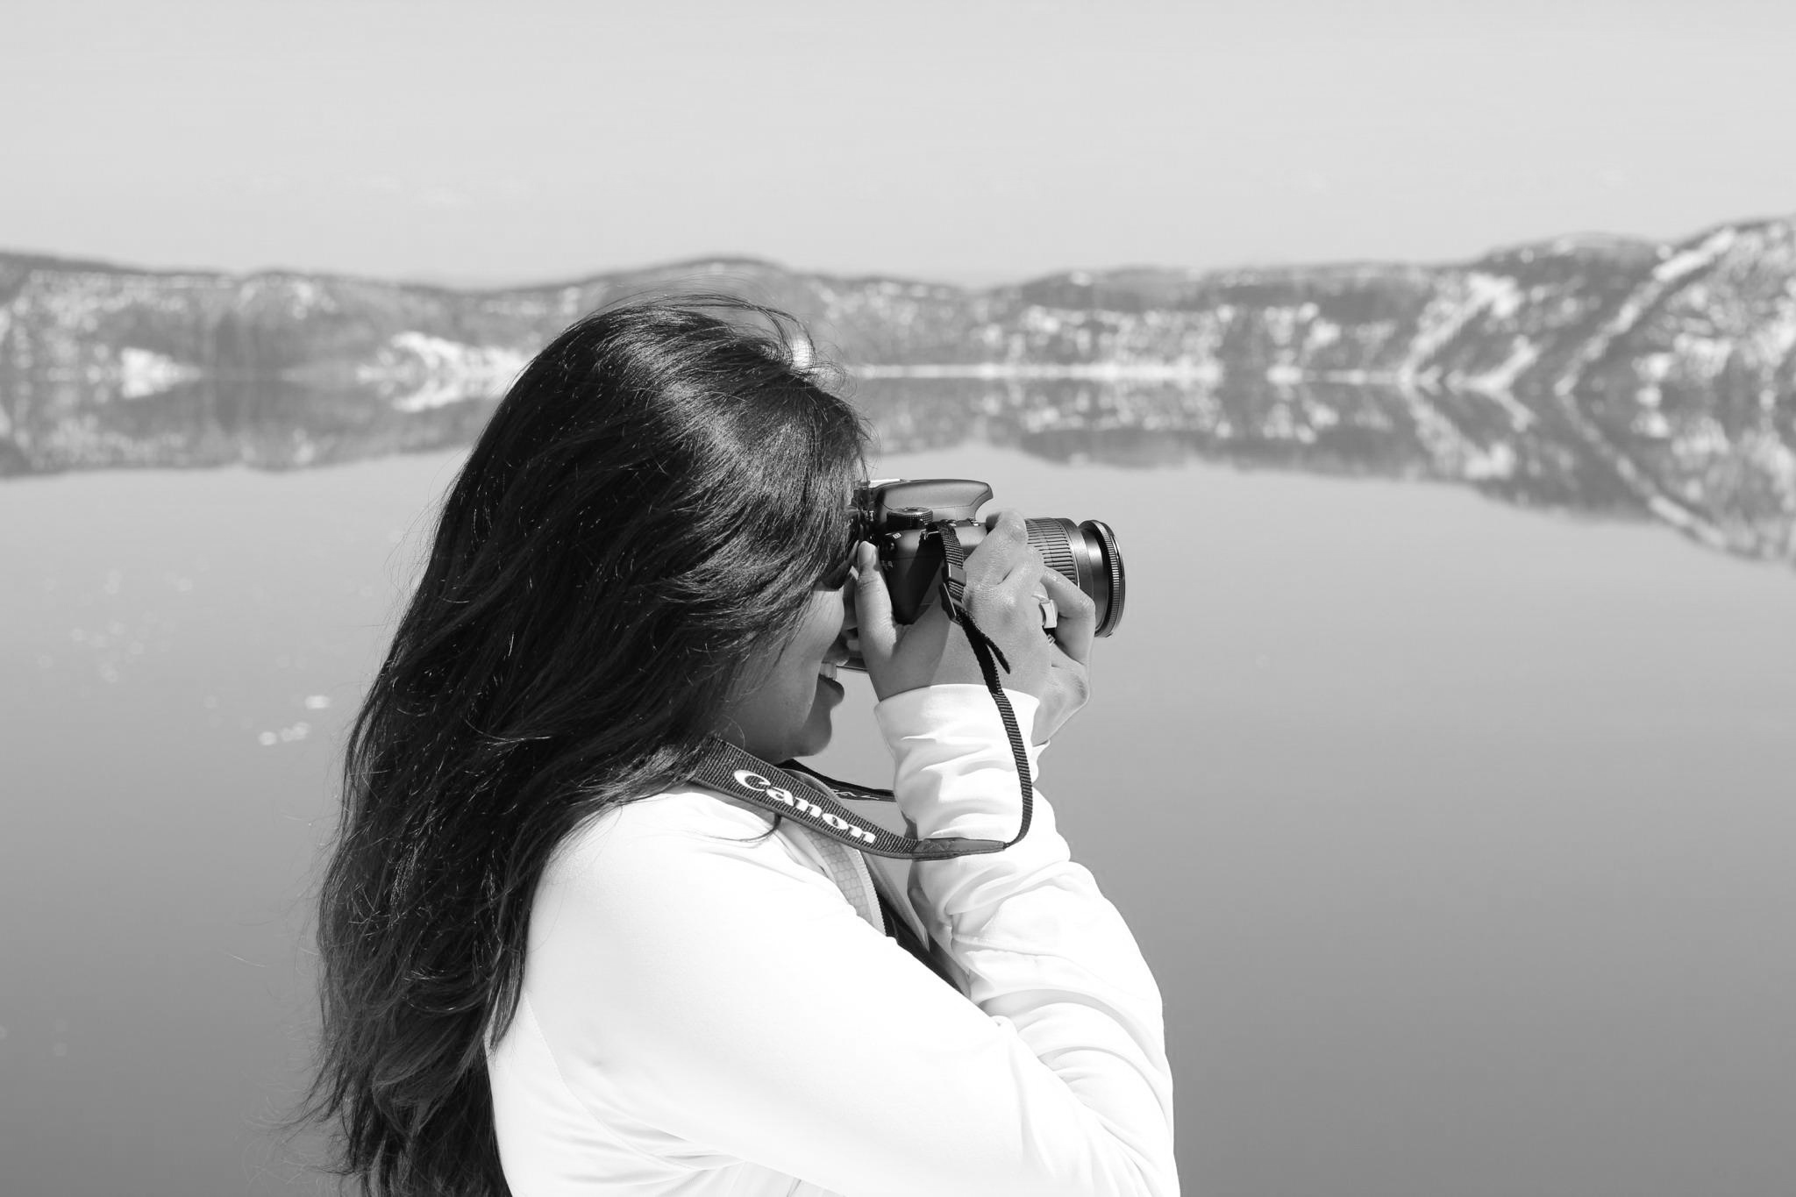
Lab Luminance Enhancement
(x – min) * (255/(max – min))

Slide 9
Color2Gray Technique
Convert rgb color space to L*a*b color space
Compute Target difference
Solve Least square Optimization
Notes:
Numpy is an extension to the python programming language, supports large multi-dimensional arrays, matrices etc.
OpenCv (open source computer vision library, is a library of programming functions.

Slide 10




Target difference
Luminance Difference =
Chrominance difference =
refers to a* and b* channel differences
Notes:
Numpy is an extension to the python programming language, supports large multi-dimensional arrays, matrices etc.
OpenCv (open source computer vision library, is a library of programming functions.

Slide 11
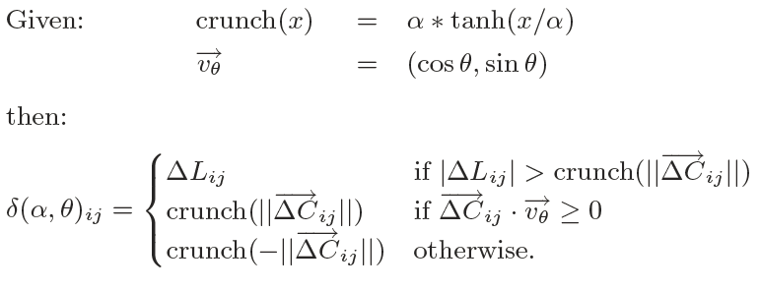
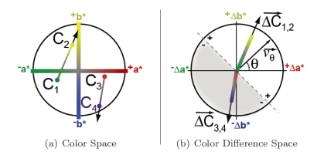
Target difference contd.
Notes:
Numpy is an extension to the python programming language, supports large multi-dimensional arrays, matrices etc.
OpenCv (open source computer vision library, is a library of programming functions.

Slide 12

Least square Optimization
Where gi and gj are gray values at i^{th} pixel and j^{th} pixel
minimize ( objective, g0, method='BFGS’,
jac=objective_der,
options={'maxiter’:10})
Notes:
Numpy is an extension to the python programming language, supports large multi-dimensional arrays, matrices etc.
OpenCv (open source computer vision library, is a library of programming functions.
minimize(objective, g0_f, method='BFGS', jac=objective_der, options={'maxiter':2,
Objective_der : partial derivative at each location.

Slide 13





Color2Gray results
Maxiter: 2
Alpha: 10
Theta: 135
Maxiter: 10
Alpha: 10
Theta: 135
Maxiter: 20
Adding 80 to all pixels

Slide 14
Learnt/Used
I have used
Python
imread and imwrite functions in OpenCV
math module
Minimize function in Optimize module of Scipy
rgb2lab function in color module
Numpy, Scipy
Notes:
Numpy is an extension to the python programming language, supports large multi-dimensional arrays, matrices etc.
OpenCv (open source computer vision library, is a library of programming functions.

Slide 15
Results

Slide 16
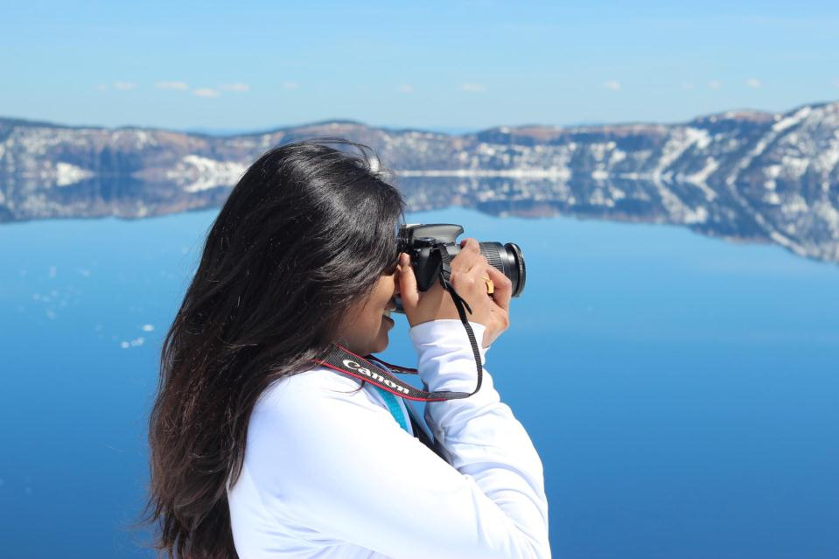
Input
Input

Slide 17
Input
average

Slide 18
Input
XYZ Luminance

Slide 19
Input
YUV Luminance

Slide 20
Input
Lab Luminance

Slide 21
Input
Lab Luminance Enhancement

Slide 22
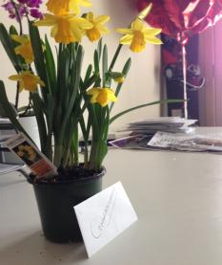
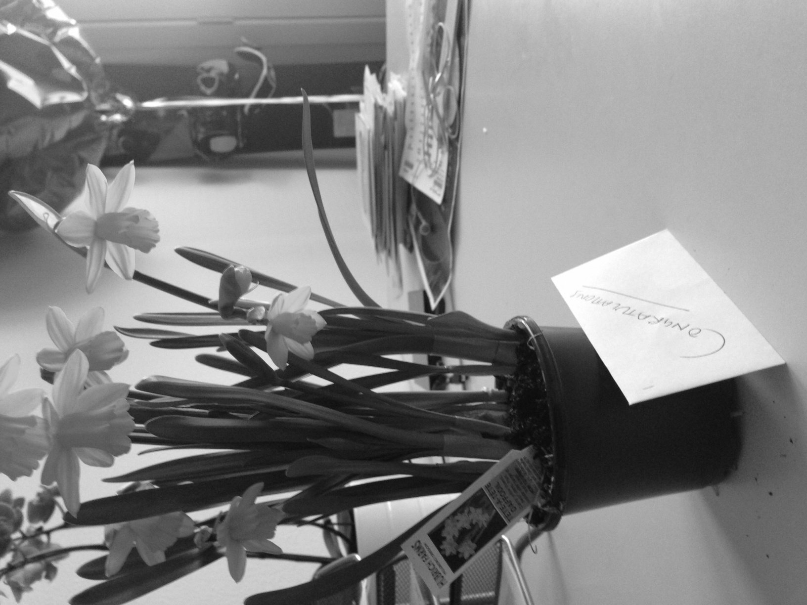
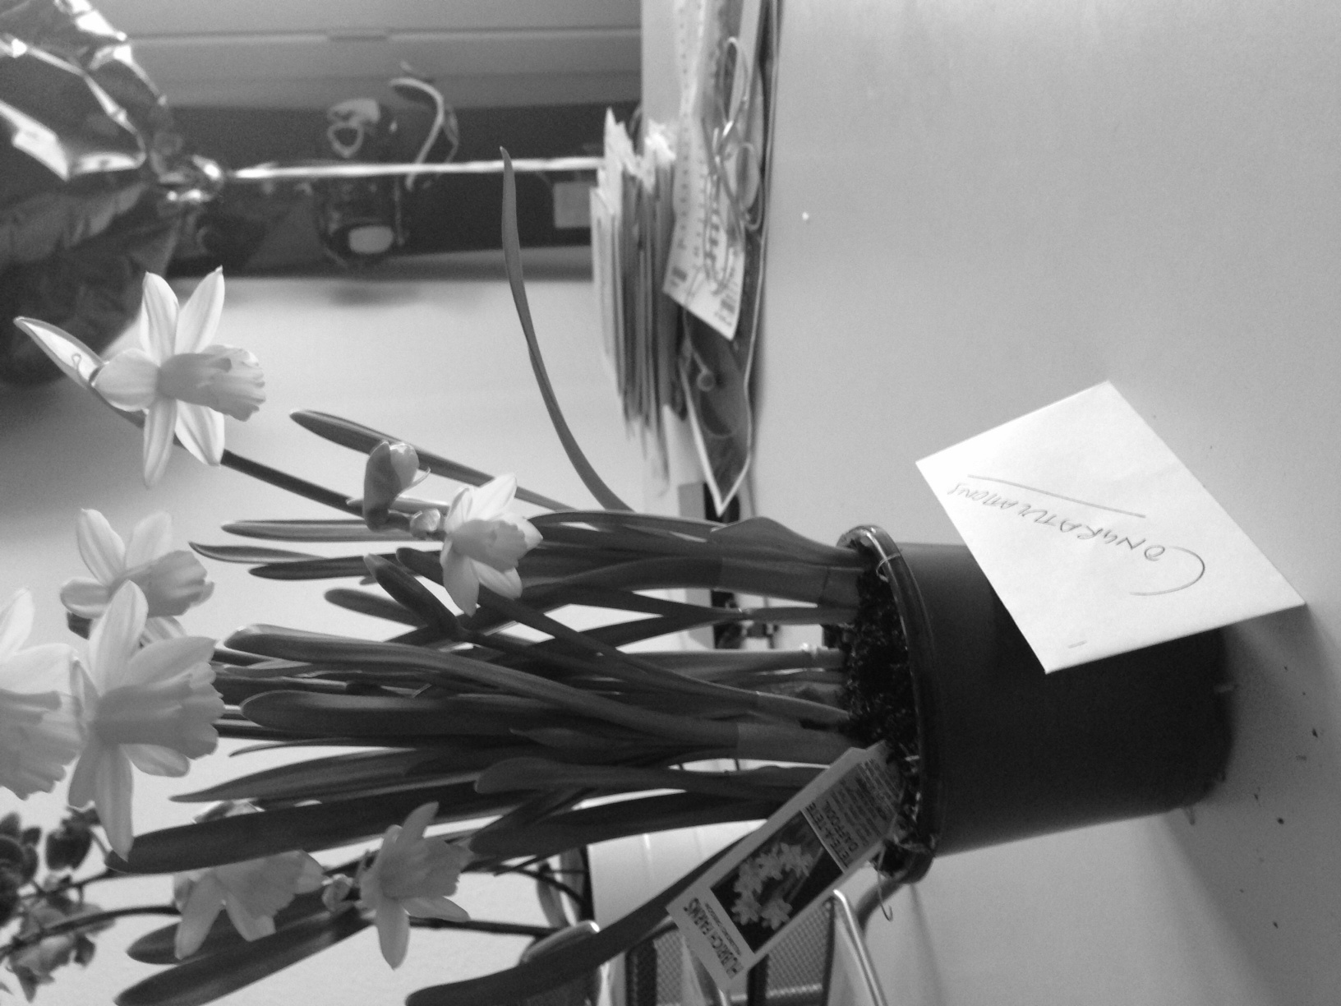

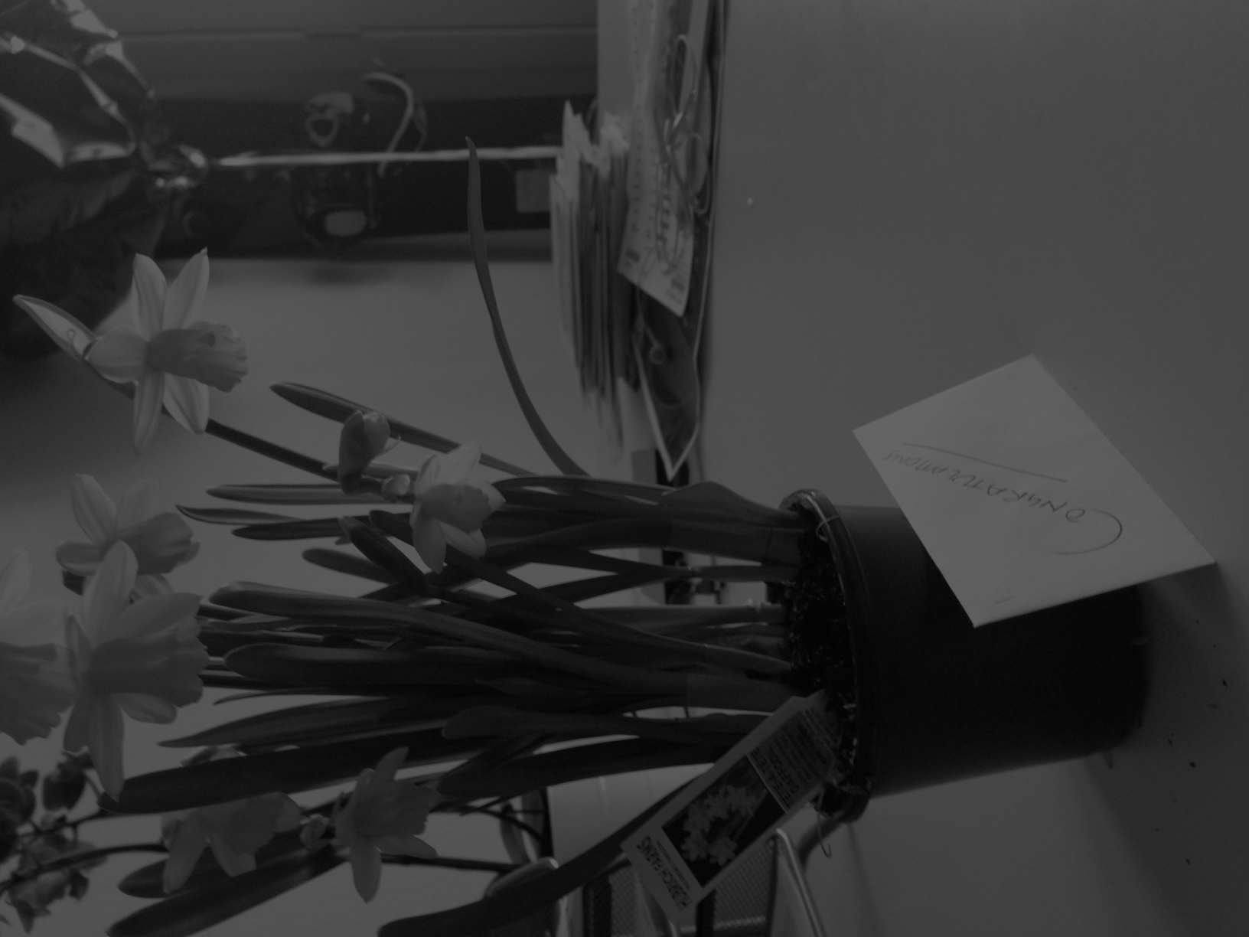
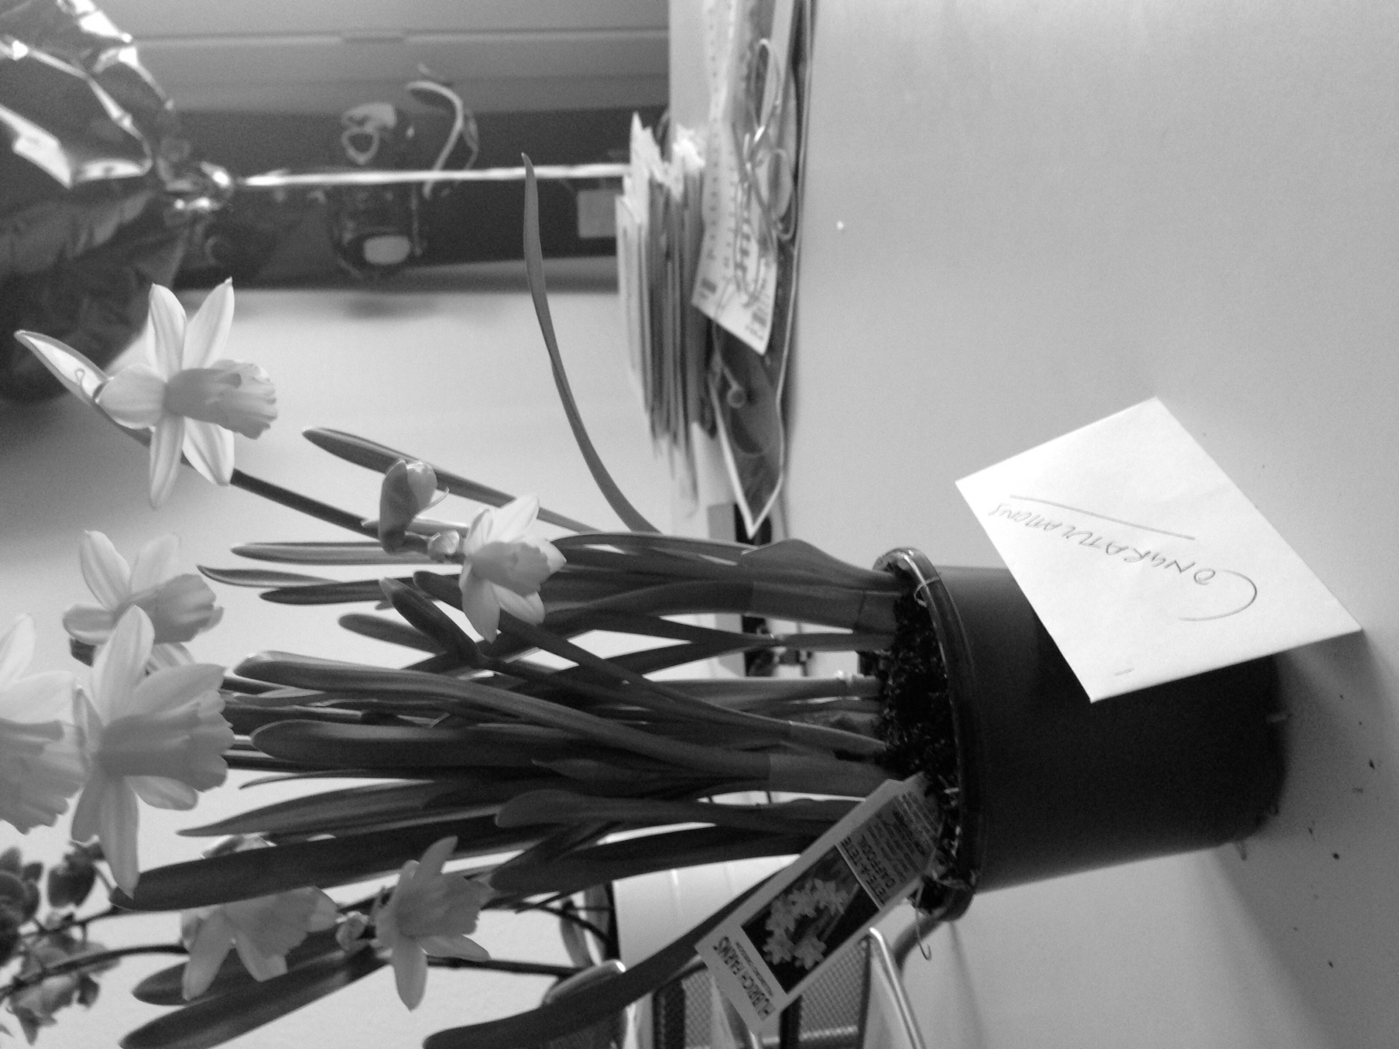
input
Average
XYZ Luminance
YUV Luminance
Lab Luminance
Lab luminance Enhancement

Slide 23
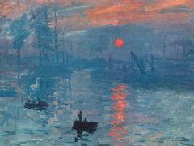
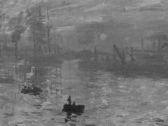
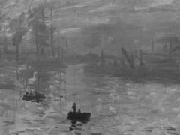
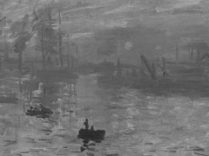
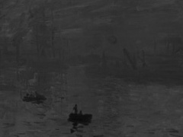
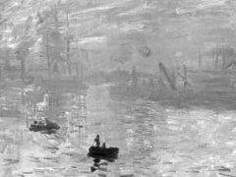
input
Average
XYZ Luminance
YUV Luminance
Lab Luminance
Lab luminance Enhancement

Slide 24





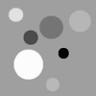
input
Average
XYZ Luminance
YUV Luminance
Lab Luminance
Lab luminance Enhancement

Slide 25
Challenges
Understanding Target difference
Implementing Optimization
Taking lot of time
Setting maximum Iterations

Slide 26
Future work
More experiments
On more images
Increasing number of iterations
Changing alpha and theta

Slide 27
References
Color2Gray: http://www.cs.northwestern.edu/~ago820/color2gray/
Rgb to lab : http://stackoverflow.com/questions/13405956/convert-an-image-rgb-lab-with-python
Optimization using python : http://docs.scipy.org/doc/scipy/reference/tutorial/optimize.html

Slide 28
Questions

