Slide 1
WINNING THAT GRAMMY
STUDY OF WINNERS AND NOMINEES FOR BEST RAP SONG
SCOTT SNOW IST 652
WINTER 2019

Slide 2
Data Acquisition
Challenges
Inconsistent tabling
More popular albums had track listings that included producers and writers with the table labeled with class or id tags
Less popular albums had simply a list of tracks and durations with no tags.
The program handled most tables well but was not complex enough to tackle the less well annotated tables.
Inconsistent naming
Many times credits are taken directly from a release. Often the artist is credited by their full name for songwriting credits. This wasn’t always consistent.
Some songwriters would be P. McCartney in some places and Paul McCartney in others.
The custom CSV was slightly time consuming but reduced these errors for the most important data objects
Uses BeautifulSoup for web scraping
List of Songs and pertinent information scraped from Wikipedia
Lyrics scraped from genius.com
Manual CSV created for the winner’s and nominees
Manual correction CSV for incorrectly created Genius.com URL’s

Slide 3
Data Manipulation
Used regular expressions to change the url format between class titles, text and Wikipedia and Genius URLs.
\s(\(.+\)) – removes a parenthetical from a string. On Wikipedia, songs with general names have an added notation in the title and URL such as Mercy (Kanye West song)
“(.*?)“ – captures text inside of quotes within a string. This was used to find the first printed string in the row of text which was the album name.
[^a-zA-Z0-9\-]* - captures only alphanumeric characters. This is used for genius.com where the URL’s have all special characters removed. The exception is the dash which is used to separate all terms.
Used datetime to and calendar to transform the string release date into a datetime object.
The range of dates of interest is Oct 1, 2002 through Sep 30, 2016. This is because the first award for Best Rap Song wasn’t given until 2004.
2017-2018 were excluded because Wikipedia has different formatting for those years.
Generator Method for querying certain data elements:
[fxurls.loc[x,"goodurl"] for x in range(fxurls.shape[0]) if url == fxurls.loc[x,"badurl"]]

Slide 4
Analytical Questions
Which words choices seem to be most closely associated with winning?
Which producers / songwriters are most associated with nominations?
Can producers/songwriters be used as association rules to predict nomination?

Slide 5

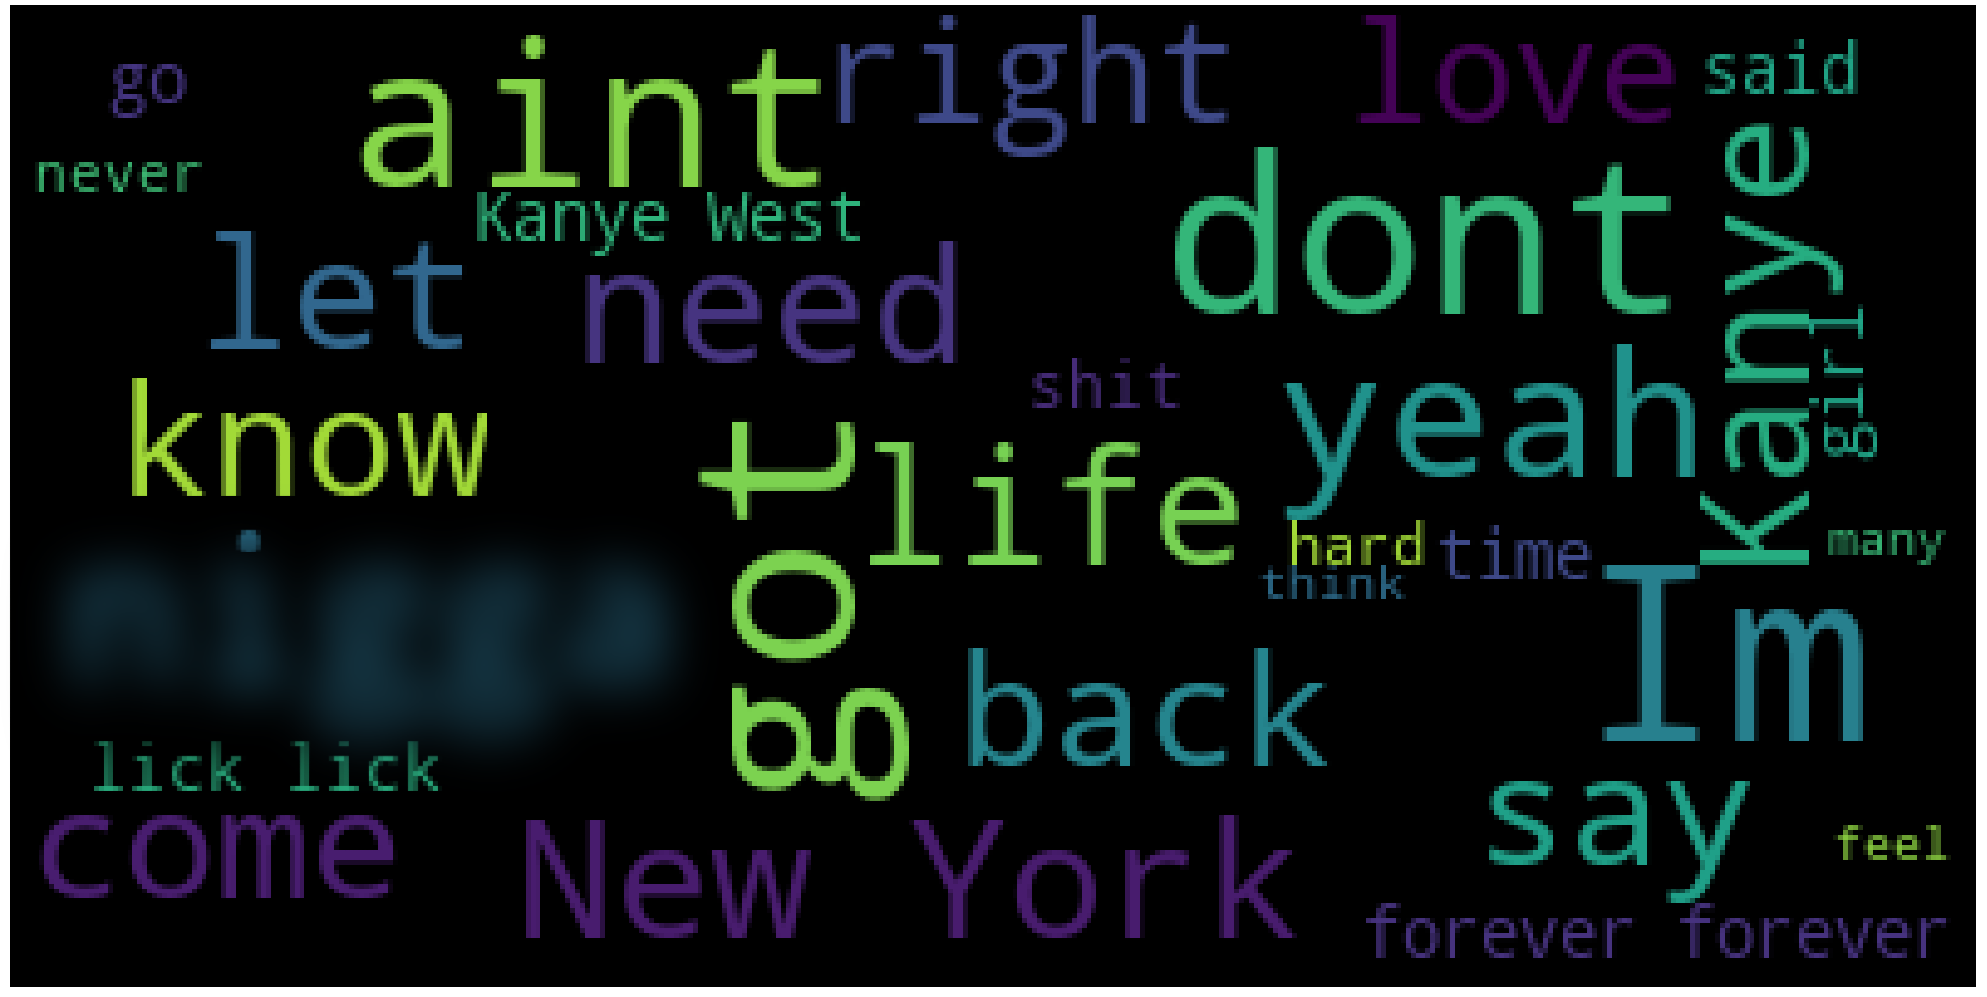
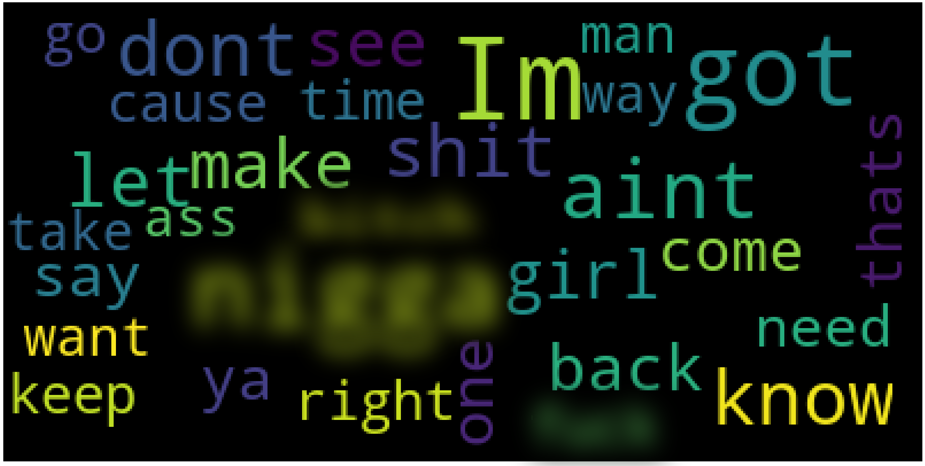
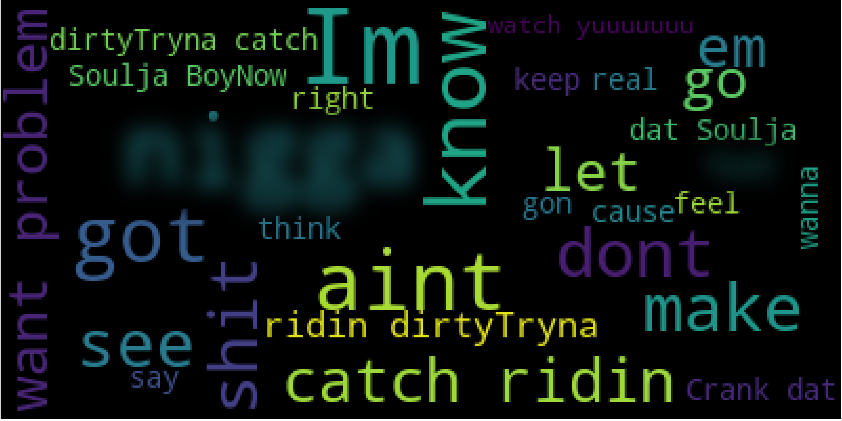
Visualizations
Total words in each category:
Winners : 4309
Nominees: 17659
Everyone: 159199
Unique words in each category:
Everyone: 35168
Nominees: 5622
Winners: 1855
Average occurrence of a word:
Everyone: 4.527
Nominees: 3.141
Winners: 2.323
Winners
Everyone Else
Nominees

Slide 6
Interesting Finds
Early winners that also won later in their career generally had more songwriters credited for their later wins or nominations
Many songwriters and producers have multiple wins but never as the primary artist:
No I.D.
Andre Young (Dr. Dre)
Pharrell Williams
Timbaland
Two songs included phrases that dominated in frequency compared to the rest:
Chamillionaire - Ridin
Soulja Boy – Crank That
These songs precipitated the current style of multiple reptitions.

Slide 7
Conclusions
Word choice does matter:
Many of the songs who weren’t nominated swore more often than nominees and winners
Additionally, winners had more reference to something relatable such as the city of New York
Additionally, word complexity seems to indicate nominees and wins with some exceptions.
Some producers and songwriters have a talent for making anyone’s song a hit. Artists such as Jay-Z, Kanye West, Dr. Dre, Lil-Wayne, and Eminem appeared multiple times as artist, songwriter, and/or producer. It is likely there are strong associations between nominations/wins and those artists.
Fun fact: Paul McCartney was nominated for Best Rap Song in 2016 in conjunction with his work on Kanye West’s song “All Day”
Fun fact # 2: Macklemore and Ryan Lewis have an interesting song called “Brad Pitt’s Cousin”

Slide 8
Still to Do
Generate Association Rules to answer the third question.
Resolve issues with data pipeline
Many producers and songwriters with special characters and inconsistent naming.

