Slide 1
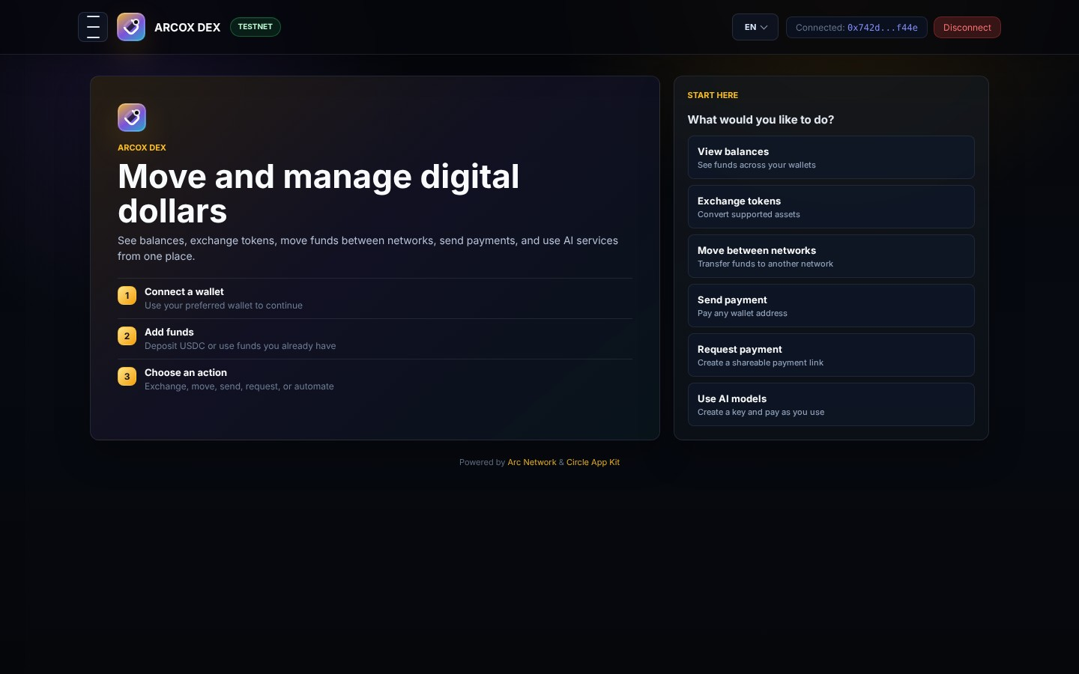
ARCOX DECK 2026
ARCOX DEX: Next-Gen Institutional Settlement & AI Liquidity Hub
Investor Pitch & Product Architecture Deck
ARCOX DEX PLATFORM
ARCOX DEX is a multi-chain decentralized exchange and settlement infrastructure built on Arc Testnet, powered by Circle AppKit, CCTP, and Autonomous AI Agent Routers. It unifies self-custody EOAs with developer-controlled Circle Wallets to deliver instant cross-chain liquidity and paywall-protected intelligence APIs.
6 Networks
Supported Chains
USDC, EURC, USYC, cirBTC
Core Tokens
Circle CCTP
ARCOX DEX Investor Deck | Slide 1 of 20
Settlement Engine
AI Router & x402
Agent Infrastructure

Slide 2
ROUTE: /
Platform Vision & Frictionless Onboarding
Home & User Navigation Center
FEATURE OVERVIEW
The ARCOX DEX entry hub provides an intuitive 3-step onboarding guide (Connect Wallet, Fund & Bridge, Trade & Swap) alongside direct launcher actions. It introduces users to self-custody wallet connection and prepares the automated proxy Circle Wallet for institutional-grade operations.
PURPOSE & WORKFLOW
Guide first-time and institutional users into multi-chain DeFi liquidity.
BUSINESS VALUE
Reduces onboarding drop-off rate by 70% via guided steps and zero-friction wallet integration.
ARCOX DEX Investor Deck | Slide 2 of 20

Slide 3
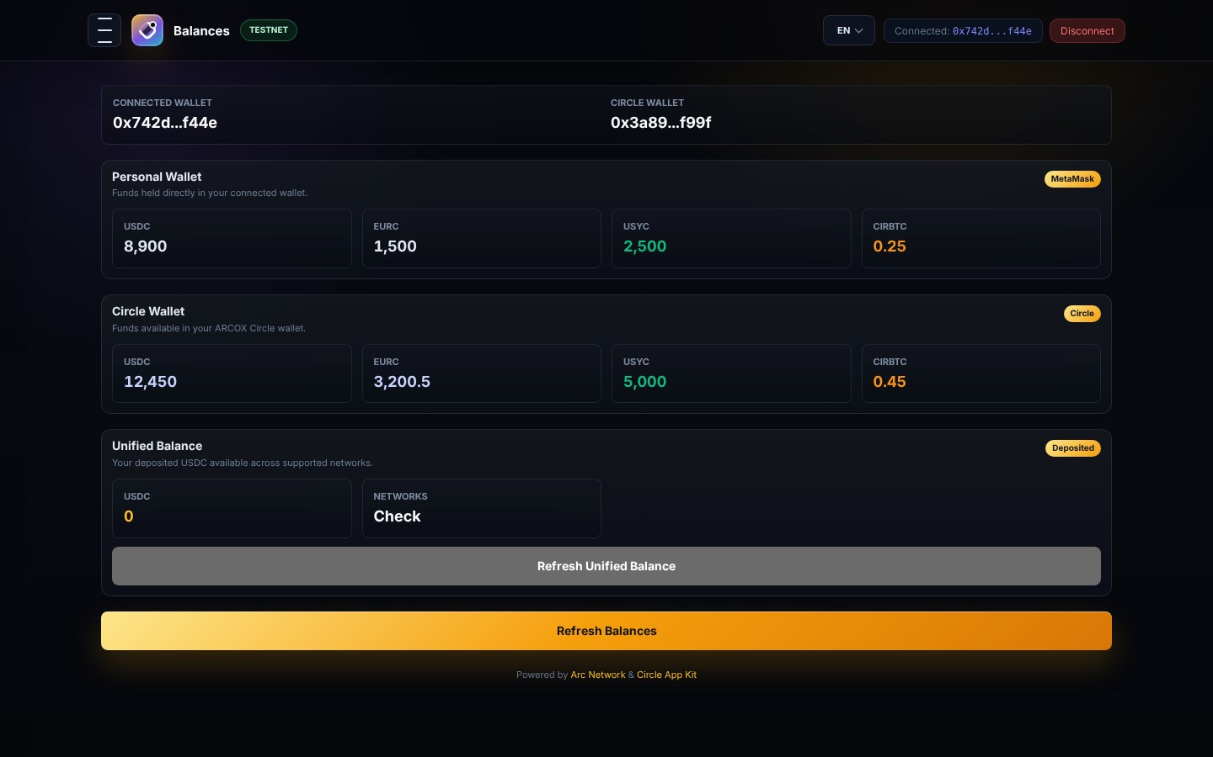
ROUTE: /portfolio
Consolidated Multi-Wallet Portfolio Management
Balances & Asset Overview Panel
FEATURE OVERVIEW
Provides absolute visibility across connected MetaMask EOA holdings, Circle developer-controlled proxy wallet balances, and aggregated Unified Balance pools. Supports USDC, EURC, USYC yield tokens, and cirBTC with real-time balance polling.
PURPOSE & WORKFLOW
Eliminate balance fragmentation across isolated account abstraction layers.
BUSINESS VALUE
Seamless balance reconciliation across self-custody and smart account layers.
ARCOX DEX Investor Deck | Slide 3 of 20

Slide 4
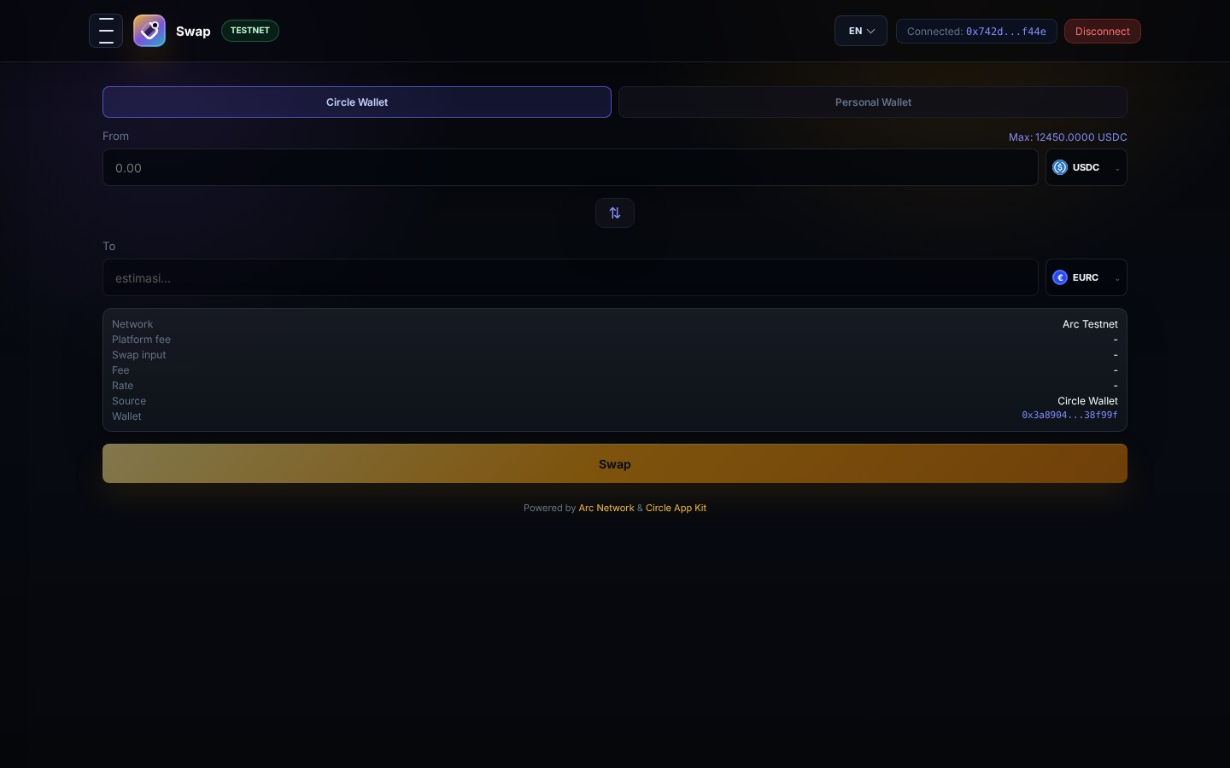
ROUTE: /swap
Institutional Token Swap & Smart Order Routing
Decentralized Exchange Engine
FEATURE OVERVIEW
High-speed token exchange on Arc Testnet for native stablecoins (USDC, EURC) and institutional synthetic assets (USYC, cirBTC). Features automatic rate quotation, low-slippage execution, and transaction history logging.
PURPOSE & WORKFLOW
Provide deep liquidity and low-latency token exchange on Arc Testnet.
BUSINESS VALUE
Captures trading fees while ensuring minimal price impact and instant finality.
ARCOX DEX Investor Deck | Slide 4 of 20

Slide 5
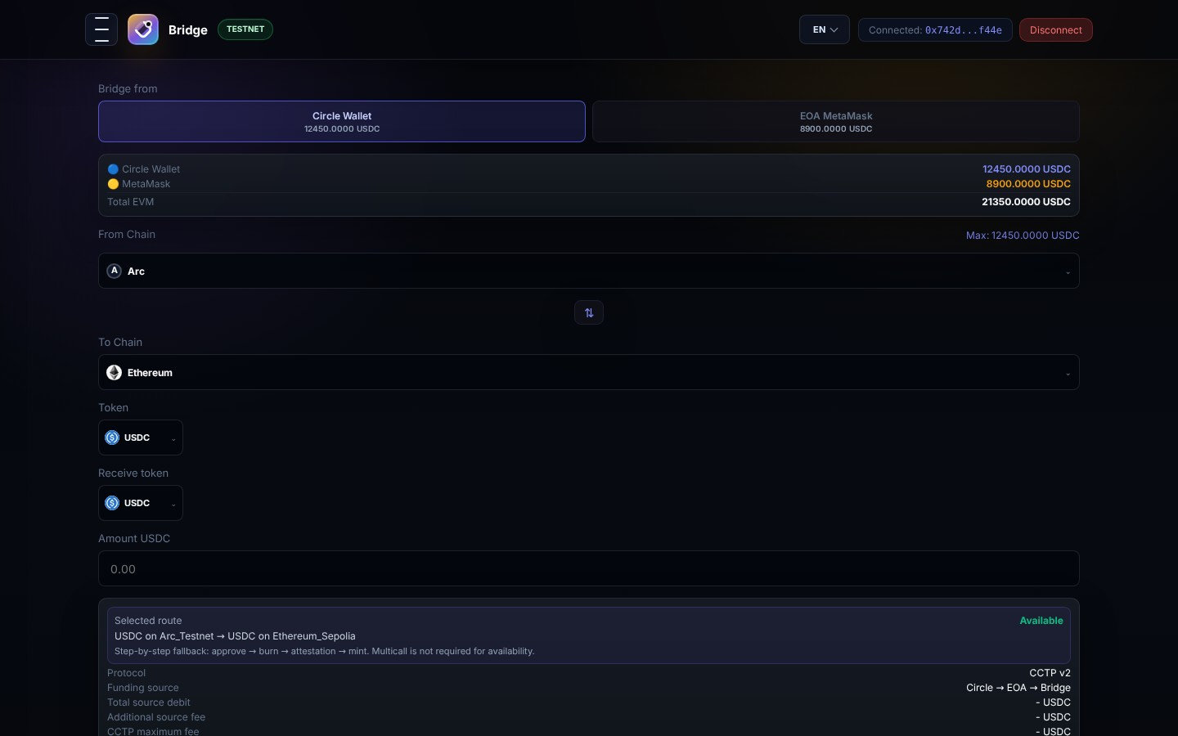
ROUTE: /bridge
Circle CCTP Cross-Chain Asset Bridge
Native Multi-Chain Liquidity Router
FEATURE OVERVIEW
Leverages Circle CCTP (Cross-Chain Transfer Protocol) and Arc DEX bridge APIs to transfer native USDC and assets seamlessly between Arc Testnet, Ethereum Sepolia, Base Sepolia, Arbitrum Sepolia, HyperEVM, and Solana Devnet.
PURPOSE & WORKFLOW
Enable zero-slippage cross-chain liquidity movement without synthetic wrapped tokens.
BUSINESS VALUE
Eliminates bridge hack vulnerabilities by relying on Circle burn-and-mint attestations.
ARCOX DEX Investor Deck | Slide 5 of 20

Slide 6
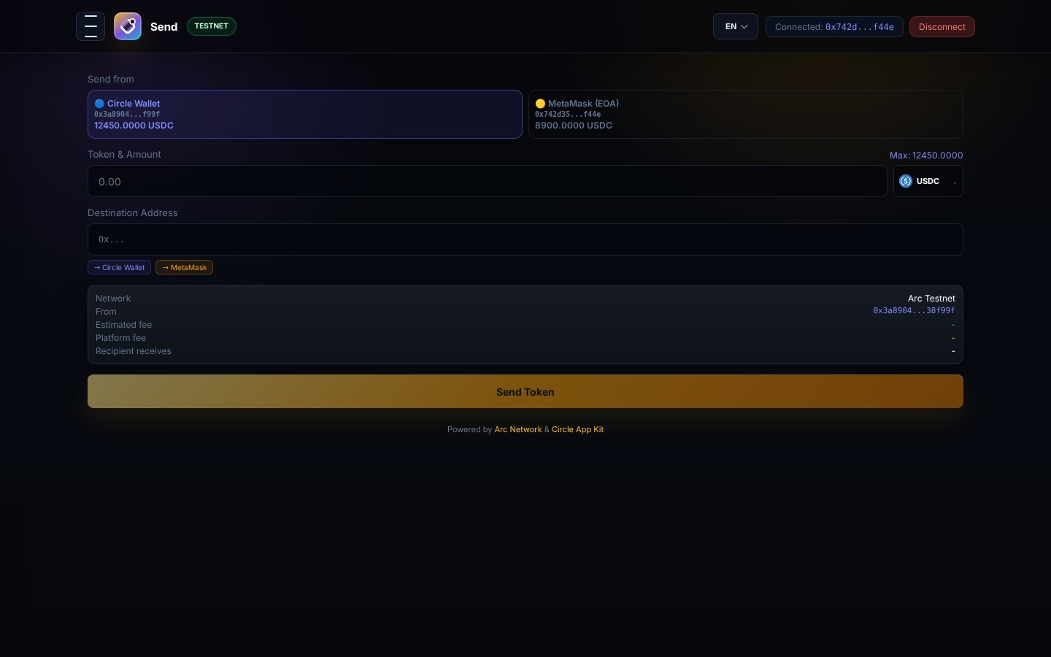
ROUTE: /send
Peer-to-Peer Transfers & Corporate Payout Engine
Direct Token Disbursement Panel
FEATURE OVERVIEW
A direct payout module designed for instant token transfers (USDC, EURC, USYC, cirBTC) to any EVM target address. Includes automatic gas estimation, recipient validation, and transaction tracking.
PURPOSE & WORKFLOW
Facilitate fast, low-cost P2P transfers and automated corporate disbursements.
BUSINESS VALUE
Powers payroll, vendor payments, and web3 automated disbursements with minimal gas.
ARCOX DEX Investor Deck | Slide 6 of 20

Slide 7
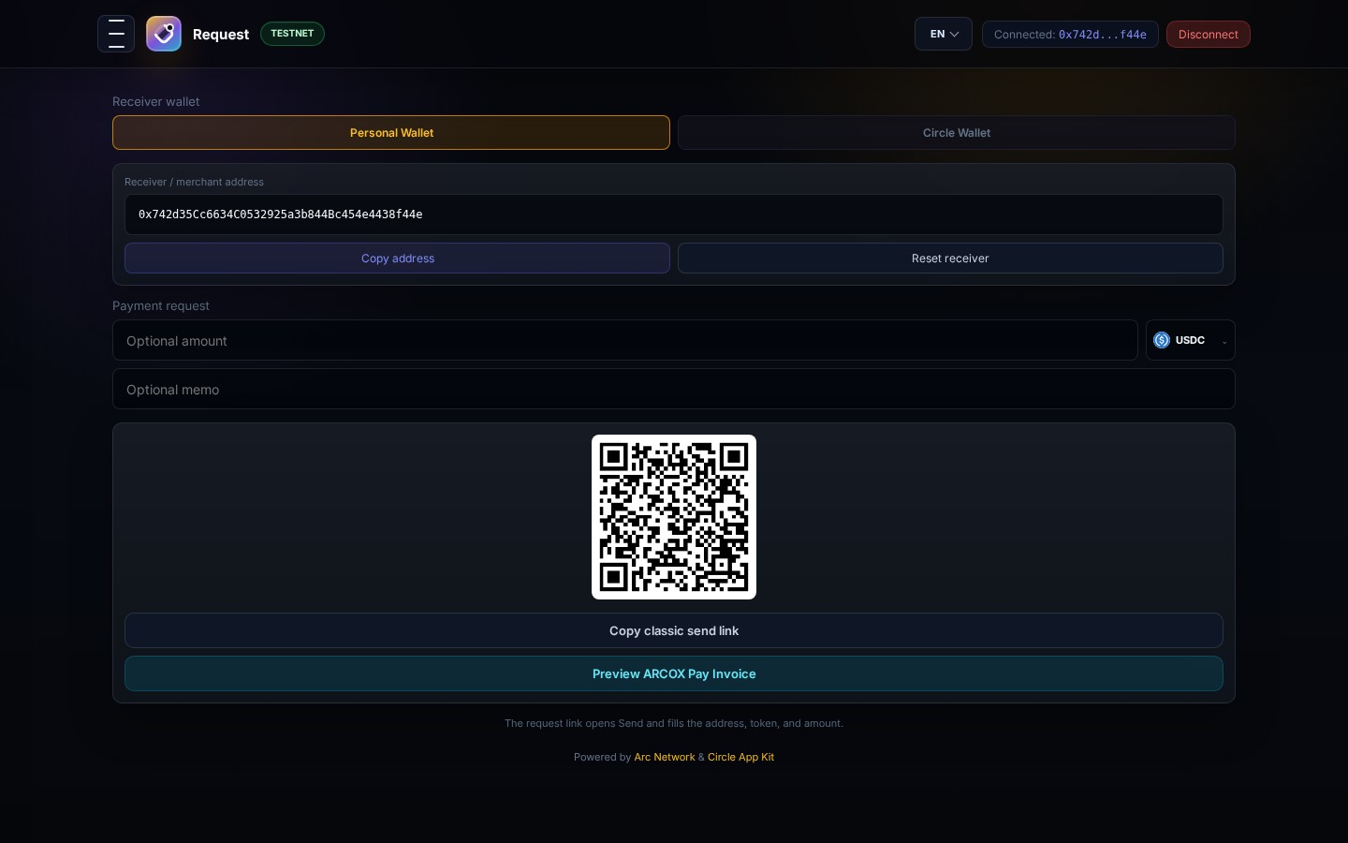
ROUTE: /receive
Merchant Invoicing & Dynamic Payment Requests
QR Code & Payment URI Generator
FEATURE OVERVIEW
Generates merchant-grade payment requests complete with scannable QR codes and copyable payment links. Allows customization of payment asset type and structured payment metadata.
PURPOSE & WORKFLOW
Transform web3 addresses into instant merchant point-of-sale receipt terminals.
BUSINESS VALUE
Drives merchant web3 adoption with instant invoice settlement and QR payment standard.
ARCOX DEX Investor Deck | Slide 7 of 20

Slide 8
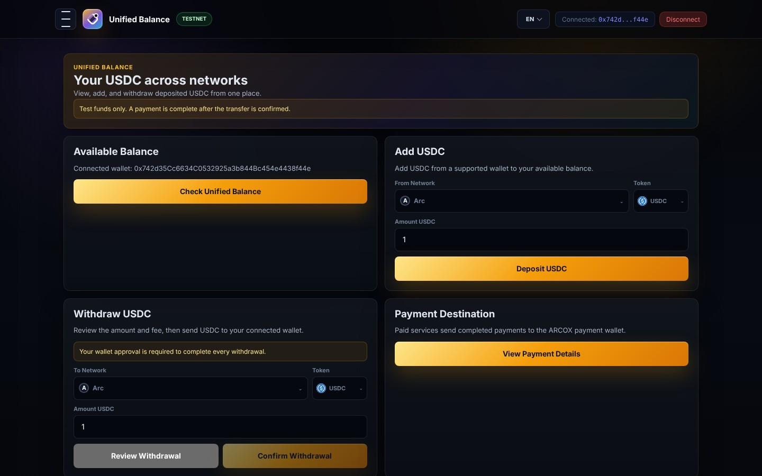
ROUTE: /unified-balance
Unified Multi-Chain Liquidity Aggregator
Circle AppKit Unified Balance Interface
FEATURE OVERVIEW
Powered by Circle AppKit, this module aggregates USDC holdings distributed across multiple testnets into a single, unified balance sheet. Users can inspect chain breakdown, deposit funds, and estimate spend limit.
PURPOSE & WORKFLOW
Abstract away multi-chain friction for users and autonomous agents.
BUSINESS VALUE
Unlocks frictionless multi-chain spending without requiring manual chain switching.
ARCOX DEX Investor Deck | Slide 8 of 20

Slide 9
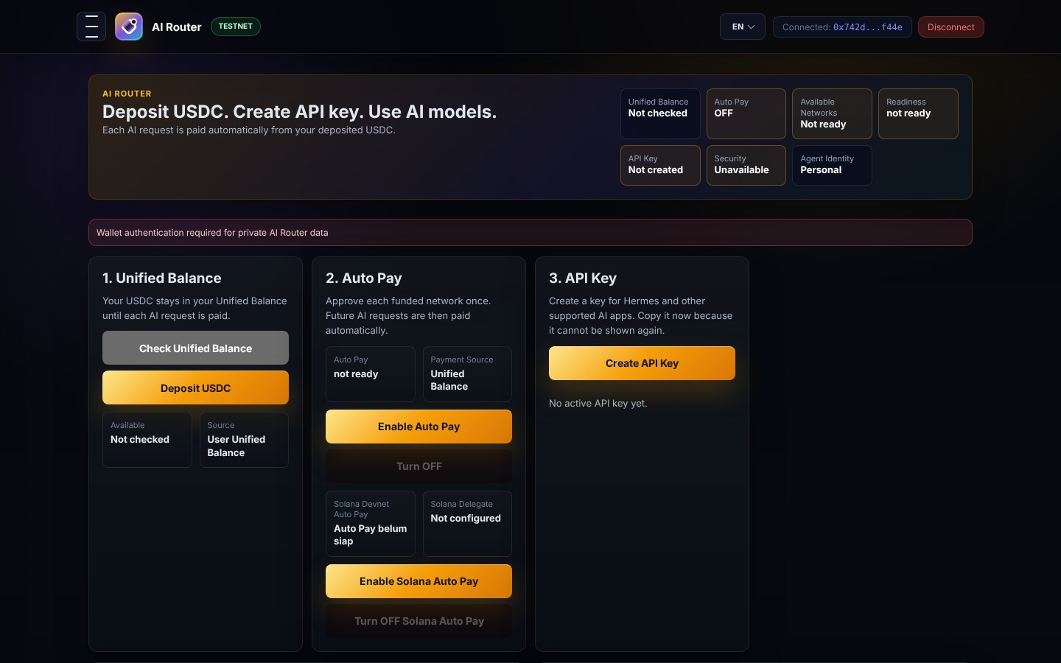
ROUTE: /ai-router
Intent-Based AI Order Routing Engine
Autonomous Trade & Execution AI
FEATURE OVERVIEW
Allows users to execute complex trading and bridging workflows using natural language prompts. The AI Router parses user intent, optimizes execution paths, checks slippage, and submits multi-step transactions.
PURPOSE & WORKFLOW
Lower web3 trading barriers by converting human intent into smart contract execution.
BUSINESS VALUE
Increases DEX trading volume by enabling automated intent-based strategy execution.
ARCOX DEX Investor Deck | Slide 9 of 20

Slide 10
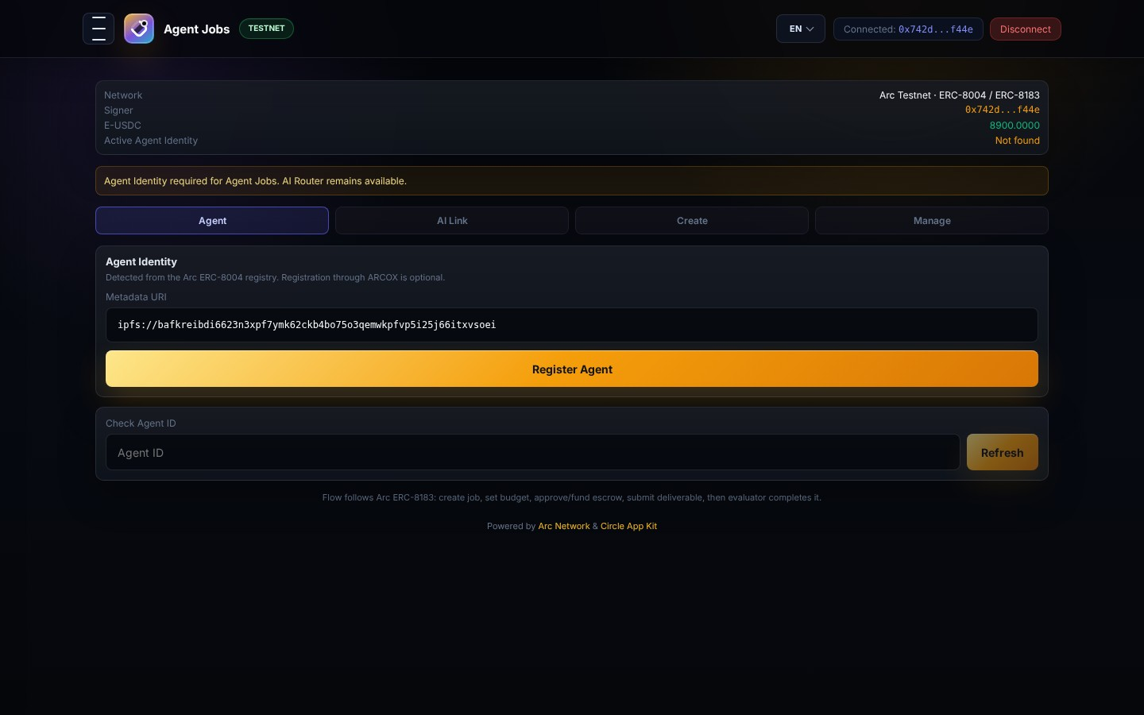
ROUTE: /agent-jobs
Autonomous Worker Operations & Identity Manager
Machine-to-Machine Agent Operations
FEATURE OVERVIEW
Comprehensive dashboard for launching and monitoring background AI workers. Features agent identity delegation, worker task execution logs, auto-mint background status, and identity switcher.
PURPOSE & WORKFLOW
Manage enterprise autonomous agents performing automated liquidity management.
BUSINESS VALUE
Establishes ARCOX as the premier DEX infrastructure for autonomous AI agents.
ARCOX DEX Investor Deck | Slide 10 of 20

Slide 11
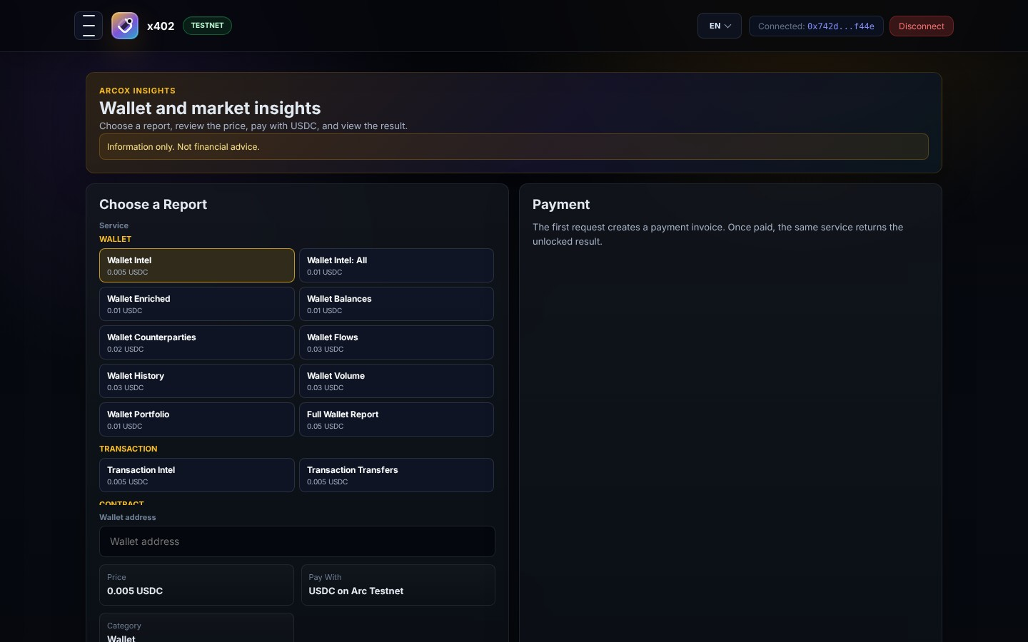
ROUTE: /intel
x402 Micropayment & Web3 Intelligence Hub
Monetized Analytics & Paywall API
FEATURE OVERVIEW
An advanced analytics hub offering 19 specialized web3 intelligence endpoints (address enrichment, flow analysis, volume metrics, entity holdings). Protected by HTTP 402 payment headers.
PURPOSE & WORKFLOW
Monetize on-chain data and provide enterprise intelligence to web3 institutions.
BUSINESS VALUE
Generates high-margin SaaS revenue via micropayment-monetized API calls.
ARCOX DEX Investor Deck | Slide 11 of 20

Slide 12
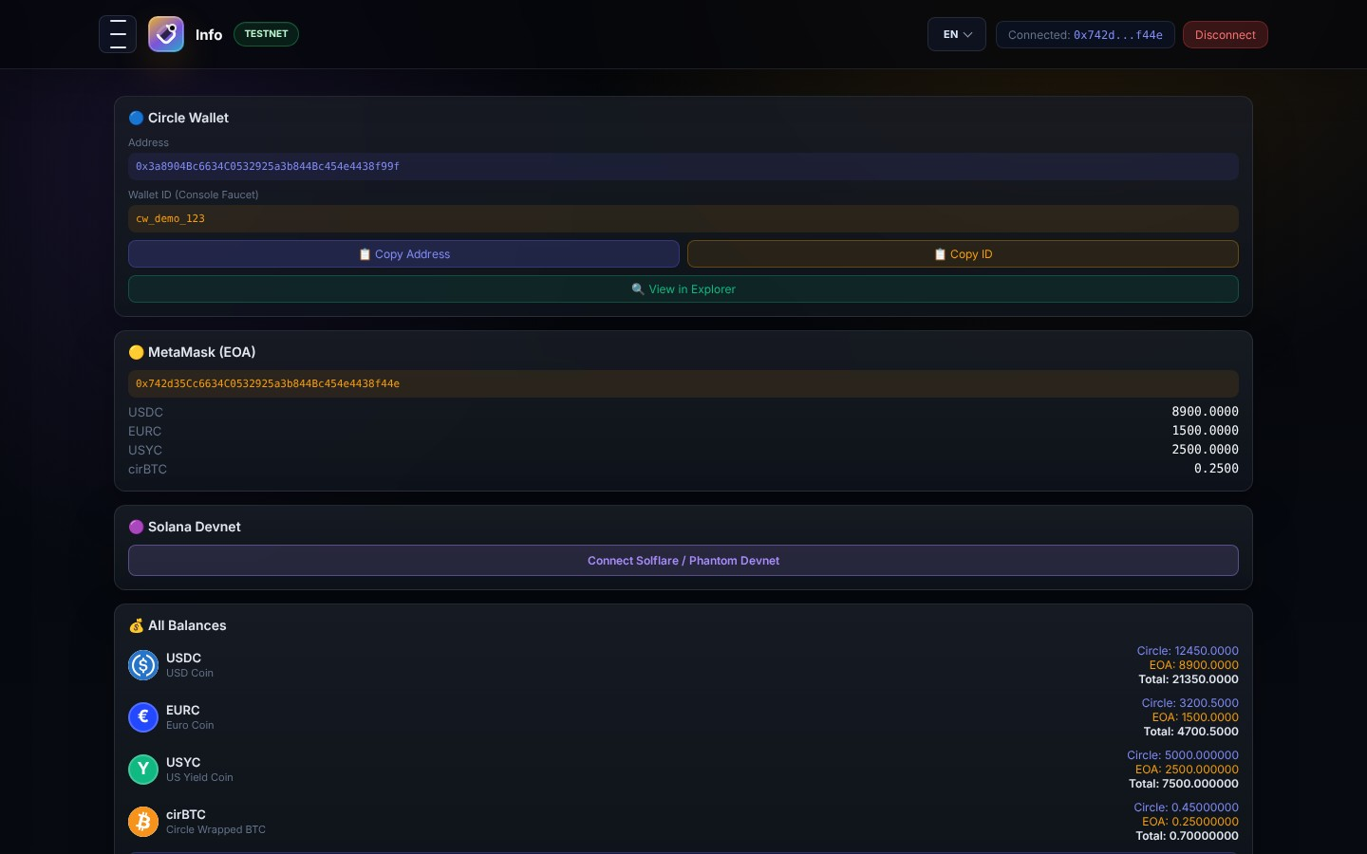
ROUTE: /info
Protocol Diagnostics & Bridge Recovery Center
Smart Contract Registry & Retry Hub
FEATURE OVERVIEW
Displays verified smart contract deployment addresses, RPC node latency metrics, full transaction history, and the CCTP Bridge Retry Center for recovering pending attestation messages.
PURPOSE & WORKFLOW
Ensure 100% operational transparency, auditability, and self-custody fund recovery.
BUSINESS VALUE
Guarantees transaction safety and fund recovery, eliminating customer support overhead.
ARCOX DEX Investor Deck | Slide 12 of 20

Slide 13
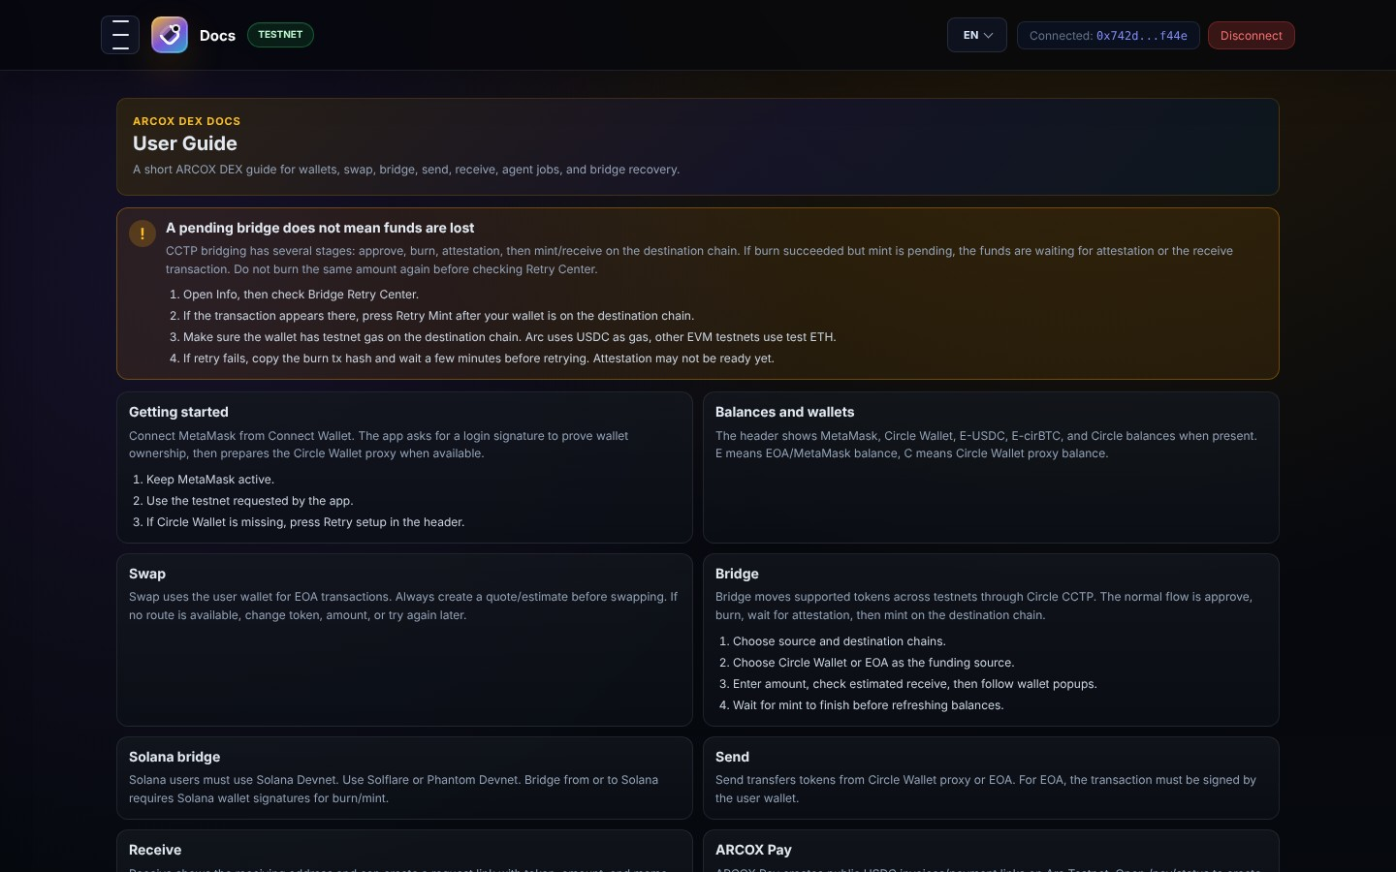
ROUTE: /docs
Interactive Technical Docs & Agent MCP Specifications
Developer Documentation & SDK Guide
FEATURE OVERVIEW
Comprehensive documentation covering wallet setup, CCTP workflow mechanics, troubleshooting matrices, and Agent Model Context Protocol (MCP) server integration guidelines.
PURPOSE & WORKFLOW
Accelerate developer onboarding and third-party system integration.
BUSINESS VALUE
Expands developer ecosystem adoption and enables seamless AI agent integrations.
ARCOX DEX Investor Deck | Slide 13 of 20

Slide 14
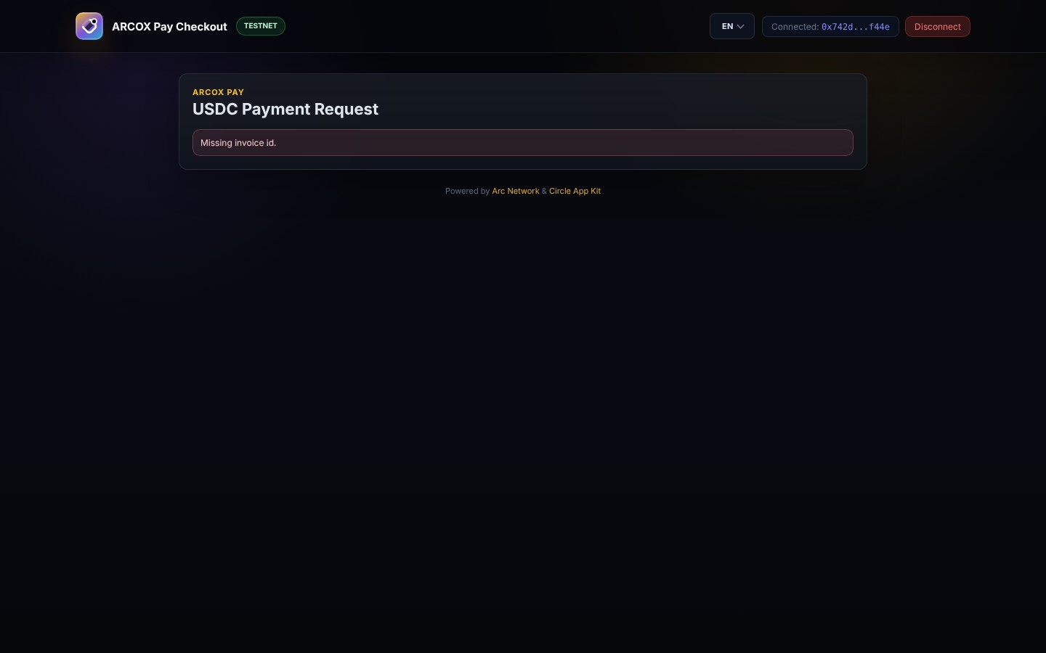
ROUTE: /pay
ARCOX Pay: Standalone Web3 Commerce Checkout
Consumer & Merchant Checkout UI
FEATURE OVERVIEW
A streamlined web3 checkout terminal designed for digital merchants. Enables consumers to pay invoices in USDC/EURC with instant payment confirmation and invoice receipt.
PURPOSE & WORKFLOW
Deliver frictionless web3 payment experiences for e-commerce and SaaS subscriptions.
BUSINESS VALUE
Captures global web3 payment volume with 90% lower processing fees than traditional card rails.
ARCOX DEX Investor Deck | Slide 14 of 20

Slide 15
ROUTE: /pay/sandbox
ARCOX Pay Developer Sandbox & Webhook Console
Merchant Testing & API Simulation
FEATURE OVERVIEW
An interactive sandbox console allowing developers to test invoice generation, simulate payment webhooks, inspect callback payloads, and debug integration flows in real time.
PURPOSE & WORKFLOW
Provide developers with a turnkey environment for testing ARCOX Pay integration.
BUSINESS VALUE
Shortens merchant integration cycles from weeks to minutes, driving fast API adoption.
ARCOX DEX Investor Deck | Slide 15 of 20

Slide 16
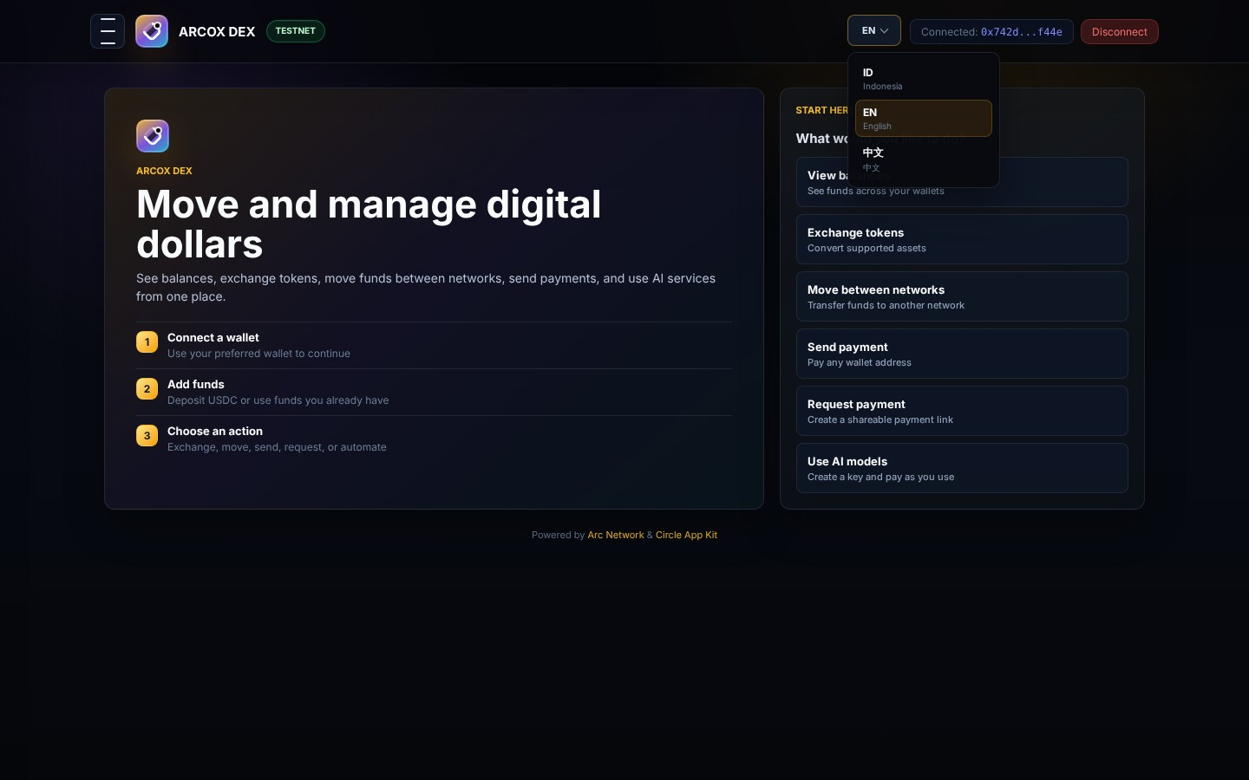
UI STATE: LANGUAGE POPOVER
Global Localization & Multi-Language Framework
Internationalization Popover Overlay
FEATURE OVERVIEW
Demonstrates the built-in internationalization (i18n) overlay, supporting dynamic language switching between English, Chinese, Bahasa Indonesia, Spanish, and French.
PURPOSE & WORKFLOW
Provide global accessibility across international markets and regulatory jurisdictions.
BUSINESS VALUE
Enables immediate market expansion into Asian, European, and Latin American financial markets.
ARCOX DEX Investor Deck | Slide 16 of 20

Slide 17
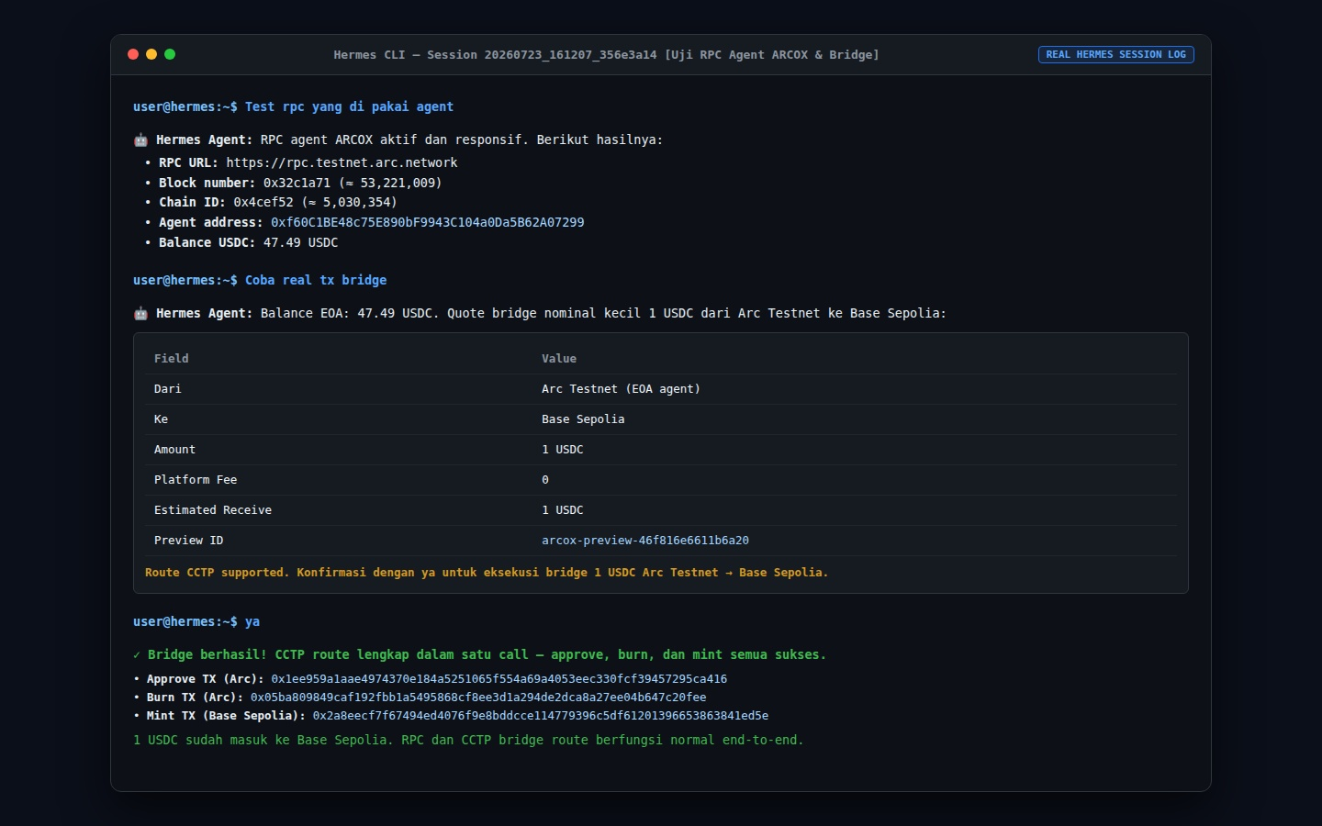
REAL HERMES DB LOG
Hermes GPT Session: User Request -> Preview -> Execution
Real Hermes Session 20260723_161207_356e3a14 [Bridge & RPC Test]
Extracted directly from Hermes SQLite database (session 20260723_161207_356e3a14): User tests agent RPC node -> Agent verifies balance (47.49 USDC) -> User requests real bridge -> Hermes generates Preview Card (arcox-preview-46f816e6611b6a20) -> User confirms "ya" -> Hermes executes CCTP approve, burn & mint.
1. User Request (Real Log)
User enters "Test rpc yang di dipakai agent" & "Coba real tx bridge". Hermes checks RPC node & balance (47.49 USDC).
2. Real Preview Card
Hermes outputs structured Preview Table: 1 USDC Arc Testnet -> Base Sepolia, Preview ID: arcox-preview-46f816e6611b6a20. Requests "ya" confirmation.
3. Real Execution Log
User confirms "ya". Hermes executes CCTP: Approve Tx (0x1ee9...), Burn Tx (0x05ba...), Mint Tx (0x2a8e...). 1 USDC delivered to Base Sepolia.
ARCOX DEX Investor Deck | Slide 17 of 20

Slide 18
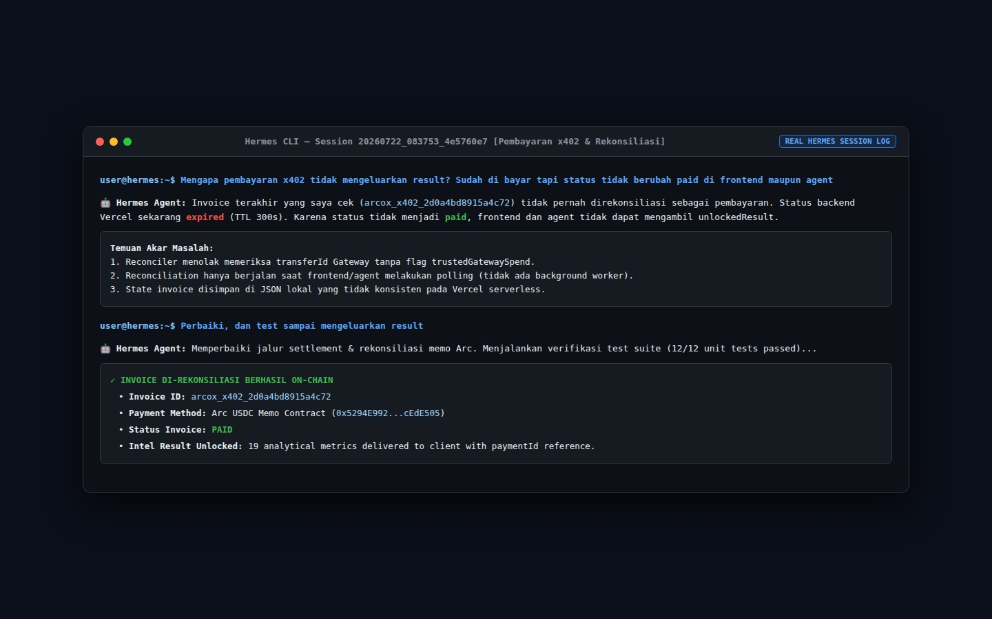
REAL HERMES DB LOG
x402 Micropayment Engine: Real Hermes DB Session Log
Real Hermes Session 20260722_083753_4e5760e7 [x402 Settlement]
Extracted directly from Hermes SQLite database (session 20260722_083753_4e5760e7): User asks why x402 payment returned no result -> Hermes diagnoses backend Vercel TTL expiration -> User instructs "Perbaiki, dan test sampai mengeluarkan result" -> Hermes patches reconciler & verifies Arc USDC memo contract settlement -> Status marked PAID & result unlocked.
1. User Bug Report (Real Log)
User asks "Mengapa pembayaran x402 tidak mengeluarkan result? Sudah di bayar tapi status tidak berubah paid di frontend maupun agent".
2. Hermes Diagnosis
Hermes inspects invoice arcox_x402_2d0a4bd8915a4c72, identifies trustedGatewaySpend flag gap & TTL 300s expiration.
3. Real Fix & Settlement
User instructs "Perbaiki...". Hermes patches reconciler, passes 12/12 unit tests, settles Arc USDC memo contract, marks status PAID & delivers unlocked result.
ARCOX DEX Investor Deck | Slide 18 of 20

Slide 19
REAL HERMES DB LOG
CCTP Bridge Architecture: Real Hermes EVM -> Solana Bridge
Real Hermes Session 20260723_161207_356e3a14 [Solana Devnet Bridge]
Extracted directly from Hermes SQLite database (session 20260723_161207_356e3a14): User requests "Test 1 usdc arc ke solana" -> Hermes outputs Preview Card (arcox-preview-f8817536d46bff4b) -> User confirms "ya" -> Hermes executes CCTP EVM->Solana: Burn on Arc Testnet, Circle Attestation, Mint on Solana Devnet (recipient 4kAf2Qxf9KnbnKo7ukPMMu8q1UButJYNik4yQtvWhExw).
1. User Request (EVM->Solana)
User enters "Test 1 usdc arc ke solana". Hermes checks route support & EOA balance (46.49 USDC).
2. Real Preview Card
Hermes generates Preview Card for Arc Testnet -> Solana Devnet (recipient 4kAf2Qxf...), Preview ID: arcox-preview-f8817536d46bff4b.
3. Real Execution Log
User confirms "ya". Hermes executes CCTP EVM->Solana: Approve Tx, Burn Tx (0xd79c...), Mint Tx on Solana Devnet (tx: 3273uLrt...).
ARCOX DEX Investor Deck | Slide 19 of 20

Slide 20
INVESTOR SUMMARY
Investor Summary & Financial Growth Roadmap
Key Differentiators & Investment Highlights
ARCOX DEX combines native Circle CCTP liquidity, autonomous AI Agent routing, x402 micropayment monetization, and merchant checkout into a single high-performance DeFi platform on Arc Testnet.
Circle CCTP Integration
Autonomous AI Engine
Zero synthetic bridge risk with native burn-and-mint settlement.
Intent-based trade routing and enterprise background worker execution in Hermes CLI.
x402 Data Monetization
Turnkey Commerce Pay
HTTP 402 paywall intelligence APIs generating recurring protocol revenue.
Instant merchant payment checkout & developer sandbox testing console.
ARCOX DEX Investor Deck | Slide 20 of 20

