Slide 1
AWS Health Notifications Tracker
Centralized Visibility & AI-Powered Insights for 200+ Account AWS Organizations
Demo Presentation | USPTO AWS Innovation Team | April 2026
Powered by AWS

Slide 2
The Challenge
Managing AWS Health events at scale across a large AWS Organization
Missed Deadlines
Critical maintenance windows and deprecation notices are buried in 200 individual account dashboards. There is no organization-wide view, so teams regularly miss required actions.
Manual, Fragmented Tracking
Operations teams must manually check each account in the AWS Console. Spreadsheets used to track follow-up status become stale within hours and have no ownership workflow.
No Prioritization or AI Assistance
Raw AWS Health events contain dense technical text with no plain-English summary. Teams cannot distinguish Critical from Low urgency at a glance, and there is no automated action recommendation.
Result: Compliance risk, reactive operations, and engineer burnout from manual account monitoring.
AWS Health Notifications Tracker | USPTO AWS Innovation Team
April 2026

Slide 3
Solution: AWS Health Notifications Tracker
Automated collection • AI summarization • Deadline tracking • Follow-up workflow
Automated Collection
AI Summarization
Centralized Dashboard
Proactive Reminders
Follow-up Workflow
EventBridge triggers Health Collector Lambda every 15 minutes. AWS Organizations Health API aggregates events from all 200 accounts automatically.
Amazon Bedrock (Claude Haiku) converts raw AWS API events into plain-English summaries, step-by-step action items, urgency scores, and extracted deadlines.
React SPA on CloudFront shows stats cards, service/urgency charts, sortable event list, and deadline countdowns — all accounts in a single view.
Daily SNS email digest for events with deadlines within 7 days. Critical events re-escalate at 3 days remaining.
Per-event owner assignment, status tracking (Pending / In Progress / Resolved), and free-text notes — persisted to DynamoDB and visible org-wide.
AWS Health Notifications Tracker | USPTO AWS Innovation Team
April 2026

Slide 4
Architecture
Serverless • FedRAMP Authorized • us-east-1 • ~$10–15/month
EventBridge
health-collector
DynamoDB
llm-summarizer
Amazon Bedrock
rate(15 min)
Lambda Python 3.12
HealthEvents table
Lambda Python 3.12
Claude Haiku
DynamoDB Streams
EventBridge
S3 Archive
deadline-reminder
SNS Topic
cron(0 9 * * ?)
Raw event JSON
Lambda Python 3.12
Email digest
API reads from DynamoDB
api-handler
API Gateway
CloudFront
Lambda Python 3.12
HTTP API (open)
React SPA + S3
Users (browser)
EventBridge Scheduler
Lambda Functions
DynamoDB
CloudFront / S3
API Gateway
SNS
AWS Health Notifications Tracker | USPTO AWS Innovation Team
April 2026

Slide 5
AWS Services Used
All FedRAMP Authorized • us-east-1 commercial • No NAT Gateways, no always-on EC2
Service
Purpose
FedRAMP Status
Est./mo
AWS Health API (Orgs)
Source of all health events across all accounts
FedRAMP Auth
~$0
Lambda (x4)
health-collector, llm-summarizer, deadline-reminder, api-handler
FedRAMP Auth
~$1–2
DynamoDB (on-demand)
Primary store — events, status, follow-up tracking
FedRAMP Auth
~$5–10
Amazon Bedrock
Claude Haiku — plain-English summaries & action extraction
FedRAMP Auth
~$1–2
S3 (x2 buckets)
Raw event archive + React SPA static assets
FedRAMP Auth
<$1
CloudFront
CDN for React SPA with Origin Access Control
FedRAMP Auth
<$1
API Gateway HTTP API
REST backend for the React frontend (no auth required)
FedRAMP Auth
~$1
EventBridge Scheduler
rate(15 min) for collector + cron(09:00 UTC) for reminders
FedRAMP Auth
<$1
SNS
Deadline alert email digests to the ops team
FedRAMP Auth
<$1
CloudWatch Logs
All Lambda logs with 30-day retention
FedRAMP Auth
<$1
Total estimated monthly cost at steady state (50K events, 200 accounts, 500 Bedrock calls):
~$10–15 / month
AWS Health Notifications Tracker | USPTO AWS Innovation Team
April 2026

Slide 6
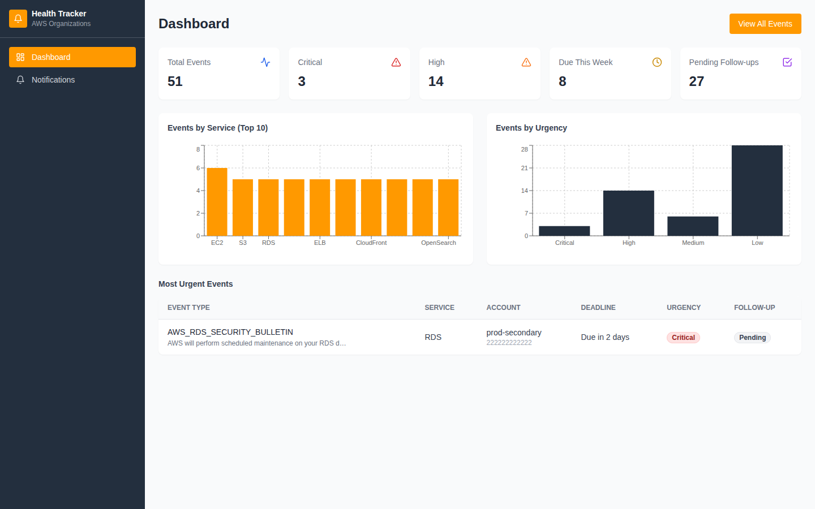
Dashboard
Real-time stats, urgency charts, and upcoming critical deadlines at a glance
Stats cards • Events by Service bar chart • Events by Urgency chart • Top critical events table
AWS Health Notifications Tracker | USPTO AWS Innovation Team
April 2026

Slide 7
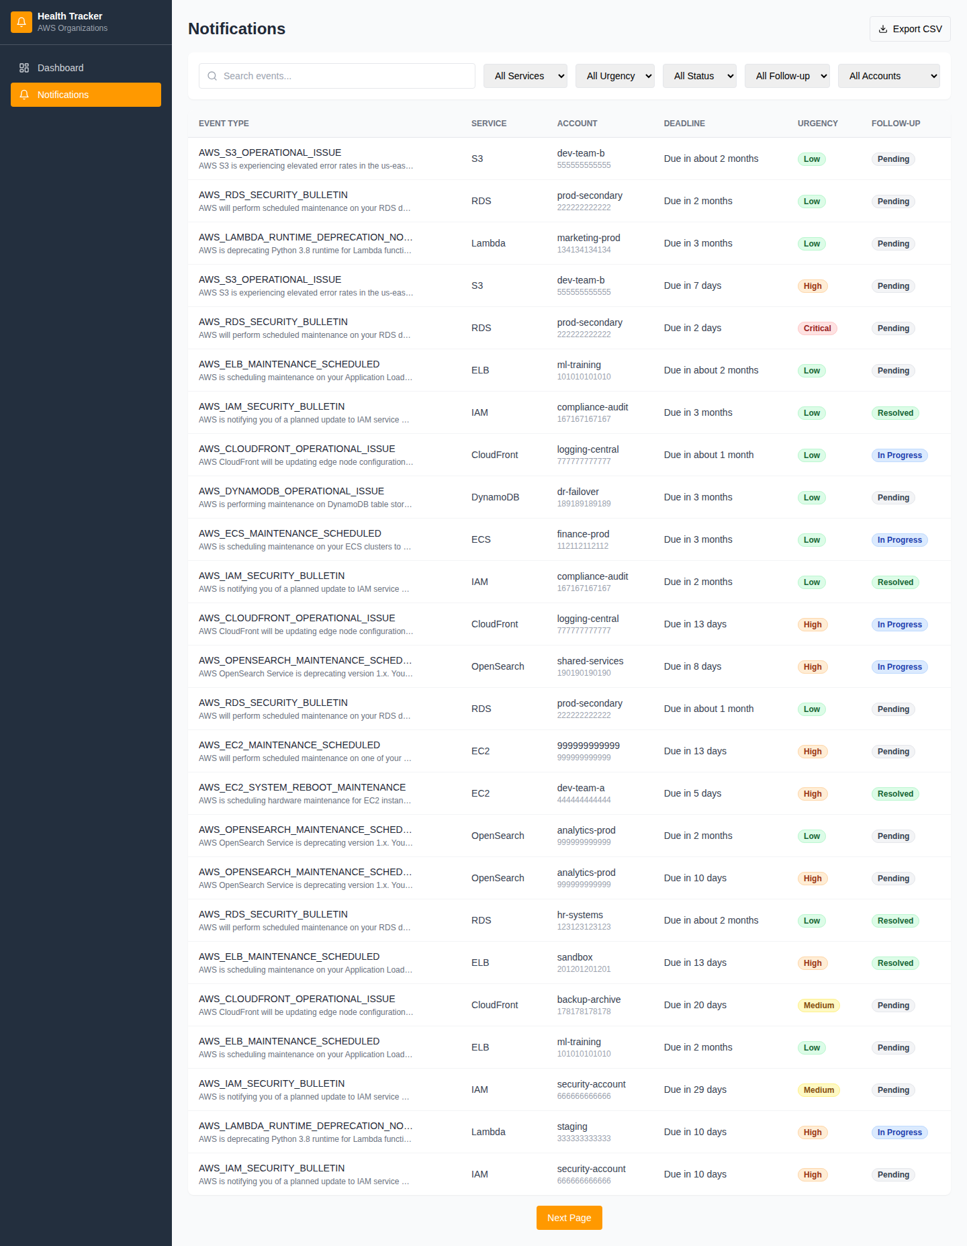
Notifications List
All 200 accounts in one sortable, searchable table — with deadline countdowns
Search • Filter by Service / Urgency / Status / Account • Deadline countdown • CSV export
AWS Health Notifications Tracker | USPTO AWS Innovation Team
April 2026

Slide 8
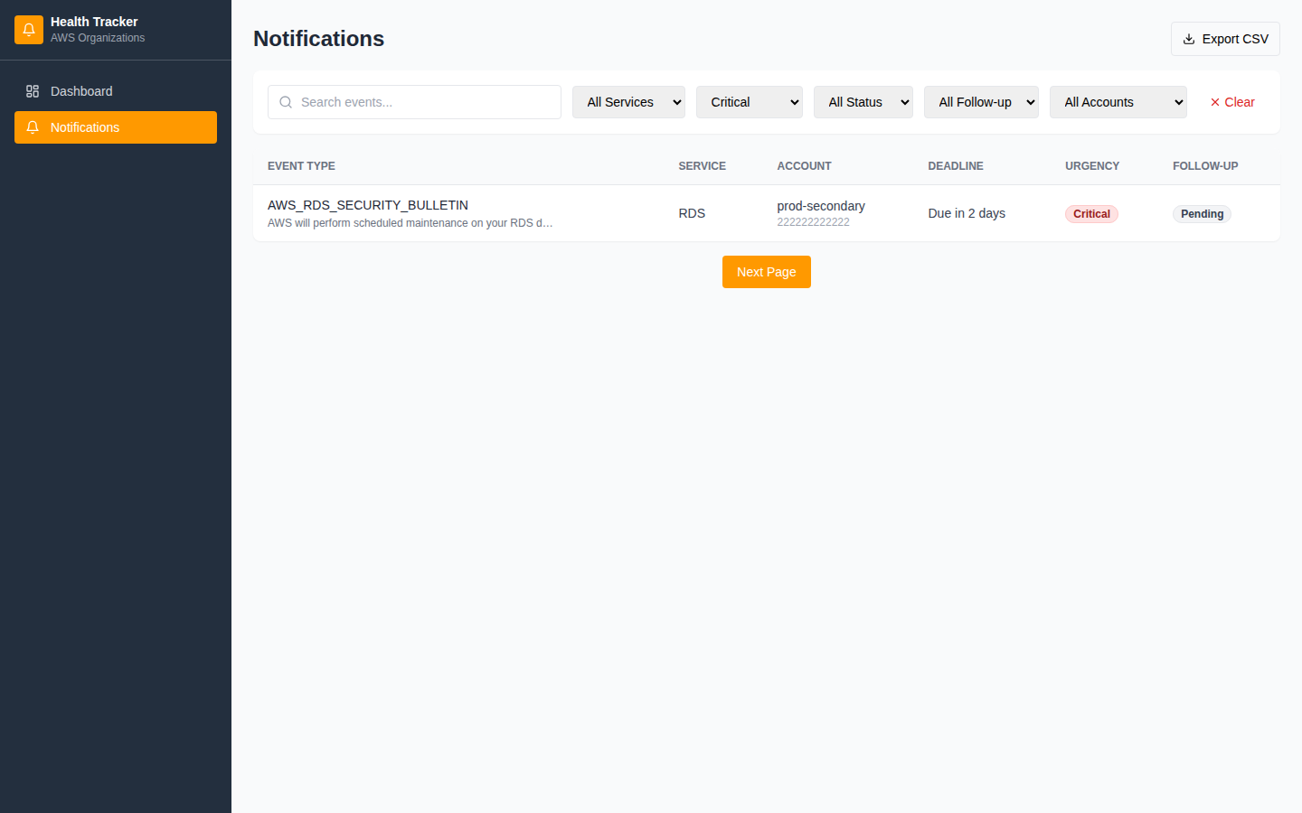
Intelligent Filtering
Instantly surface Critical events across all accounts — filter by any dimension
Filter to Critical urgency — all accounts — sorted by soonest deadline first
AWS Health Notifications Tracker | USPTO AWS Innovation Team
April 2026

Slide 9
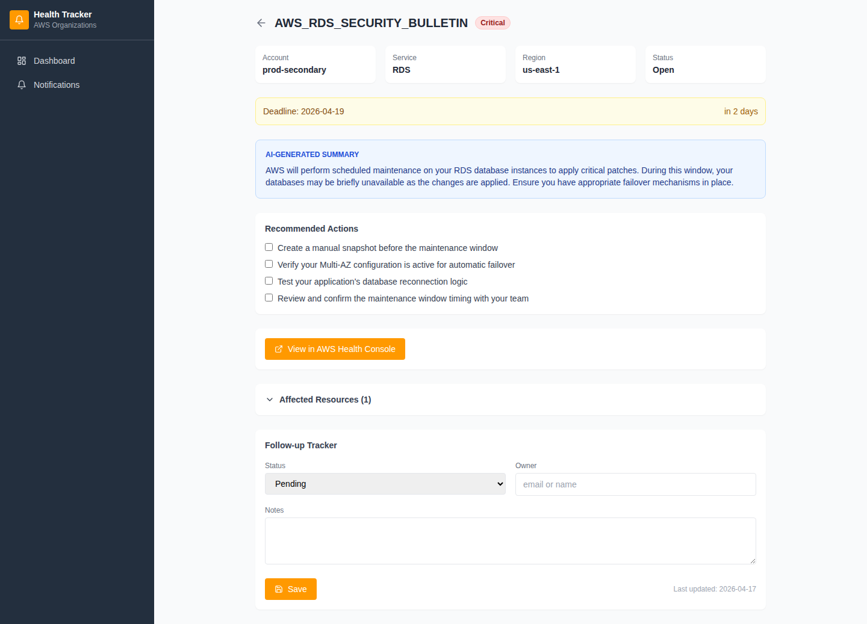
AI-Generated Event Detail
Amazon Bedrock (Claude Haiku) turns raw Health API events into actionable guidance
Plain-English Summary
2–3 sentence stakeholder-ready description generated by Claude Haiku via Amazon Bedrock.
Recommended Actions
3–5 specific, step-by-step action items extracted from the raw event description.
Urgency + Deadline
Auto-classified: Critical / High / Medium / Low. Deadline extracted in ISO 8601 format.
Follow-up Tracker
Assign an owner, set status (Pending / In Progress / Resolved), add notes. Saved to DynamoDB.
AWS Health Notifications Tracker | USPTO AWS Innovation Team
April 2026

Slide 10
Security & Compliance
FedRAMP Authorized services only • IAM least-privilege • No data leaves us-east-1
FedRAMP Authorized Services Only
Every AWS service used — Lambda, DynamoDB, S3, CloudFront, API Gateway, Bedrock, EventBridge, SNS, CloudWatch — is FedRAMP Authorized in us-east-1 commercial.
IAM Least-Privilege Roles
Each of the four Lambda functions has a dedicated IAM execution role scoped to only the exact actions and resources it requires. No wildcard actions, no shared roles.
Encryption at Rest & in Transit
DynamoDB tables encrypted with AWS-managed keys. S3 buckets use S3-managed encryption. All API traffic uses TLS 1.2+. CloudFront enforces HTTPS redirect.
No Public Access
S3 frontend bucket is private — served exclusively through CloudFront with Origin Access Control. Archive S3 bucket blocks all public access. No public DynamoDB endpoints.
Audit & Observability
All Lambda invocations log to CloudWatch with 30-day retention. DynamoDB Point-in-Time Recovery enabled. EventBridge Scheduler retries failed Lambda invocations automatically.
AWS Health Notifications Tracker | USPTO AWS Innovation Team
April 2026

Slide 11
Roadmap & Next Steps
Phase 2 enhancements to further reduce operational toil for USPTO cloud teams
Phase 1 — Complete
Phase 2 — Near-term
Phase 3 — Strategic
Automated event collection across all 200 accounts
Slack / Teams integration for real-time notifications
AWS Systems Manager automated remediation runbooks
AI summaries and action items via Amazon Bedrock
ServiceNow ticketing — auto-create incident for Critical
Account tag-based team ownership routing
React dashboard: stats, filtering, search, CSV export
Cognito / SSO authentication when federation available
Historical trend analysis via Bedrock insights
Follow-up ownership tracking with deadline reminders
Multi-region failover support (us-west-2)
USPTO ITSM / CMDB integration for asset correlation
Repository: github.com/saspto/aws-health-notifications-tracker Live app: https://d2vuz8nfxuvkbe.cloudfront.net
AWS Health Notifications Tracker | USPTO AWS Innovation Team
April 2026

