Slide 1
aws
INNOVATION DEMO · AWS ADMINISTRATION TEAM
AWS Features Tracker
AI-Powered Discovery, Summarization & Search of AWS Announcements
Real-time RSS ingestion
Claude Haiku AI summaries
Searchable web app
Presented by the Cloud Administration Team · April 2026

Slide 2
The Challenge: Staying Ahead of AWS Innovation
AWS releases 2,000+ new features per year — how do admins keep up?
2,000+
~5 min
166 hrs
$0
new AWS features/year
avg reading time each
total annual reading time
billable value of that time
Pain Points
The Opportunity
Manual RSS monitoring — easy to miss critical announcements across dozens of categories
Automate the discovery, summarization, and cataloguing of every AWS announcement — so admins spend minutes on insights instead of hours on reading.
No searchable history: 'Did AWS update Lambda concurrency limits this quarter?'
Raw HTML descriptions bury critical details in marketing language
No service-level filtering — irrelevant noise drowns out what matters to your team
Knowledge is siloed — each admin tracks different services independently

Slide 3
SOLUTION ARCHITECTURE
AWS Features Tracker — How It Works
EventBridge Scheduler
Fetcher Lambda
SQS Queue
Summarizer Lambda
DynamoDB + S3
→
→
→
→
Every 6 hours
Parses RSS · Dedupes
Reliable delivery 3× retry + DLQ
Claude Haiku via Bedrock
Persistent store JSON archive
▼ API & Frontend Layer
API Gateway HTTP API
API Lambda
CloudFront CDN
React SPA (S3)
→
→
→
5 REST routes Read-only, no auth
/features /services /types /health
Edge caching /api/* passthrough
TypeScript + Vite Tailwind CSS
Tech Stack
Python 3.12 · Lambda arm64
Amazon Bedrock · Claude Haiku
DynamoDB on-demand · S3
React 18 + TypeScript + Vite
AWS SAM (Infrastructure as Code)
~$0.31 / month

Slide 4
Built for AWS Admins Who Research & Analyze
Every feature is designed around the admin workflow — discover, evaluate, act.
Automated Discovery
AI-Generated Summaries
Powerful Search & Filters
Fetches aws.amazon.com/new/feed/ every 6 hours via EventBridge Scheduler. Zero manual effort.
Claude Haiku (Bedrock) produces 3-5 sentence engineer-focused summaries with structured output.
Full-text search across title, summary and service. Filter by service, type, date. URL-based state.
No manual RSS monitoring
Feature type auto-classified (8 categories)
Search 'lambda timeout' — instant results
Deduplication on guid
3 key points extracted per announcement
Date range: what changed in Q1 2026?
Feature Type Classification
Shareable URLs
Reliability Built-In
Bedrock classifies every item into one of 8 types: new-feature, GA, preview, deprecation, and more.
All filters live in the URL. Copy the link and share a specific filtered view with any team member.
SQS DLQ retries failures 3×. CloudWatch alarms on errors and DLQ depth. IAM least-privilege.
Color-coded badges for instant scanning
Bookmark filtered views
DLQ 7-day retention — no announcement lost
Filter dashboard to only what matters today
Back button preserves search context
CloudWatch alarms on errors and DLQ

Slide 5
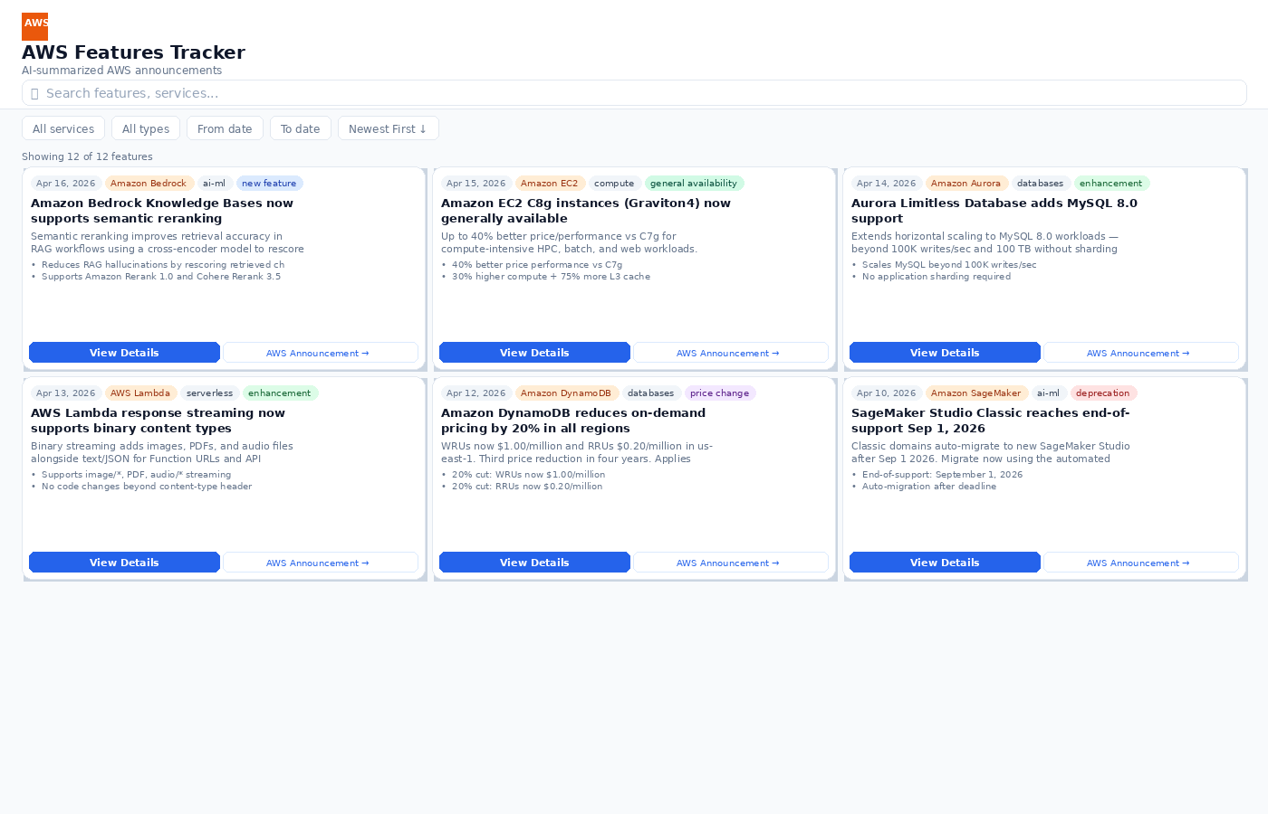
LIVE DEMO — SEARCH & DISCOVERY
Main Dashboard — Browse & Search All AWS Announcements
KEY HIGHLIGHTS
Live search bar with 300ms debounce
Filters: service, type, date, sort order
Result count always visible
Color-coded feature type badges
AI key points expandable per card
Direct link to AWS announcement

Slide 6
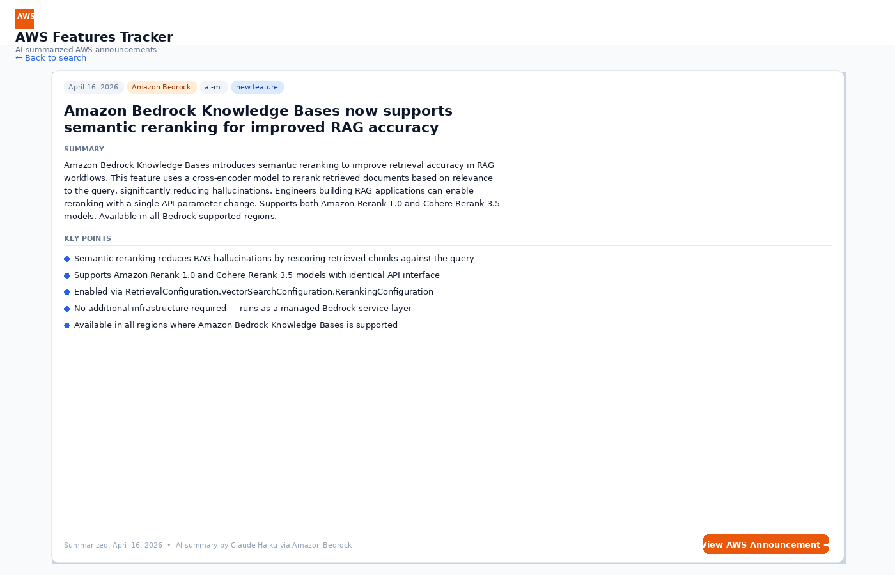
LIVE DEMO — FEATURE DETAIL
Feature Detail Page — Deep-Dive Into Any Announcement
KEY HIGHLIGHTS
Badges: date, service, domain, type
3–5 sentence AI summary, engineer-focused
Structured key points for evaluation
One-click link to AWS announcement
Back button preserves search state
Summarized-at timestamp for audit

Slide 7
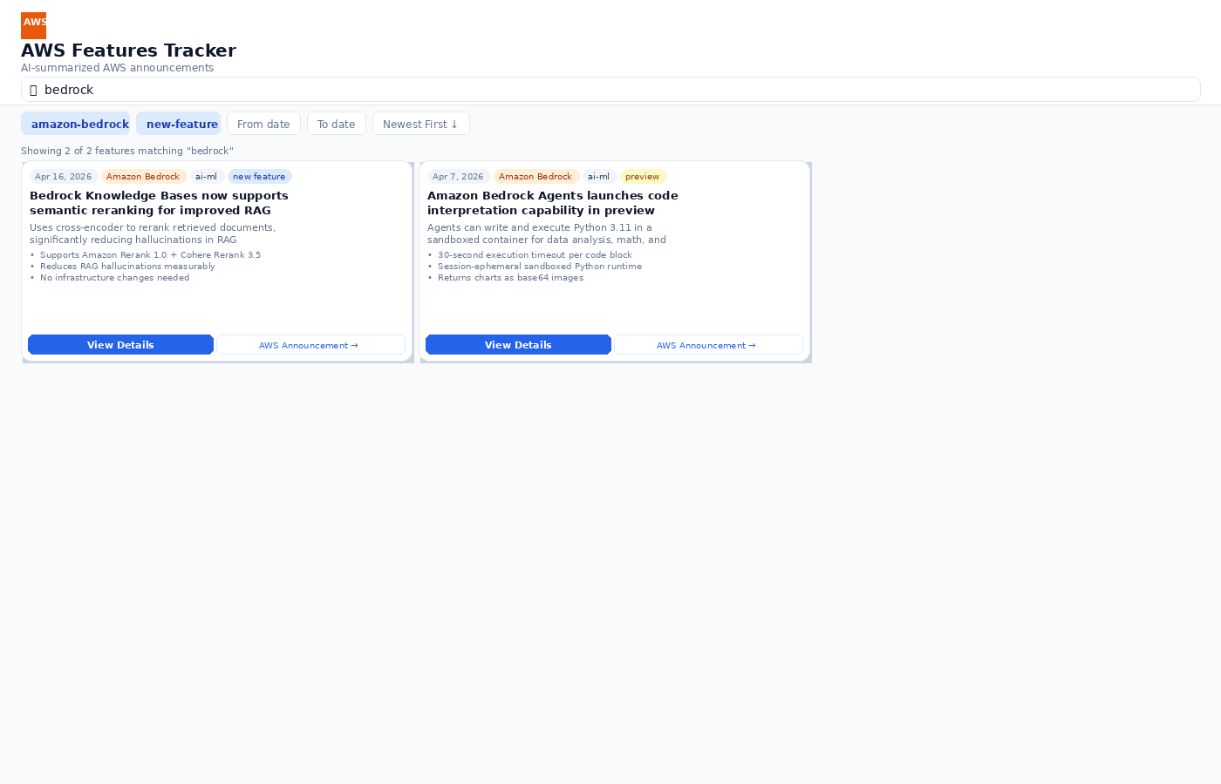
LIVE DEMO — FILTER & SEARCH
Filtered: 'bedrock' · service: amazon-bedrock · type: new-feature
KEY HIGHLIGHTS
Keyword search matches title & summary
Active filter pills shown in header
Real-time result count
URL captures all filters — shareable
Infinite scroll auto-loads next page
Works across all 8 feature types

Slide 8
Real-World Use Cases for AWS Admins
From reactive monitoring to proactive innovation — the tracker enables both.
Weekly Innovation Review
Pre-Migration Research
Deprecation Tracking
Every Monday: filter last 7 days, sort newest first. In 15 minutes the team identifies 3-5 features worth piloting — replacing 2 hours of manual reading.
Before adopting Graviton4, search 'graviton4' to see all GA announcements, enhancements, and price changes in one scrollable timeline.
Filter type=deprecation to build a living list of EOL services. Share the URL with the architecture team as a standing reference bookmark.
from_date=7d ago · sort=newest
q=graviton4 · type=general-availability
type=deprecation · sort=oldest
Cost Optimization
New Service Evaluation
Region Expansion Watch
Filter type=price-change to catch every DynamoDB, Lambda, and S3 reduction. Calculate savings and present the business case for migration.
Leadership asks 'should we adopt VPC Lattice?' — search the tracker for a complete feature history to assess service maturity and trajectory.
Filter type=region-expansion for services you use. Know the moment a needed service reaches your target region before checking the console.
type=price-change
q=vpc lattice · date=2025-2026
type=region-expansion · service=amazon-eks

Slide 9
AI INTELLIGENCE LAYER
How Claude Haiku Transforms Raw AWS Announcements
RAW RSS INPUT
AI-ENRICHED OUTPUT
<title>Amazon Bedrock Knowledge Bases now supports semantic reranking for improved RAG accuracy</title> <description> <p>Amazon Bedrock Knowledge Bases now supports semantic reranking, a technique that improves retrieved results for RAG applications...</p> <p>A cross-encoder model reranks initially retrieved chunks based on query relevance, reducing hallucinations and improving response quality...</p> </description> <category>general:products/amazon-bedrock</category> <category>marketing:marchitecture/ai-ml</category>
feature_type:
new-feature
summary:
Amazon Bedrock Knowledge Bases introduces semantic reranking to improve retrieval accuracy in RAG workflows. A cross-encoder model rescores retrieved chunks by relevance, significantly reducing hallucinations. Enable with a single API parameter. Supports Amazon Rerank 1.0 and Cohere Rerank 3.5.
→
Claude Haiku
key_points:
• Reduces hallucinations by rescoring chunks • Supports Rerank 1.0 + Cohere Rerank 3.5 • Single RetrievalConfiguration API param • No infra changes required

Slide 10
Cost-Efficient, Secure, and Production-Ready
Minimal cost, FedRAMP-aligned services, least-privilege IAM, full observability.
Monthly Cost Estimate (~500 features/month)
Security & Compliance
Service
Monthly Cost
All services FedRAMP Moderate authorized (us-east-1 commercial)
IAM least-privilege — each Lambda has only the permissions it needs
Lambda (3 functions, arm64)
~$0.01
S3 Block Public Access ON — CloudFront OAC, no direct bucket access
DynamoDB on-demand
~$0.02
No VPC required — all traffic via AWS service endpoints
API Gateway public read-only — no write surface exposed
S3 (summaries + SPA assets)
~$0.03
CloudFront (PriceClass_100)
~$0.10
Reliability & Observability
Bedrock Claude Haiku (500 summaries)
~$0.15
SQS DLQ with 7-day retention — no announcement ever lost
Up to 3 automatic Bedrock retries before dead-lettering
SQS + EventBridge Scheduler
$0.00 (free tier)
CloudWatch Alarm: Summarizer errors > 10/hr
TOTAL
~$0.31/month
CloudWatch Alarm: DLQ messages > 0
CloudFront + Lambda arm64 — low-latency, globally available

Slide 11
WHAT'S NEXT
Roadmap — Where We Can Take This
Q2 2026
Q3 2026
Q4 2026
SNS / Slack alerts — ping #aws-updates when new features match your watchlist
Impact scoring — Claude estimates cost/effort/risk of adopting each feature
Cost savings calculator — quantify savings from price-change announcements
Per-admin service watchlist — personalized feed based on your AWS footprint
Multi-account tagging — link features to the accounts/OUs they affect
Deprecation calendar — auto JIRA tickets for EOL services
Weekly digest email: top 5 features relevant to your services
Comments & status: evaluating / piloting / adopted / declined per team
Executive dashboard — monthly report of adopted innovations & saved $

Slide 12
The tracker is live today.
Start using it this week.
https://d1s77r5nnbdjdt.cloudfront.net
Try It Now
Add Your Watchlist
Give Feedback
Open the app, search for any service you manage, and find features you may have missed this quarter.
Tell us the top 10 AWS services your team owns — we'll prioritize those filters in the next sprint.
What integrations, views, or alerts would make this tool indispensable to your daily workflow?
AWS Features Tracker · Lambda · Bedrock · DynamoDB · CloudFront · ~$0.31/month · April 2026

