Slide 1
RA
INNOVATION DEMO · ENGINEERING & PROJECT MANAGEMENT
Rally Analysis App
AI-Powered Sprint Analytics & Executive Reporting for Rally / CA Agile Central
Automated daily exports
Claude AI summaries
Sprint analytics & insights
Presented by the Engineering & Cloud Administration Team · April 2026

Slide 2
The Challenge: Rally Data Without Context
Rally holds all your project data — but generating insights requires hours of manual work.
Hours
3+
0
Manual
spent weekly writing sprint summaries
tools open to answer one status question
minutes execs spend reading raw CSV data
copy-paste process from Rally to reports
Pain Points
The Opportunity
Generating sprint summaries is a 2–3 hour manual process at end of every sprint
Automate every step — daily export, AI narrative generation, analytics computation — so your team gets insights without the manual grind.
Rally exports are raw CSV — no narrative context, no insights, no executive language
Analytics require pivot tables, formulas, and manual chart building in Excel
Stale or blocked stories go unnoticed until stand-ups — too late to act
Different stakeholders need different formats: engineering vs. C-suite vs. PM

Slide 3
SOLUTION ARCHITECTURE
Rally Analysis App — How It Works
Rally (CA Agile Central)
Fetcher Lambda
S3 Exports Bucket
Summary Lambda
S3 Summaries + API
→
→
→
→
Features, Stories, Tasks via API
Daily 3PM EST + on-demand
CSV per day with presigned URLs
Claude Opus 4 3 summary types
JSON summaries + analytics compute
▼ Presentation Layer
EventBridge Scheduler
API Gateway HTTP API
CloudFront CDN
React SPA (S3)
→
→
→
Daily cron 3 PM EST
5 endpoints CORS enabled
Global delivery + OAC for S3
TypeScript + Vite Tailwind CSS
Tech Stack
Python 3.12 · Lambda arm64
Anthropic Claude Opus 4
Rally REST API v2
React 18 + TypeScript + Vite
Recharts · jsPDF · docx · xlsx
AWS SAM (Infrastructure as Code)

Slide 4
Everything Your Team Needs — Automated
From daily Rally exports to AI-generated executive reports — zero manual effort.
Automated Daily Exports
Three AI Summary Types
Sprint Analytics Dashboard
EventBridge triggers a Lambda every day at 3 PM EST to pull Features, Stories, and Tasks from Rally. CSV saved to S3 with presigned download URLs.
Claude Opus 4 generates Weekly, Monthly, and Quarterly summaries — each tailored to audience. Main narrative, executive 2-pager, and per-story detail.
Automatic computation of burndown, velocity, cycle time, and resource allocation from raw Rally data. No spreadsheets needed.
Zero manual export steps ever again
Main summary: 4,096 tokens of narrative
Burn charts: actual vs. ideal per sprint
On-demand trigger also available in UI
Executive: C-suite focused, metrics-first
Velocity trend across rolling sprints
Stale Story Detection
Multi-Format Export
Cycle Time & Outlier Detection
Automatically surfaces stories not updated in 7+ days. Warning at 7d, critical at 14d. Sorted by severity so the most blocked items appear first.
Download any summary as PDF, Word DOCX, or Excel XLSX with a single click. Each format is properly structured with headings, bullets, and tables.
Tracks story creation to acceptance date. Flags statistical outliers at mean + 1.5σ so teams can investigate systemic delays proactively.
Warning threshold: 7 days without update
PDF via jsPDF with markdown rendering
Mean + 1.5σ outlier threshold
Critical threshold: 14+ days — acts as blocker
DOCX via docx library — ready to email
Owner-level breakdown for accountability

Slide 5
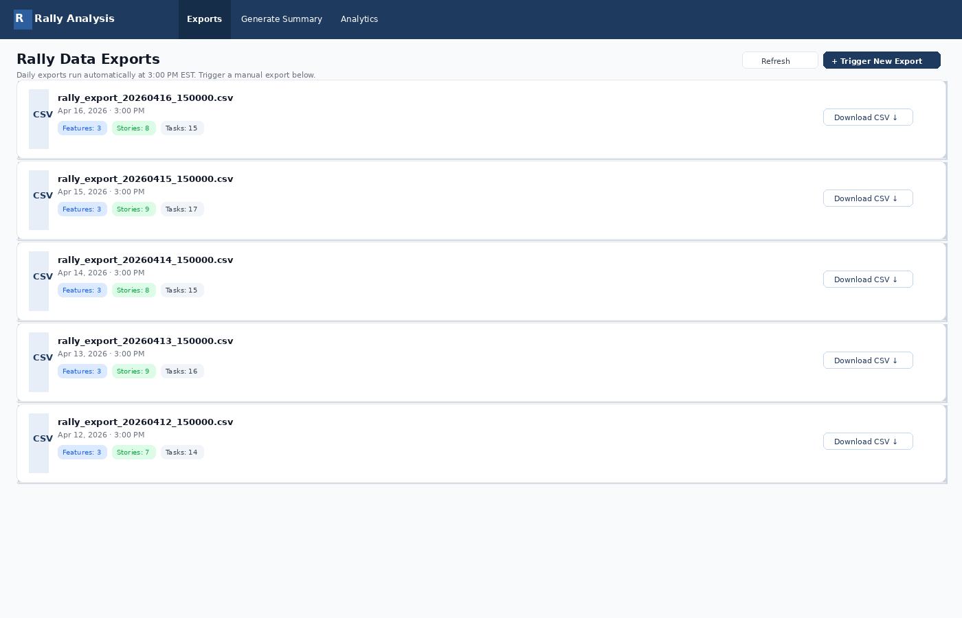
LIVE DEMO — EXPORTS DASHBOARD
Exports Dashboard — Daily CSV Exports from Rally
KEY HIGHLIGHTS
Auto-export runs daily at 3 PM EST
Manual trigger available on demand
Feature / Story / Task counts per export
Presigned S3 URLs for secure download
Full export history retained in S3
CSV format for downstream tooling

Slide 6
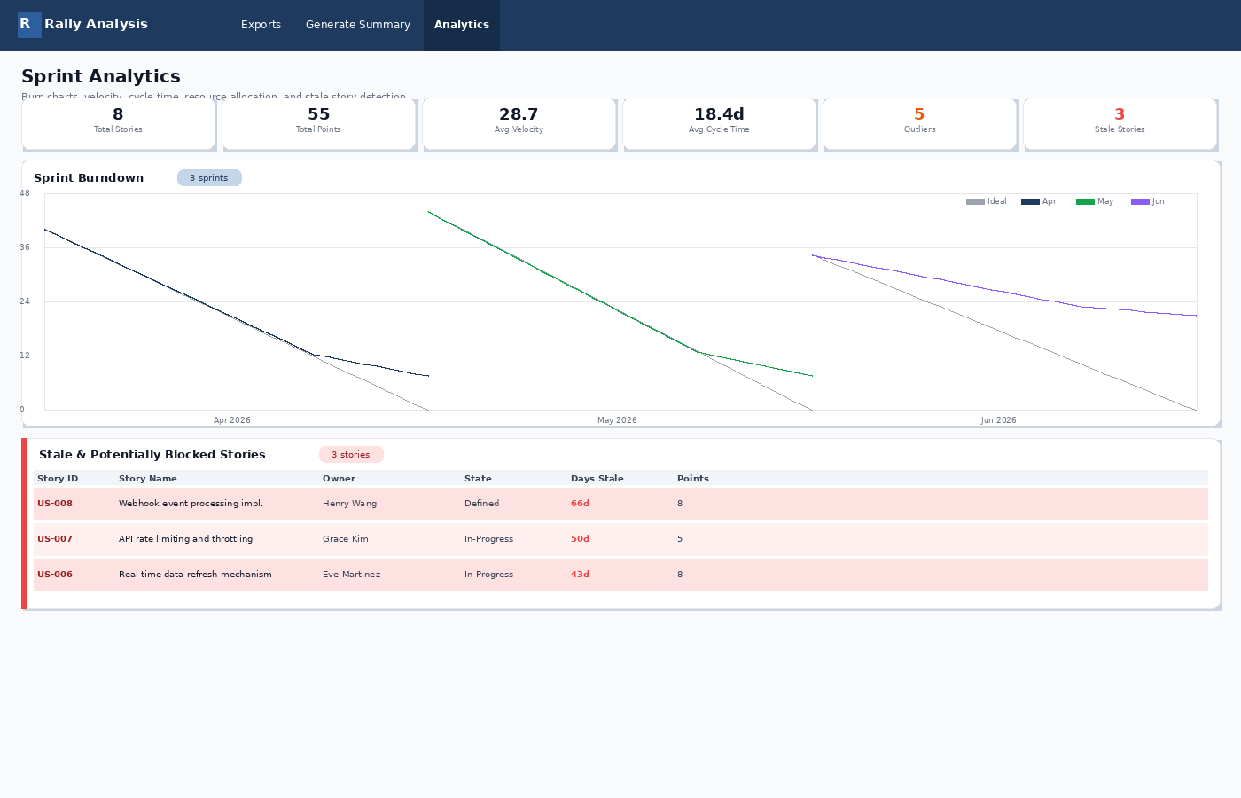
LIVE DEMO — ANALYTICS DASHBOARD
Analytics Dashboard — Sprint Burndown, Velocity & Stale Stories
KEY HIGHLIGHTS
6 KPI cards: stories, points, velocity, cycle time
Burndown: actual vs ideal line per sprint
Three sprints shown: Apr / May / Jun 2026
Resource allocation by team member
Stale story table with severity flags
Outlier detection at mean + 1.5 sigma

Slide 7
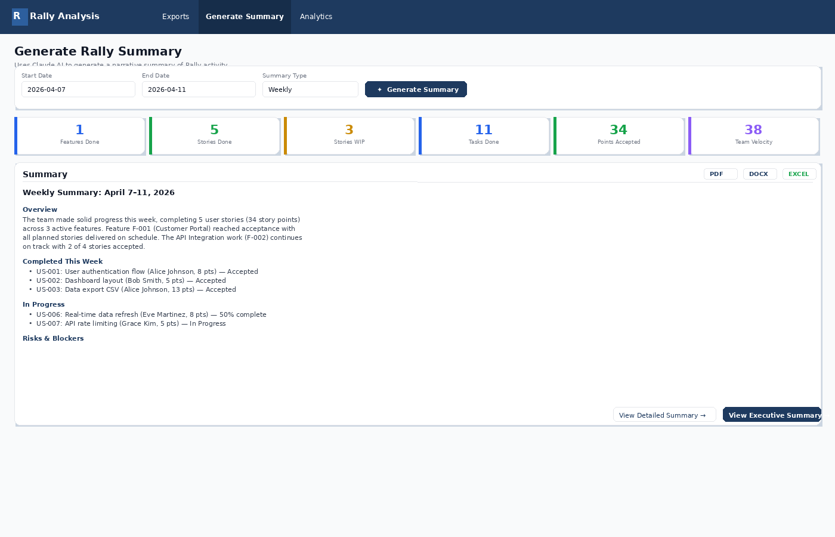
LIVE DEMO — AI SUMMARY GENERATION
AI Summary Page — Claude-Generated Narrative Summaries
KEY HIGHLIGHTS
Date range picker + Weekly/Monthly/Quarterly
6 live metrics from Rally export data
Full narrative summary generated by Claude
One-click export: PDF, DOCX, or Excel
Navigate to Executive or Detailed summary
Structured markdown: Overview, Risks, Metrics

Slide 8
Who Uses It and How
Every role in the delivery chain gets what they need — automatically.
Engineering Manager
C-Suite / Executive
Scrum Master / Agile Coach
Every Friday afternoon, open the app, select the last 2-week sprint, and generate a Monthly summary. Download as DOCX and paste into the sprint retrospective doc in 2 minutes.
Receive a weekly Executive Summary email (Slack/SNS roadmap item) with portfolio health status, velocity trend, and any active blockers — no Rally login required.
Open Analytics before daily stand-up to check the stale stories table. Immediately see which stories have gone silent and who owns them.
Summary type: Monthly · Download: DOCX
Executive Summary · Metrics · Health status
Analytics → Stale & Blocked Stories
Portfolio Manager
Release Manager
Engineering Lead
Select a full quarter date range and generate a Quarterly summary. Download as PDF for inclusion in the QBR deck — done in under 5 minutes.
Use the cycle time chart to identify which story types consistently become outliers. Feed findings into the Definition of Ready to prevent future delays.
Review the Resource Allocation chart to spot team members who are overloaded (high actual vs. estimated hours) or under-utilized before the next sprint planning.
Summary type: Quarterly · Download: PDF
Analytics → Cycle Time Analysis
Analytics → Resource Allocation

Slide 9
AI INTELLIGENCE LAYER
How Claude Opus 4 Transforms Raw Rally Data Into Insights
RAW RALLY EXPORT (CSV)
AI-GENERATED SUMMARY OUTPUT
FormattedID,Name,State,Owner,Points,CreationDate,AcceptedDate US-001,User auth flow,Accepted,Alice Johnson,8,2026-04-01,2026-04-09 US-002,Dashboard layout,Accepted,Bob Smith,5,2026-04-01,2026-04-08 US-003,Data export CSV,Accepted,Alice Johnson,13,2026-04-02,2026-04-10 US-004,OAuth integration,In-Progress,Carol Davis,5,2026-04-03, US-005,Search/filter UI,Completed,Bob Smith,3,2026-04-04, US-006,Real-time refresh,In-Progress,Eve Martinez,8,2026-03-01, US-007,API rate limiting,In-Progress,Grace Kim,5,2026-03-15, US-008,Webhook events,Defined,Henry Wang,8,2026-02-28, F-001,Customer Portal,Accepted,,,2026-03-15,2026-04-10 F-002,API Integration,In-Progress,,,2026-03-20, F-003,Performance Opt.,Defined,,,2026-04-01,
summary type:
weekly
narrative:
The team delivered strong results this week, completing 5 user stories (34 story points) across the Customer Portal and API Integration features. Feature F-001 reached full acceptance. Team velocity of 38 pts exceeds the 30-pt target.
→
metrics:
Claude Opus 4
features_completed: 1 stories_completed: 5 stories_in_progress: 3 tasks_completed: 11 total_points: 34 team_velocity: 38
risks:
US-008 (Henry Wang) — 45 days stale Recommend escalation before next sprint.

Slide 10
Lightweight, Secure, and Production-Ready
Serverless architecture keeps costs minimal. IAM least-privilege, S3 OAC, no public data exposure.
Monthly Cost Estimate (~500 summaries/month)
Security & Compliance
Service
Monthly Cost
S3 Block Public Access ON — CloudFront OAC for frontend, no direct bucket access
IAM least-privilege — each Lambda has only the permissions it needs
Lambda (4 functions, 512MB, 300s)
~$0.05
Rally API key and Anthropic key stored in SSM Parameter Store (encrypted)
API Gateway HTTP API
~$0.01
API Gateway no-auth read endpoints — no write surface exposed publicly
All traffic via HTTPS — CloudFront enforces TLS, no HTTP
S3 (exports + summaries + SPA)
~$0.05
CloudFront (PriceClass_100)
~$0.10
Reliability & Observability
Anthropic Claude Opus 4 (500 calls)
~$7.50
EventBridge schedule survives Lambda cold-starts — retries built in
Lambda timeout 300s — handles large Rally workspaces without truncation
EventBridge Scheduler
$0.00 (free tier)
Mock mode (VITE_USE_MOCK=true) enables full UI demo without AWS/Rally
TOTAL
~$7.71/month
Presigned S3 URLs expire after 1 hour — no persistent public links
Python pytest + Vitest unit test suites for backend and frontend

Slide 11
WHAT'S NEXT
Roadmap — Where We Can Take This
Q2 2026
Q3 2026
Q4 2026
Slack / Teams integration — post summary to #sprint-updates automatically after each export
Predictive risk scoring — Claude flags stories at risk of missing sprint before it happens
Executive portfolio view — multi-team rollup with cross-project health scores
Multi-project support — select from multiple Rally workspaces in a single dashboard
Jira / Azure DevOps connector — same analytics for teams not on Rally
Capacity planning assistant — Claude recommends sprint load based on historical velocity
Trend charts — rolling 6-month velocity and cycle time trend visualization
Shareable report links — generate a read-only URL for any summary to share with stakeholders
Auto-generated retrospective — AI identifies patterns and suggests process improvements

Slide 12
The app is live and running today.
Your next sprint report writes itself.
https://d28e9pzfl4v2ga.cloudfront.net
Try It Now
Connect Your Workspace
Request a Feature
Open the app, trigger a manual export from your Rally workspace, and generate your first AI summary in under 2 minutes.
Provide your Rally ZSESSIONID and workspace name — we'll configure the Lambda environment variables and run the first export for you.
Tell us which report formats, integrations, or analytics views would make this tool indispensable to your sprint workflow.
Rally Analysis App · Lambda · Claude Opus 4 · DynamoDB · CloudFront · AWS SAM · April 2026

