Slide 1
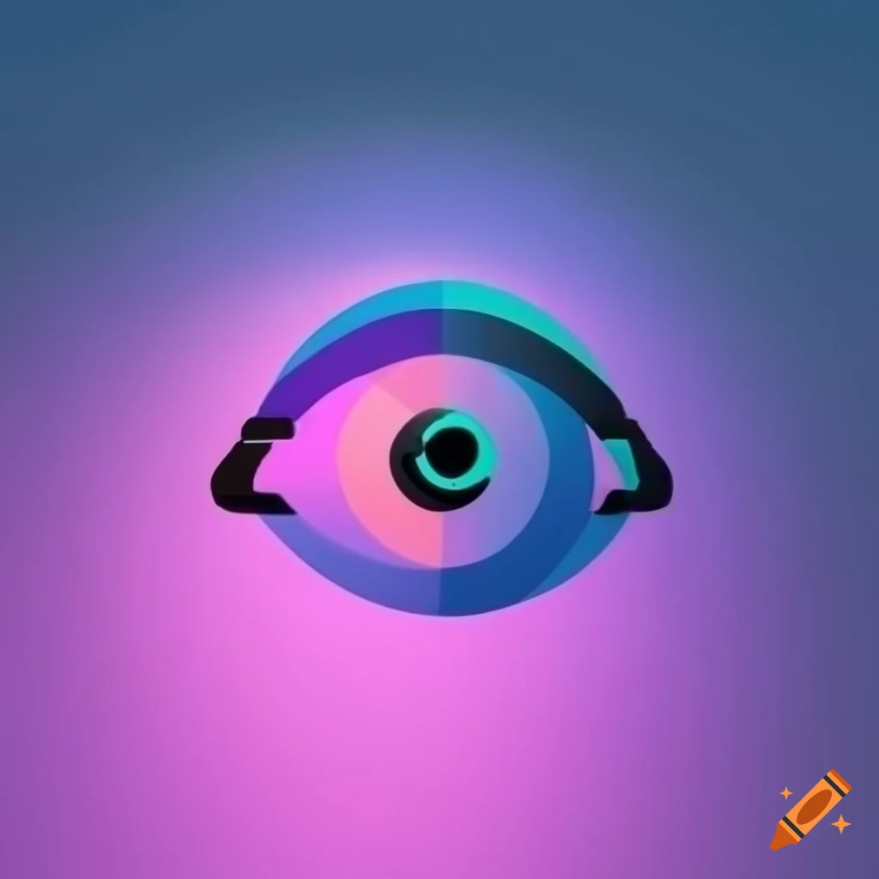





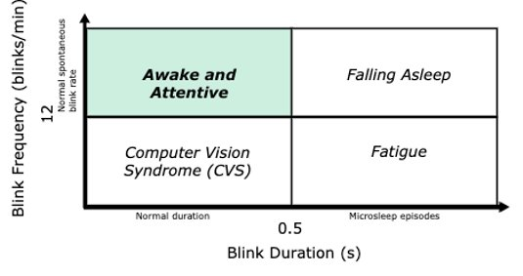
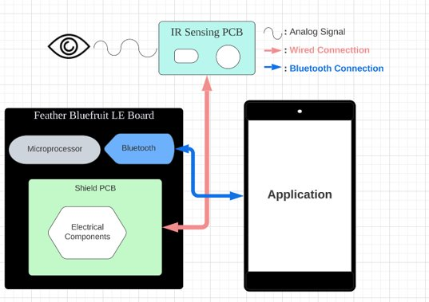
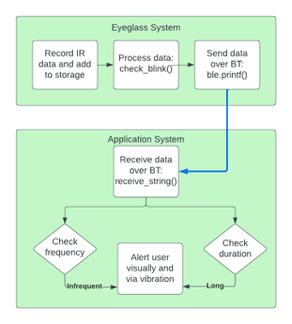
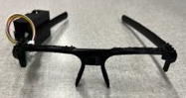

B.L.I.S.S.
Taisuke Miyamoto, Tergel Molom-Ochir,
Sashank Rao, Heta Shah
Faculty Advisor: Prof. Qiangfei Xia
Abstract
System Overview
The emergence of low-power wearable devices has enabled mobile health monitoring, wearable and sensor computing, applied machine learning, and physiological signal processing without relying on large processing units. However, despite the recent development of low power devices and energy constrained nature of these devices, there has not been a development of low cost, low power blink frequency and detection systems. In this report, we investigate the development of an energy efficient and low-cost blink frequency and duration sensing system BLISS. A two-part system, comprised of a pair of glasses in communication with a mobile application, was designed to make the system lightweight and to increase power endurance. Our results show that low-power high accuracy devices can be built using cheap electronic parts. We conclude that with the help of BLISS, we will be able to avoid drowsiness-related car accidents and serious conditions such as Computer Vision Syndrome.
BLISS results in a low-cost, energy efficient, and lightweight design that detects blink frequency and duration using an IR sensor while communicating wirelessly using Bluetooth. The IR sensor is the lightest and least expensive sensor from the four different methods used in previous blink detection research, in which other options include camera, EEG, and EOG. We considered using these methods at least once in our project but due to their characteristics, we opted out and finalized IR sensing for blink detection. The information will be transmitted to an app on a phone using Bluetooth. The app will be used to alert the user using audio.
Block Diagram
Final Product
Specifications
✔ The system will be contained in a 3D custom printed chassis
✔ The pair of glasses will communicate with a smart phone via BLE
✔ The system will detect blinks with >90% accuracy
✔ The user's blink rate and duration will be displayed on the smart phone display
✔ The smart phone should vibrate when long blink durations or low blink frequencies are detected
Detect blink frequency of the user to within ±1 blink/min
Detect blink duration of the user to within 0.1 seconds
Operate in a stable, indoors lighting environment
Be unobtrusive to the user when collecting data
Alert the user when their blink frequency is less than 12 times per minute (average blink frequency is around 12 blinks per minute)
Alert the user when their average blink duration is longer than 0.5 seconds (average blink duration is around 0.5 seconds)
Alert the user effectively yet discreetly
Observe eye safety regulations for IR sensor
Acknowledgements
Special thanks to Professor Qiangfei Xia for guiding us through developing this product. Thank you to Prof. Gummeson and Prof. Siqueira for evaluating our project and providing invaluable feedback. Special shoutout to our course coordinators and M5 staff for all their help.
Disclaimer: We strongly advised against utilizing this device for extended durations, as it is solely intended for experimental purposes.
Department of Electrical and Computer Engineering
ECE 415/ECE 416 – SENIOR DESIGN PROJECT 2023
College of Engineering - University of Massachusetts Amherst
SDP23

Slide 2
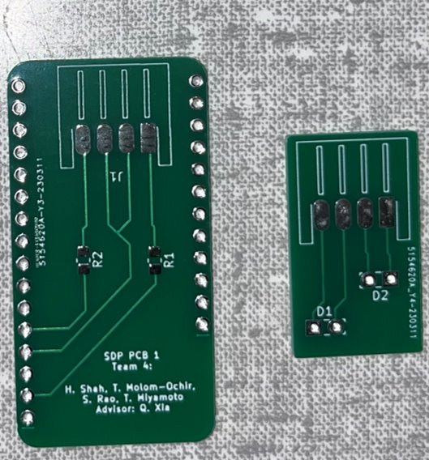
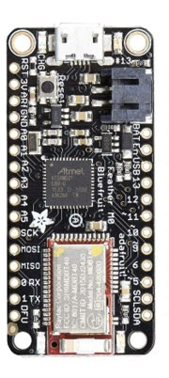
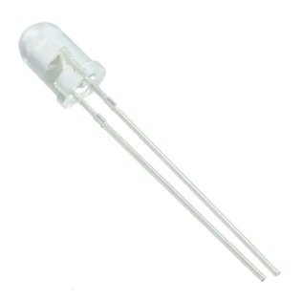
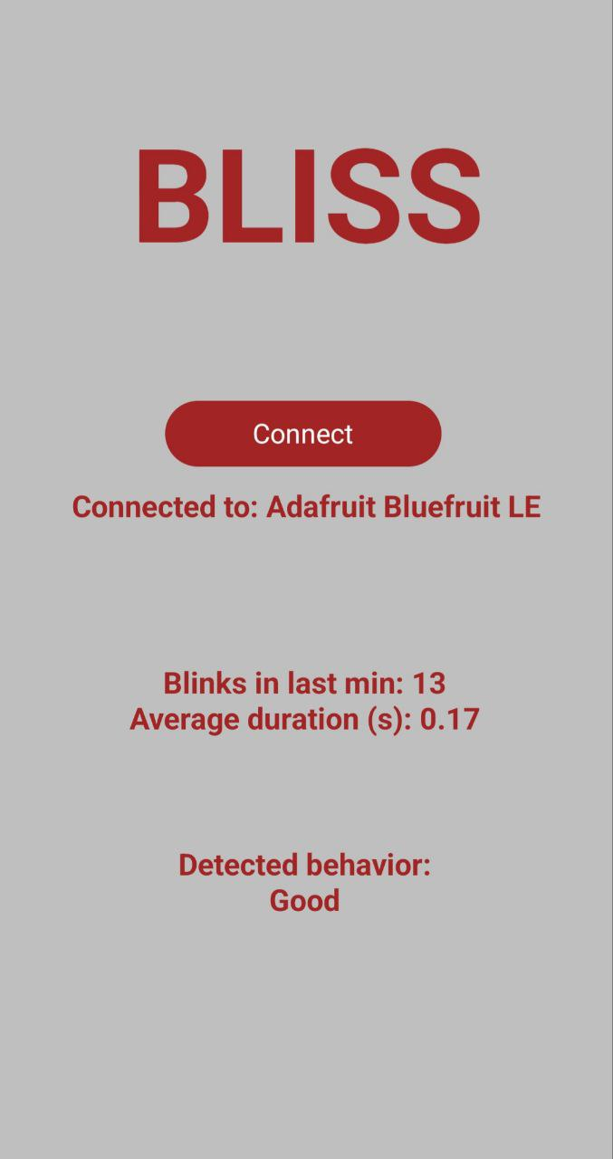
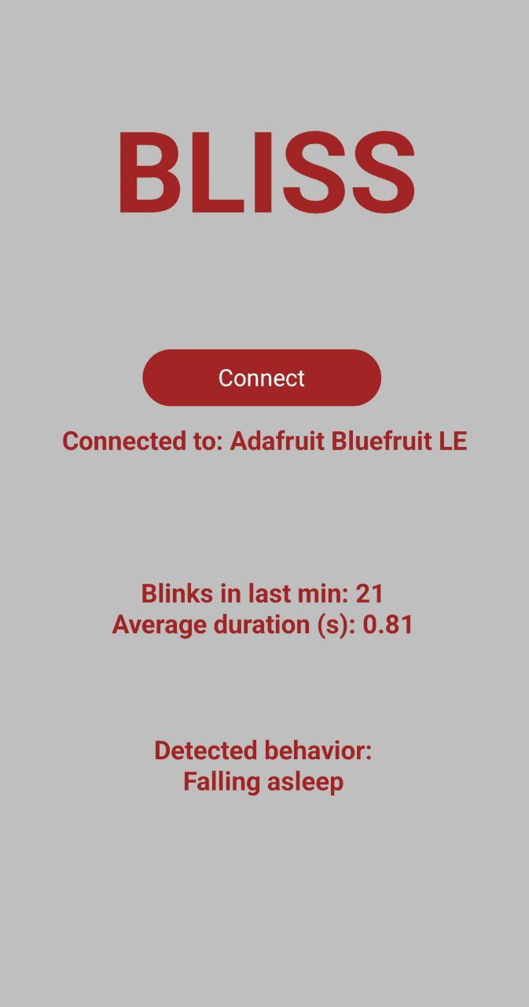
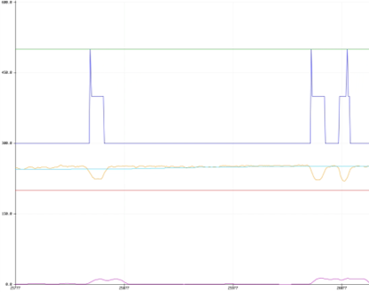
Hardware Specifications
PCB
Shield PCB: 2g Sensor PCB: 1g
Adafruit Feather M0 Basic Proto - ATSAMD21 Cortex M0
ATSAMD21 Cortex M0 based
Bluetooth Low Energy (BLE) NRF51822 module
Current Draw: ~7mA
Sleep Mode: 20uA
Idle Mode: 7mA
Typical usage with peripherals running: 25 mA to 80 mA
IR emitter
- Unit Price: $2.93
- Voltage Forward: 1.55V
- Current – DC Forward: 100mA
- Operating Temperature: -20°C ~ 80°C
Software Overview
BLISS Application
Sample IR sensor and smooth data
2. Calculate standard deviation
3. Calculate moving average weighted by standard deviation (higher STDs correlates with blinks)
Blink edge detection: smoothed data slope exceeds threshold
Blink duration detection: smoothed data is significantly different from STD-weighted moving average
The app displays the following information:
The Condition (Computer Vision Syndrome, falling asleep, fatigue, and good)
Average blink frequency over 1 minute
Average blink duration
Results
Cost
Two 1-minute experiments comparing accuracy of​
​
Stationary head vs.​ Constantly moving head​
Development
Final Prototype
Period​ | Totals​
PDR​ | $0.00 ​
MDR​ | $58.35 ​
CDR​ | $139.98 ​
FPR​ | $222.81 ​
Cumulative​ | $421.14 ​
Part​ | Price​
PCB​ | $5.13 ​
IR sensors​ | $3.88 ​
MCU​ | $29.99 ​
Battery​ | $7.95 ​
Total​ | $46.95 ​
​ | Stationary​ | Moving​
Actual blinks​ | 34​ | 24​
Counted blinks​ | 37​ | 28​
False negatives​ | 0​ | 2​
False positives​ | 3​ | 6​
Accuracy​ | 91%​ | 67%​

