Slide 1
Sample Visualizations created in Tableau
Shashwat Anand a.shashwat@wustl.edu linkedin.com/shashwatanand94

Slide 2
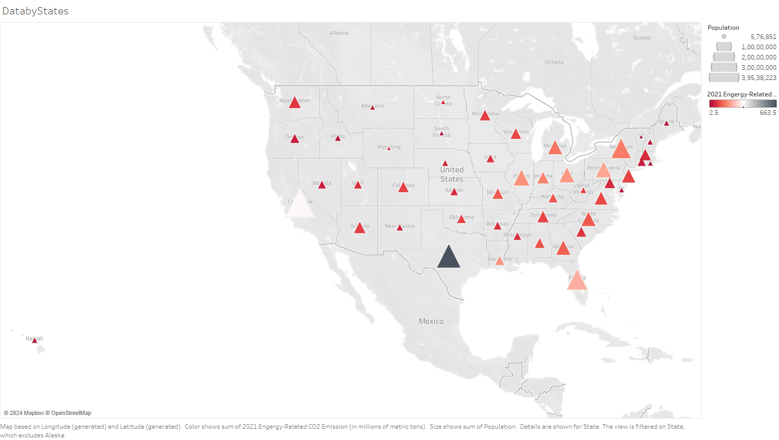

Slide 3
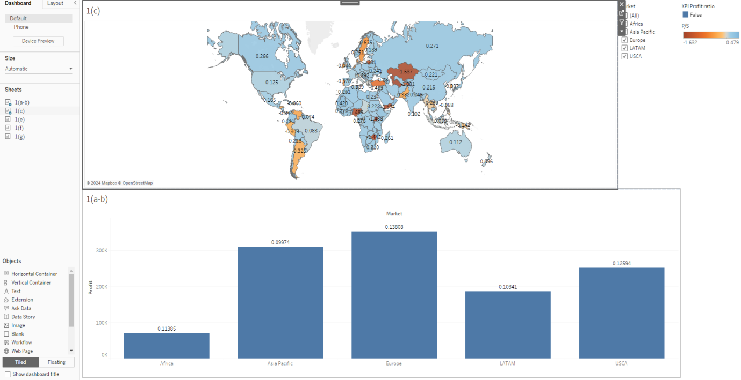

Slide 4
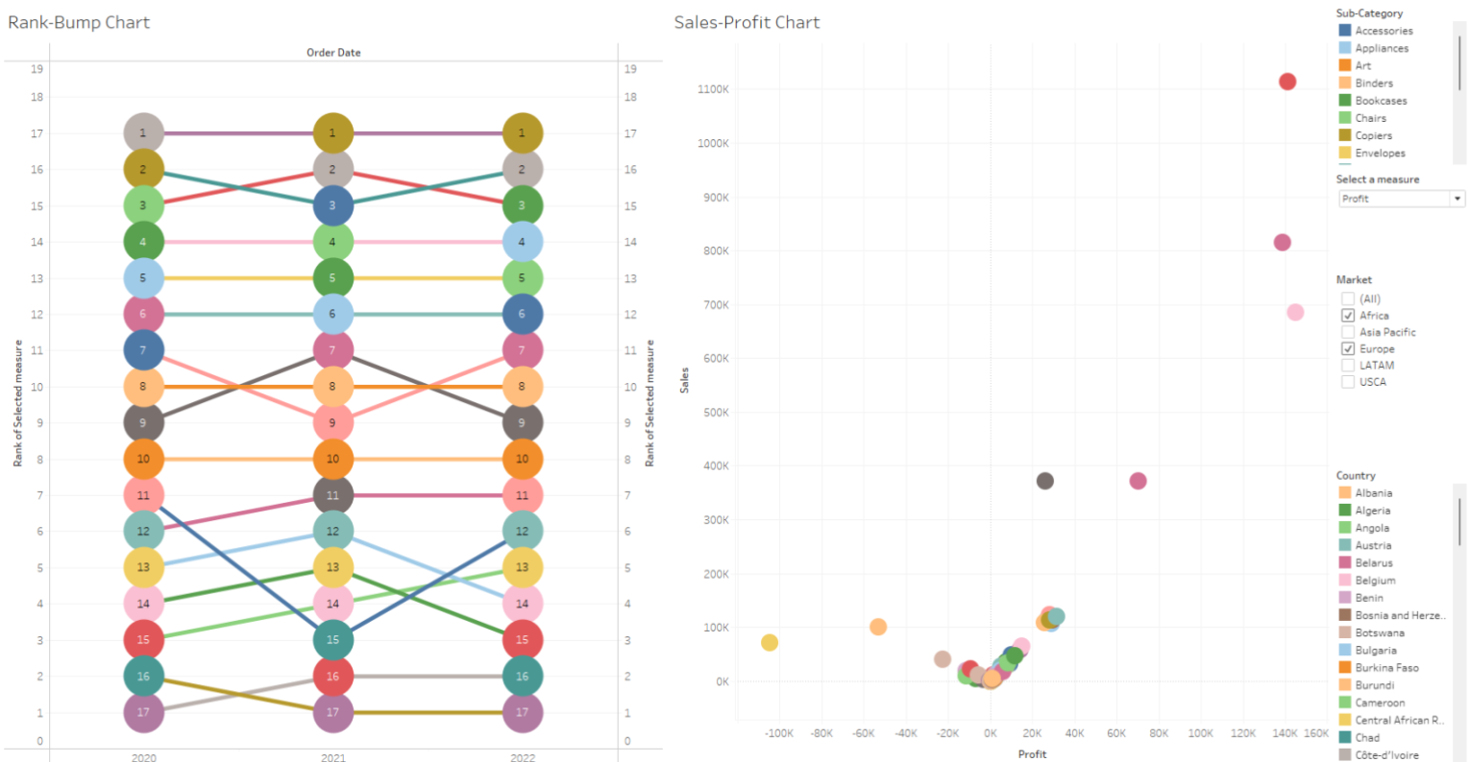

Slide 5
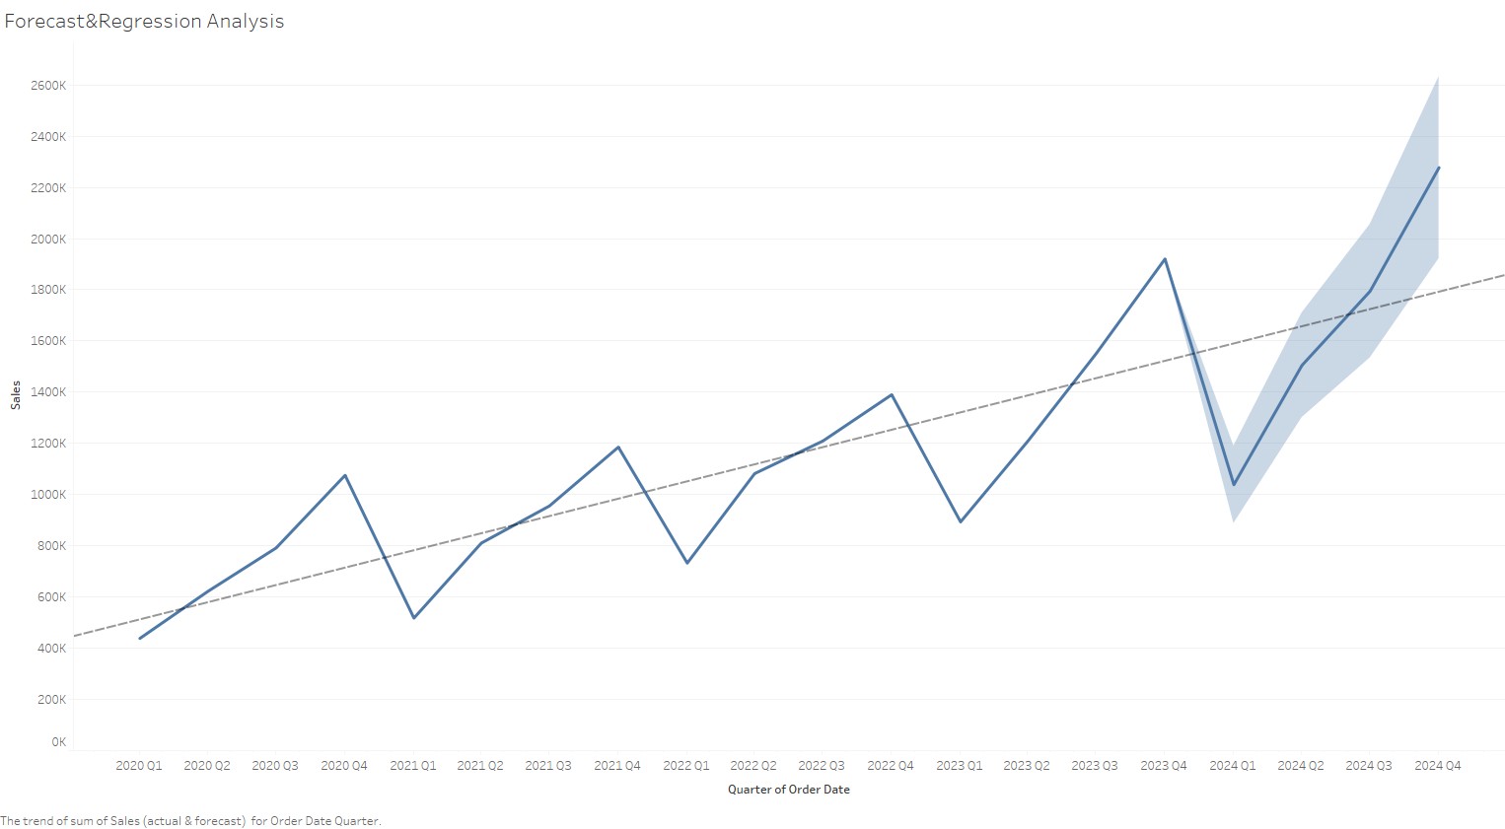

Slide 6
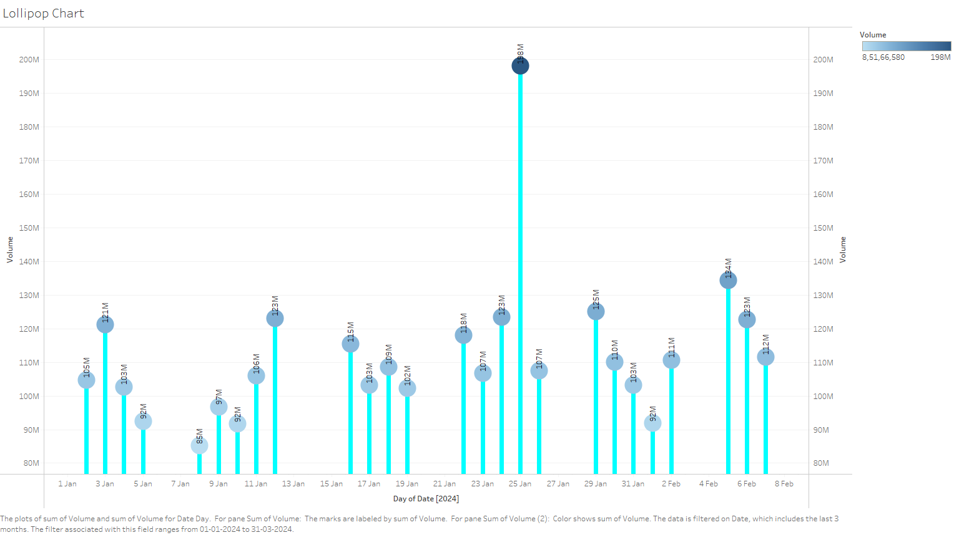

Slide 7
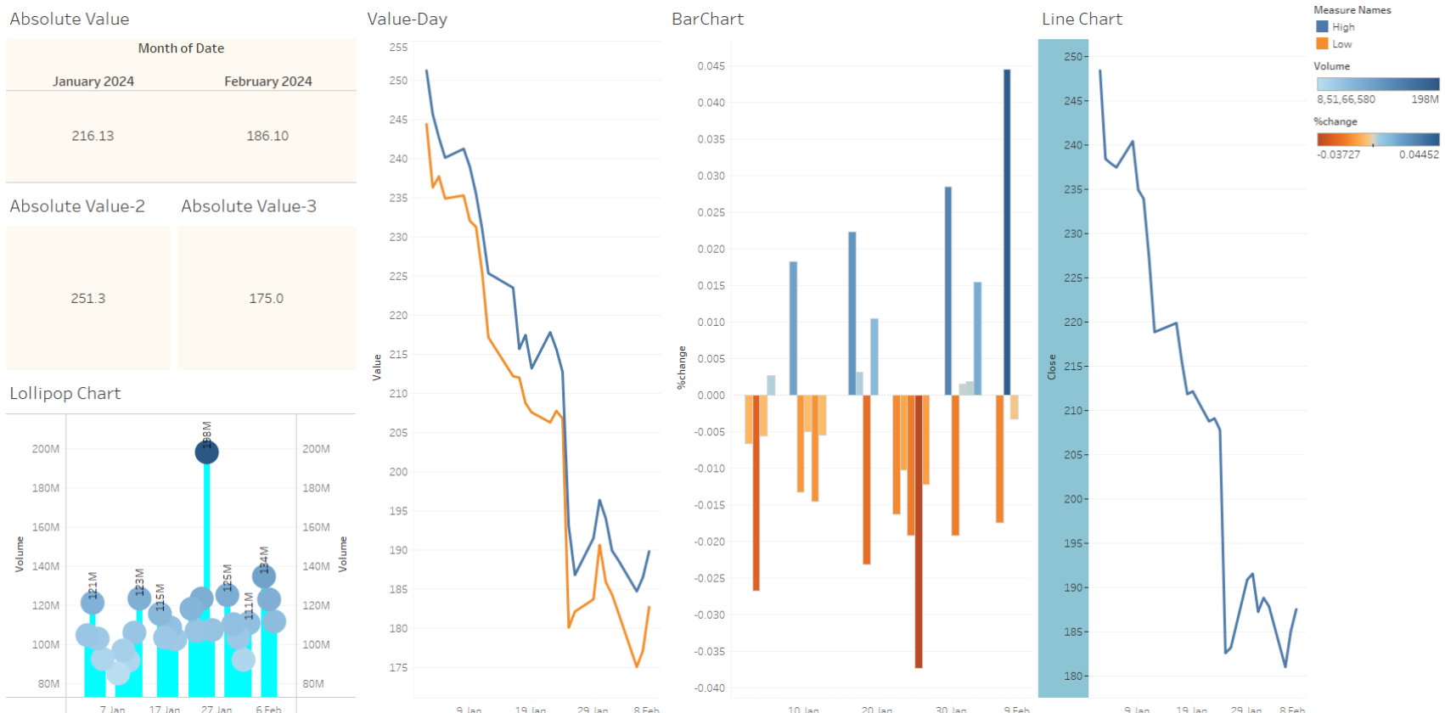

Slide 8
Thank you!

