Slide 1
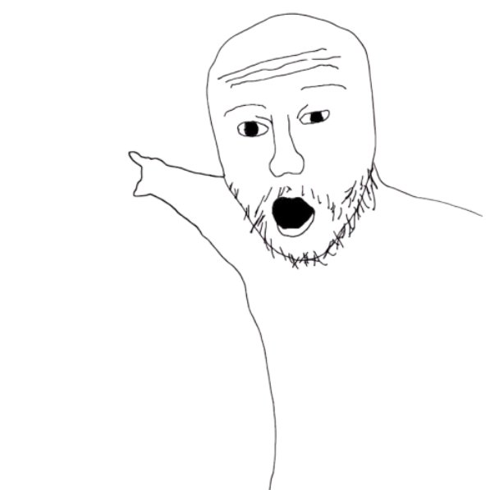
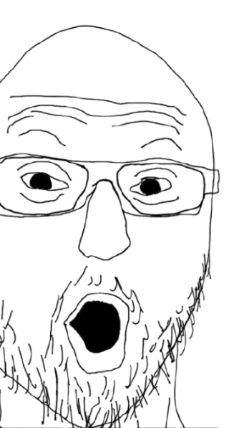
OOP course
Voice Assistant
Team 03

Slide 2

Table of content
Team member
Overview
Key feature
Feasibility
what do we have here?
Timeline

Slide 3
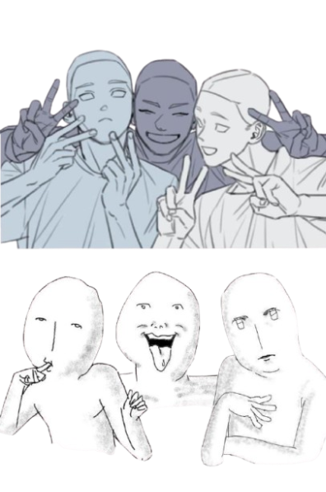
Team member!!!
Hong Limhak
Vean
Sovanvirak
Keo Seavpav

Slide 4

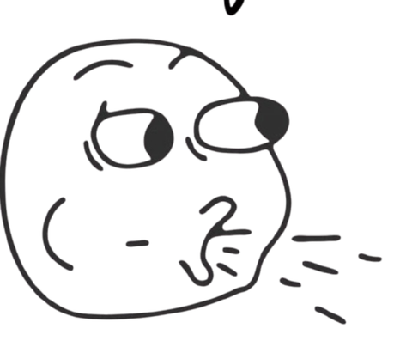
Project Overview
Product
Voice Assistance is a Python text-to-speech (TTS) system that can transfer from text to voice which can overlay on Microsoft Word and other apps for ease of use.
Product important
A lab study tool that can change student behavior from being lazy in reading to being ready to listen. Main focus is student and illiterate people in Cambodia.

Slide 5
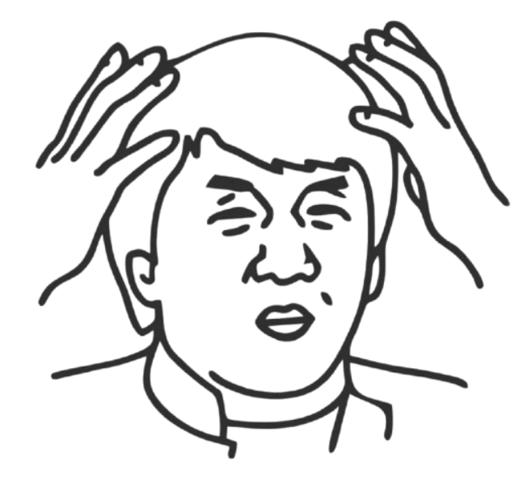
Key features
Text to Speech (core)
Background clipboard listener
History Handling
GUI

Slide 6
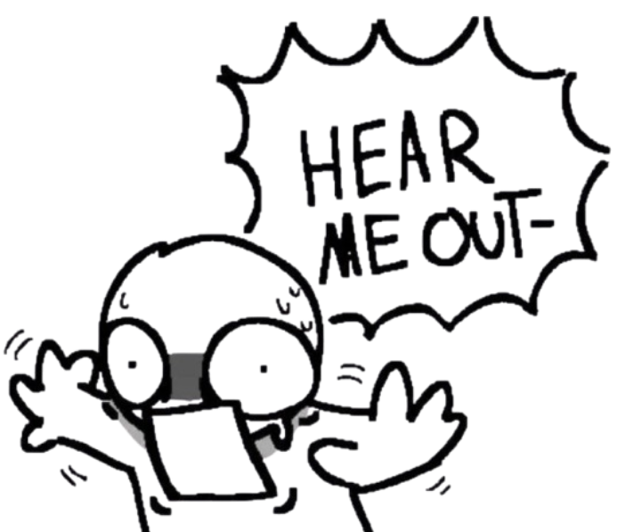
Text-to-speech
Convert selected text to speech
using pyttsx3 for offline conversion
accept manual input
file and error handling
Queue based speaking
related to OOP

Slide 7
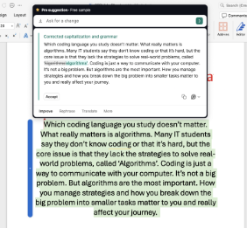

Background listener
Listen to user ctrl+c
Push item into software
appear above other software

Slide 8
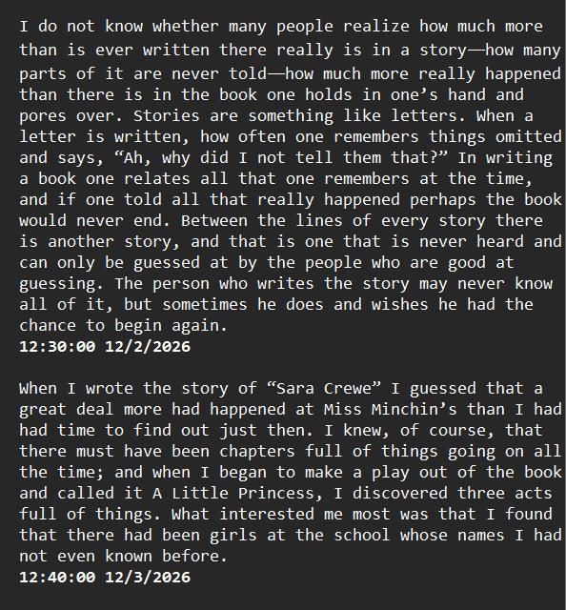

History Handling
Push read item to txt
Have time stamp for each block
Good for tracking

Slide 9
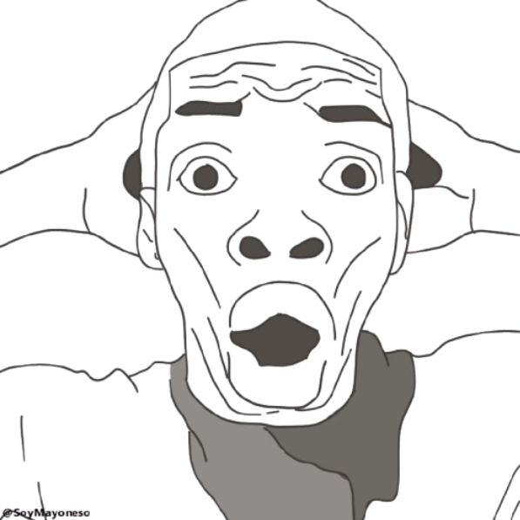

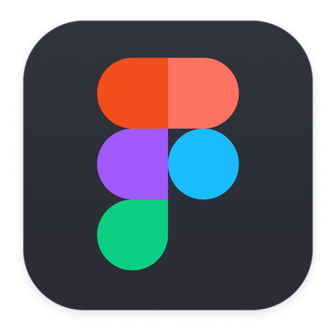
GUI
Link for demostration.

Slide 10

Feasibility
Proven Libraries
pyttsx3 : offline TTS no internet require, Well document, easy to integrate with OOP
PyQt6 : Mature framework for desktop GUI. Qthread prevent UI freeze during speech
keyboard +Pillow+OpenCV: All available via pip.USed in real_world apps - no risk of missing features.

Slide 11

Manageable Scope
Clear Role Separation: Each member owns one module such as TTS Engine, Overlay/Hotkey, GUI-no overlap, no confusion.
OOP Architecture: TTSEngine class encapsulates complexity. Easy to text independently before integration.
Scoped Feature Set: English only, 250-word limit - intentional constraints that keep scope under control.

Slide 12
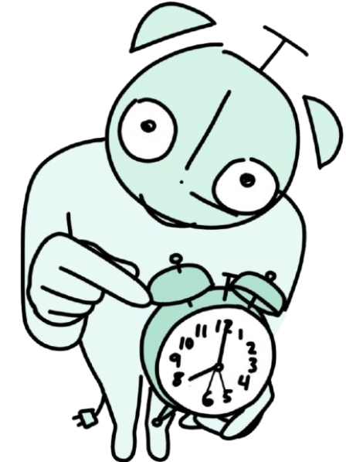
Realistic Timeline
Week 1 -Research
Concept understanding for each member's assigned area. Low-risk phase.
Week2+3 - Build & implement
Core coding sprint .Modular design means parallel progress across all 3 members. Combine all code and connect with GUI
Week 4 Integrate
Software testing and Debugging. Code Finalization, GUI Finalization. Wrapping up

Slide 13
Timeline Overview
W1
W2
W3
W4
Research TTS & pyttsx3
Explore overlay workflow
Design Figma UI mockup
Explore PyQt6 basics
Build TTS Engine & apply OOP concept
Code Implementation
Code Integration + combination with GUI
Code Implementation
Debugging and software testing
Code Finalization
GUI finalization
Slide presentation
Wrapping up

Slide 14
Thank You

