Slide 1
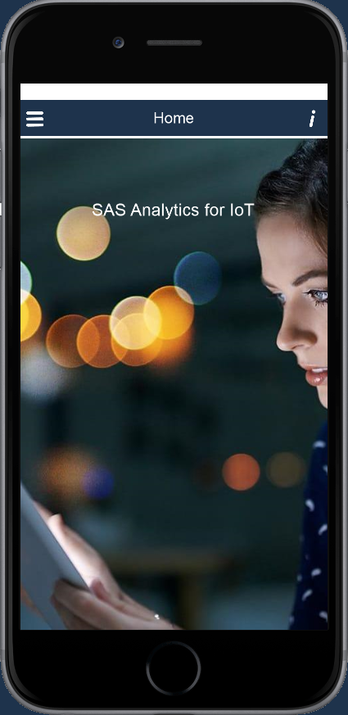
SAS ESP and Mobile Data
Tom Tuning
Notes:
Hello TT here. I am a solution architect here at SAS in the IoT division.
Today let’s talk about using analytics on data from a mobile phone, to create an anomaly detector.

Slide 2
Details
Phone data collected
Accelerometer data (X,Y,Z Gravity and X,Y,Z motion )
Gyroscope
Location data (Speed, altitude, direction, lat, long )
Simple MQTT architecture
JSON formatted messages
ESP runs advanced analytics, returns results
MQTT Broker
Mobile
ESP
Notes:
As you may know a mobile phone has many built in sensors. These include an
Accelerometer
Gyroscope
GPS
In this project I am going to concentrate on examining the accelerometer data, specifically the X,Y,Z gravity measurements.
I am using a simple MQTT architecture.
Data is collected from phone sensors, JSON encoded and passed to an MQTT broker via a specific topic.
ESP will listen for messages on this topic and process them.
Once the results are ready, ESP will post them to second topic which will be consumed by the mobile app for display.

Slide 3
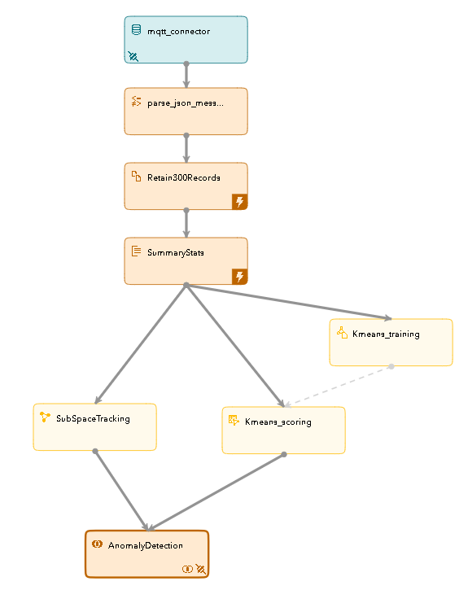

Anomaly Detection
MQTT Broker
Featured Functions
MQTT connector
JSON parsing
Retention
Aggregation
Analytical Models
Subspace Tracking
K-means
Summary statistics
Dynamic model training
Unsupervised learning
ESP
Notes:
We are going to use the accelerometer data to create an anomaly detector. This will highlight the following features of SAS Event Stream Processing:
MQTT connector
Using Functions to parse JSON messages
Retaining groups of messages memory for processing and
Aggregate statistics
This project will also show how easy it is to dynamically train and score unsupervised analytic models such as subspace tracking and k-means and then use the results to detect anomalies.

Slide 4
Window Type: Detail
source: input from MQTT
function: parse JSON message
copy: create retention 300 records
aggregate: create summary stats
train: dynamic k-means training
calculate: train and score SST
score: k-means scoring
join: merge and publish to topic
Notes:
If we take a closer look at the ESP project we can see just how powerful it is. A lot can be accomplished in just a few windows.
BTW, in ESP the rectangular boxes are called windows and the connectors between them are called edges.
Icons placed on the left side of a window indicate inputs. While icons on the right side describe outputs.
First there is the source window, shown here in blue, which contains our MQTT connector. This is where events flow into the project.
Second there is a function window which will parse the incoming JSON message into ESP variables defined by a schema.
Next , using a copy window we will keep the most current 300 events in memory for processing.
Using an aggregate window we can create summary statistics, such as averages and standard deviation, from the 300 events.
The train window dynamically creates a k-means model which is then passed to the scoring window.
The scoring window uses the model created by the training window to score incoming event data and create results.
The calculate window bundles the training and scoring together. In one window a subspace tracking model is created and then used to score incoming events.
Since I split the event flow to show how ESP can leverage multi-threaded parallel processing. We need a join window to merge the events and publish them to an outbound MQTT topic.
Once our results are published to the outbound MQTT topic our anomaly detector is complete.

Slide 5
Demo Details
MQTT Broker
Mobile App
MQTT broker setup
Sensors
ESP Studio
Project review
Anomaly Detection
ESP
Notes:
We will demo this in 3 stages.
I will show you around the mobile application.
How to configure broker settings and general application flow
We will jump over to ESP studio and see how you can interactively view and develop ESP projects
Go back to the mobile application and test out the anomaly detection

Slide 6
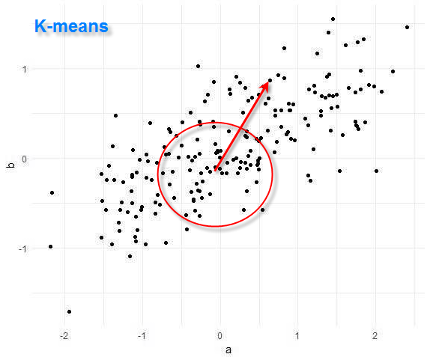


Notes:
The train window dynamically creates a model based on the analytical model specified, in this case, K-means.
By clicking this dropdown you can see here a full list of the support algorithms:
* Linear Regression
* SVM (Support Vector Machine)
* Logistic Regression
* Recommender
* TSNE (T-distributed Stochastic Neighbor Embedding)
We can also see the parameters used to train the model and the input variables as well.
I really like this because it is easy to try different settings. For example, you can easy adjust the number of clusters and see what setting works best for your data.
The dynamically trained model is passed to the scoring window from the training window and used to score each new event.
In our phone sensor example, we might place the phone on a flat surface and leave it there for 30 seconds.
Since the phone is not moving all the accelerometer readings will be nearly zero.
Zero becomes the center point of our k-means cluster.
As the phone begins to move we need to examine the output variable min_dist. Greater distances from the center of the cluster indicates deviations from the baseline.
Let’s go back into test mode and view values live. You can see as I move the phone the min Distance increases indicating an abnormality.

Slide 7
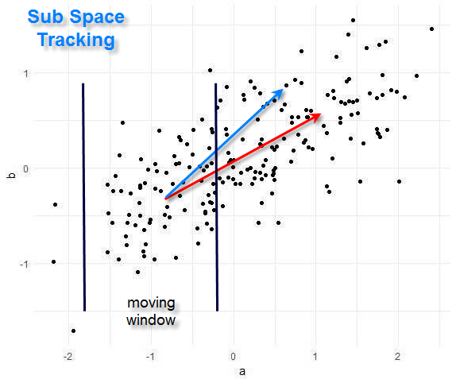
Notes:
The calculate window does both training and scoring for the subspace tracking algorithm.
As with the training window, by clicking the drop down you can see a complete list of supported algorithms.
Once SST is selected you simply pick your input parameters, which variables you would like to use and define your output variables.
When we enter test mode we can see the principle components which are computed from out inputs as well as the key metrics that track subspace.
For my phone demo I have found that like residualOut best when determining if the phone is moving or stationary.
Therefore this is the value I am returning in my JSON string to the mobile application.
Now that all the data science is done we need to join all the information into one event and then send it back to the MQTT broker.
The broker will then deliver it back to our mobile device to be displayed.
If we look at the schema we see our newly combined data includes fields calculated by SST, k-means and summary statistics.

Slide 8
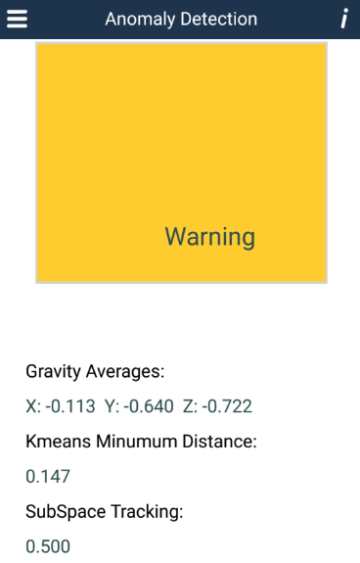

Slide 9
Notes:
This repository has shown some key features found in Event Stream Processing.
Using ESP you can easily collect data from remote sensors using industry standard protocols.
After parsing, we then retained events in memory so that advanced analytical methods can be used to create an anomaly detector.
Dynamic model training allows models to be continuously trained based on real time data and is shown here using both the calculate and train windows.
Data can be a easy combined using the join window and then published to an outbound topic.
The mobile platform provides a level of personal interaction with the data that cannot be easily replicated using canned data sources.
It helped me better understand how SST and k-means work in an interactive environment and I hope it will help you as well.
Let’s enter test mode again. This time examining the output from the join window. I have selected the fields I am most interested in, namely
xGravity
residualOut
and min_dist
When I lay may phone on my desk for 30 seconds, zero becomes my baseline. Therefore, residualOut and min_dist are also near zero.
After 30 seconds I can start moving the phone and you will notice how these metrics start to increase indicating a deviation from the baseline.
Now you might think, why do I need to do all of this? I can just check if X gravity is greater than zero.
That question can be answered simply by turning the phone on its side. When I do this you can see xGravity become -1. Therefore, -1 becomes the new normal.
Dynamically calculating baseline metrics eliminates manual setting of these values.
Imagine, how difficult it would be to set the upper and lower ranges for all the sensors in a factory. It might be practically impossible.
This repository has shown some key features found in Event Stream Processing.
Using ESP you can easily collect data from remote sensors using industry standard protocols.
After parsing, we then retained events in memory so that advanced analytical methods can be used to create an anomaly detector.
Dynamic model training allows models to be continuously trained based on real time data and is shown here using both the calculate and train windows.
Data can be a easy combined using the join window and then published to an outbound topic.
The mobile platform provides a level of personal interaction with the data that cannot be easily replicated using canned data sources.
It helped me better understand how SST and k-means work in an interactive environment and I hope it will help you as well.

Slide 10
