Slide 1
AWS Data Ingestion
IoT Core, Kinesis, Event Stream Processing

Slide 2
Objectives
This project will describe how to ingest IoT devices data into the AWS using IoT Core and Kinesis.

Slide 3



















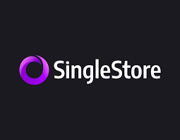



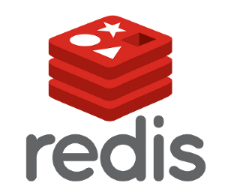


Analytics for IoT Reference Architecture
Edge
On-Premise or Off-Premise Data Center or Cloud
Management & Business Integration
Ingestion,
Provisioning ,
Device Management
Stream Processing
Sensors
IoT Gateways
Event Stream
Manager
Model Building, Data Exploration, Reporting, ModelOps
ESP Model updates
SAS Model Manager
SAS Visual Analytics
SAS Visual Statistics
SAS VDMML
SAS Visual Forecasting
On-Premise Device Management
Message Bus
SAS ESP Server
SAS Decision Manager
3rd Party & Open-Source Apps
SAS ESP Edge
Azure IoT Hub
Data Selection & Launchers
APIs
AWS IoT Core
Low Latency
Data Stores
Enterprise Data Sources
GCP IoT Core
Sensor-focused Data Model
Data Flow
SAS
MES
Model Updates
3rd Party
Data Lake
ERP
CRM

Slide 4


AWS IoT Architecture
Overview
Edge
AWS Cloud
Devices
AWS IoT Core
AWS Kinesis
SAS ESP Server
Monitoring
Management
Security
Rules
Provisioning
Messaging
Data Retention
Pub/Sub
Scalable
Real-Time
Streaming Analytics
Consumer
Real-Time

Slide 5


Amazon Kinesis Video Streams
Amazon Kinesis Data Streams
Amazon Kinesis Data Firehose
AWS IoT Core

