Slide 1
Demographics from Video
Using SAS Analytics for IOT Image Analysis.
Tom Tuning
Notes:
To I would like to talk to you about how you can use SAS to train and deploy an analytics solution which gleans demographic information from a live video stream.

Slide 2
Agenda
Overview
Architecture
Training vs Production
Demo
Summary
Notes:
Show the steps needed to create and end to end solution for collecting images at the edge and passing them to ESP in order to run in stream image analytics in order to determine if a person is happy or angry. This presentation assumes a novice amount of expertise, with the goal of describing the overall concepts with links to other subject matter for further learning.
Architecture: describe the CAS environment needed to create the astore file vs the ESP environment needed to use the astore file.
CNN: before we dive into the weeds it is good to do a high level overview about what we are trying to achieve.
DLPy: go through the steps needed to create an astore file.
ESP: describe the parts of ESP and what we are using
esppy: describe what is running on the 1st pi and how it communicates with ESP.
Show the total solution.

Slide 3
Goal
Determine Demographics from Video Cameras
Face Detection
Age – Ages grouped category
Gender – Male or Female
Emotions – Happy, Neutral, Sad, Fear, Surprise, Angry
AIOT link: https://www.sas.com/en_us/software/analytics-iot.html
Use Cases:
Retail
Security
Customer Intelligence
Notes:
Imagine if you could leverage existing security cameras in your enterprise and determine things like. Average age of clients; whether customers tend to be male or female. Or perhaps be able to determine the general emotional state of people in the checkout line. Now imagine this running in real time running off of streaming data collected in stores. This type of customer intelligence is key to understanding and improving marketing and security practices.
This demo will show how to train multiple deep learning algorithms and use them collectively to achieve several types of analytical insight from one image. You will also see how SAS integrates seamlessly with python to achieve these results.

Slide 4
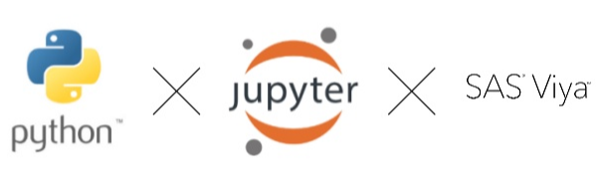
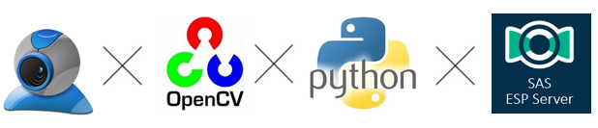
Architecture
Training vs Production
Training
Machine Learning training environment based on Viya
Python interface to SAS, DLPy, SWAT
Production
Software: Python; CV2; ESP;
Notes:
To reach our goal we will need two types of environments. First is a SAS deep learning CAS environment where we can processes 1000s of images so that a machine learning model in the form of an astore file may be produced. The second environment runs our models along with any business logic .

Slide 5

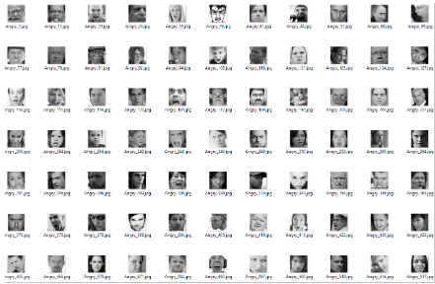
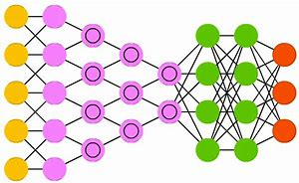


Architecture
Images
Training
Portable Analytics
Face Detection
ASTORE
Age
ASTORE
Image Data
Deep Learning
Gender
ASTORE
Emotions
ASTORE
Notes:
For this proof of concept we are going to train 4 Image analytic models. The first is a face detection model which uses object detection to locate faces in the video feed. The next 3 are image classification models for:
Age
Gender
Emotions.
SAS Viya takes advantage of GPUs to make training faster. The python interface DLPY increases ease of use.

Slide 6

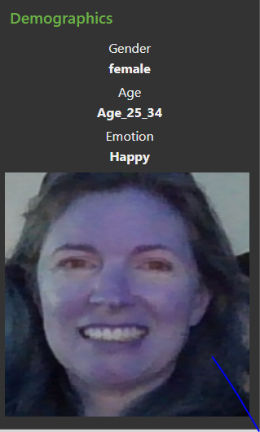
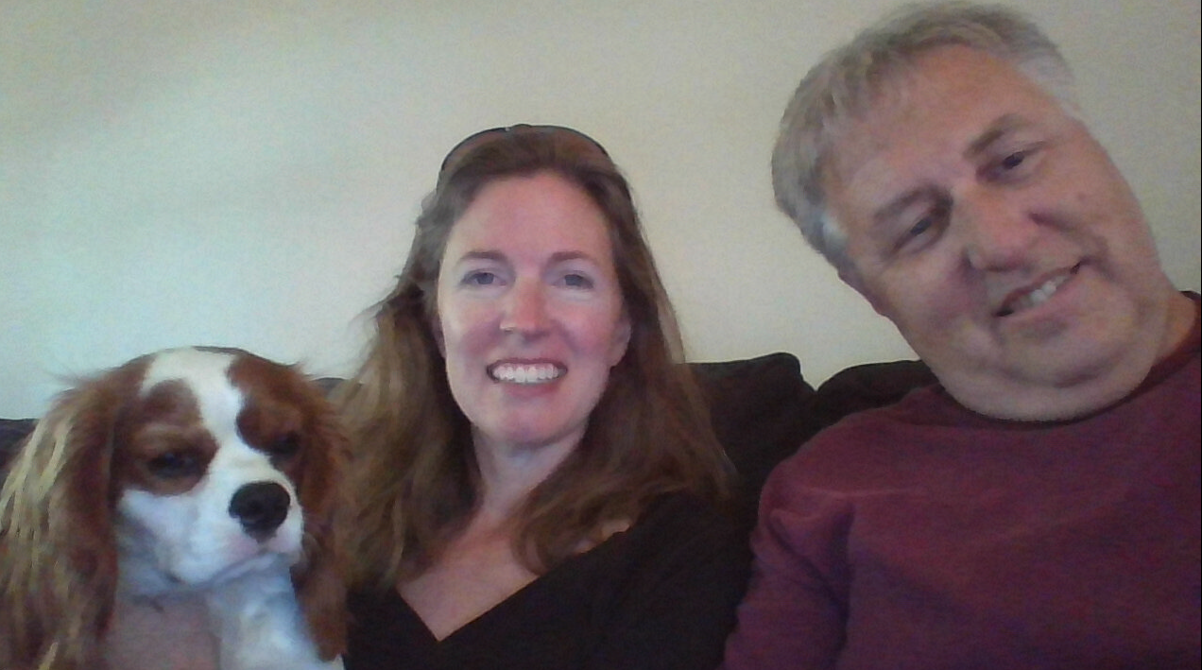

Architecture
Production
ESP Server
Face Detection
Age
Multi-threaded
Image
ASTORE
ASTORE
Gender
Union
Filter
Connector MQTT
ASTORE
Emotion
ASTORE
Notes:
Once we have our models trained. We transfer them to a production ESP server which is directly connected to a security camera. Here we are using the UVC connector however other types of connections are available.
ESP takes in a image which may contain multiple human faces. Non human faces are ignored. Each face is cropped and then sent to the 3 downstream astore files simultaneously. Python and OpenCV are used in the cropping process. The results are recombined in the Union window, things we don’t need are filtered and the output is converted to JSON and placed on an MQTT queue for consumption by our little node-js GUI.
Let’s take a look at this in action.

Slide 7
Image Analytics in Action
Summary
SAS Analytics for IOT provides a fast cloud ready environment for training and deploying image analytic models.
Training and Production can be enhanced by using GPUs.
SAS ESP provides a platform for utilizing those models to reach your business goals.
Streaming data may be transformed or enhanced in real time.
Models can be used in parallel to solve even more complex problems.
What’s next?
Notes:
SAS AIOT provides one product purchase and has all the tools needed for this proof of concept.
What problems are you trying to solve? SAS has the answers.
Thanks for watching

