Slide 1
ESP High Availability using Kafka on Viya 4
Implementing 1 + N failover
Tom Tuning
Notes:
Hello, TT here. I am a solution architect here at SAS in the IoT division. Today I would like to talk to you about how to build a high availability system using SAS’s Event Stream Processing and a fault tolerant message bus call Kafka.

Slide 2
Introduction
Failover
The act of switching between redundant servers upon failure so that no events are lost
Requires 1+N ESP servers as well as a Kafka cluster also implementing failover
Replicated Kafka message queues guarantee message delivery and synchronize ESP server failover
EVENTS
Server X
ACTIVE
Server Y
STANDBY
EVENTS
Notes:
Notes:
High Availability systems are built on the concept of failover and failover is defined as the act of switching between redundant servers upon failure so that no events are lost. ESP implements 1 + N failover using multiple ESP servers in conjunction with replicated Kafka message queues across a multi-node Kafka cluster. The idea is to ensure uninterrupted processing of data in the event of a failure within a business-critical environment.

Slide 3
High Level Architecture
All ESP servers receive same message content and run same model. Only active ESP appends to outbound topics.
Publisher
ESP Server
ACTIVE
Subscriber
Publisher
EVENTS
EVENTS
EVENTS
EVENTS
Message Bus
Message Bus
Publisher
Subscriber
ESP Server
Publisher
STANDBY
Message Bus guarantees delivery and synchronization.
Notes:
Notes:
High availability is achieved by building redundancy into every level of the architecture. Redundant publishers guarantee messages are delivered to the message broker. The Kafka message broker ensures message delivery through replicated brokers and topics. Failover in ESP is accomplished by seamlessly transitioning event processing and subscription from an active instance of an ESP engine to a standby instance when the active instance fails.
Lastly, multiple subscribers ensures message delivery.

Slide 4

ESP Failover Example
Kubernetes
ESP
ESP
Kafka Cluster
ESP
ESP
ESP Kafka Adapter
Publisher
ESP
ACTIVE
ESP Kafka Adapter/Connector
STANDBY
Subscriber
ESP Kafka Adapter/Connector
ESP Kafka Connector
ESP Kafka Connector
Publisher
Zookeeper
Inbound topic
Outbound topic
EVENTS
EVENTS
CSV
CSV
Broker 0
Broker 1
Broker 2
Replicated Partition 0
Replicated Partition 0
Replicated Partition 0
Notes:
Notes:
Today I would like to walk you through the following HA demo system.
Here I have expanded the Kafka Cluster portion of the diagram to show how our inbound and outbound topics are replicated across 3 brokers and sequencing is maintained by using a single partition.
In this example 5 ESP servers are deployed into a Kubernetes cluster.
This includes 2 redundant publishers, 2 ESP servers running our main project and 1 subscriber.
The flow goes like this:
A bash script writes data into a file which is then read by the ESP publishers running a File and Socket adapter/connector.
The active publisher connects to Kafka and adds the message to the inbound queue.
Both ESP servers process all the messages from the inbound topic. However, only the active ESP server writes to the outbound topic.
An ESP Kafka subscriber adapter/connector, picks up the messages and writes them to an output file.
In the case of an ESP server failure, the standby server transitions to an active state and starts adding messages to the outbound topic.
Kubernetes watches over all the ESP server pods and ensures availability.
---------------------------
When the server fails, Zookeeper alerts us and the Standby server is identified to be the new Active engine. If the new Active server is not currently at the same message id as the one that failed, it will synchronize using the messages stored in the subscriber connector's buffer. Once synchronization is complete, the Standby is switch to be the Active server.

Slide 5
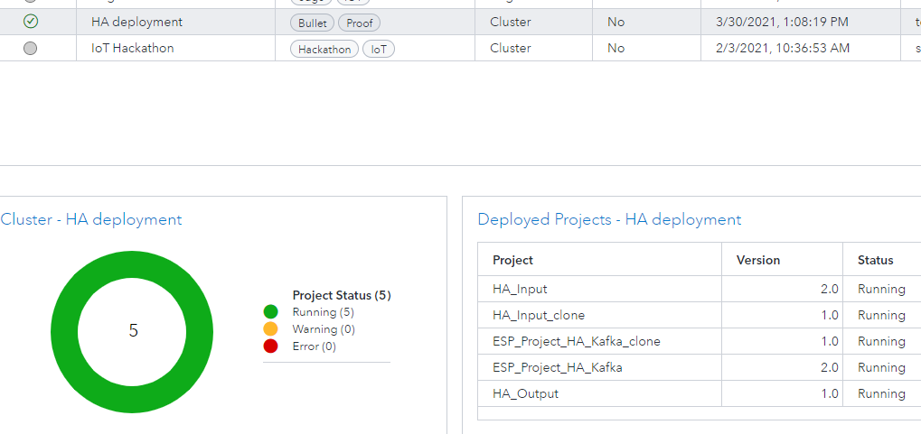
Notes:
Now let’s walk thru a demo scenario.
Here I have created an HA deployment
Let’s fill this deployment with our ESP projects consisting of 2 input projects, 2 projects which perform our calculations and 1 output project.
But first I will get the data flowing by starting the create-data bash script which will create one event per second for 9000 seconds.
I will use an opensource tool called LENS to view and manager the Kubernetes cluster which is running our ESP server pods.
The pods are sorted by age. So as I start new pods they will appear at the top of the lists.

