Slide 1
Stream Architecture Design Guide

Slide 2



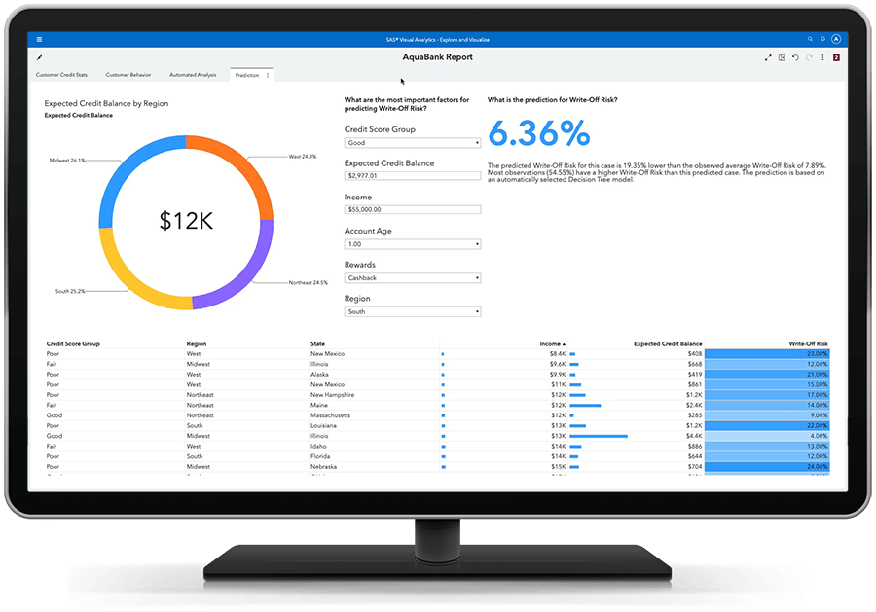
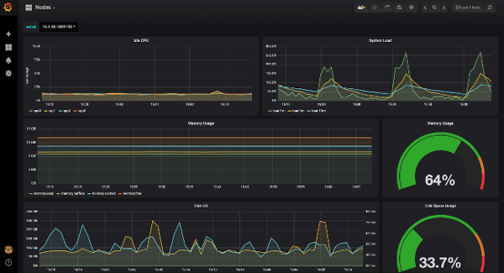



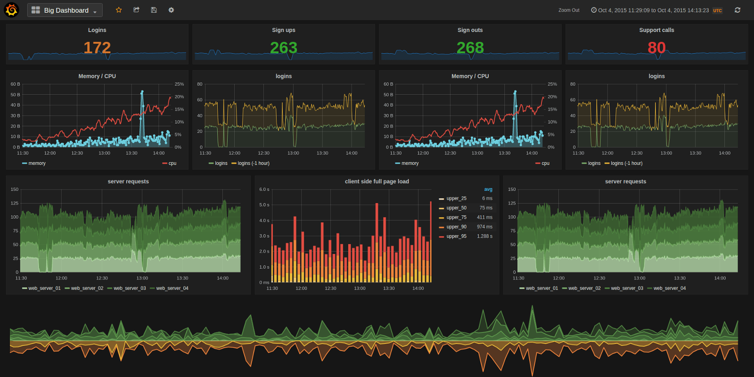




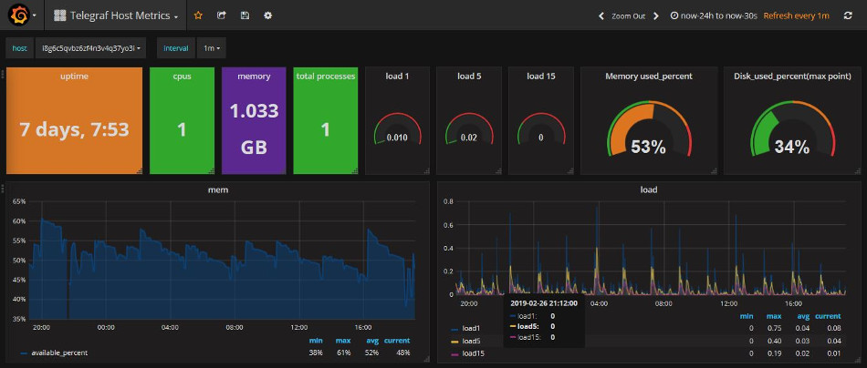







Streaming System Design Considerations
Requirements
Desig
Analyze
Display
Monitoring
Ingest
Store
long
short
Alerts
Dashboards
On-prem
Platform

