Slide 1
Image Classification Using Rubik’s Cubes
Using SAS Deep Learning with ESP for Image Analysis.
Tom Tuning

Slide 2
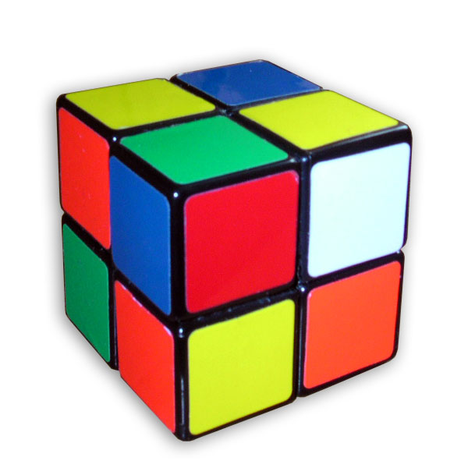
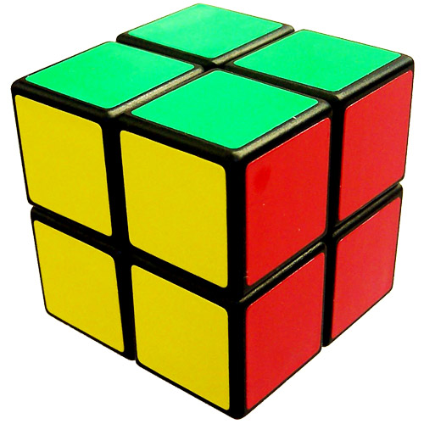
Overview
Guaranteed Quality
Using image classification to understand quality
Product Control
Quality Management
Defect Prevention
Data Set Creation
Model Lifecycle
Computer Vision Model Training
Streaming Analytics

Slide 3
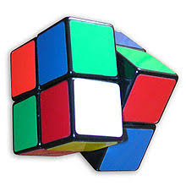
Goal
Imagine you are responsible for cube quality
How might you determine your plants quality metrics
Determine preventive actions
Automate quality
Good or Bad?
Notes:
Imagine you are responsible for cube quality at your company and you need to provide the plants quality metrics, determine preventive actions based on those metrics and formulate a plan to automate and improve the plant quality for the future. Computer Vision and Image classification will help you towards these goals.

Slide 4
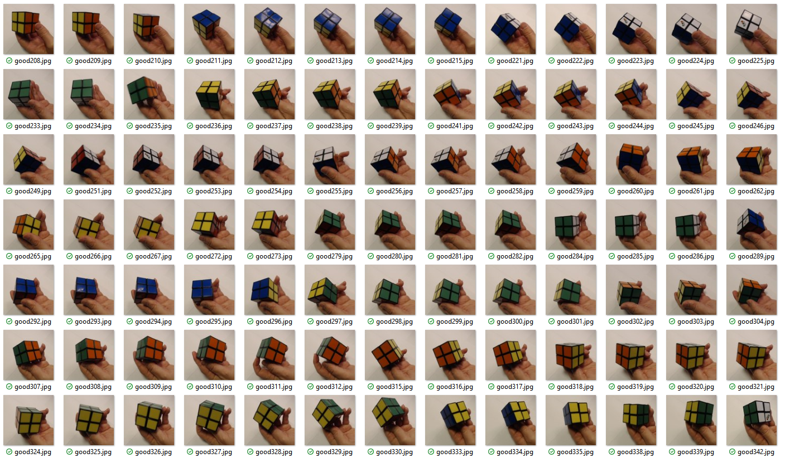
Images
How many
1000 per class
What size
Ideally 224 by 224 pixels
Split into 2 sets, train and test
Categorized by class
Good, Bad and Empty
More classes may be added
Notes:
One of the most important components to a well trained model is an awesome dataset.
Many people think you need 10s of thousands of images to train a model. The number of images you need depends on your project of course but a good rule of thumb is you will need at least 1000 images of each class because you have to split them into training and test data sets.
Collect images from the camera you will use in production, including the lighting which will be available.

Slide 5
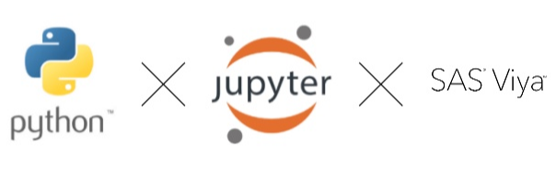
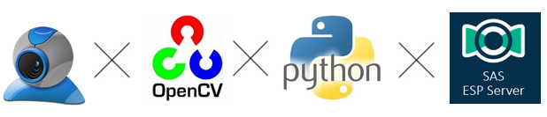
Model Lifecycle
Training vs Production
Training
Acquire and organize images
Model training environment based on VDMML
DLPy: Python interface to Viya
Jupyter notebook server, used for interactive testing
Production
Event Stream Processing
Pre-trained model
Score streaming images
ESPPy: Python interface to ESP
Notes:
To Complete the model lifecycle there are two distinct environments needed
First is a SAS deep learning CAS environment where the model is created and maintained.
The second is an ESP environment which uses models trained by the first step in a production application.

Slide 6



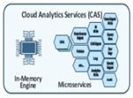

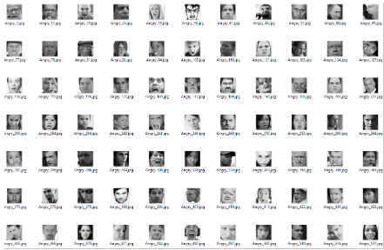
Computer Vision Model Training
Training
Control
Controller
Workers
DLPy / SWAT
ASTORE
Images
VDMML
SAS Viya
Viya multi node environment
Python interface to SAS, DLPy
Jupyter Notebook server, used for interactive testing
training/
test
Image Data
Deep Learning
Notes:
The CV model training process involves taking images, running deep learning algorithms on those images and creating a portable astore file. We do that by first separating the images into a test and training dataset. Load them into Viya and run deep learning algorithms against the images. Viya takes the workload and farms it to the worker nodes to complete the work efficiently.
The process is controlled via 2 python API libraries called DLPy and SWAT. These commands are run interactively using a Jupyter notebook.
DLPY: Deep Learning Python Interface
SWAT: https://github.com/sassoftware/python-swat (Scripting Wrapper for Analytics Transfer) Sets up session with Viya and control CAS actions.
Jupyter: https://jupyter.org/ web application that allows you to create and share documents that contain live code, equations, visualizations and narrative text.
SAS Viya is a cloud-enabled, in-memory analytics engine; based on an expandable microservices architecture;
Astore: Condensed form of the Convolutional Neural Network that is used to run our model from SAS ESP.

Slide 7



Streaming Analytics
Collect webcam image
Python interface to ESP, ESPPy
OpenCV
Production
ESP Server
ESPPy
Image
OR
ASTORE
ESPPy
Notes:
Our production environment uses the astore file created by the training process to score images in real time. SAS Event Stream Processing does all the heavy lifting here. The ESP server represented here can be on the edge or in the cloud because this example shows how to connect to the ESP server over a websocket REST interface using ESPPy. A python script running near the camera does pre-processing on the image before ending them to ESP.
OpenCV is used to grab frames from the webcam. The pictures are downsized and base64 encoded. Then using esppy images are sent to the ESP server for analysis. ESPPy is also used to listen and format the results that ESP produces.
ESP: Event Stream Processor
Astore: Condensed form of the Convolutional Neural Network that is used to run our model from SAS ESP.
OpenCV: Python library that allows you to capture and manipulate images.
ESPPy: Python library that allows communication and control of an ESP Server.

Slide 8
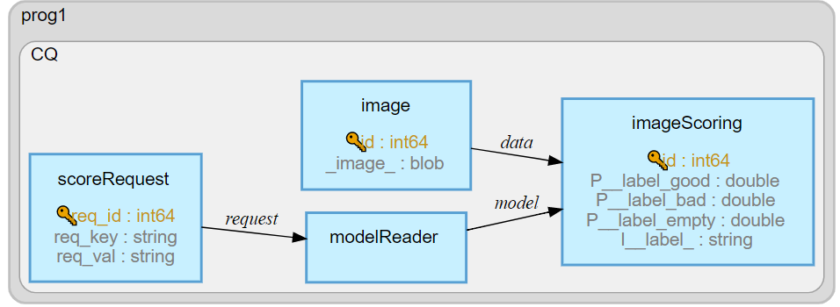
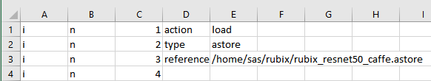
ESP and Computer Vision
ESP Details
ESP Server needs the following:
XML file which represents the streaming model to be run
Access to the ASTORE file generated by the DL process
CSV file which is used to load the ASTORE file on startup.
ASTORE
Notes:
The ESP flow show here is quite simple and straightforward. The scoreRequest and modelReader windows handle getting the CV model loaded into memory.
The image window processes incoming pictures sent by our ESPPy python script and the imageScoring windows generates our results.
Event Stream Processing: SAS ESP is an extremely fast streaming analytics engine, also architected to run in the Data Center and out to an edge.
The ScoreRequest and Image windows are Source windows: That means they listen for inputs via connectors. In this case a WebSocket and a File Listener. Images are base64 encoded strings which can be sent in as XML, CSV or JSON.

Slide 9
Building the Total Solution
Summary
Using DLPy and SWAT you can use Python APIs and run SAS’s Deep Learning modules.
Take advantage of existing best of class CNN models
SAS Viya provides a fast cloud ready environment
Faster run times
Multi server throughput
ESP enables streaming analytics
ESPPy, python interface to ESP
Build and control streaming models
Inject and Visualize data
Runs on Small edge devices

