Slide 1



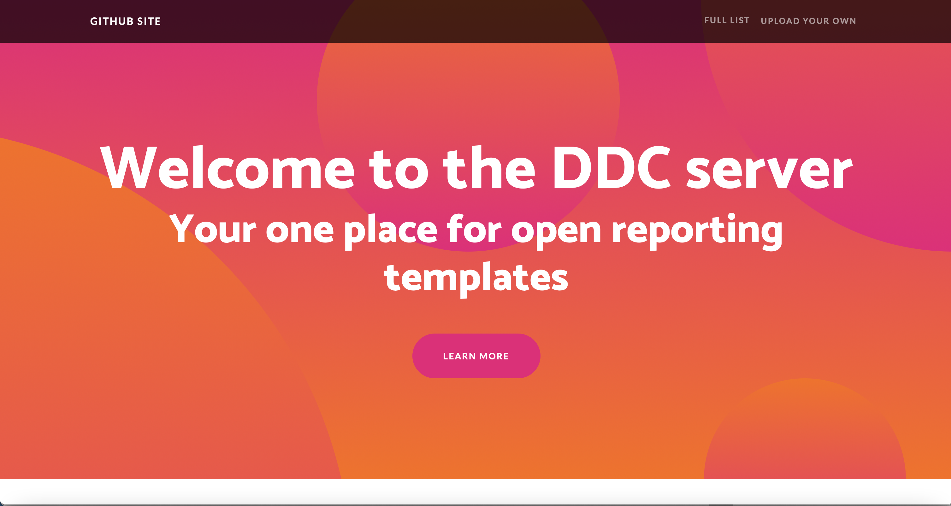




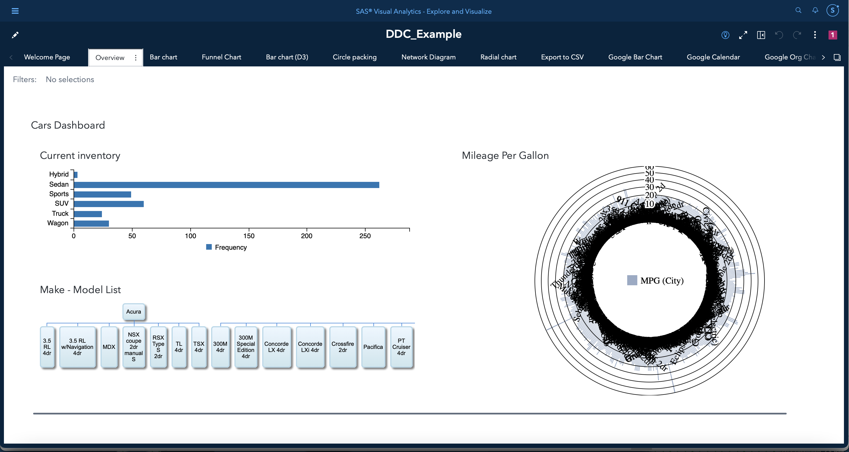
Data-driven Content (DDC) Server architecture
Registry
SAS Visual Analytics on SAS Viya
Viya 4 environment
Namespace: <webapp>
Namespace: <viya>
Container
Ingress/LB
x N
Microservices
Container
Container
Container
Visual
Analytics
Service B₁
Service B₂
Container
Container
Container
Service C₃
Service C₄
Service C₅
Notes:
Web app containerized and deployed in separate namespace within same K8s cluster
App exposed as a K8s Load Balancer
Application updates as per image pull policy
Container
Container
Container
Service X₁
Service X₂
Service X_{n}

