Slide 1
Forecasting the Equity Risk Premium Out-of-Sample:
Regularized ML, Technical Indicators & Tactical Asset Allocation
EC4308 Machine Learning and Economic Forecasting — Group Project (Week 13)
Leon • En Shao • Sasinthiran Kannan • Vienna
Notes:
Vienna (0:45): title, the Goyal-Welch puzzle in one sentence, roadmap of the talk.

Slide 2
Motivation: Can anything beat the historical average?
Goyal–Welch (2008, 2024) vs Neely, Rapach, Tu & Zhou (2014)
The equity premium is the single most important input for portfolio choice — 1 month of lead time is economically valuable.
Goyal & Welch: essentially no macro fundamental beats the prevailing mean out-of-sample; Goyal–Welch–Zafirov (2024) reach the same conclusion with an expanded dataset of 57 monthly series.
Neely et al. (2014): 14 technical indicators (MA, MOM, OBV) DO predict the premium out-of-sample on 1966–2011.
Our question: with modern regularized ML, do technical indicators + macro lags beat the prevailing mean on the extended 1951–2025 sample?
We match 99.98% of published signal-months; the time-aligned Neely regression has 178 initial pairs versus 181 months in the original design.
Notes:
Vienna (1:00): set up the puzzle. Emphasise: replication first, extension second.

Slide 3
Data: 899 months, 98 predictors, zero lookahead
Target: monthly log equity premium (%), y = 100·(ln(1+Rᵐ) − ln(1+Rᶠ)), S&P 500 over the risk-free rate.
Macro: the 14 Goyal–Welch predictors, each with lags 1–6 → 84 columns.
Technical: 14 binary Neely signals — 6 MA, 2 MOM, 6 OBV — computed from raw index level + S&P 500 volume.
Sample: 1951-02 → 2025-12; predictors aligned to 'observable at end of month t' — no lookahead leakage.
Validation: our computed signals match the published Neely series in 99.98% of signal-months (12/14 exact).
Fixed 240-pair rolling window; first h=1 forecast targets 1971-03; n = 658 OOS months.
Notes:
Leon (1:15): data sources, alignment convention, the 99.98% validation number, sample dates.

Slide 4
Methods: 7 models + 2 combinations vs the prevailing mean
Benchmark: prevailing (historical) mean — the only admissible benchmark.
Models (same 98-predictor matrix, re-estimated every window):
  LASSO (hdm, theoretical penalty — no CV) & post-LASSO
  Ridge and Elastic Net (glmnet, 10-fold CV inside the window)
  PCR & PLS (CV-selected components) • Random Forest (500 trees, fixed seed)
Combinations: equal-weight 1/N and constrained Granger–Ramanathan (Σw=1, w≥0, weights from past OOS errors only).
Horizons h ∈ {1, 3, 12}; DM (1995) tests with HAC lag h−1; Clark–West as appendix check.
Notes:
En Shao (1:30): one line per method, stress the no-lookahead CV protocol and the GR constraint.

Slide 5
Time-aligned Neely et al. (2014) estimates
Expanding-window bivariate regressions, one signal at a time, Clark–West test
1966–2011: VOL_2_9 R²_OOS = 0.189% (CW p = 0.1929), VOL_2_12 = 0.114% (p = 0.2469), VOL_3_12 = 0.531% (p = 0.0772).
These are three focal estimates; none of the six volume rules is significant at 5%.
The corrected expanding-window estimates use signal-month predictors to forecast the following month's return.
Extension 2012–2025: selected VOL estimates are -1.514%, -0.95%, and -0.313%.
Notes:
Sasi (1:15): explain the predictor/target timing change and report the recalculated estimates and tests.

Slide 6
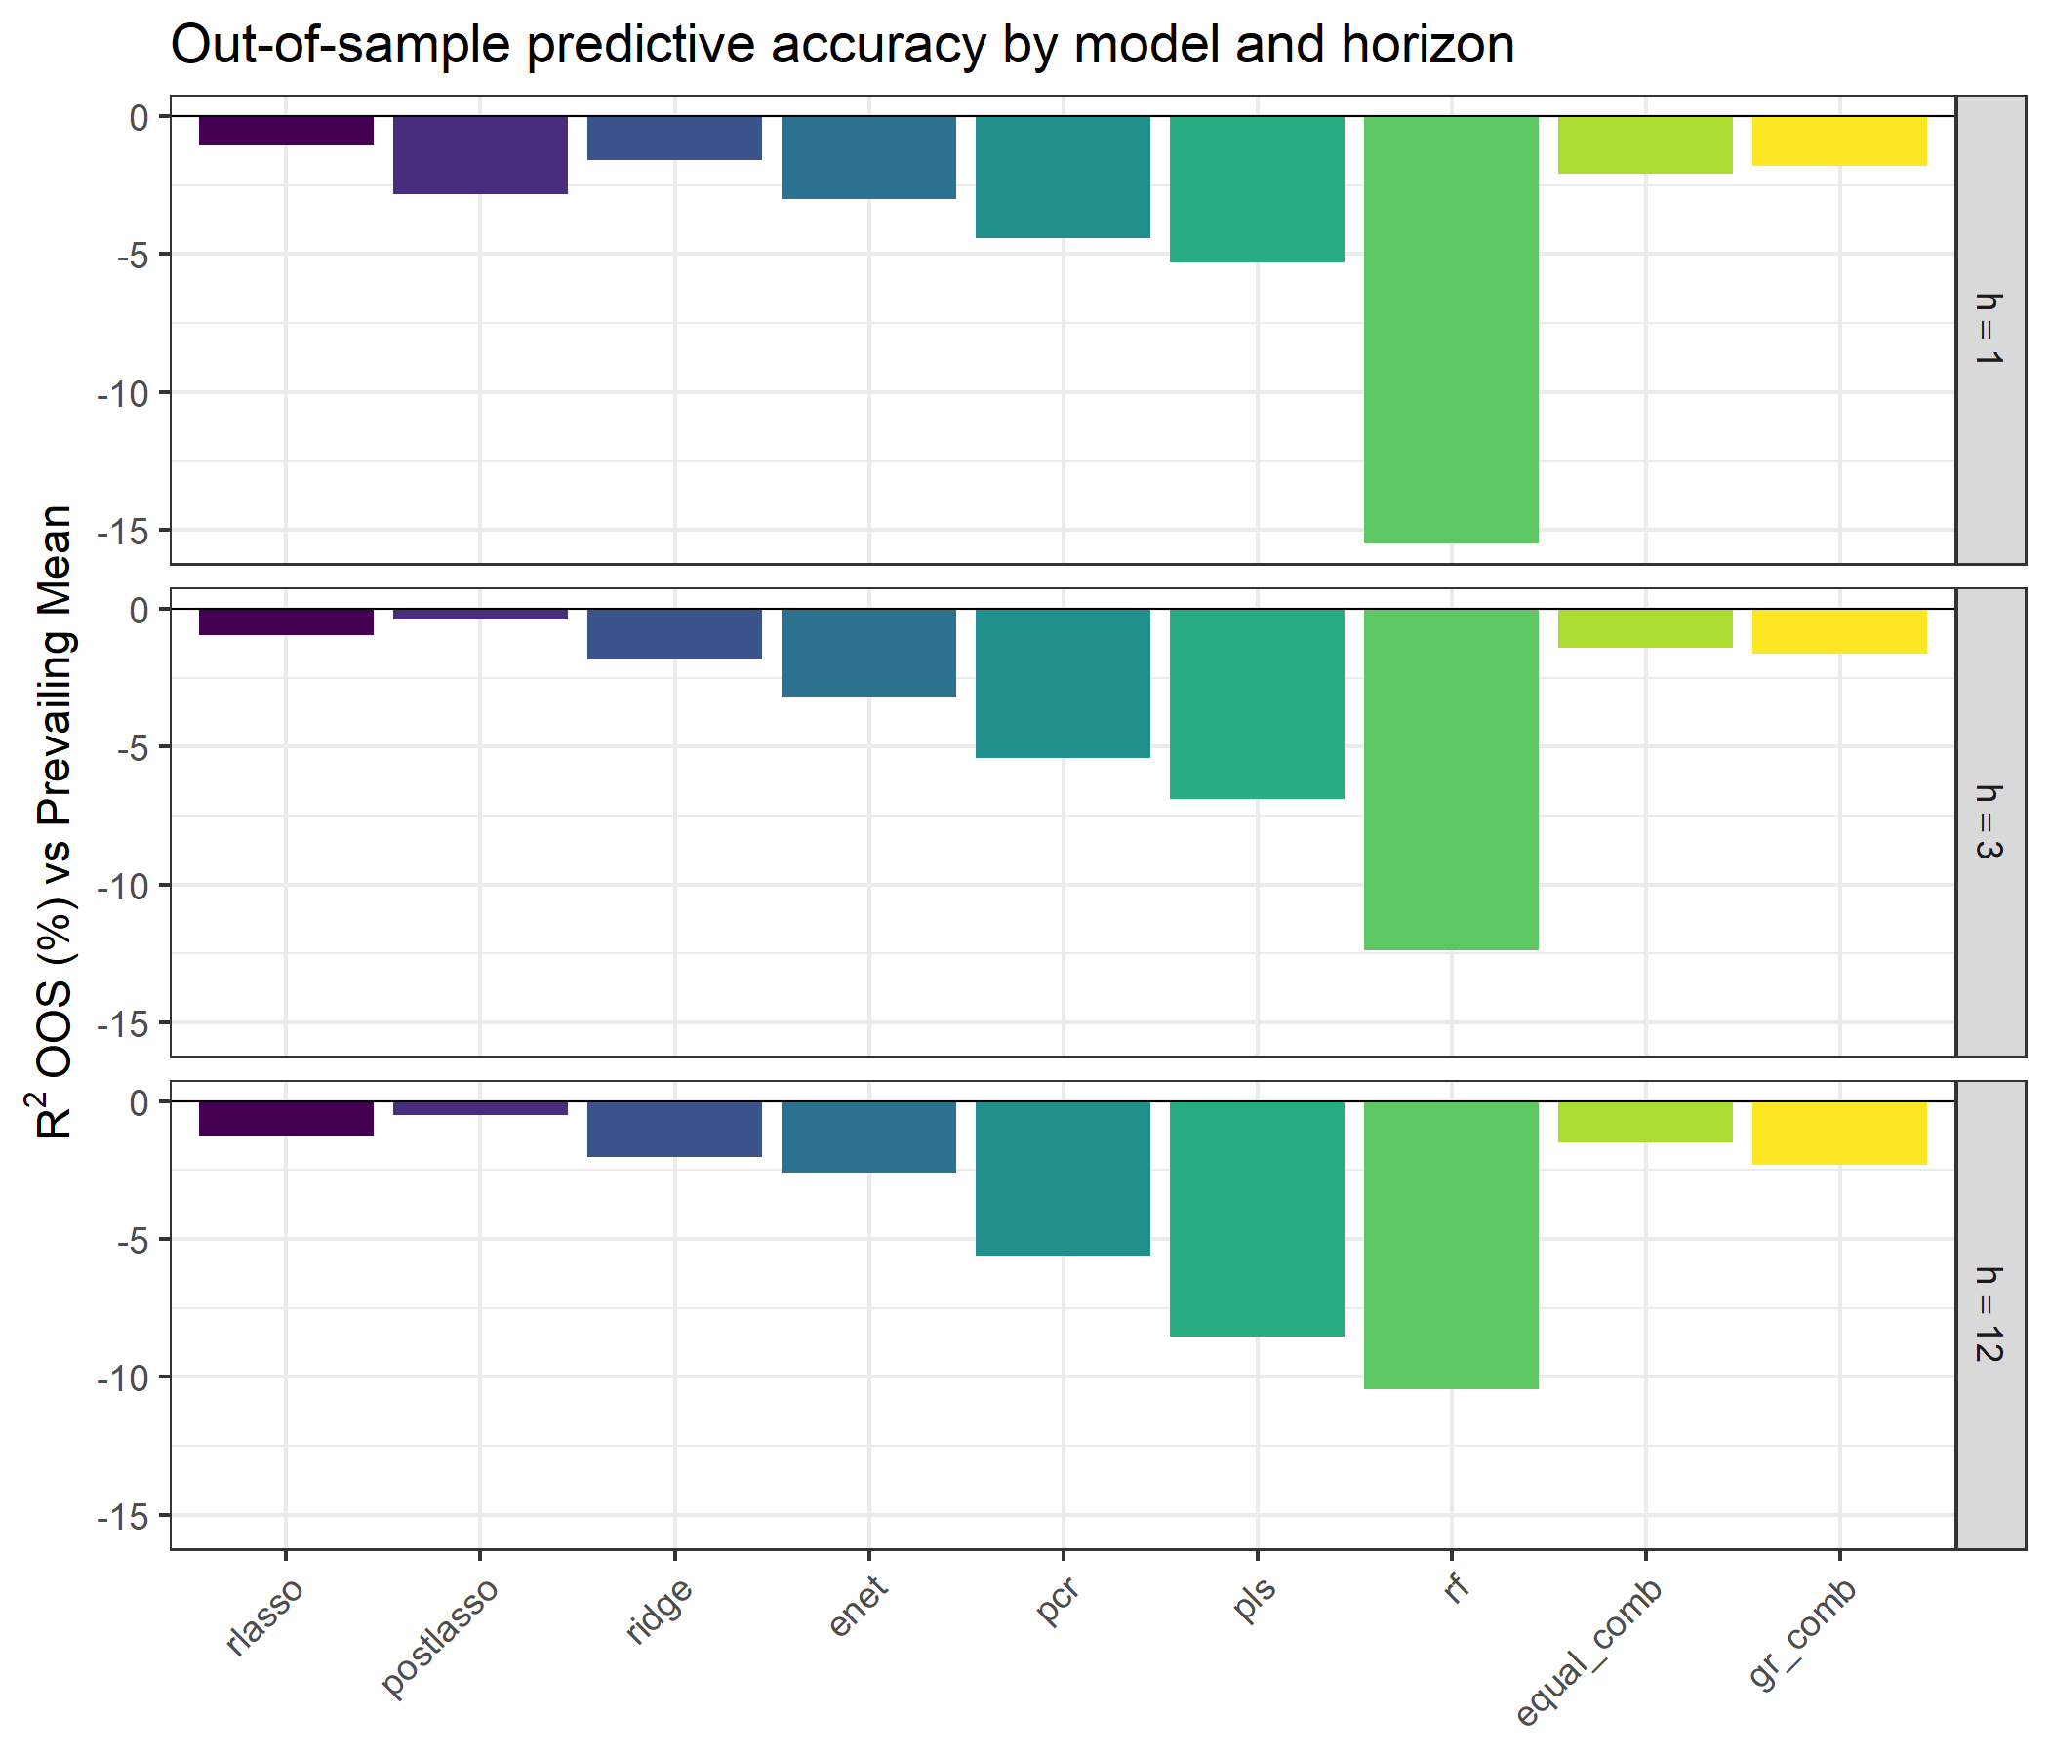
Result 1: nothing beats the prevailing mean on the extended sample
Main ML OOS targets: h=1 Mar 1971–Dec 2025; h=3 Jul 1971–Dec 2025; h=12 Jan 1973–Dec 2025
All models show NEGATIVE R²_OOS at every horizon: the Goyal–Welch result, reproduced with modern ML.
At h=1: LASSO R²_OOS = -1.056%; GR = -1.804% (PM RMSE 4.403).
h=1 hit rates: 53.5%–59.7% vs PM 59.9%.
One-sided h=1 tests show no significant improvement (minimum DM p=0.834; CW p=0.106).
R²_OOS is a descriptive comparison with the prevailing-mean benchmark; it does not establish a causal mechanism.
Notes:
Sasi (1:15): negative results are results — correct execution matters more than a positive sign. Walk through the bar chart.

Slide 7
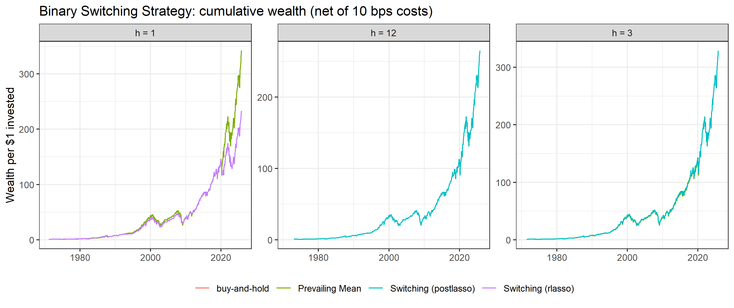
Economic strategies: negative h=1 utility gains
Switching (LASSO, 10 bps): max drawdown -44.4% vs buy-and-hold -50.2%; terminal wealth $232.7 vs $341.9.
At h=1, 10 bps net, mean–variance ΔU: LASSO -0.39%, post-LASSO -2.07%, GR -0.99% p.a.
All h=1 forecast-based mean–variance utility differences are negative; fee sensitivity is reported in the paper.
Notes:
Sasi (1:15): report the forecast-strategy results as sample estimates; distinguish wealth, drawdown, and utility.

Slide 8
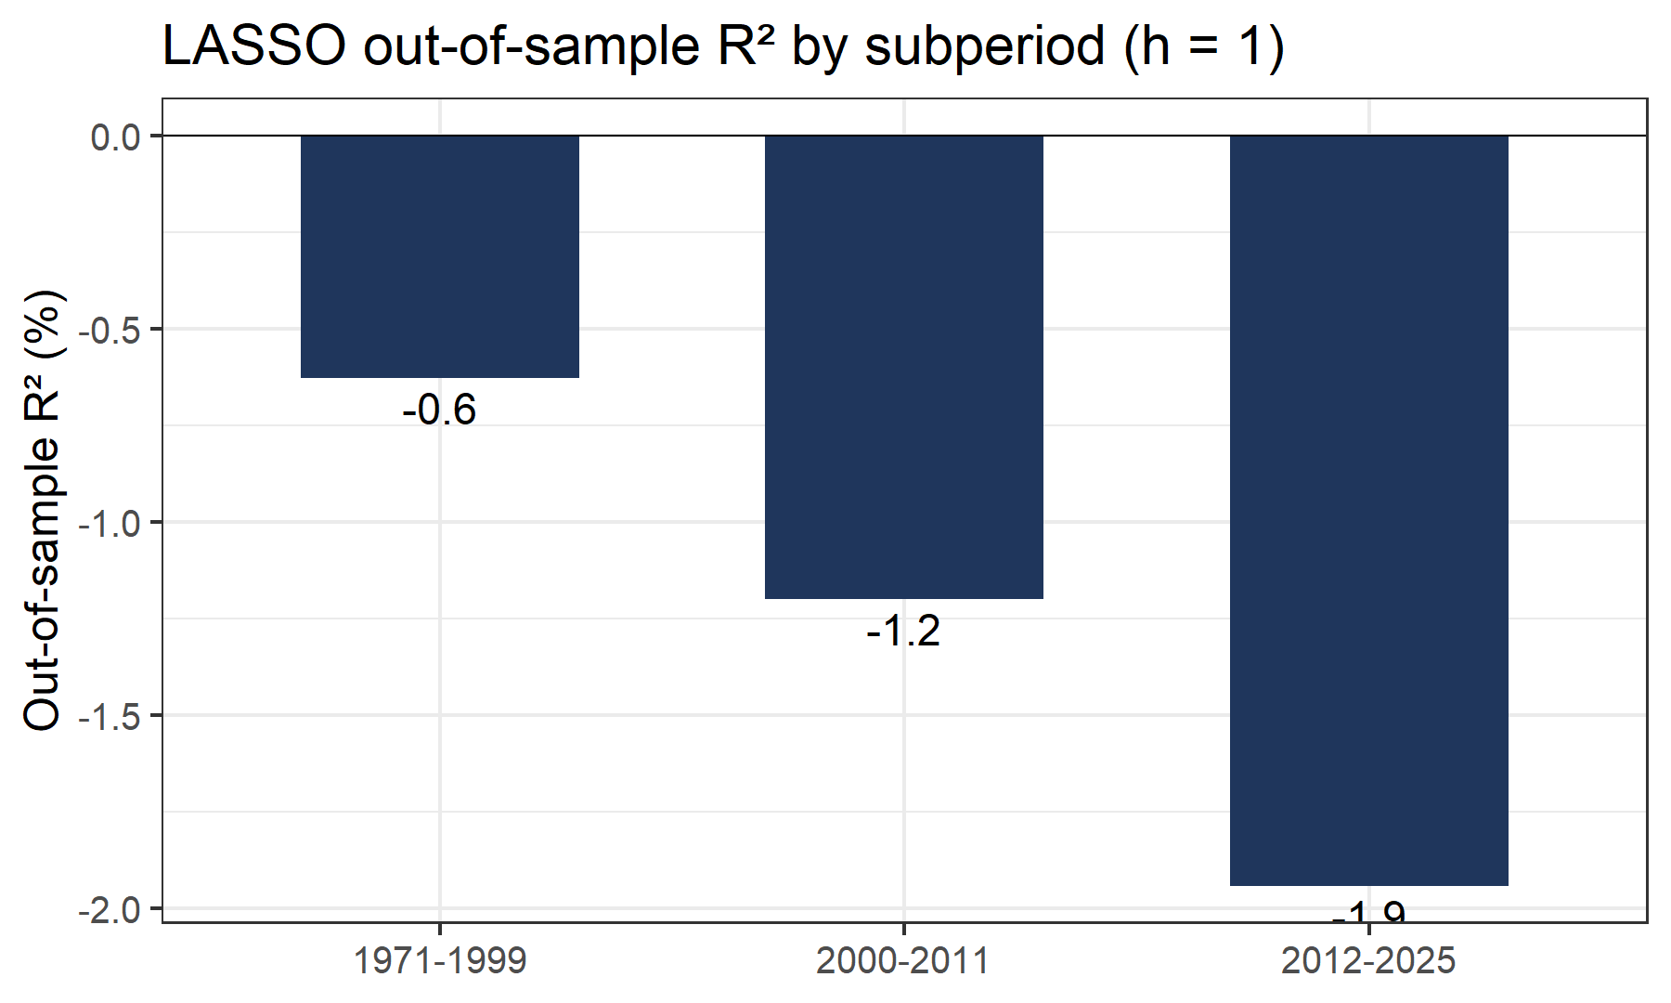
How do results vary across subperiods?
Subperiod R² comparisons are descriptive; they do not show that recessions cause changes in forecast performance.
This design does not test explanations involving passive flows or arbitrage speed.
The corrected Neely replication does not find 5% significance for the selected volume signals.
Macro-only and technical-only predictor-set comparisons are reported in the appendix.
Notes:
Vienna (1:00): describe the subperiod comparisons without presenting them as causal evidence.

Slide 9
Conclusion
We match Neely et al.'s published signals in 99.98% of signal-months; none of the six time-aligned volume rules is significant at 5%.
Extended to 2025, all model R² estimates are negative; one-sided tests show no significant accuracy improvement, and hit rates are close to but not uniformly below the benchmark.
At h=1, the LASSO switching strategy has lower terminal wealth than buy-and-hold and a modestly smaller maximum drawdown; mean-variance ΔU is negative.
The corrected results do not support claiming that forecast-based strategies improve point accuracy or mean-variance utility.
Notes:
Vienna (0:45): wrap-up, hand over to Q&A.

Slide 10
Thank you — questions?
Notes:
All four members (2:00): En Shao on model choices, Sasi on evaluation details, Leon on data, Vienna on interpretation.

