Slide 1
Forecasting the Equity Risk Premium Out-of-Sample:
Regularized ML, Technical Indicators & Tactical Asset Allocation
EC4308 Machine Learning and Economic Forecasting — Group Project (Week 13)
Leon • En Shao • Sasinthiran Kannan • Vienna
Notes:
Vienna (0:45): title, the Goyal-Welch puzzle in one sentence, roadmap of the talk.

Slide 2
Motivation: Can anything beat the historical average?
Goyal–Welch (2008, 2024) vs Neely, Rapach, Tu & Zhou (2014)
The equity premium is the single most important input for portfolio choice — 1 month of lead time is economically valuable.
Goyal & Welch: essentially no macro fundamental beats the prevailing mean out-of-sample; Goyal–Welch–Zafirov (2024) reach the same conclusion with an expanded dataset of 57 monthly series.
Neely et al. (2014): 14 technical indicators (MA, MOM, OBV) DO predict the premium out-of-sample on 1966–2011.
Our question: with modern regularized ML, do technical indicators + macro lags beat the prevailing mean on the extended 1951–2025 sample?
We replicate Neely et al. exactly (signals match 99.98%), then extend the sample to 2025.
Notes:
Vienna (1:00): set up the puzzle. Emphasise: replication first, extension second.

Slide 3
Data: 899 months, 98 predictors, zero lookahead
Target: monthly log equity premium (%), y = 100·(ln(1+Rᵐ) − ln(1+Rᶠ)), S&P 500 over the risk-free rate.
Macro: the 14 Goyal–Welch predictors, each with lags 1–6 → 84 columns.
Technical: 14 binary Neely signals — 6 MA, 2 MOM, 6 OBV — computed from raw index level + S&P 500 volume.
Sample: 1951-02 → 2025-12; predictors aligned to 'observable at end of month t' — no lookahead leakage.
Validation: our computed signals match the published Neely series in 99.98% of signal-months (12/14 exact).
Fixed 240-month rolling window; first OOS forecast 1971-02; n = 659 OOS months at h = 1.
Notes:
Leon (1:15): data sources, alignment convention, the 99.98% validation number, sample dates.

Slide 4
Methods: 7 models + 2 combinations vs the prevailing mean
Benchmark: prevailing (historical) mean — the only admissible benchmark.
Models (same 98-predictor matrix, re-estimated every window):
  LASSO (hdm, theoretical penalty — no CV) & post-LASSO
  Ridge and Elastic Net (glmnet, 10-fold CV inside the window)
  PCR & PLS (CV-selected components) • Random Forest (500 trees, fixed seed)
Combinations: equal-weight 1/N and constrained Granger–Ramanathan (Σw=1, w≥0, weights from past OOS errors only).
Horizons h ∈ {1, 3, 12}; DM (1995) tests with HAC lag h−1; Clark–West as appendix check.
Notes:
En Shao (1:30): one line per method, stress the no-lookahead CV protocol and the GR constraint.

Slide 5
Step 1: we replicate Neely et al. (2014) — their result survives
Expanding-window bivariate regressions, one signal at a time, Clark–West test
On their 1966–2011 sample: VOL_2_12 R²_OOS = +0.661% (CW p = 0.0152), VOL_3_12 = +0.762% (p = 0.0294) — positive and significant, same sign and order of magnitude as published (+0.33%).
Volume-based (OBV) signals carry the predictive content; MA/MOM are weaker — the same pattern as the paper.
This validates our data pipeline and test implementation before we extend the sample.
Extension 2012–2025: every signal turns negative/insignificant (VOL_3_12 = -1.282%, p = 0.429).
Notes:
Sasi (1:15): replication = credibility. Show the numbers side by side with the published ones.

Slide 6
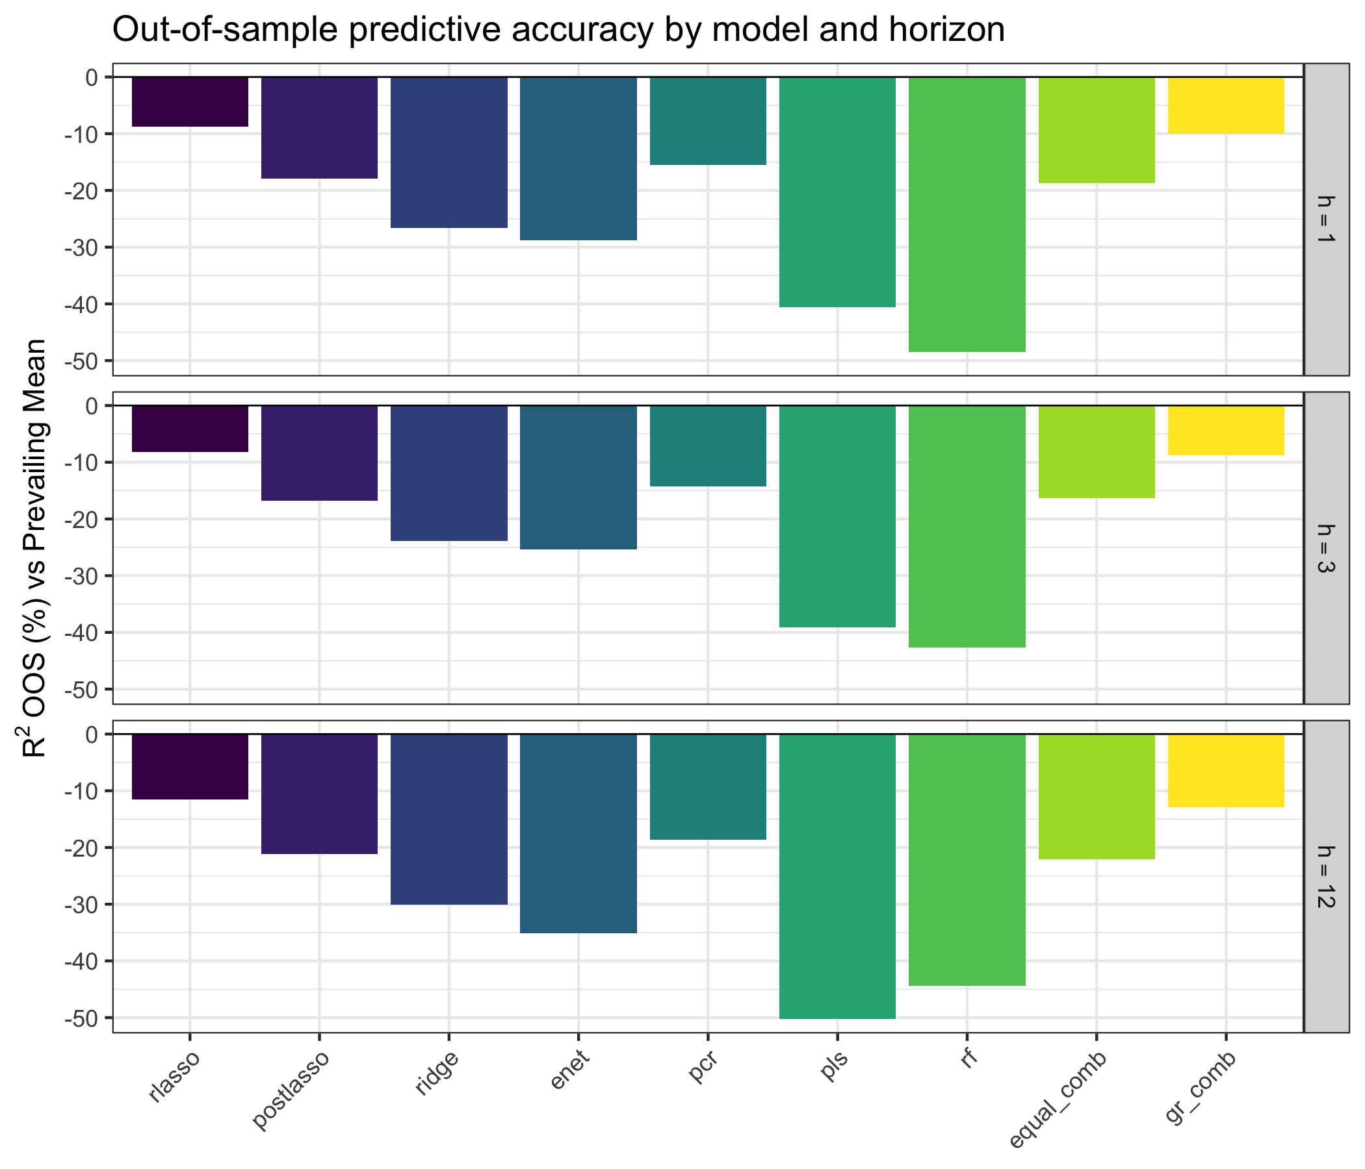
Result 1: nothing beats the prevailing mean on the extended sample
All models show NEGATIVE R²_OOS at every horizon: the Goyal–Welch result, reproduced with modern ML.
Best at h=1: GR combination R²_OOS = -10.037%, rlasso = -8.786% (PM RMSE 4.40 vs 4.614).
Hit rates 54–58% vs PM 60% — the direction of the premium is also hard to call.
Post-2000 (and post-2011) predictability decay drives the result: the information is real but transient.
Notes:
Sasi (1:15): negative results are results — correct execution matters more than a positive sign. Walk through the bar chart.

Slide 7
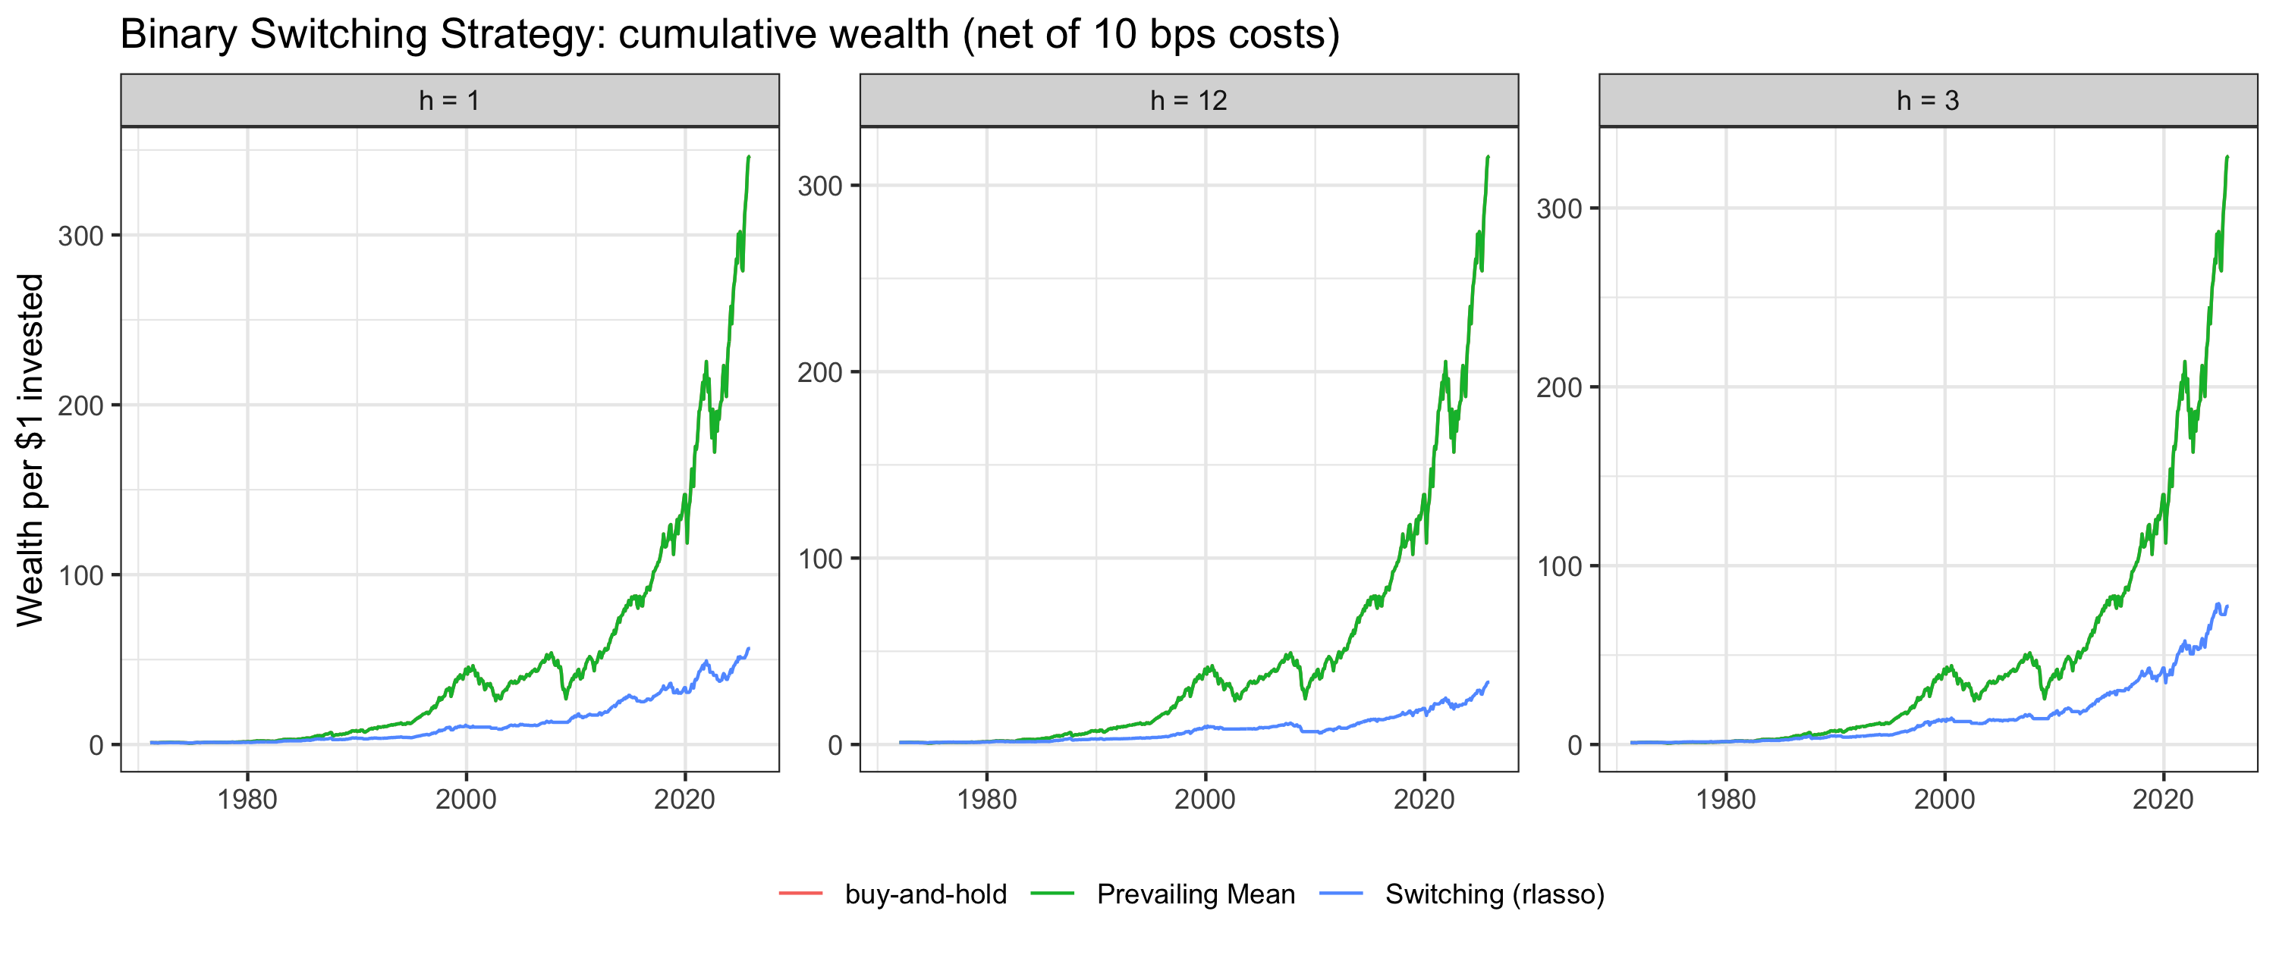
Result 2: forecasts still have economic value — drawdown control
Switching (10 bps): model strategies cap the max drawdown at -23% vs buy-and-hold -50%; terminal wealth $67.651 vs $346.470262259372 for buy-and-hold.
Mean–variance investor (γ=3): post-LASSO ΔU = +1.31% p.a., rlasso +1.22% p.a., GR +1.06% p.a. (10 bps net).
Forecasts earn their keep as risk-management signals, not as point-forecast improvements.
Notes:
Sasi (1:15): Sharpe vs wealth trade-off; ΔU interpretation; fee sensitivity 5/20 bps in the report.

Slide 8
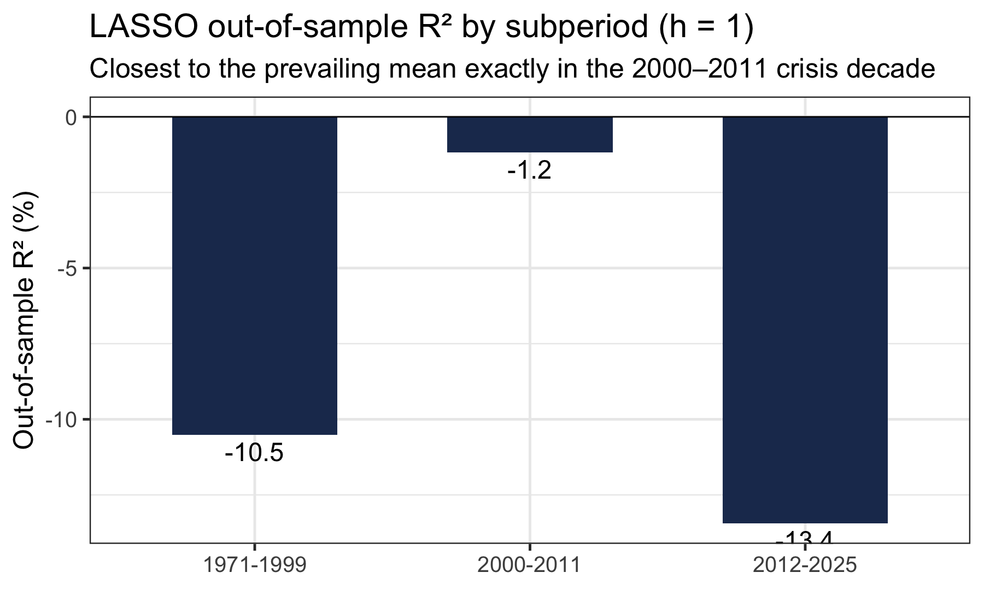
Why did predictability decay?
Recession months drive the signal value: volume/MA rules earn their R² in a handful of crisis months (2000–02, 2008–09).
Post-2011: fewer deep drawdowns, a passive-dominated market, and faster arbitrage of published signals.
Regularized multivariate fits overfit relative to the simple bivariate design — shrinkage toward the mean is aggressive.
Consistent with Goyal–Welch–Zafirov (2024): the premium remains extremely hard to predict out-of-sample.
Notes:
Vienna (1:00): economic interpretation, connect to the literature.

Slide 9
Conclusion
We reproduce Neely et al. (2014) faithfully (99.98% signal match; positive VOL-signal R²_OOS on 1966–2011).
Extended to 2025, no model — regularized, tree-based, or combined — beats the prevailing mean on RMSE/MAE or direction.
Economic value persists: switching halves the max drawdown; MV gains of +1.2–1.5% p.a. net of costs.
Lesson: honest evaluation, disciplined windows and costs matter more than model complexity.
Notes:
Vienna (0:45): wrap-up, hand over to Q&A.

Slide 10
Thank you — questions?
Notes:
All four members (2:00): En Shao on model choices, Sasi on evaluation details, Leon on data, Vienna on interpretation.

