Slide 1
bluestock_mutual_funds_dashboard
File created on: 09/06/26 12:11:50 am IST

Slide 2
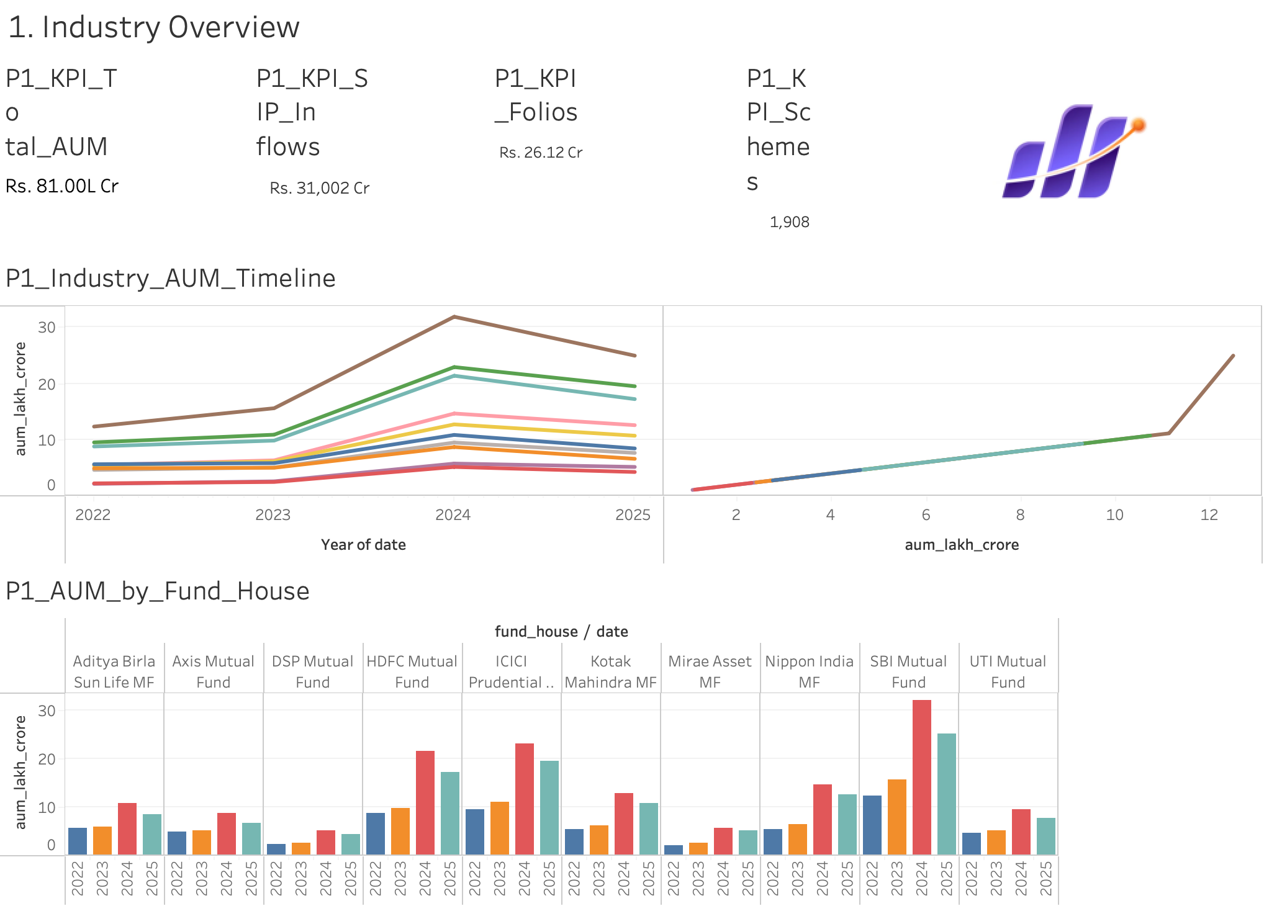

Slide 3
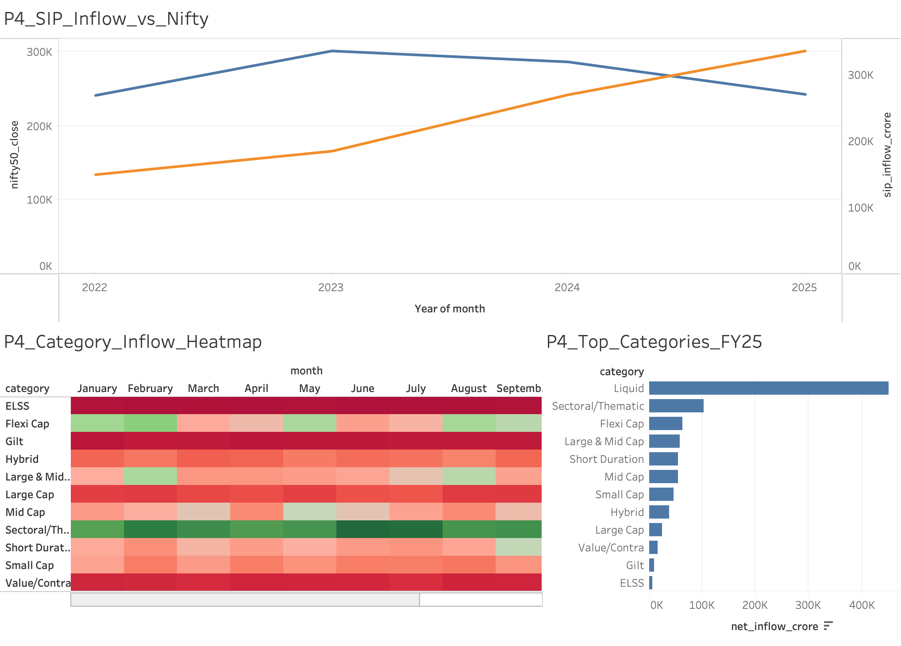

Slide 4
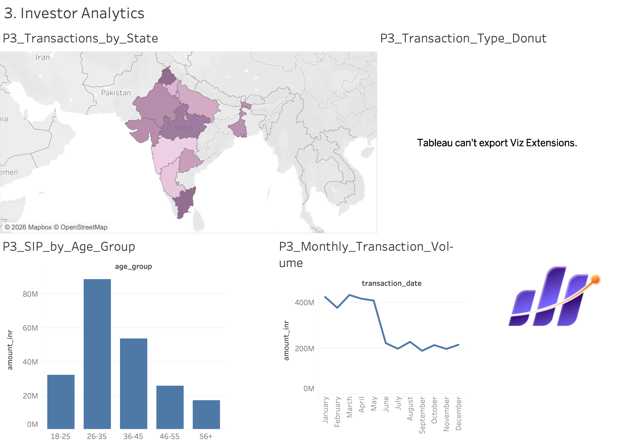

Slide 5
