Slide 1
Bluestock Mutual Fund Capstone
Data Analytics — Final Presentation
Prepared by: Atharva Ranjan | June 2026

Slide 2
Problem & Objective
The Indian mutual fund industry manages Rs 81+ lakh crore across 1,900+ schemes. Fund selection requires comparing NAV trends, risk metrics, and manager performance across complex, fragmented datasets.
Project Objectives
Build an end-to-end ETL pipeline from raw CSVs to a star-schema warehouse
Clean and validate 10 datasets with 100K+ records
Perform exploratory analysis with 18 publication-quality charts
Compute fund scorecards with CAGR, Sharpe, Alpha, and drawdown metrics
Deliver an interactive 4-page Tableau dashboard
Advanced analytics: VaR/CVaR, rolling Sharpe, investor cohorts, HHI

Slide 3
Data Sources
01 Fund Master — 40 schemes, fund houses, categories, risk grades
02 NAV History — 46K daily NAV records → 64K after calendar fill
03 AUM by Fund House — quarterly AUM across 10 fund houses
04 Monthly SIP Inflows — 48 months of SIP trend data
05 Category Inflows — monthly net flows by fund category
06 Industry Folio Count — total folio growth metrics
07 Scheme Performance — returns, alpha, beta, Sharpe for 40 funds
08 Investor Transactions — 50K transactions with demographics
09 Portfolio Holdings — stock-level fund compositions
10 Benchmark Indices — NIFTY50, NIFTY100 daily closes
Live Feed: mfapi.in — 6 bluechip scheme NAVs

Slide 4





Architecture & ETL Flow
Raw CSVs (10 files)
Python Cleaning
Processed CSVs
SQLite Star Schema
Analytics & Dashboard
Star Schema: dim_fund, dim_date → fact_nav, fact_transactions, fact_performance, fact_aum
11 SQLite tables with foreign-key integrity
Calendar forward-fill: 46K → 64K NAV rows
Automated quality reports with validation checks
Master pipeline: run_pipeline.py with 10 stages

Slide 5
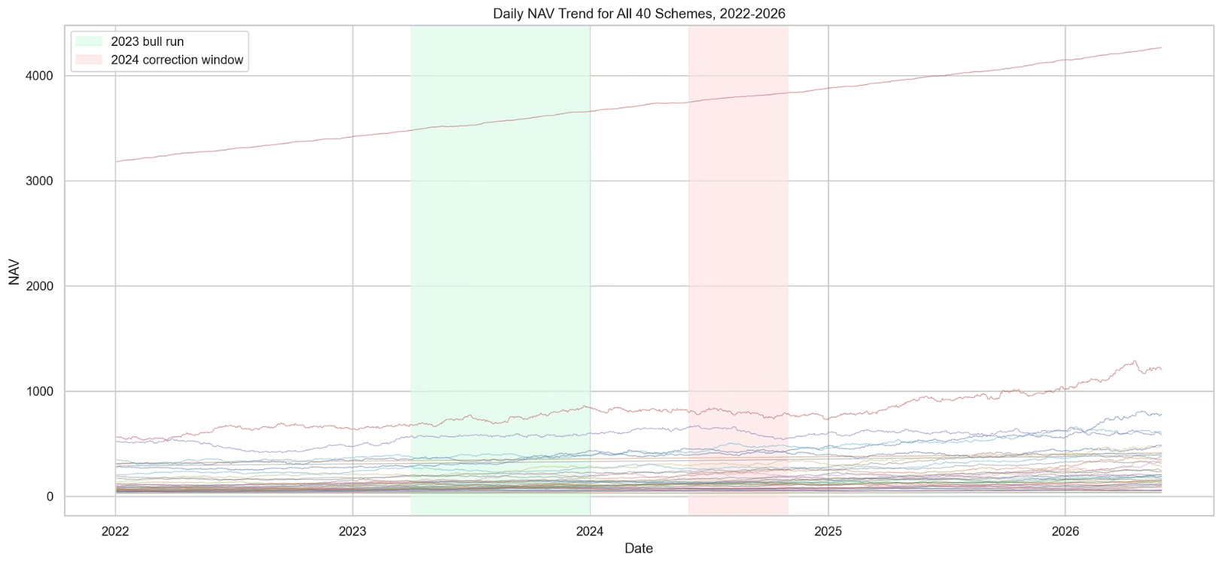
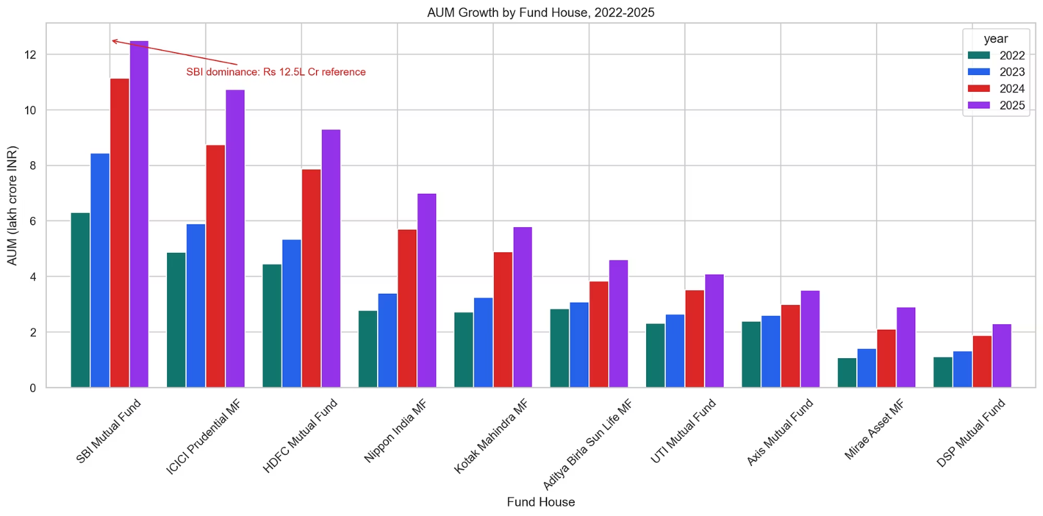
EDA Highlights — NAV & AUM
2023 bull-run and 2024 correction windows clearly visible in NAV trends
SBI Mutual Fund dominates AUM — Rs 12.5 lakh crore reference marker

Slide 6
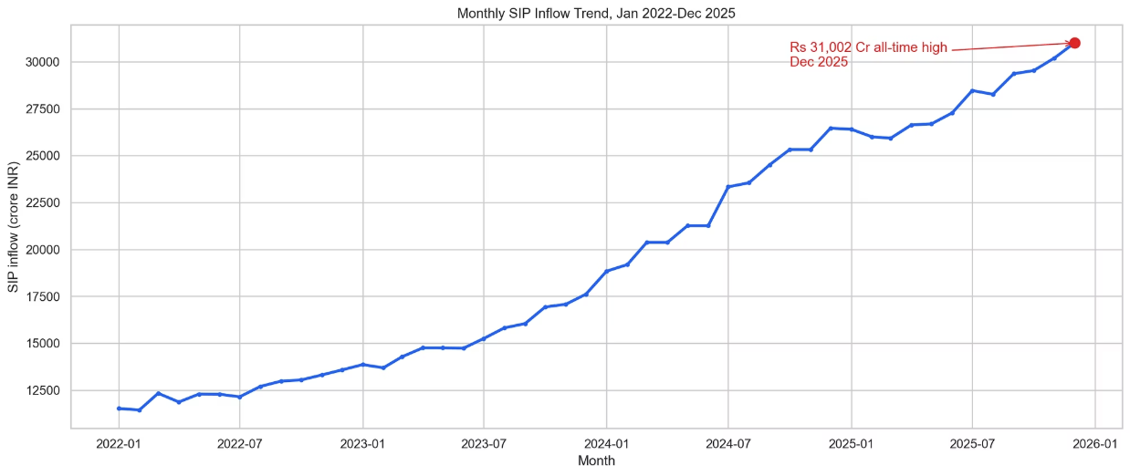
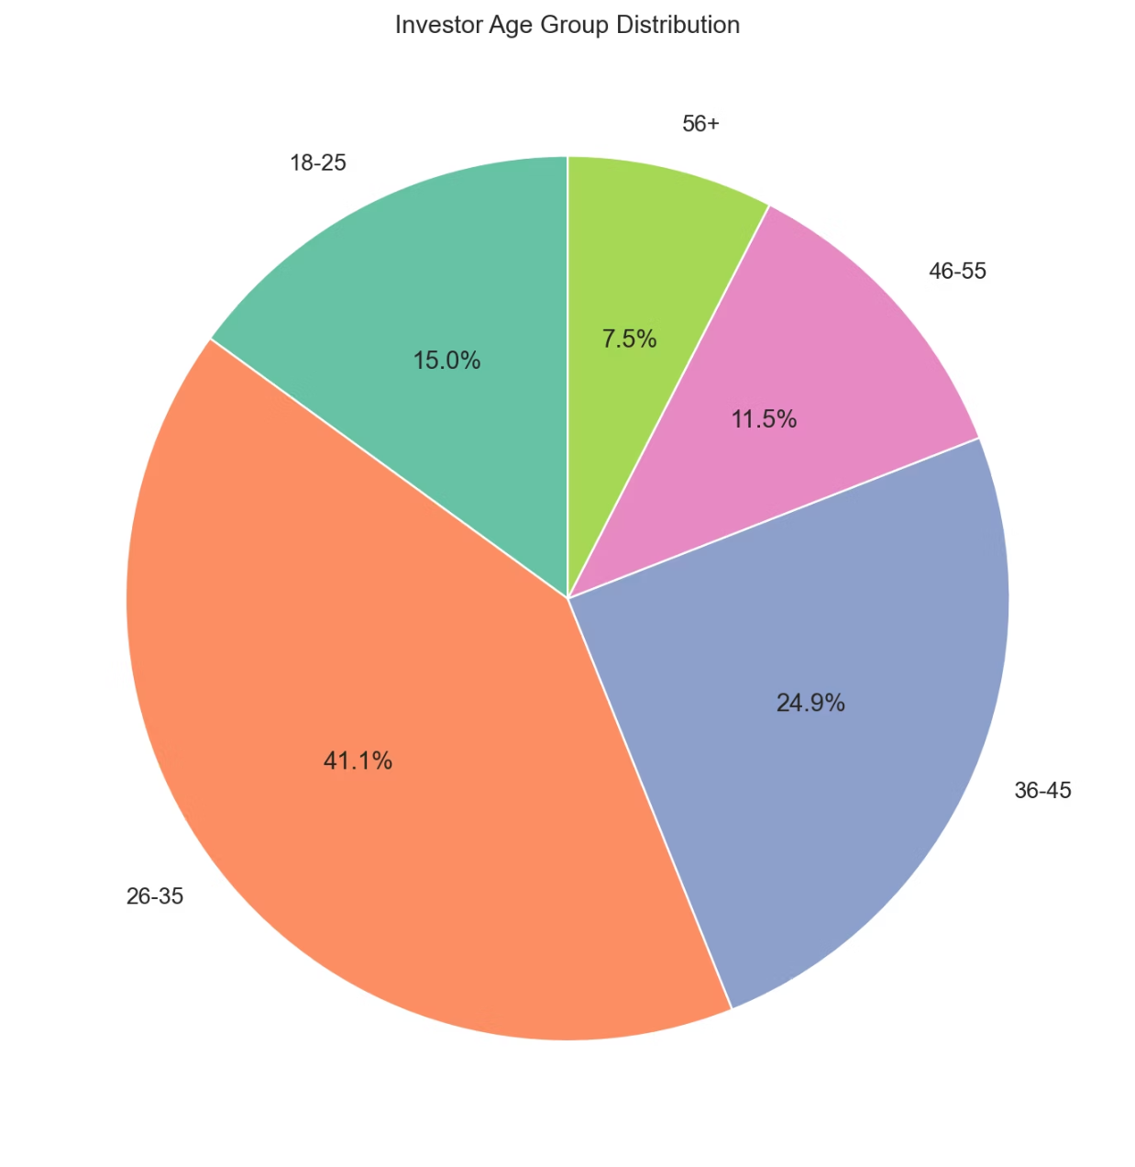
EDA Highlights — SIP & Demographics
SIP inflows reached Rs 31,002 Cr all-time high in December 2025
Investor participation distributed across multiple age bands
Industry folios doubled from 13.26 Cr to 26.12 Cr

Slide 7
Performance Metrics — Scorecard
Composite 0–100 Fund Score = 30% CAGR + 25% Sharpe + 20% Alpha + 15% Expense + 10% Drawdown
1-year and 3-year NAV CAGR computed for all 40 funds
Sharpe Ratio using 6.5% annual risk-free rate proxy
Sortino Ratio using downside-only daily volatility
Alpha and Beta via OLS regression against NIFTY100
Maximum drawdown with peak, trough, and recovery dates
Tracking error vs NIFTY50 and NIFTY100 for top 5 funds
5-year CAGR flagged as unavailable (data starts Jan 2022)

Slide 8
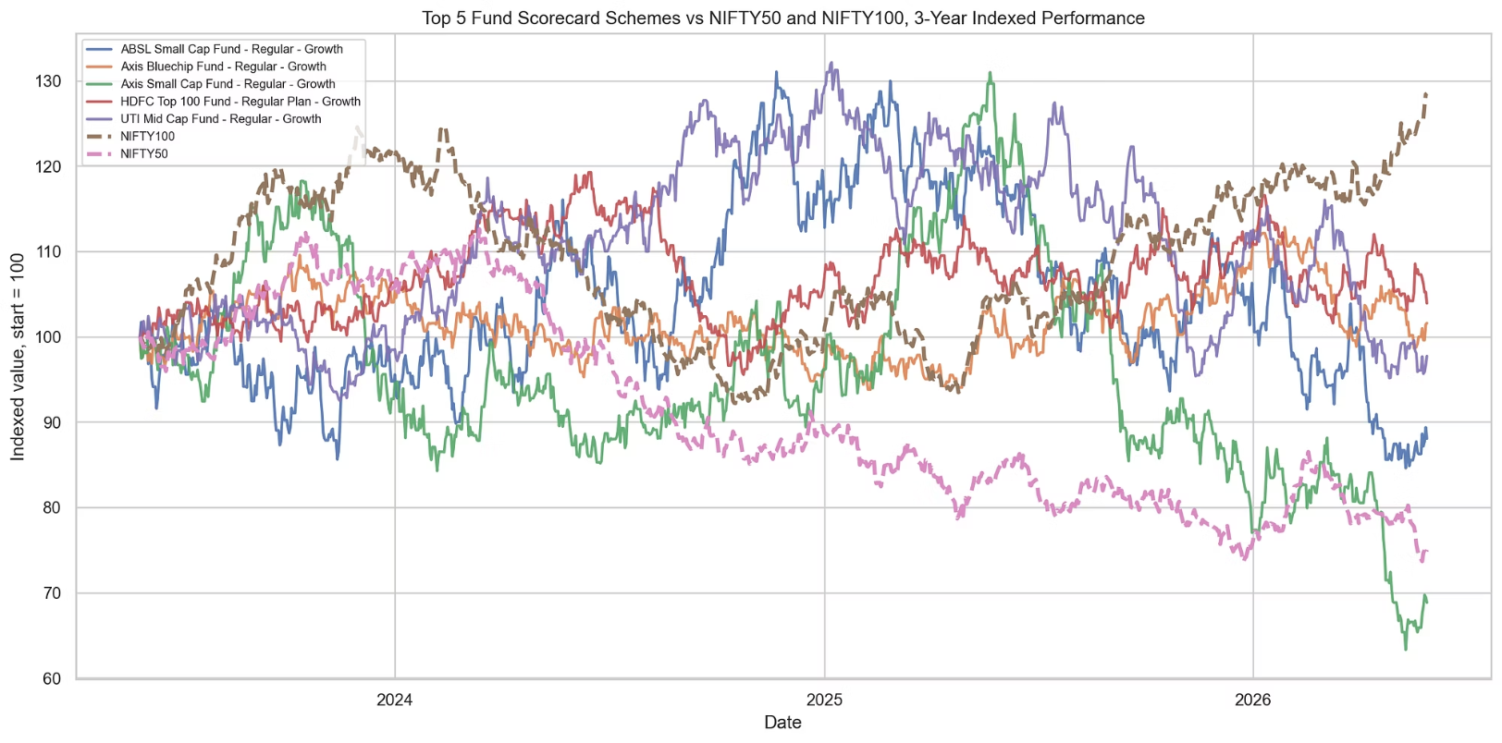
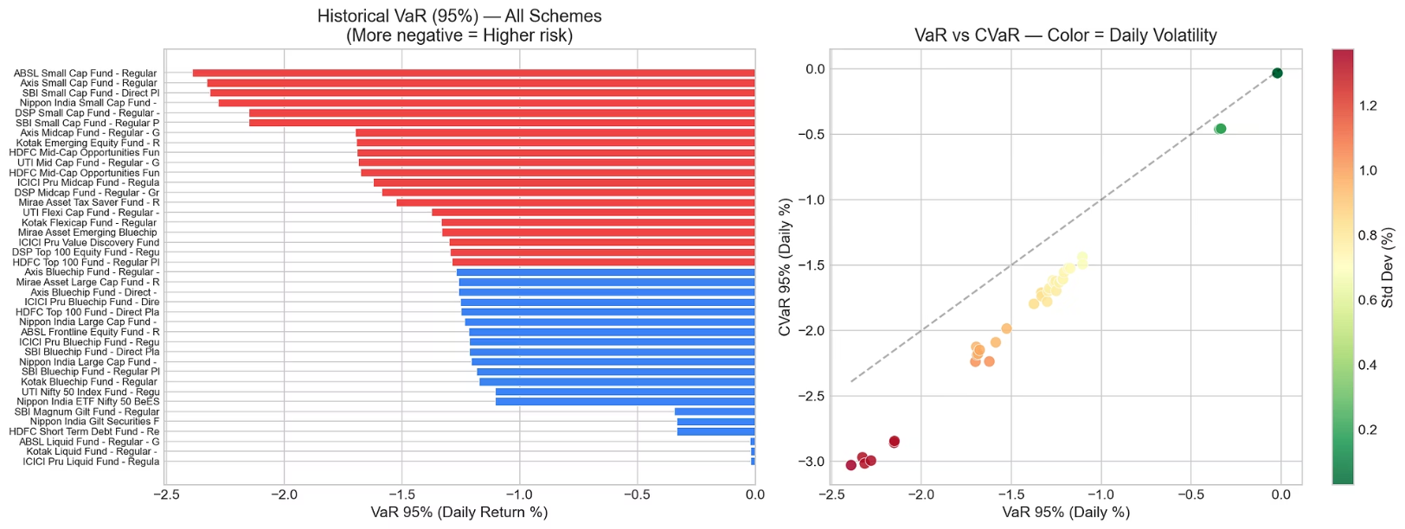
Benchmark Comparison & Risk
Top 5 scorecard funds outperformed both NIFTY50 and NIFTY100 benchmarks
VaR (95%) and CVaR computed for all 40 schemes for tail-risk assessment

Slide 9
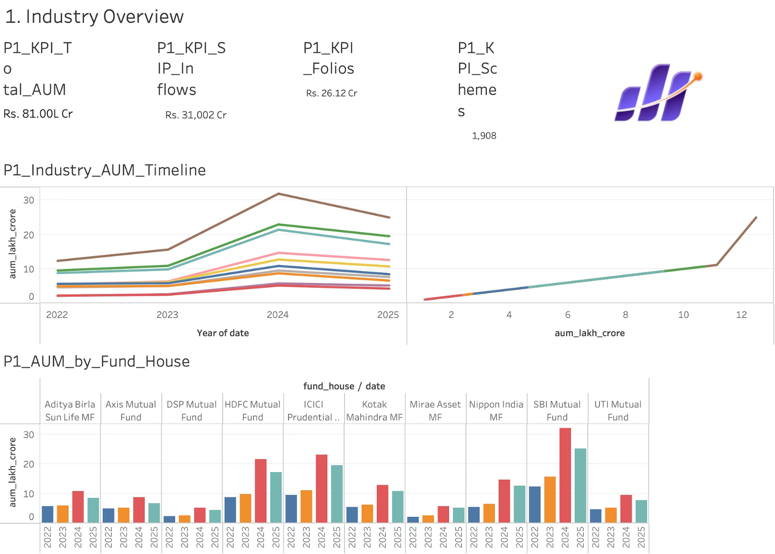
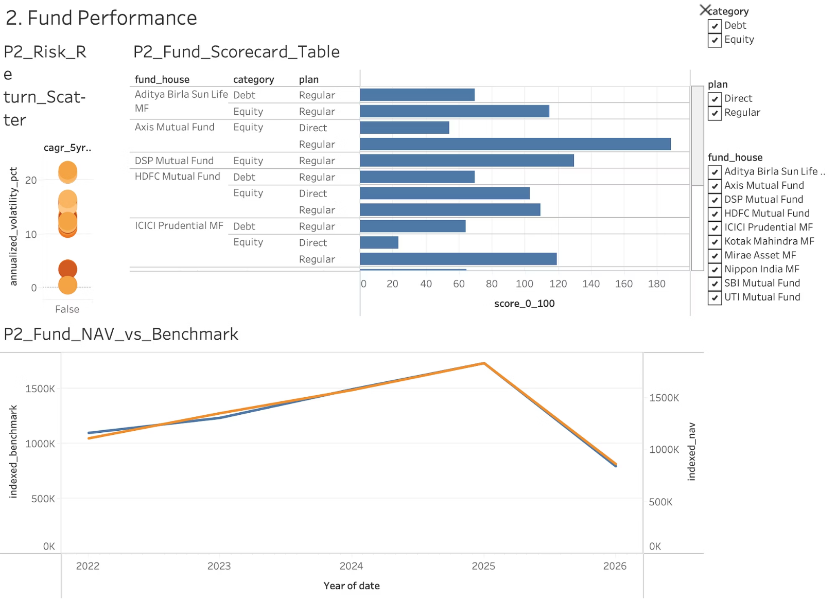
Dashboard — Industry & Performance
Page 1: Industry Overview
Page 2: Fund Performance

Slide 10
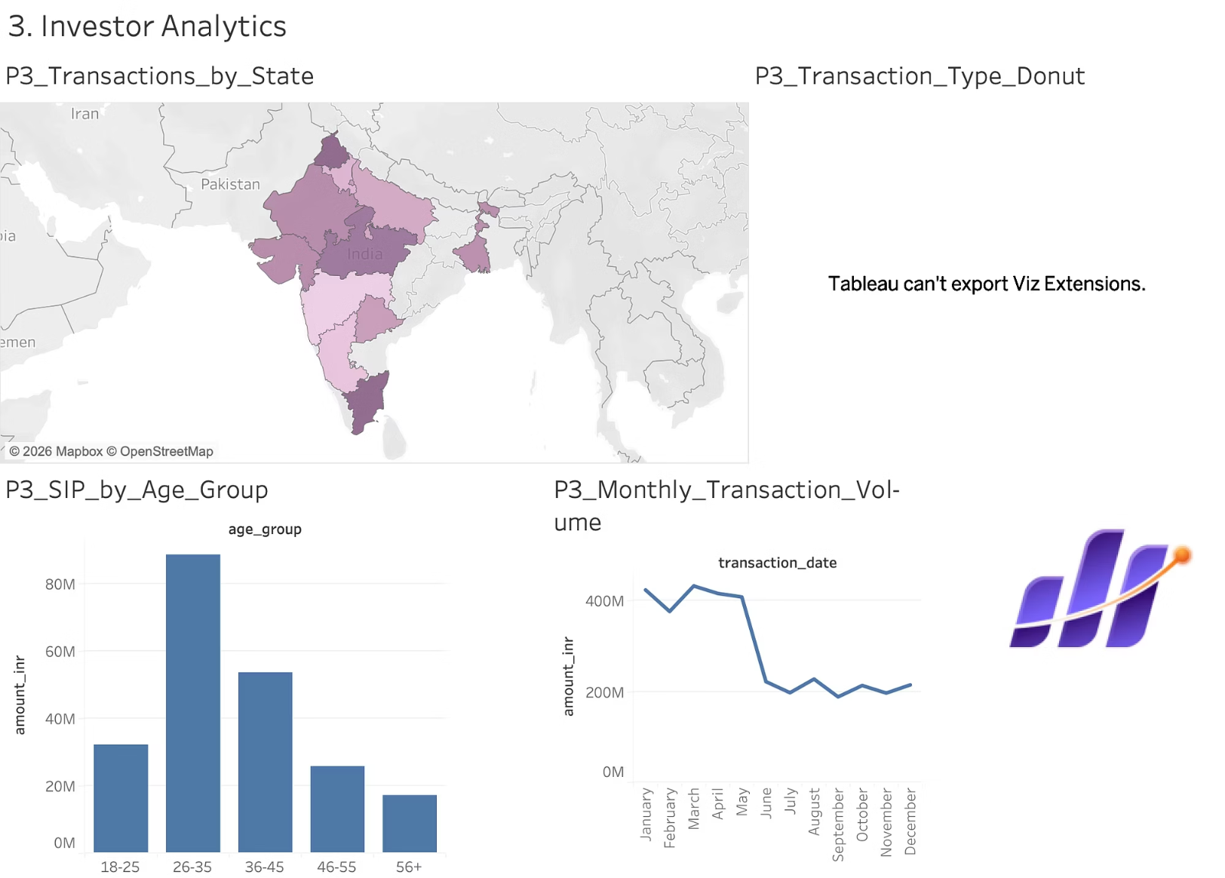
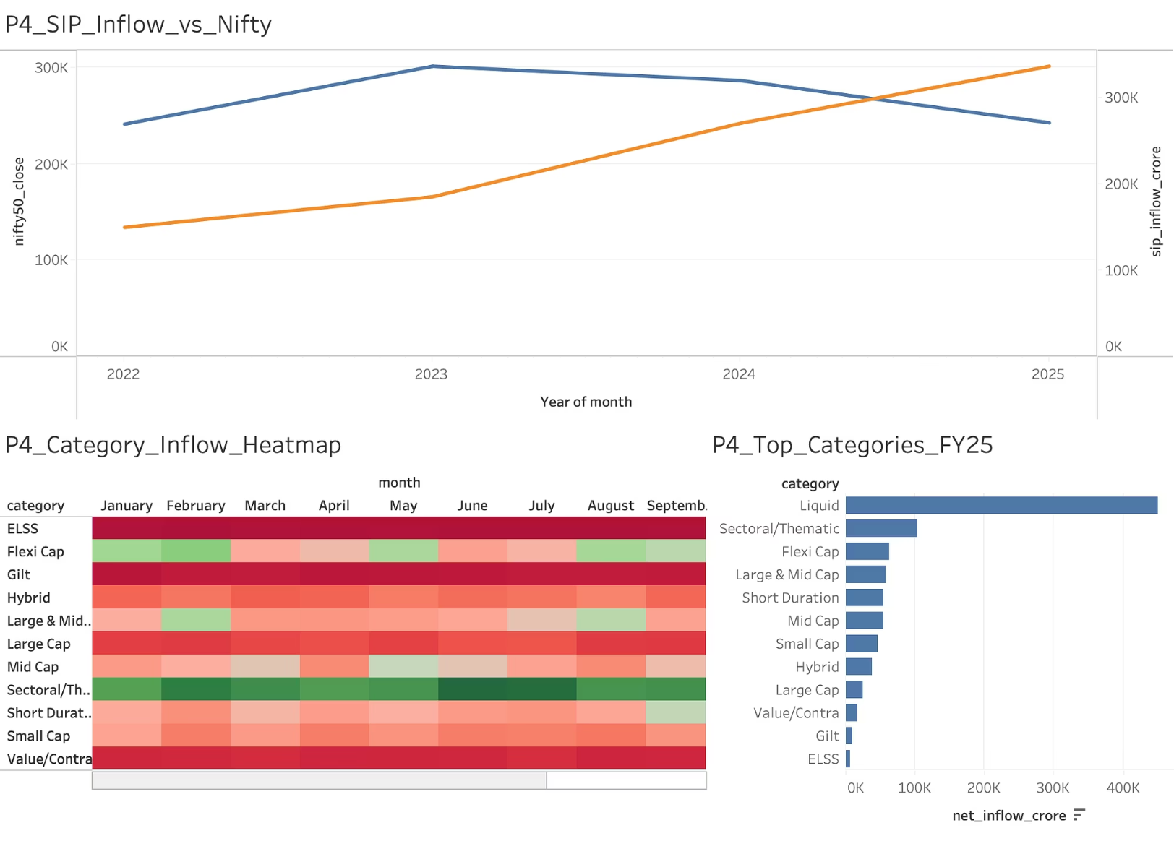
Dashboard — Investors & Market
Page 3: Investor Analytics
Page 4: SIP & Market Trends

Slide 11
Key Findings
SBI Mutual Fund leads with highest AUM; top 3 fund houses control >50% of industry AUM
SIP inflows grew 67% over 4 years, reaching Rs 31,002 Cr in Dec 2025
Industry folios nearly doubled (13.26 Cr → 26.12 Cr), showing strong retail adoption
Equity funds dominate category inflows; debt categories show seasonal volatility
Top-scored funds consistently outperformed NIFTY50 and NIFTY100 benchmarks
Forward-filled NAV data enabled accurate daily return and CAGR calculations
Alpha analysis revealed most equity funds have positive alpha vs NIFTY100
HHI analysis shows moderate sector concentration in most equity portfolios

Slide 12
Thank You
Bluestock Mutual Fund Capstone Project
Prepared by: Atharva Ranjan
GitHub: github.com/sastarogers/Bluestock_MF_Capstone_Project
June 2026

