Slide 1
24BAD106_TLAB7
File created on: 15-08-2026 12:19:32

Slide 2
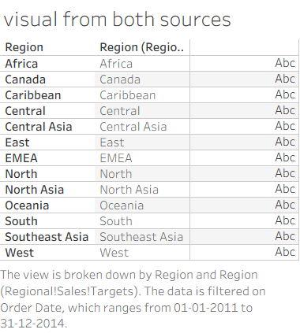

Slide 3
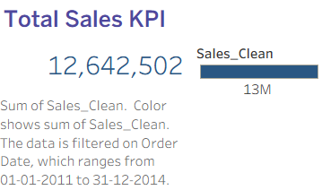

Slide 4
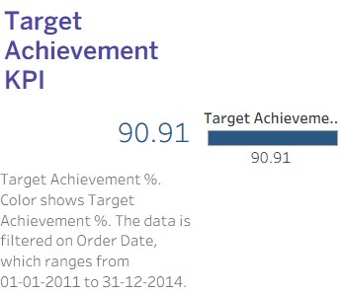

Slide 5


Slide 6
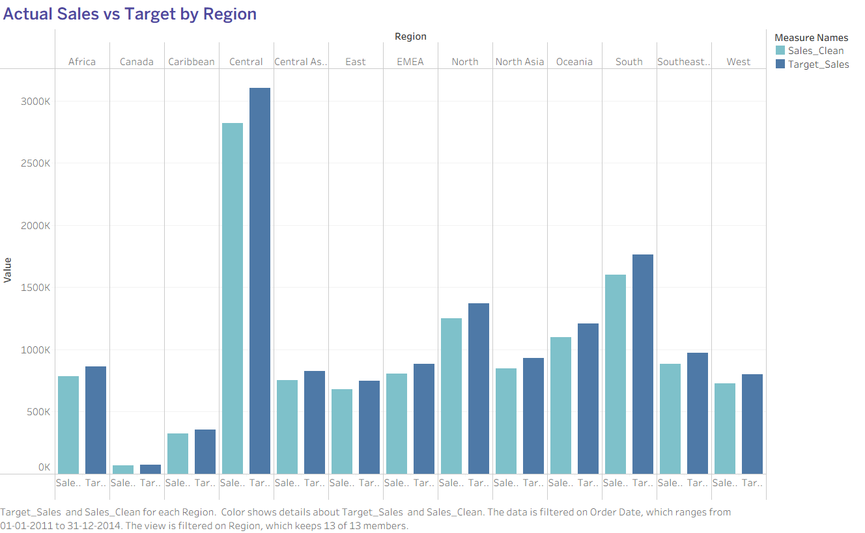

Slide 7
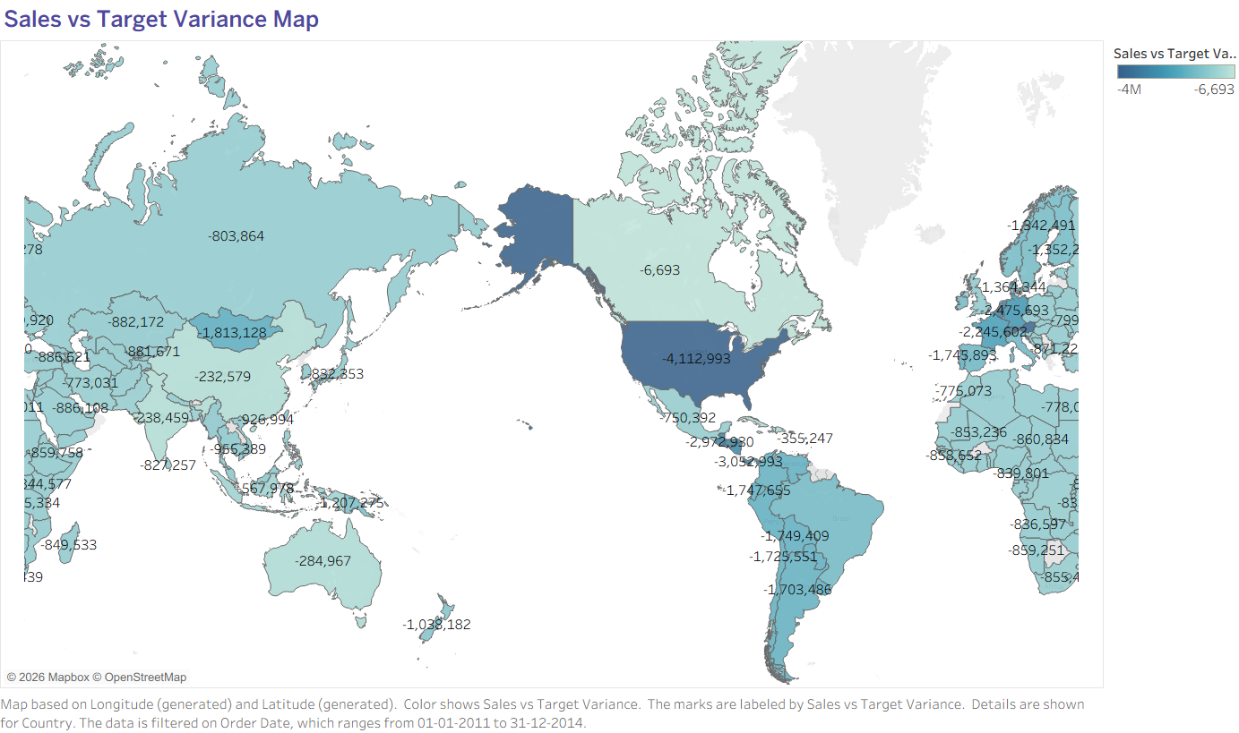

Slide 8
