Slide 1
24BAD106_TLAB8
File created on: 19-08-2026 19:01:19

Slide 2
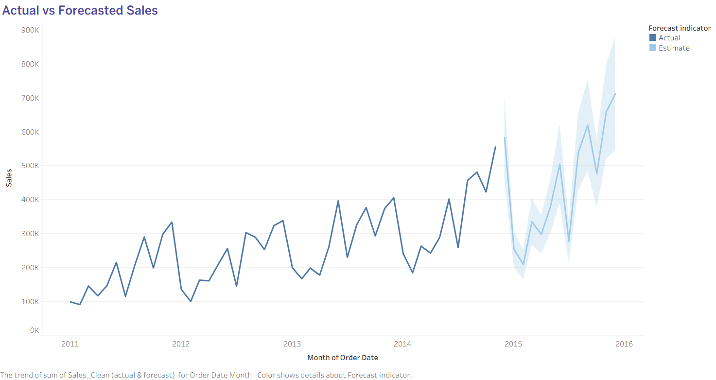

Slide 3
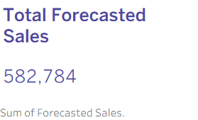

Slide 4


Slide 5
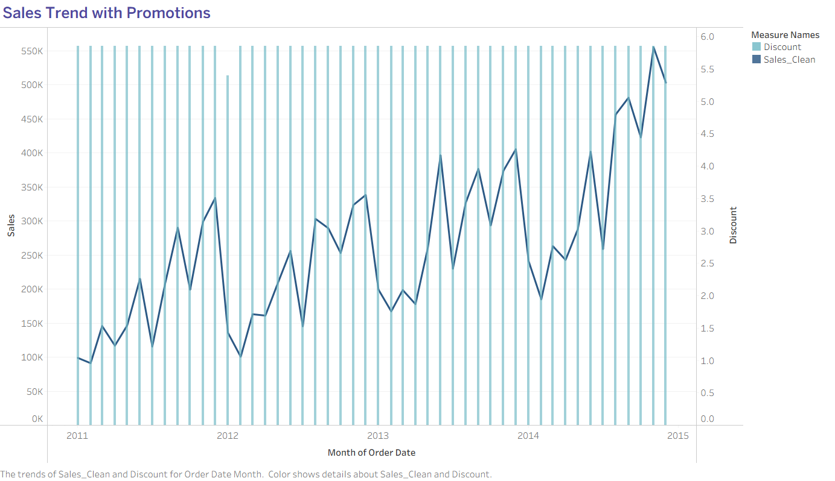

Slide 6
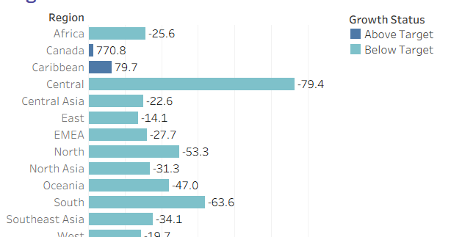

Slide 7
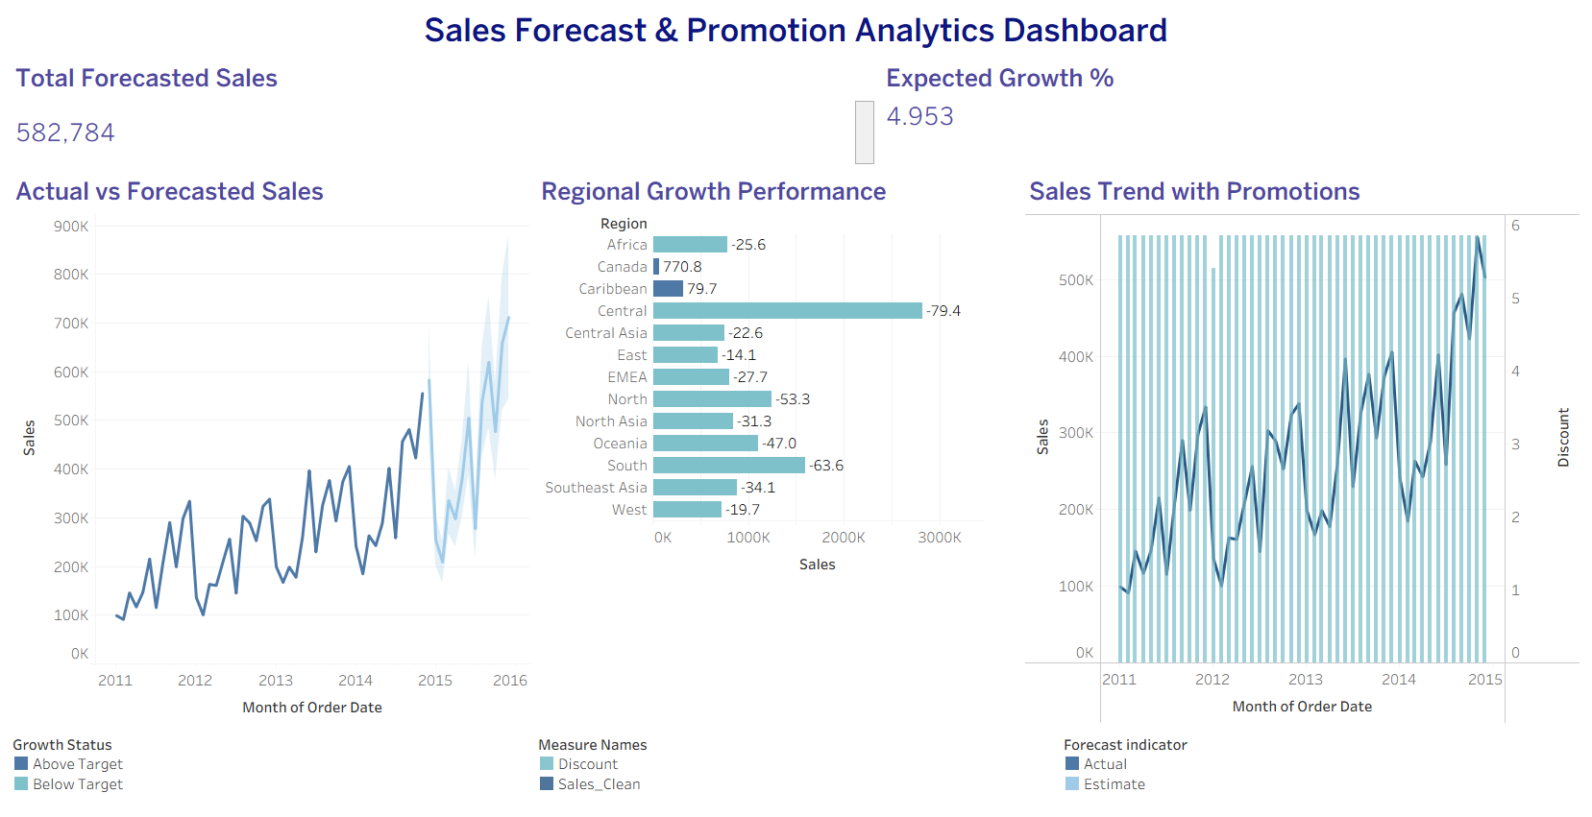

Slide 8


