Slide 1
24BAD106_TABLEAU_LAB1
File created on: 18-07-2026 22:14:17

Slide 2
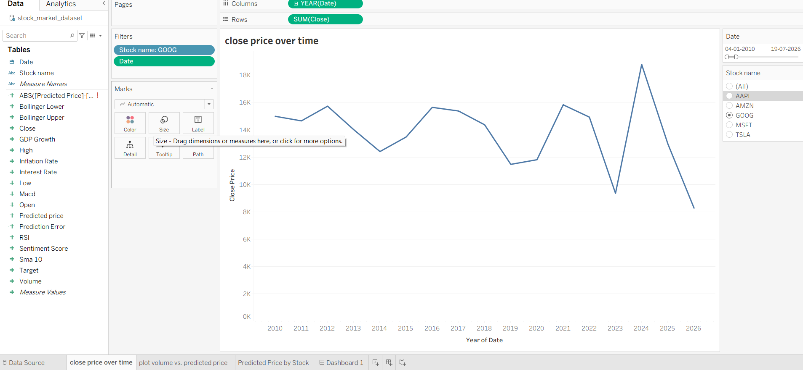

Slide 3
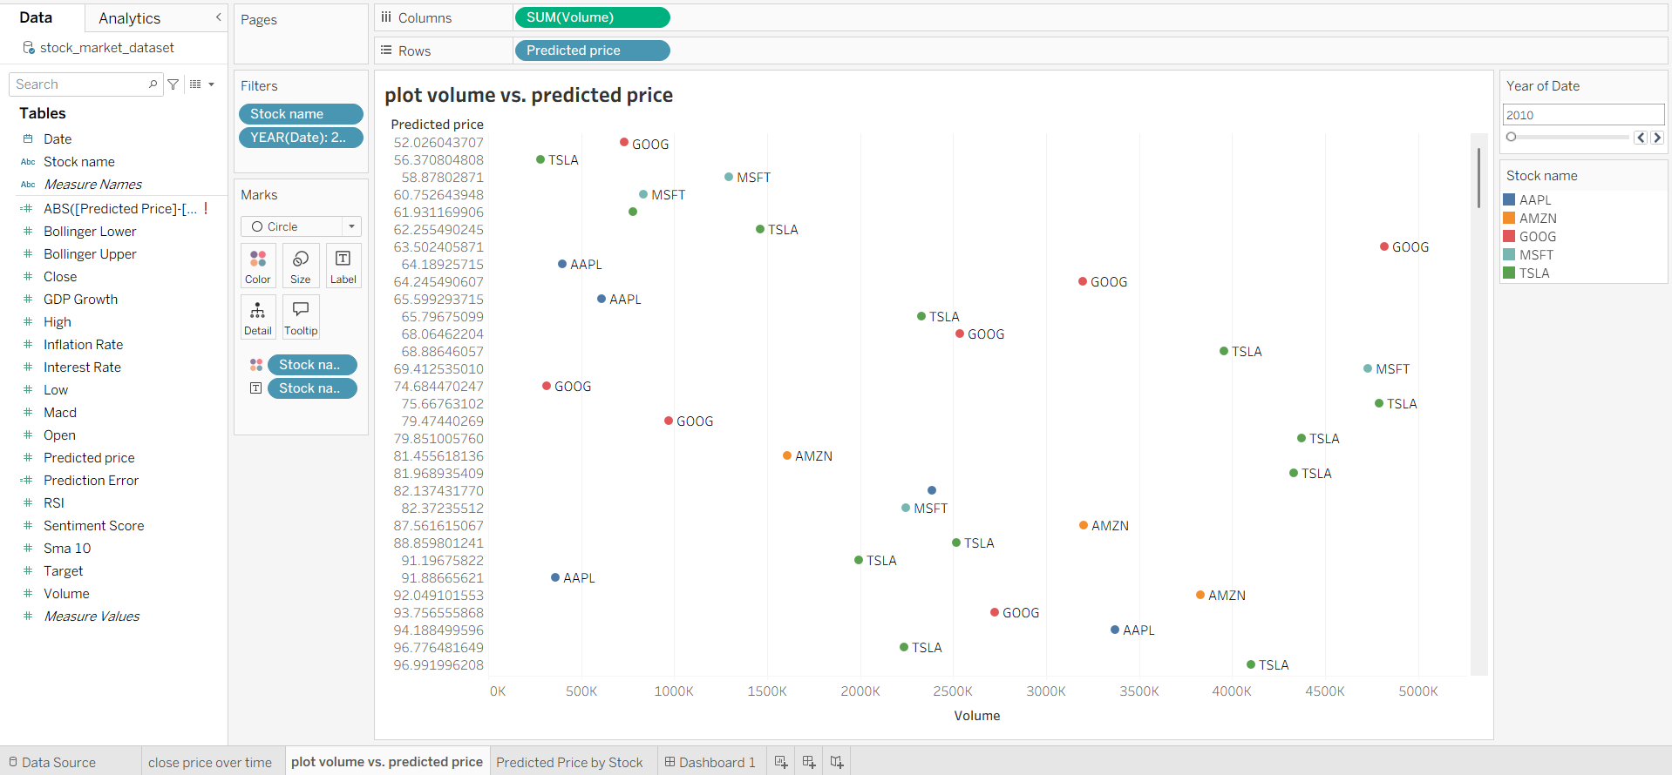

Slide 4
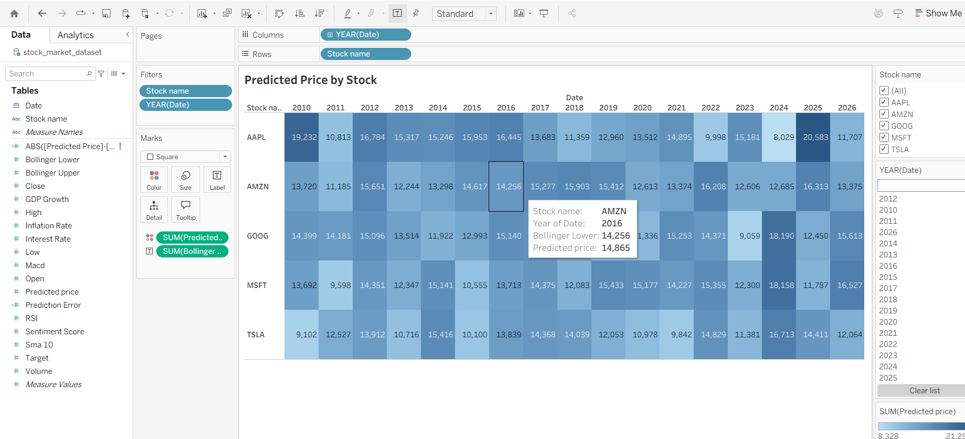

Slide 5
