Slide 1
Initial
data type
Informat
Format
Formatted
data type
Reads non-standard SAS data types
Displays SAS compatible data type

Slide 2
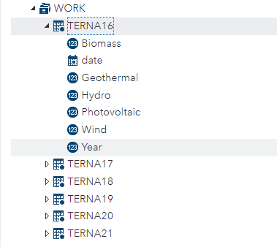
Numeric
Date
Numeric

Slide 3
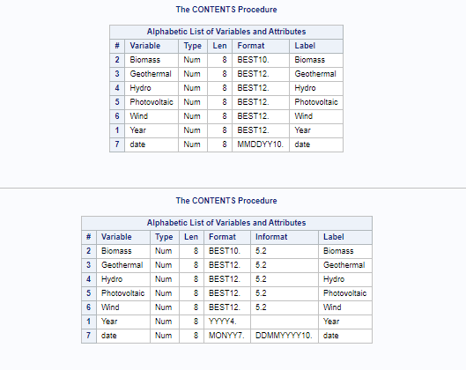
Before
After

Slide 4
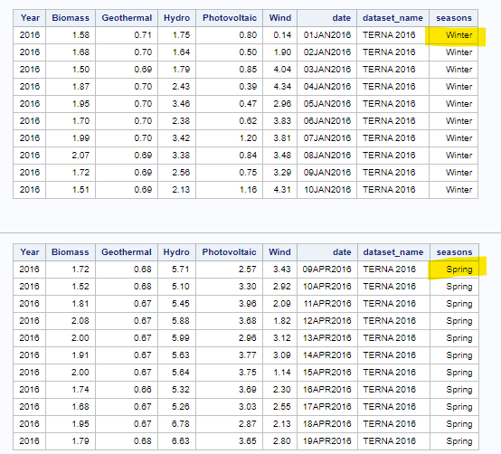
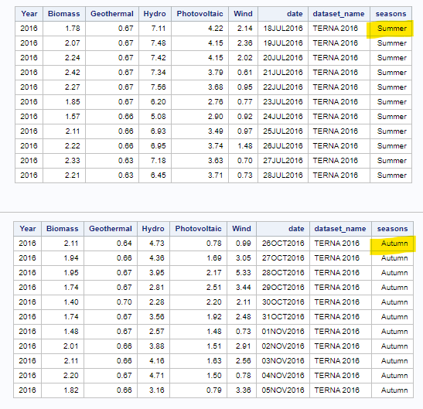

Slide 5
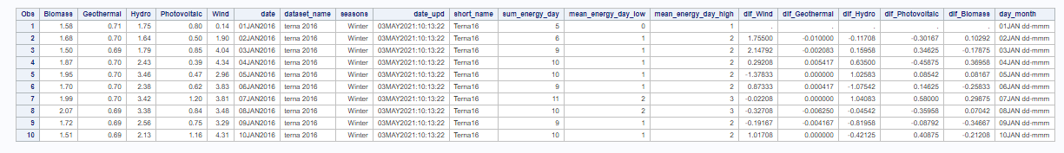
New Features
Initial variables

Slide 6
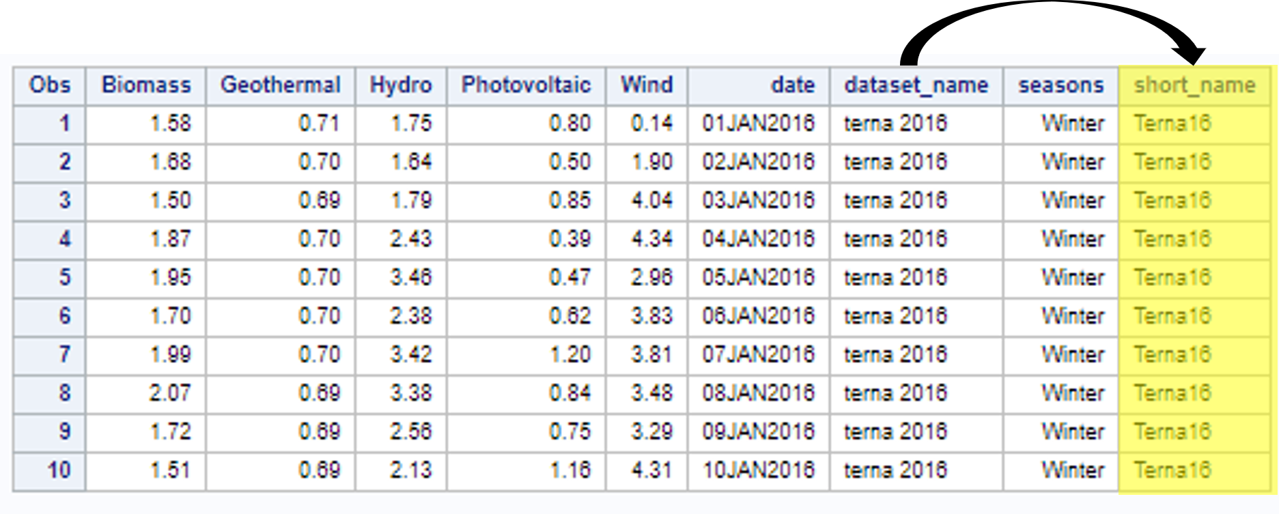

Slide 7
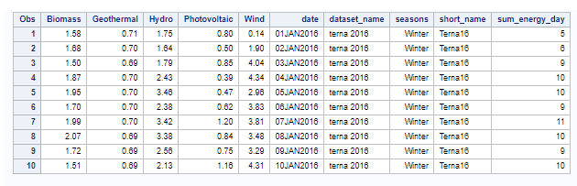
+
+
+

Slide 8
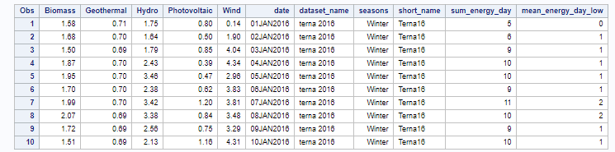
+
+
+
5

Slide 9
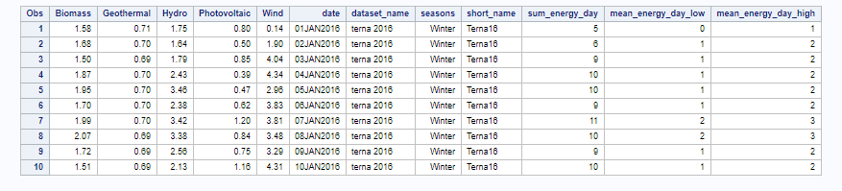
FLOOR()
CEIL()
+
+
+
5

Slide 10
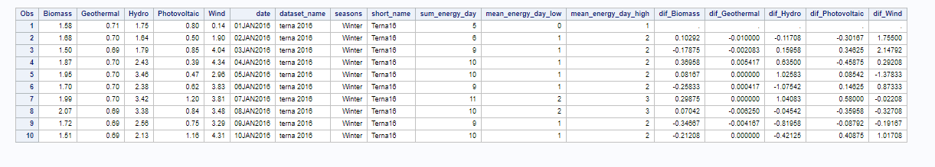

Slide 11
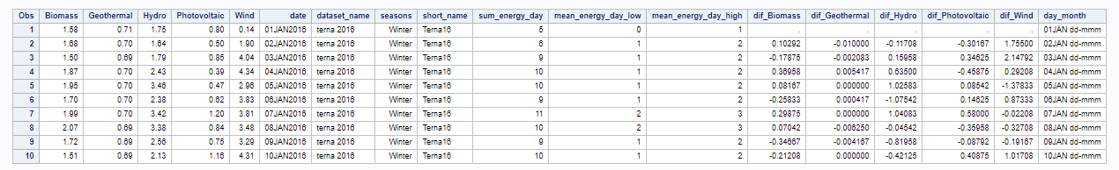
|| ‘dd-mmm’
substr(date,1,5)

Slide 12
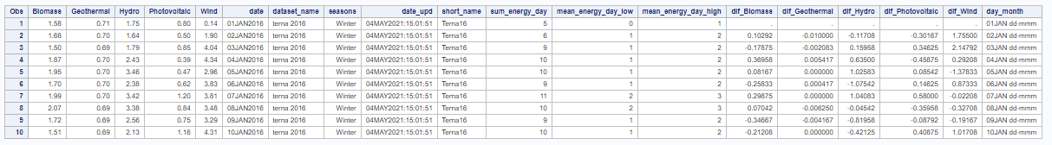
datetime()

Slide 13
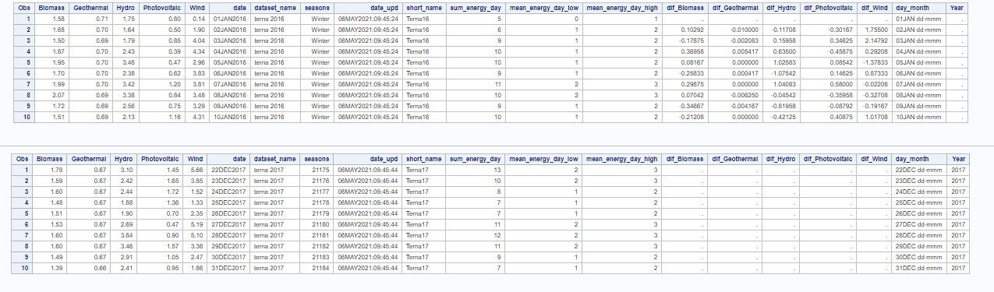
Terna16
Terna17
When variables are not present in either dataset values are automatically set to «null»

