Slide 1
Initial
data type
Informat
Format
Formatted
data type
Reads non-standard SAS data types
Displays SAS compatible data type

Slide 2
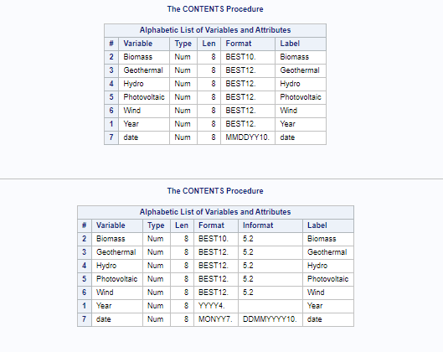
Before
After

Slide 3
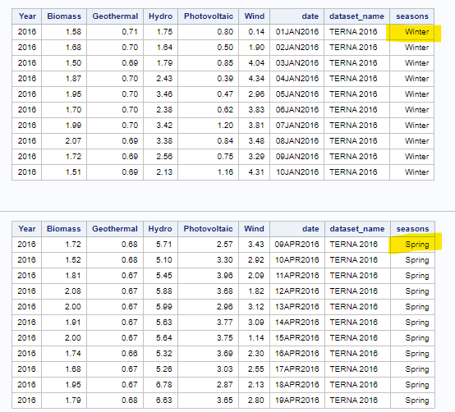
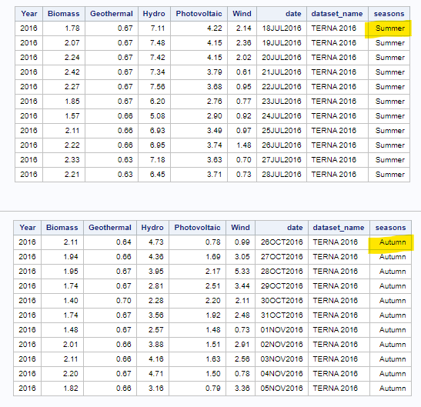

Slide 4
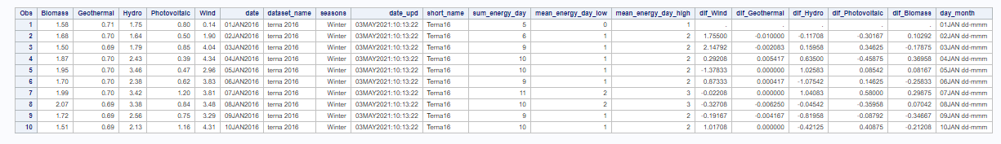
New Features
Initial variables

Slide 5
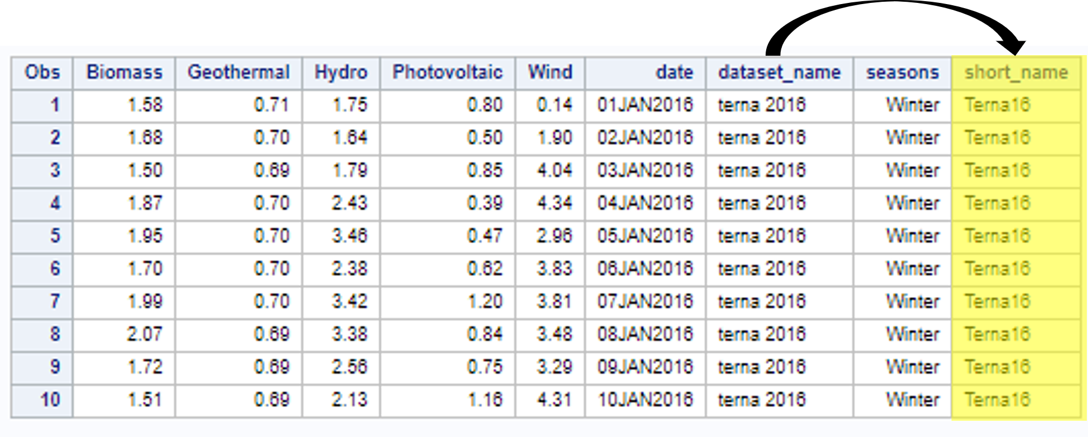

Slide 6
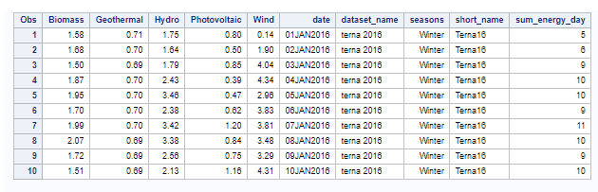
+
+
+

Slide 7
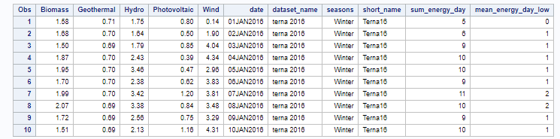
+
+
+
5

Slide 8
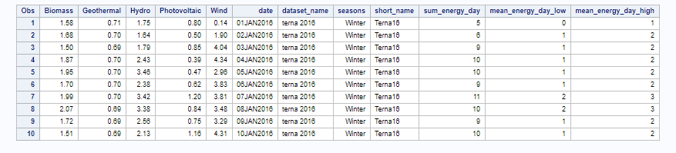
FLOOR()
CEIL()
+
+
+
5

Slide 9
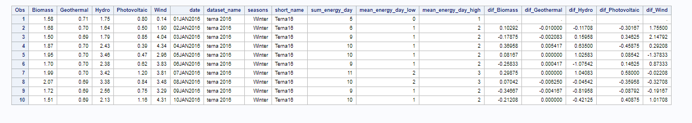

Slide 10
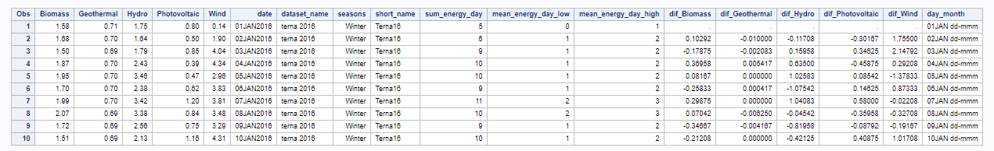
|| ‘dd-mmm’
substr(date,1,5)

Slide 11
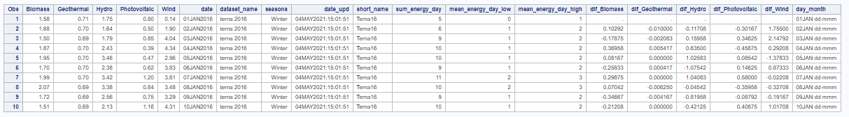
datetime()

