Slide 1
Initial
data type
Informat
Format
Formatted
data type
Reads non-standard SAS data types
Displays SAS compatible data type

Slide 2
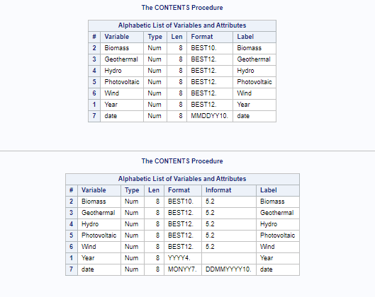
Before
After

