Slide 1
Initial
data type
Informat
Format
Formatted
data type
Reads non-standard SAS data types
Displays SAS compatible data type

Slide 2
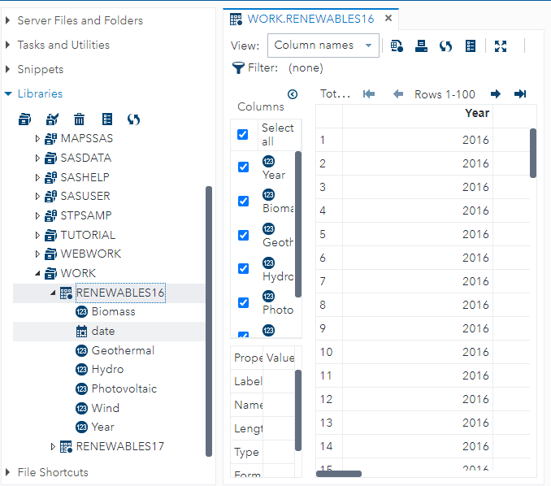
Numeric
Date
Numeric

Slide 3
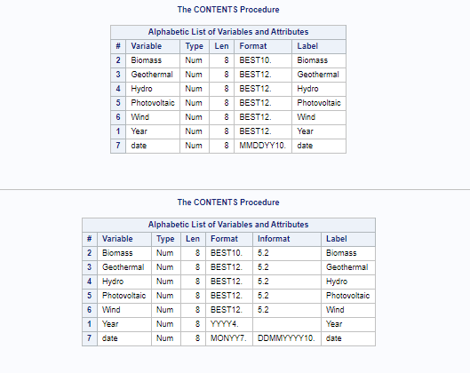
Before
After

Slide 4
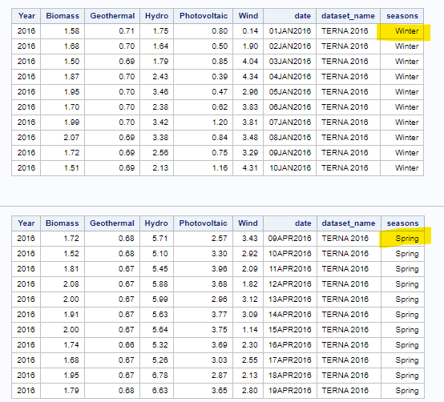
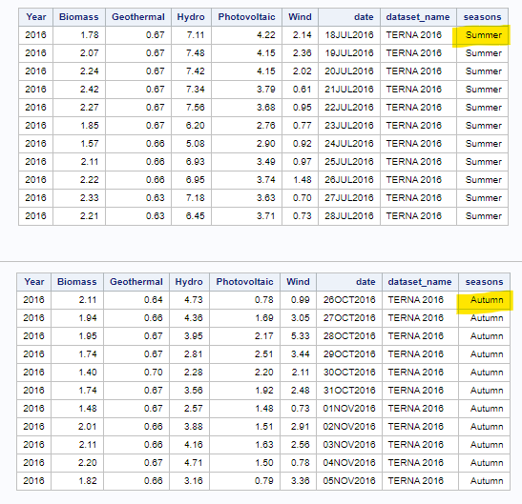

Slide 5
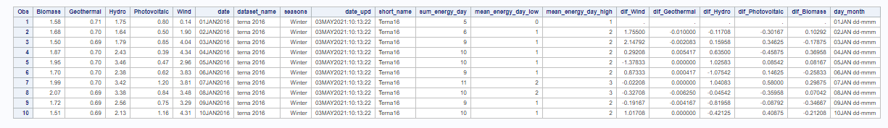
New Features
Initial variables

Slide 6
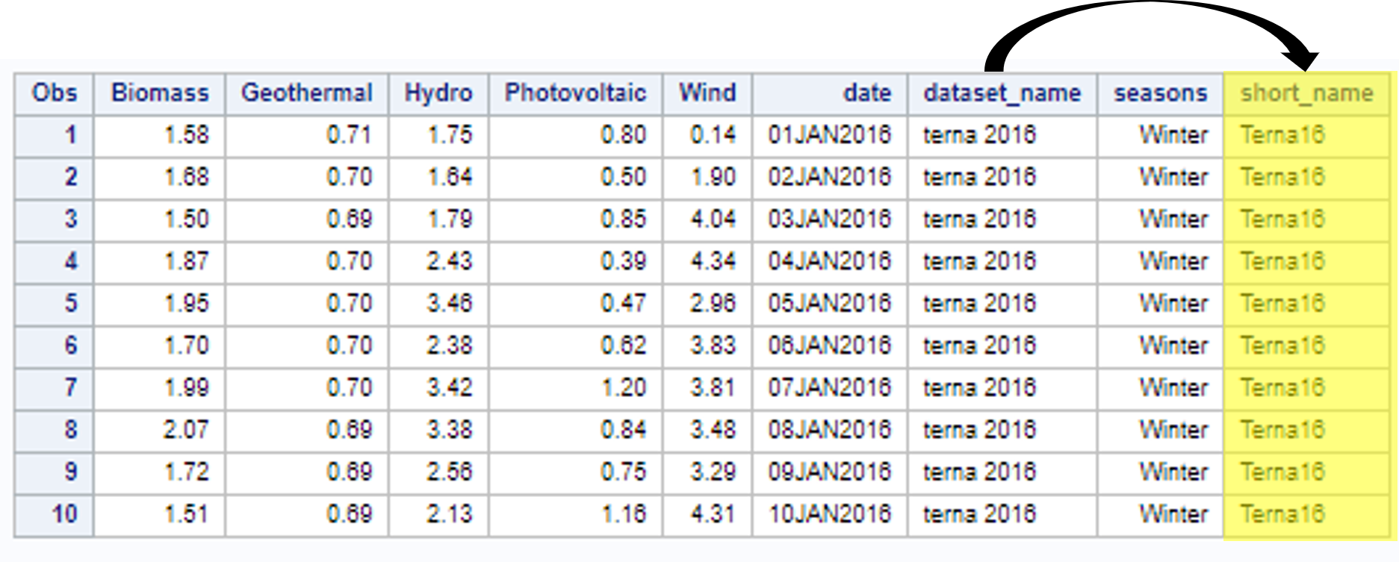

Slide 7
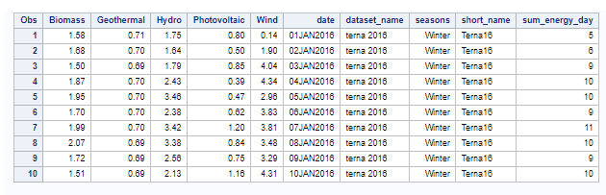
+
+
+

Slide 8
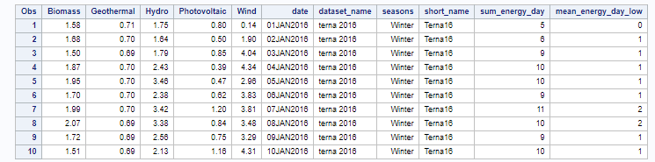
+
+
+
5

Slide 9
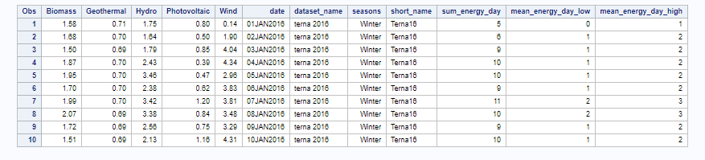
FLOOR()
CEIL()
+
+
+
5

Slide 10
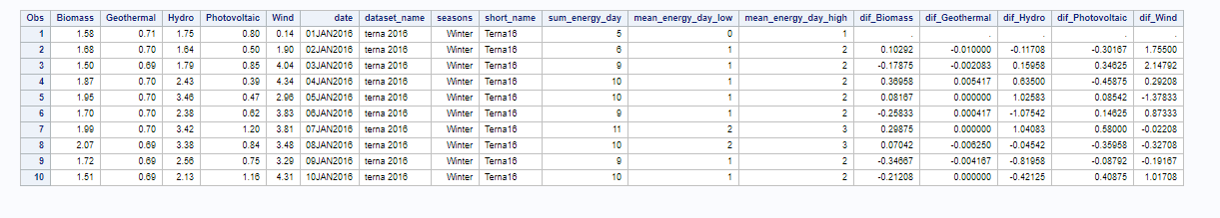

Slide 11
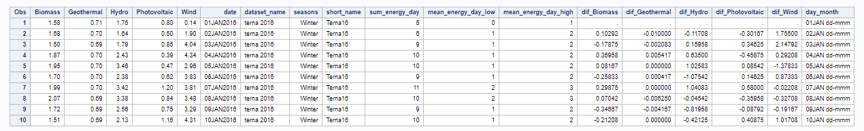
|| ‘dd-mmm’
substr(date,1,5)

Slide 12
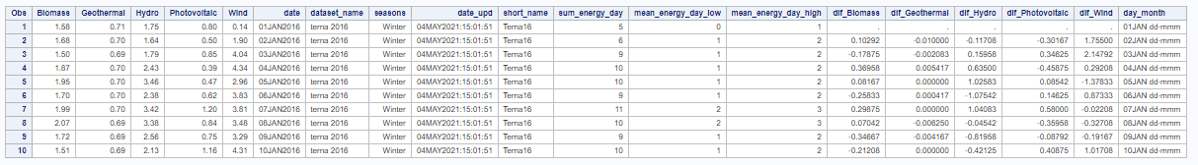
datetime()

Slide 13
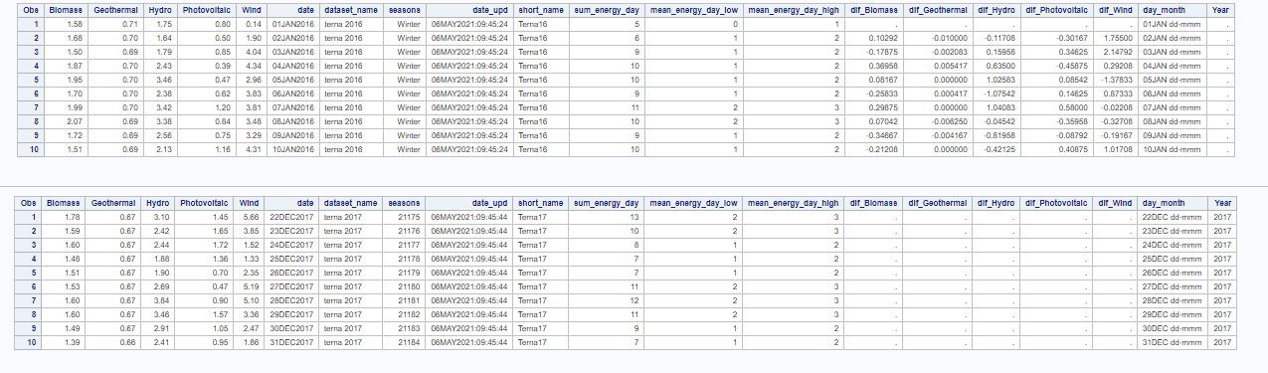
Terna16
Terna17
When variables are not present in either dataset values are automatically set to «null»

Slide 14

OUTFILE option specifies final file name and location in SAS Studio
After the file path, add the name of the new file, including the file extension
FILE_PATH
Our latest dataset
DBMS option specifies the file extension

Slide 15
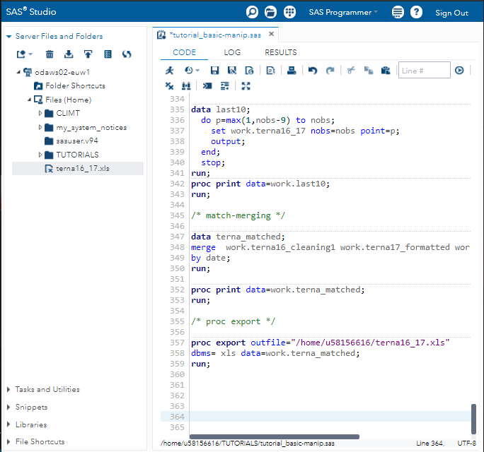
Click here to download the new file

Slide 16
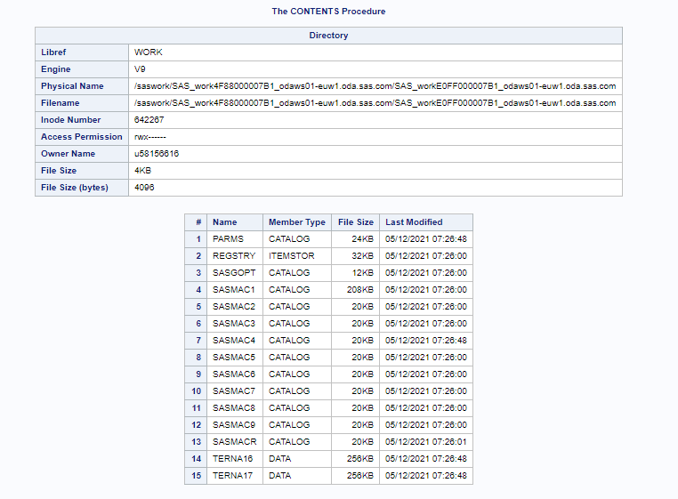
Path to fisical and file names
Your incode number
General information on your directory
Files already present in the directory.
Different memtypes (e.g. catalogs, itemstor, data) stored.
The last files are the ones we’ve just imported and uploaded!

Slide 17
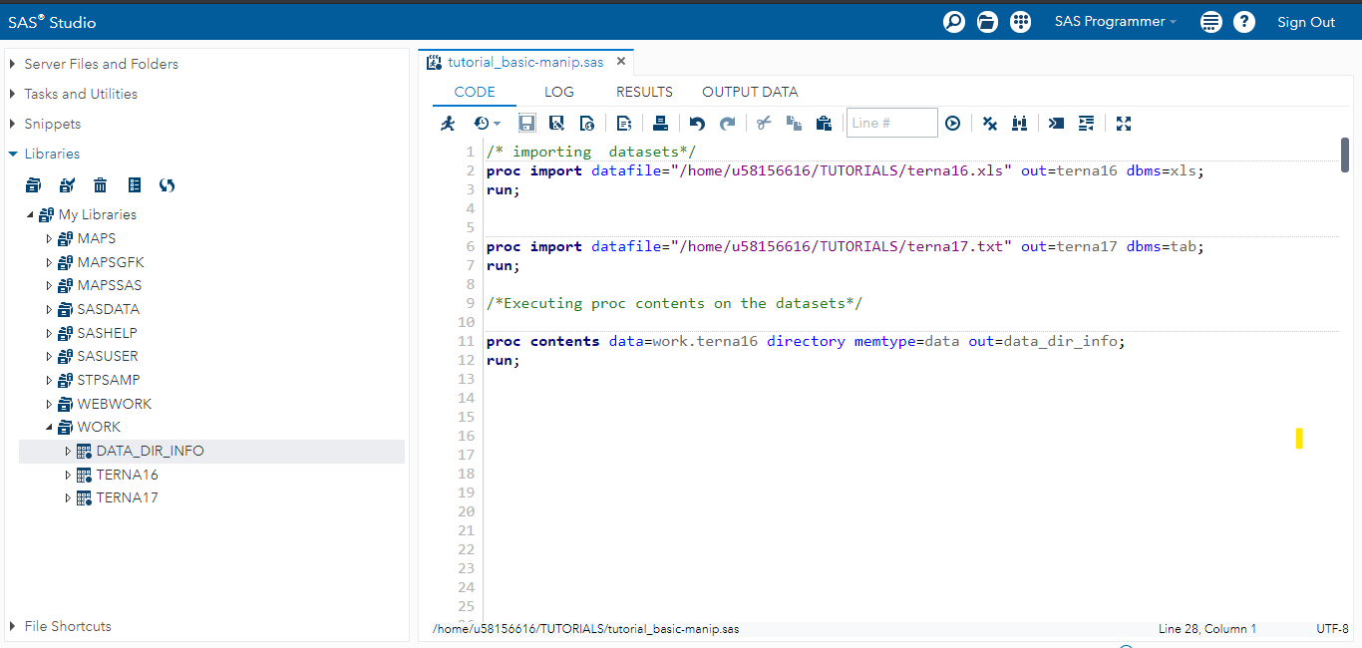
path
path

Slide 18
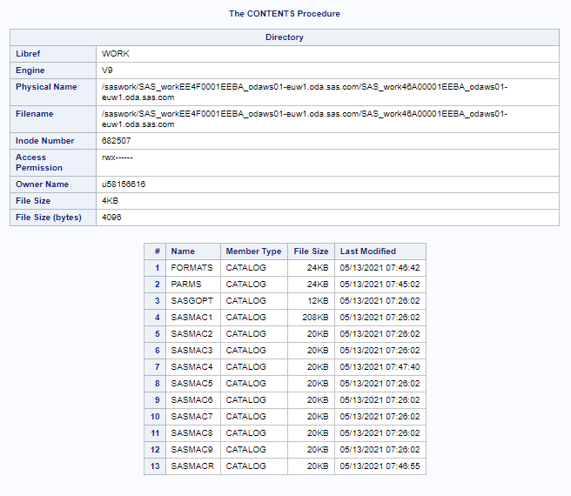
Path to fisical and file names
Your incode number
General information on your directory
Catalogs already present in the directory.
This catalog stores the formats we’ve just created

Slide 19
MACRO
statement
MACRO
processor
Regular SAS statement

Slide 20
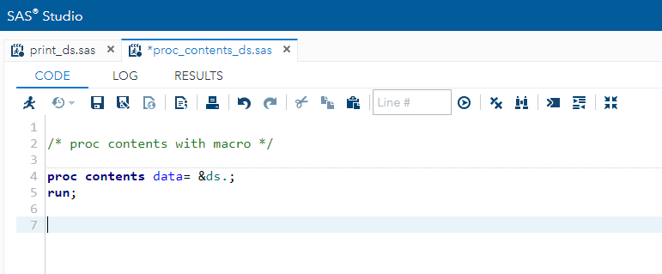
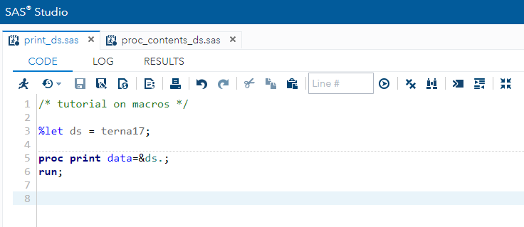
1
2

Slide 21
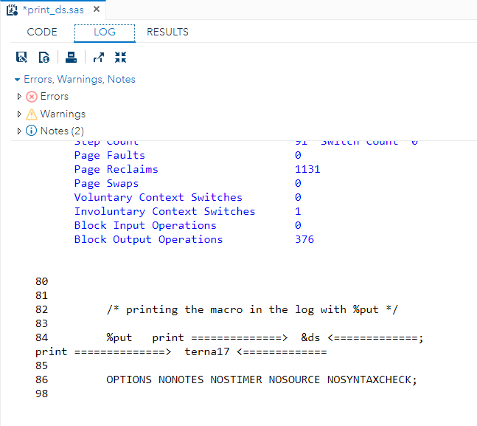
output

Slide 22
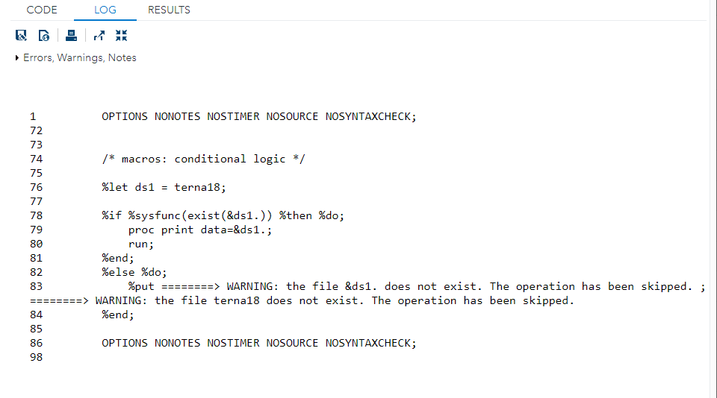

Slide 23
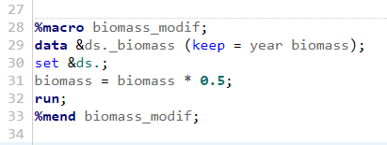
Macro initialise
Macro content
Macro close

Slide 24
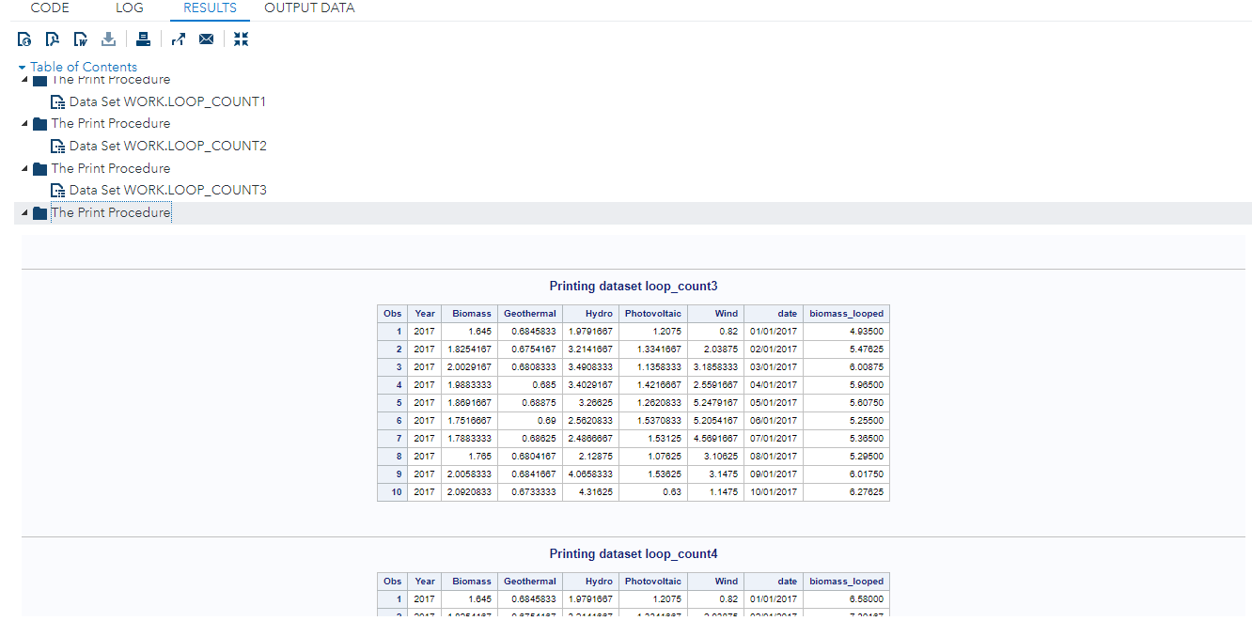
Biomass * 3
Biomass * 4

Slide 25
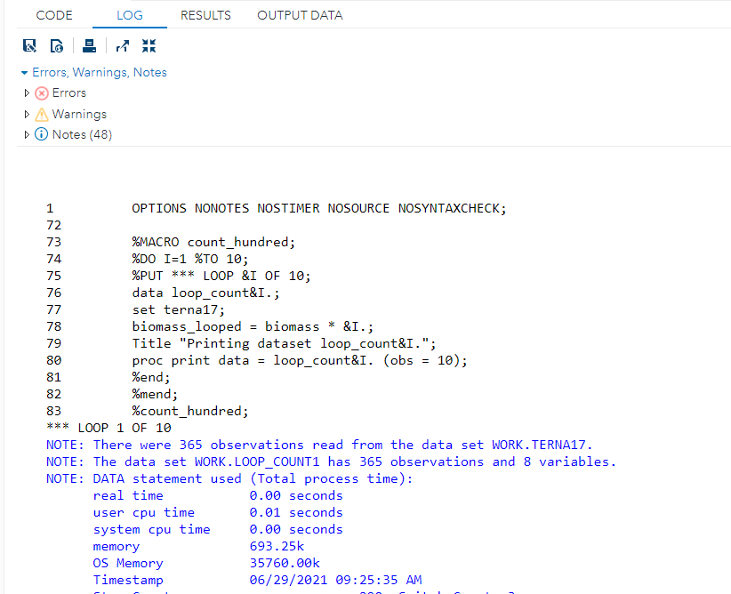
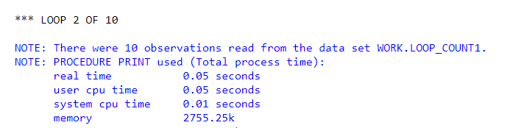
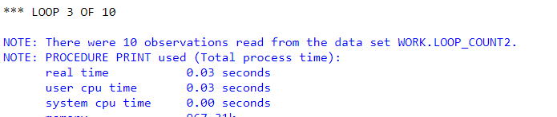

Slide 26
CALL SYMPUT routine
DATA step variables
User defined
Automatic
Macro variables
User defined
Automatic
SYMGET function

Slide 27
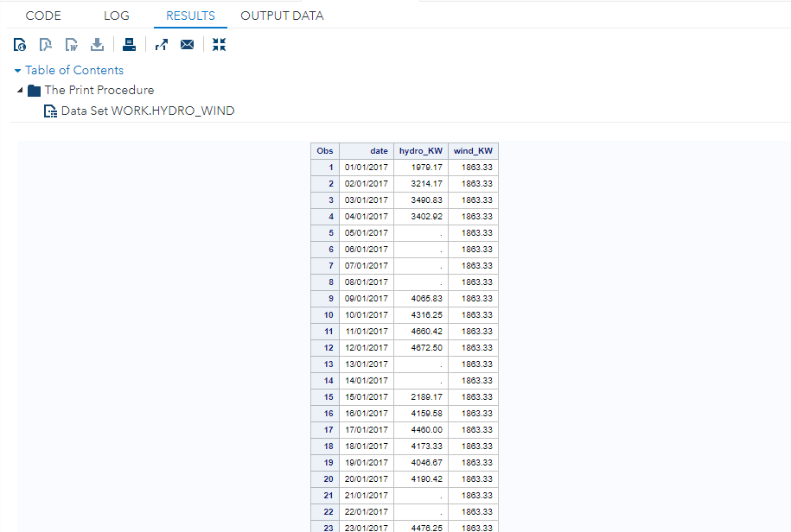
The print procedure prints out the latest dataset created: hydro_wind
The new variable hydro_KW lists all the nth values of hydro power that are true to the condition applied when the macro variable was created
The new variable wind_KW is repeated throughout the dataset because the macro variable could contain only one value which was true to the condition applied when the macro variable was created

Slide 28
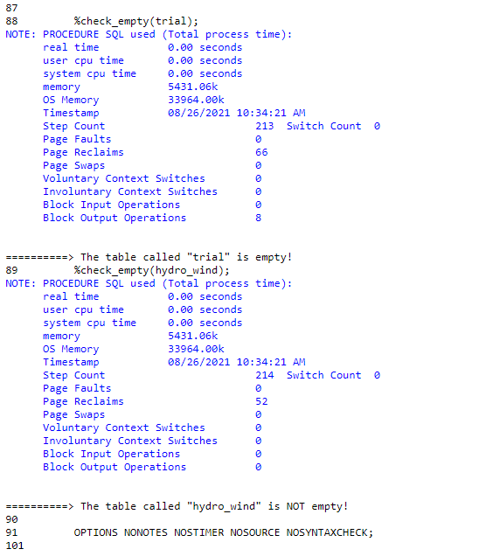
The macro check_empty processes the dataset called trial.
The note lists the details related to the processing time required to execute the macro.
The message output after the macro execution
The macro check_empty processes the dataset called hydro_wind .
The note lists the details related to the processing time required to execute the macro.
The message output after the macro execution

