Slide 1
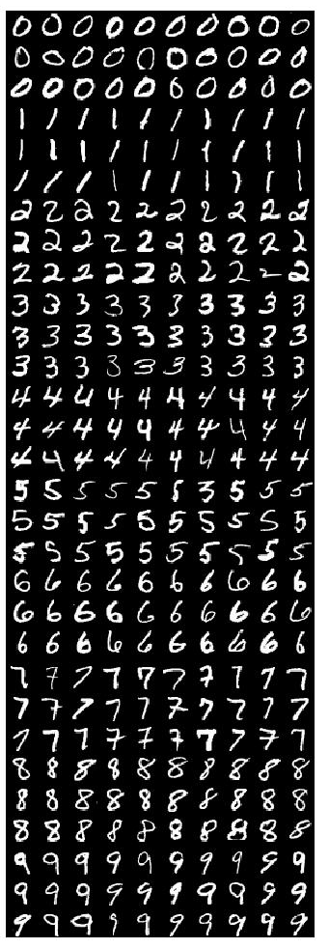
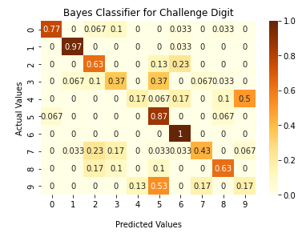
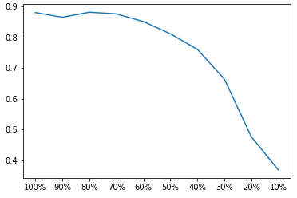
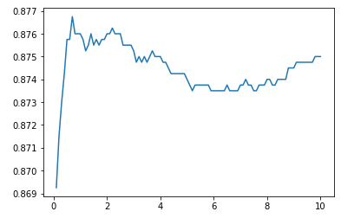
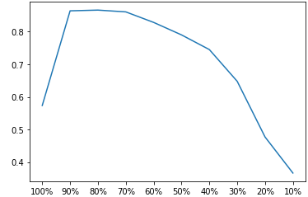
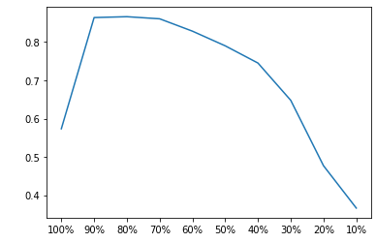
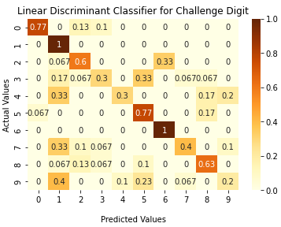
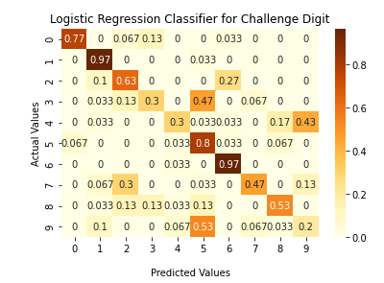
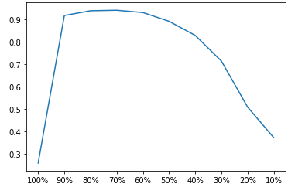
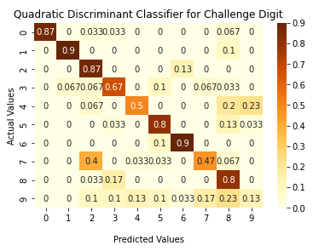
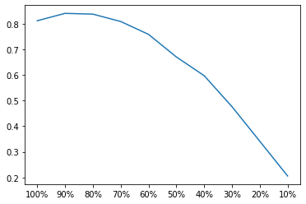
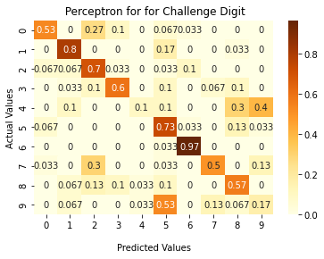



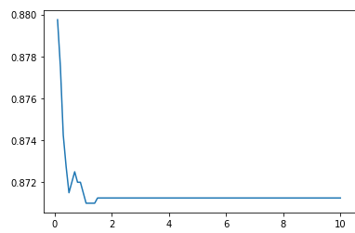
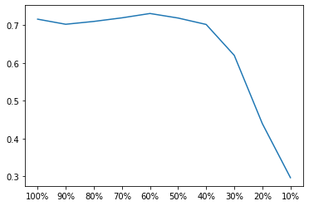
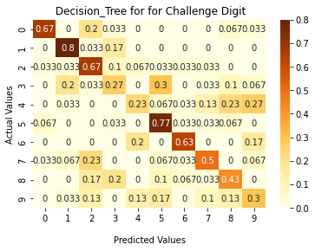



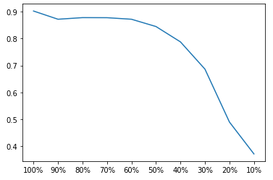
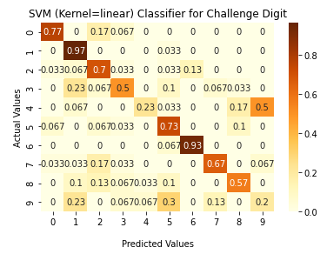
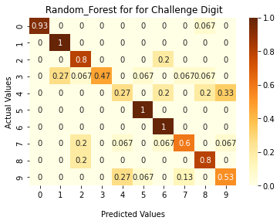

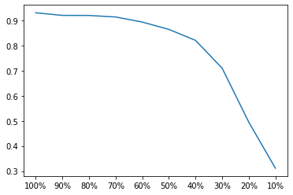
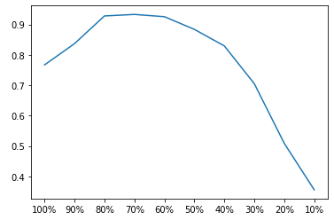
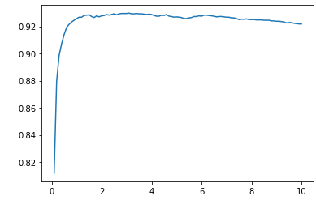
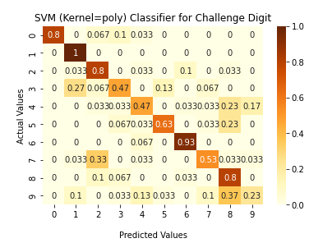
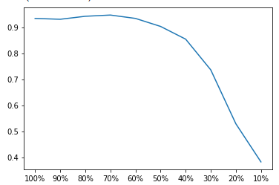
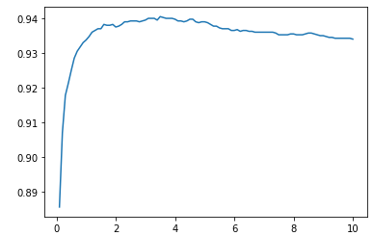
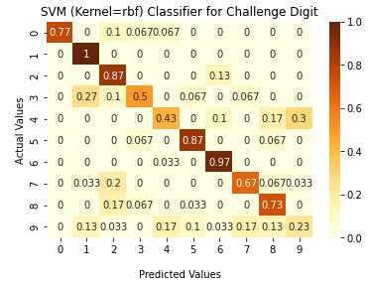
MNIST Digit Classification
CS 5487 Group 24, School of Data Science, City University of Hong Kong
Lee Chi Kin SID: 54421383 Wong Yeung Sum SID: 54450514
Introduction
Experimental Results
Experimental Results
The MNIST database is a large database of handwritten digits that is commonly used for training various image processing systems. It was created by the samples from NIST's original datasets.
The database is also widely used for training and testing in the field of machine learning. The black and white images from NIST were normalized to fit into a 28x28 pixel bounding box.
The whole MNIST database contains 60,000 training images and 10,000 testing images.
However, The result is only based on 2,000 training data and 2,000 testing data provided by the class.
Gaussian Bayes Classifiers
Training accuracy:
0.866
Test accuracy:
0.850
Challenge accuracy:
0.600
Training accuracy:
0.870
Test accuracy:
0.860
Challenge accuracy:
0.597
Training accuracy:
0. 942
Test accuracy:
0.927
Challenge accuracy:
0.690
Training accuracy:
0.902
Test accuracy:
0.885
Challenge accuracy:
0.626
Training accuracy:
0.933
Test accuracy:
0.923
Challenge accuracy:
0.666
Training accuracy:
0.946
Test accuracy:
0.933
Challenge accuracy:
0.703
Logistic Regression
Training accuracy:
0.882
Test accuracy:
0.873
Challenge accuracy:
0.593
Training accuracy:
0.840
Test accuracy:
0.836
Challenge accuracy:
0.567
Training accuracy:
0.730
Test accuracy:
0.736
Challenge accuracy:
0.527
Training accuracy:
0.931
Test accuracy:
0.931
Challenge accuracy:
0.740
Linear Discriminant Analysis(LDA)
Quadratic Discriminant Analysis(QDA)
Perceptron
Methodology
Foundation: Python
The whole project is powered by Python on Google Colab
Classification method
Gaussian Bayes Classifiers
Fisher's Discriminant Analysis (LDA and QDA)
SVM (Linear, Polynomial, Radial Basis Function kernel)
Logistic Regression
Perceptron
Decision Tree
Random Forest
Support Vector Machine(SVM) Linear Kernel
Decision Tree
Random Forest
Experimental Setup
Support Vector Machine(SVM) Polynomial Kernel
The classifiers are evaluated over 2 experiment trials. each of the trials,
Half of the data (2000 images 200 images per class) ->
training (and cross-validation of parameters) data
another half of the data will be the test data.
For a given trial, the same writer does not appear in both the training and test sets.
Data processing
creating the PCA data of explained percentage variance
from 100% to 10% for each trial.
For each trial, train a classifier using only the training set data (images and labels).
the SVM method -> 3 different kernels,
linear, polynomial, and Radial basis function (rbf),
to see the difference in the performances.
And for other methods,
Optimize hyperparameters to get the best model by getting the best training set accuracy.
Use the different explained percentage variance of PCA to find the optimal one by plotting a graph by 10-fold cross variation score.
Finally use the optimized dimension with the optimized hyperparameters model, to predict the test set for both trials 1 and 2 and then record the mean accuracy of them.
Conclusion
Classification Model | Training Accuracy | Test Accuracy | Challenge Accuracy
Gaussian Bayes | 0.866 | 0.850 | 0.600
LDA | 0.870 | 0.860 | 0.597
QDA | 0.942 | 0.927 | 0.690
SVM (Linear Kernel) | 0.902 | 0.885 | 0.626
SVM (Poly Kernel) | 0.933 | 0.923 | 0.666
SVM (RBF Kernel) | 0.946(Best) | 0.933(Best) | 0.703
Logistic Regression | 0.882 | 0.873 | 0.593
Perceptron | 0.840 | 0.836 | 0.567
Decision Tree | 0.730 | 0.736 | 0.527
Random Forest | 0.931 | 0.931 | 0.740(Best)
Support Vector Machine(SVM)
RBF Kernel

