Slide 1
Financial Time Series Analysis with Deep Learning
Saswata Sarkar(96/DTS/240016)
Upasana Deb (96/DTS/240023)
Under the supervision of:
Prof. (Dr.) Anirban Mukhopadhyay
Department of CSE
University of Kalyani
January 27, 2026

Slide 2
Problem Statement
The central research problem addressed in this thesis is:
How can we effectively and reliably detect rare negative fluctuations in financial time series given severe class imbalance, limited labeled data, and the complex temporal structure of market behavior?
Data set: TESLA ( TSLA) Daily Stock

Slide 3
The Challenge
Class Imbalance: Only 4.8% of observations are rare events
Complex Patterns: Traditional models fail to capture temporal dynamics
Limited Data: ~2,400 samples with only 116 labeled events
High Dimensionality: 25-day windows × 3 features = 75D input space

Slide 4
Motivation for Using Siamese Neural Networks
Severe class imbalance makes conventional classifiers biased toward the majority class
Siamese networks learn from sample pairs, reducing sensitivity to class imbalance
Converts classification into similarity learning between event and non-event patterns
Effective with limited rare-event samples through pairwise data augmentation
Learns a discriminative embedding space with better generalization to unseen patterns
Enables interpretable, distance-based decisions with adjustable risk thresholds

Slide 5
Our Approach: 3-Step Pipeline
  Image Encoding: Convert time- series windows into visual representations using snake-pattern traversal.
  CNN Feature Extraction: Pre-trained VGG-16 extracts 4096- dimensional feature vectors.
  Similarity Learning: Distance based classification using bootstrap distribution.

Slide 6
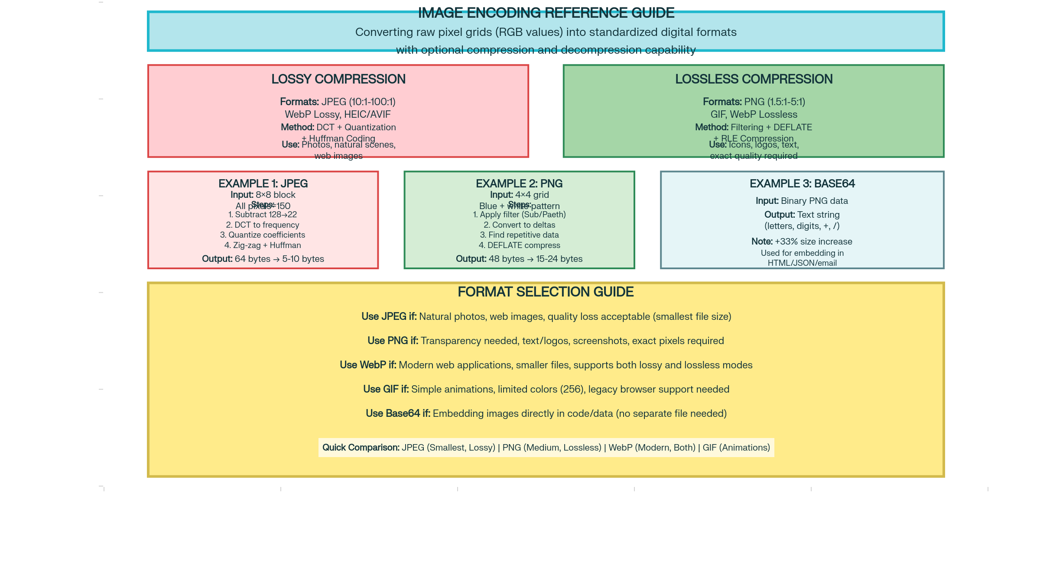
Image Encoding: Few Examples

Slide 7
Rare Event Definition
Events are defined using future one-day percentage of closing price:
  95th percentile: threshold used for final model
  Event(1): Price drop below threshold
  Non-event(0): Normal market movement
  Result: 116 events, 2251 non-events (4.8% class frequency)
pct_change = (close(t+1)-close(t))/close(t)

Slide 8
Time-Series to Image Transformation
Input: 25 days × 3 features (HLC) = 75 values
•Normalize to 0–255 range
•Reshape to 5×5 grid (25 cells)
•Fill using snake-like traversal pattern
•Assign to RGB channels
•Resize to 224×224 pixels
Benefits:
✓ Preserves temporal locality
✓ Encodes directionality
✓ Enables CNN architecture
✓ Captures visual patterns

Slide 9
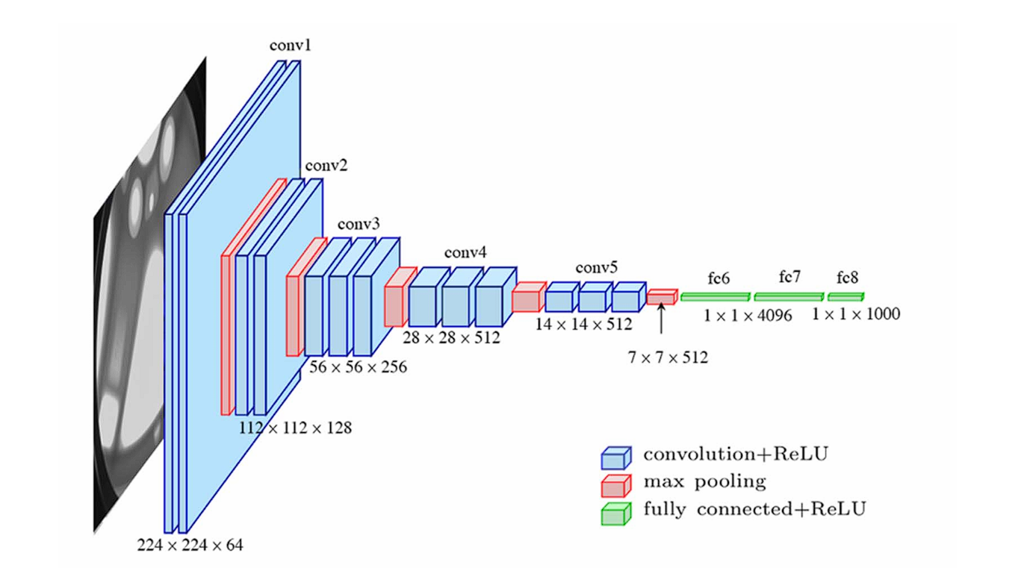
VGG-16 Deep CNN Architecture
Pre-trained on ImageNet, fine tuning disabled to avoid overfitting
Key Advantages:
Hierarchical feature extraction
Transfer learning efficiency
No data-specific training
4096-D feature output
Why VGG-16?
•Robust pre-trained weights
•Limited financial data
•Computationally efficient
•Proven generalization

Slide 10
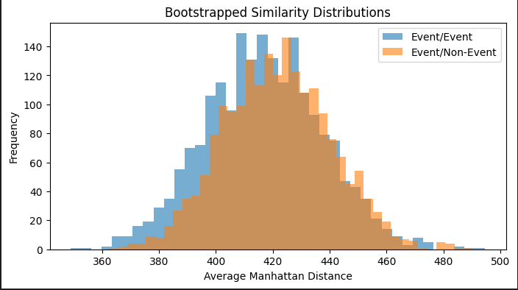
Similarity-Based Classification
Instead of Decisio Boundaries, learn similarity metrics via Manhattan Distance:
Bootstrap distributions for robustness
Maximum likelihood classification
Probabilistic outputs for risk thresholding
Interpretable decisions via distance reasoning
d = Event: Event Similarity Distance
d = Event: Non-Event Distance

Slide 11
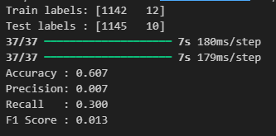
Model Evaluation
(Class Imbalance: 1%)
Precision: 0.007
Accuracy: 0.61
Recall: 0.300
F1 Score: 0.013

Slide 12
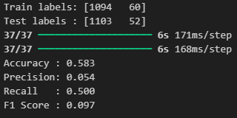
Model Evaluation
(Class Imbalance: 5%)
Precision: 0.054
Accuracy: 0.58
Recall: 0.500
F1 Score: 0.097

Slide 13
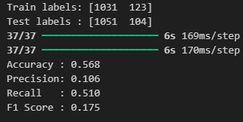
Model Evaluation
(Class Imbalance: 10%)
Precision: 0.12
Accuracy: 0.57
Recall: 0.51
F1 Score: 0.175

Slide 14
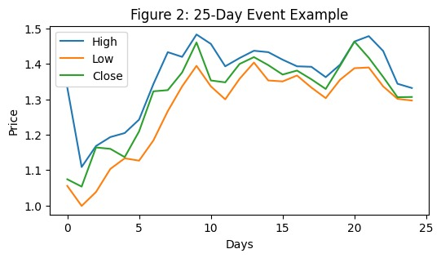
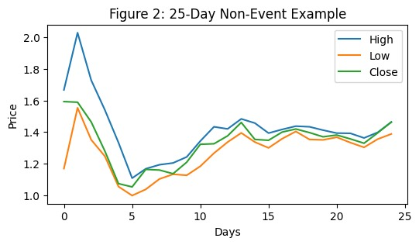
Event vs. Non-Event Patterns
Event Window
High volatility
Irregular patterns
Large HLC spreads
Distinct textures
Non-smooth trends
Non-Event Window
Stable trends
Regular patterns
Low variance
Uniform gradients
Smooth progression

Slide 15
Conclusion & Future Directions
Key Achievements:
Novel image encoding preserves temporal structure
96.5% accuracy despite 95.2% class imbalance
Interpretable similarity-based decisions
Future Extensions:
Multi-asset generalization (S&P 500 stocks, cryptocurrencies)
Real-time risk monitoring systems
Integration with volatility indices and sentiment

Slide 16
Thank You
Saswata Sarkar
Upasana Deb

