Slide 1



ANOMALY DETECTION IN INDUSTRIAL CONTROL SYSTEMS

Slide 2
Problem statement
Identify the outliers that could indicate an alert for an attack in measurement-based intrusion detection system.
Use a semi-supervised anomaly detection methods such as One class SVM, Autoencoder, IsolationForest, and Deep Learning Multi-Layer Perceptron
Build a Classification model that identifies the Anomaly based on the sensor readings and trigger an alert.

Slide 3


About the dataset
The dataset used in this project is from a HIL-based augmented ICS security (HAI)
Testbed dataset is built by collecting measurements of 86 sensors continuously for several days, and 58 sophisticated attacks are injected into the system.
The industrial control system (ICS) consists of devices, networks, and controllers to automate industrial processes. ICS contains several types of control systems, such as supervisory control and data acquisition (SCADA) systems, and distributed control systems (DCSs).
These attacks, which target four places in the system, are a combination of 14 process control loop (PCL) basic attacks.
The detection process requires being able to decide whether a new observation belongs to the same distribution as existing normal observations (which is an inlier without an attack) or should be considered as different (it is outlier) or an anomaly
Source of Dataset: (QR to dataset)

Slide 4
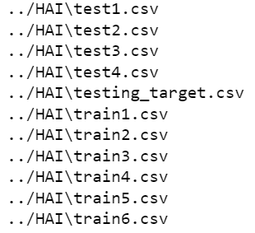
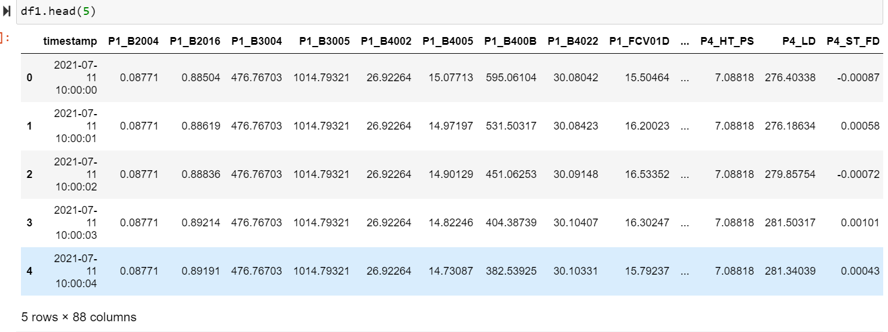
Dataset
0 to 86 columns are features and column number 87 is target, which has value of 0 and 1 (binary number) that indicates an attack.
Total six datasets to train our model and 4 attack(test) datasets.
The testbed consists of four different processes: Boiler Process (P1), Turbine Process (P2), Water treatment Process (P3), HIL Simulation(P4)
Any deviation from a normal performance could be considered an anomaly in an ICS.
It could happen due to several reasons, including a malfunction in a system’s component, insider sabotage, or an intentional cyberattack. In this context the concept of anomaly detection based on the MIDS refers to fault detection and intrusion detection. When a malfunction or insider sabotage occurs, the system tries to detect faults in the system
There are 299,201 records in Training set and 361, 200 records in the test dataset

Slide 5
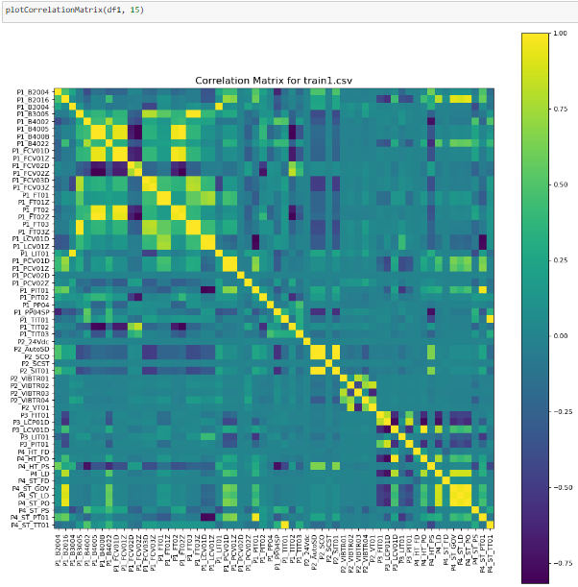
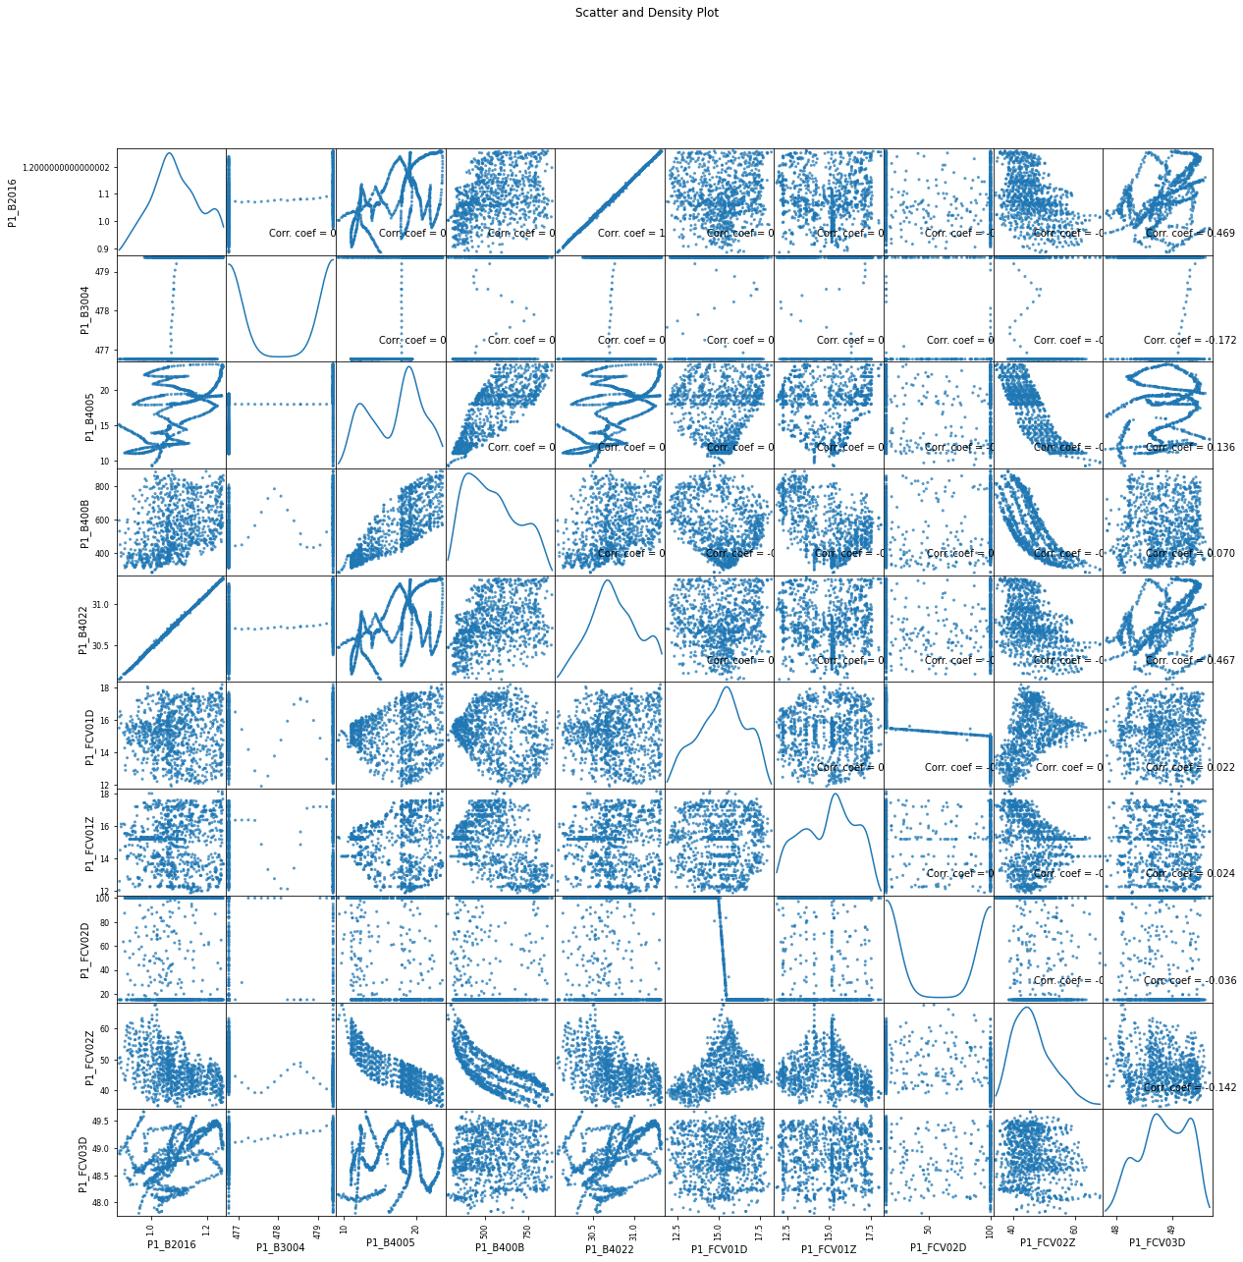
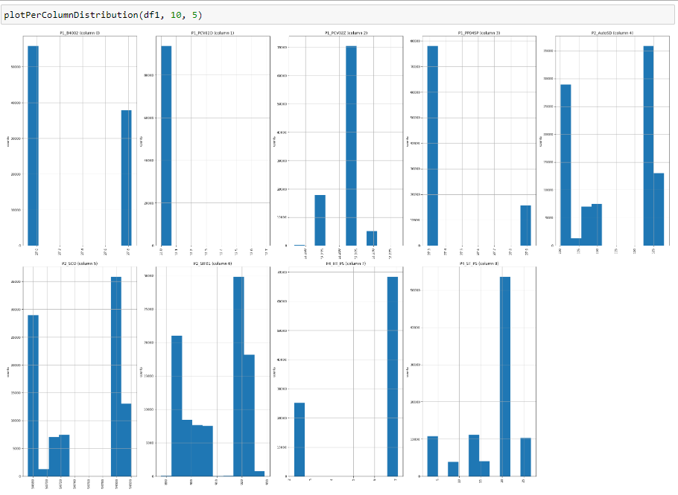
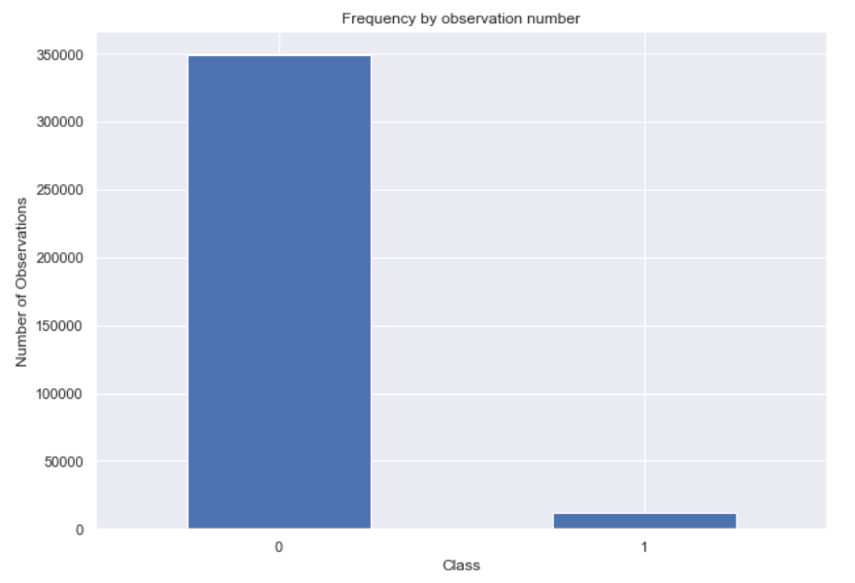
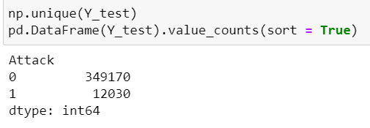
Exploratory Data Analysis
Plotted Distribution Graphs(Histogram/Bar Graph).
Acquired Correlation Matrix
Plotted Scatter and Density Plots
Notes:
Distribution graph: It shows the frequency of values in data by grouping it into equal-sized intervals or classesdistribution plot displays two different plots for the same variable
Plot correlation matrix: :The measure of the relationship between two variables statistically is called "Correlation".It is very useful to highlight the most correlated variables in a data table. In this plot, correlation coefficients are colored according to the value.

Slide 6
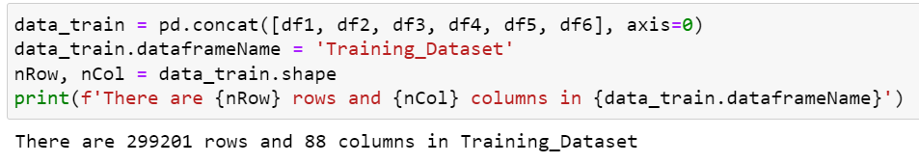
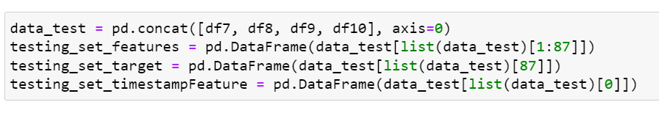
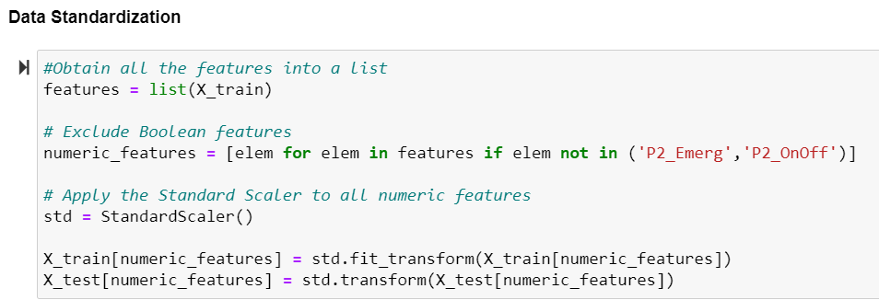
Data-preprocessing
Data Formation : Created an Overall training dataset by combining train1, train2, train3, train4, train5, train6 and test set by combining test1, test2, test3, test4.
Data Cleaning : Checked for Null and Missing Values.
Create Features space and Target column from the data_train and data_test.
Feature Engineering : Applied Random Forest Dimensionality Reduction to visualize important features.
Selected top 54 features with Non-Zero Importance.
Data Standardization: Finally, standardize the data using StandardScaler().

Slide 7
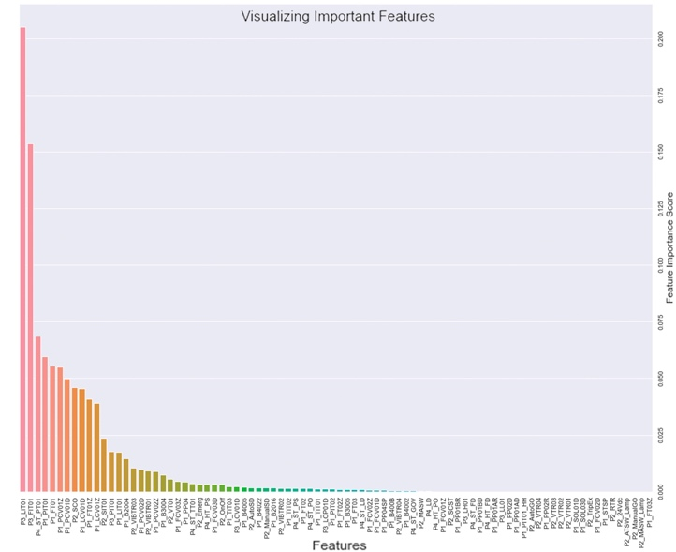
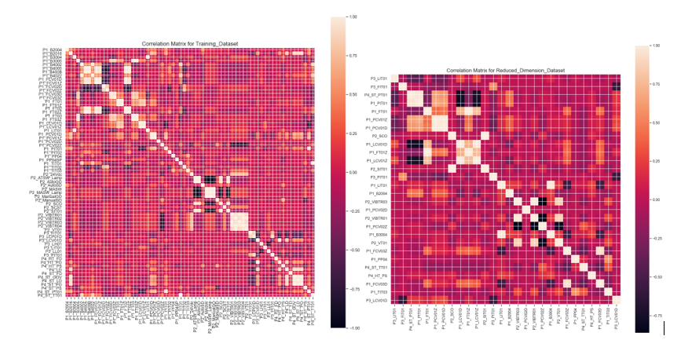
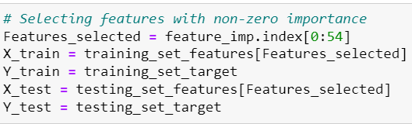
Random Forests Dimensionality Reduction Algorithm
The goal of feature selection is to find the most effective features that lead to training more accurate models and less computation time.
Random Forests are used for feature selection with its built-in attribute which calculates feature importance scores for each feature based on the ‘gini’ criterion (a measure of the quality of a split of internal nodes) while training the model.
The figure shows the correlation of the dataframe after Random forest is applied on the dataset.

Slide 8
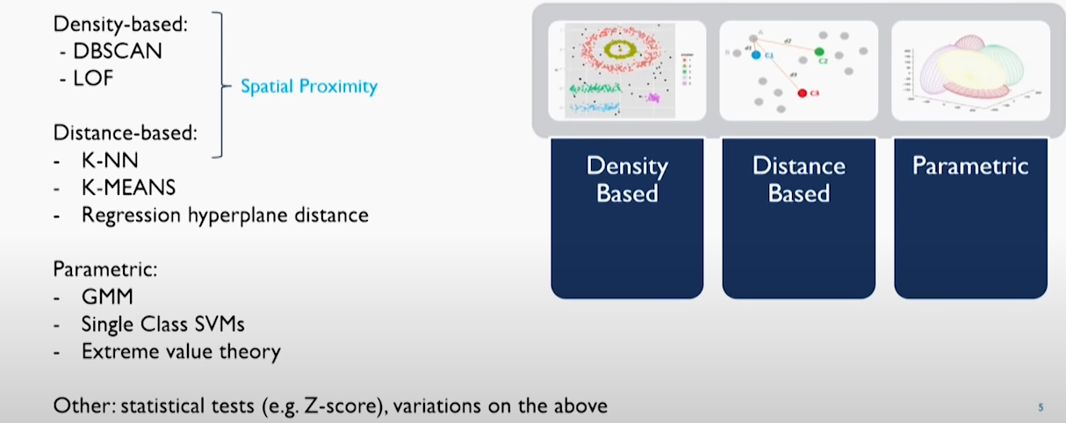
anomaly detection algorithms
Any data point/observation that deviates significantly from the other observations is called an Anomaly/Outlier.
Anomaly detection is important and finds its application in various domains like detection of fraudulent bank transactions, network intrusion detection, sudden rise/drop in sales, change in customer behavior, etc.
Some of the algorithms implemented in this project are as follows -
One class SVM
Isolation Forest
Autoencoder
MLP

Slide 9
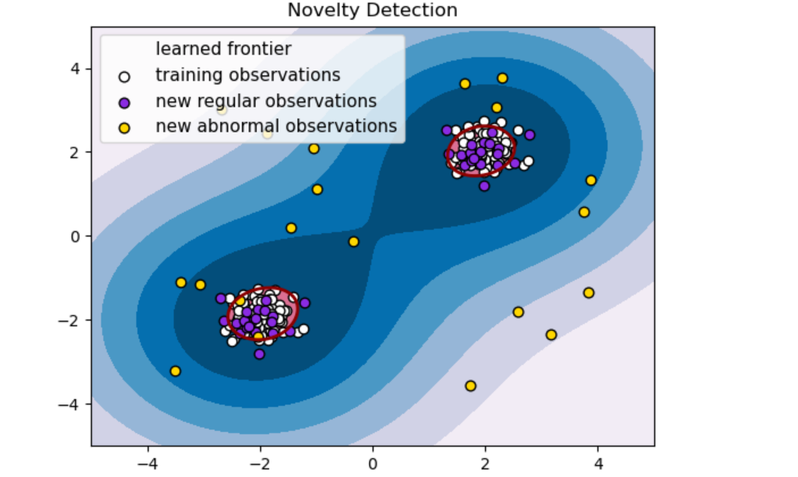
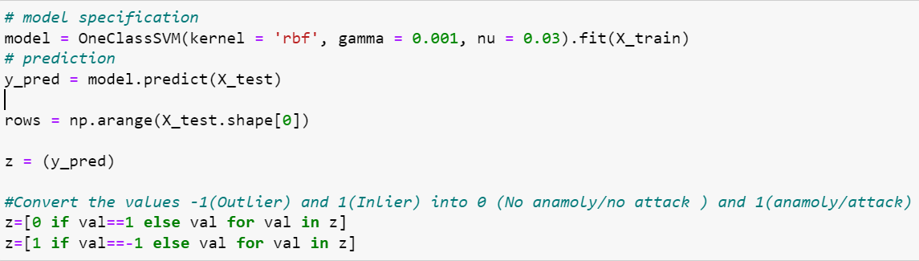
One Class SVM Model
Used for classifying new data as similar/inlier or different/outlier to the training set
It is an unsupervised algorithm that learns a decision function for novelty detection: classifying new data as similar or different to the training set
The Support Vector Method For Novelty Detection separates all the data points from the origin (in feature space F) and maximizes the distance from this hyperplane to the origin

Slide 10
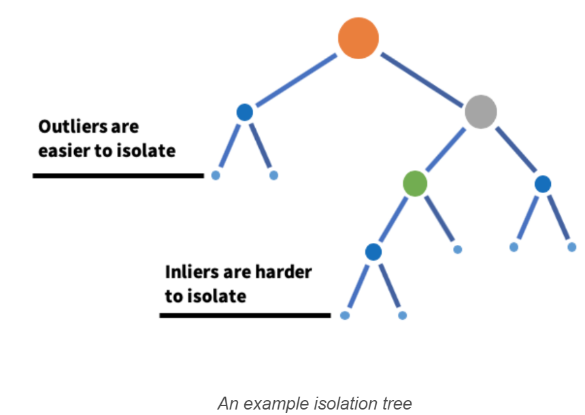
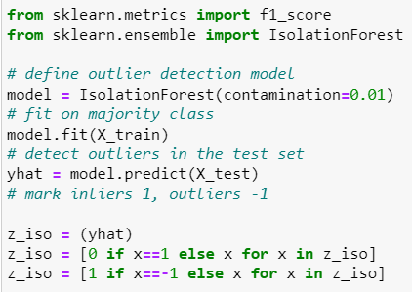
Isolation Forest Implementation
Isolation Forests(IF), similar to Random Forests, are build based on decision trees and is unsupervised model due to the absence of predefined labels.
In an Isolation Forest, randomly sub-sampled data is processed in a tree structure based on randomly selected features.
It is an ensemble regressor that uses the concept of isolation to explain anomalies
The samples that travel deeper into the tree are less likely to be anomalies as they required more cuts to isolate them.
Similarly, the samples which end up in shorter branches indicate anomalies as it was easier for the tree to separate them from other observations
Isolation Forests outlier detection are nothing but an ensemble of binary decision trees. And each tree in an Isolation Forest is called an Isolation Tree(iTree).

Slide 11
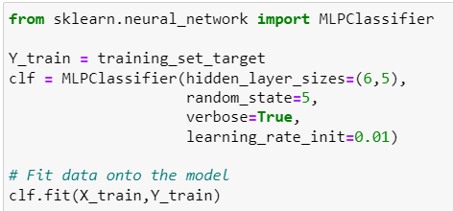
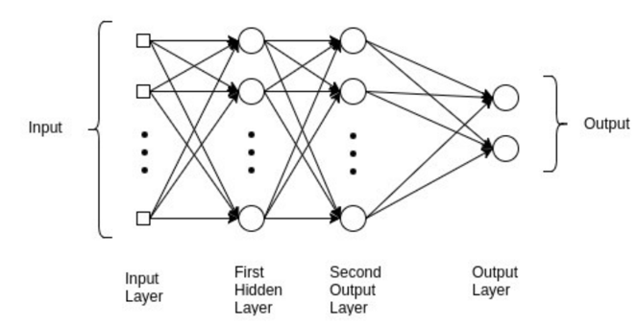
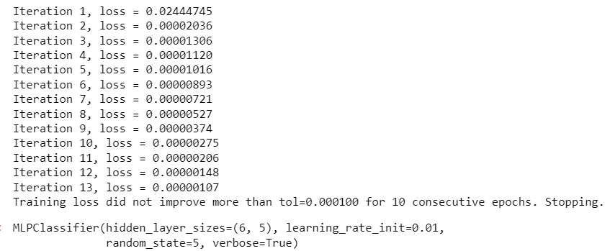
MLP Classifier Implementation
A multilayer perceptron (MLP) is a feedforward artificial neural network that generates a set of outputs from a set of inputs.
An MLP is characterized by several layers of input nodes connected as a directed graph between the input and output layers.
An MLP consists of at least three layers of nodes: an input layer, a hidden layer and an output layer

Slide 12
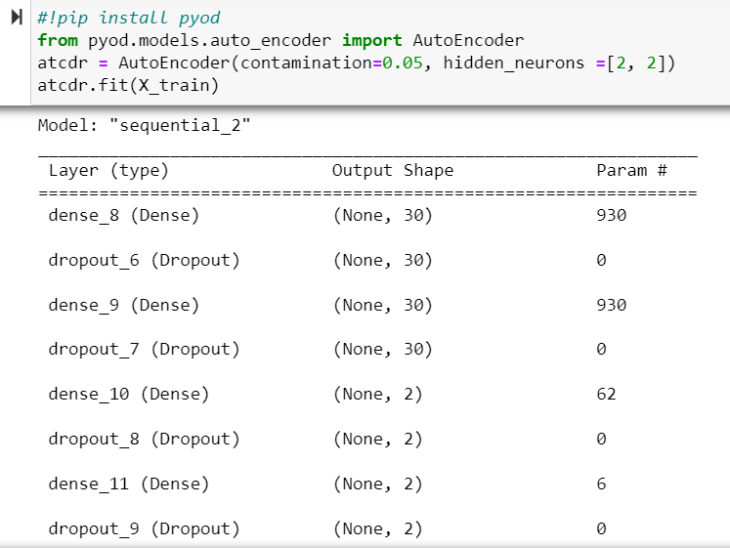
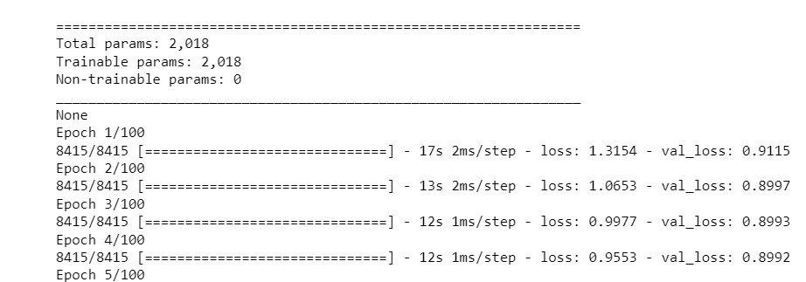
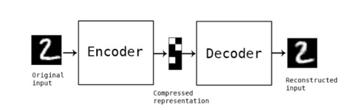
Autoencoder to Detect Anomalies
Auto Encoder (AE) is a type of neural networks for learning useful data representations unsupervisedly.
It could be used to detect outlying objects in the data by calculating the reconstruction errors
Predict raw anomaly score of test using the fitted detector
It is an unsupervised artificial neural network that learns how to efficiently compress and encode data then learns how to reconstruct the data back from the reduced encoded representation to a representation that is as close to the original input as possible
There are totally 2018 trainable parameters in the ANN that consists of 12 hidden layers

Slide 13
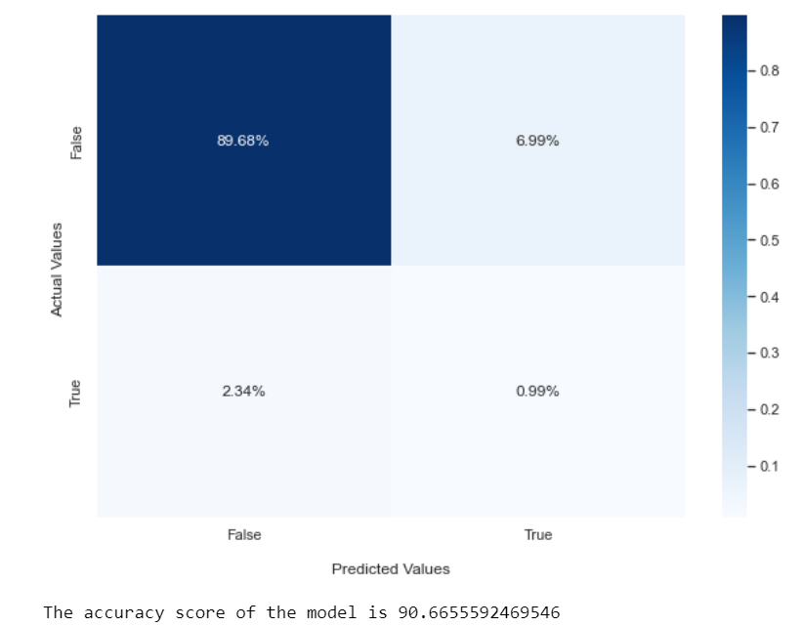
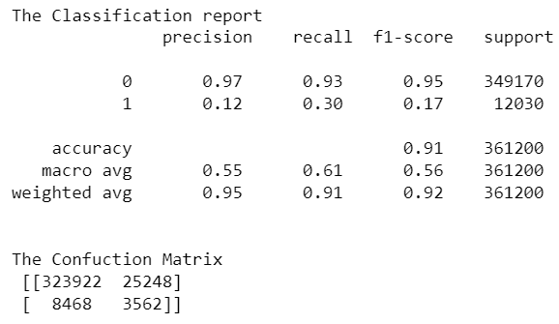
One Class SVM Results
It help us to identify anomalies in our data and filtered outlier index with the output predictions as either 1 or -1
We convert the o/p values -1(Outlier) and 1(Inlier) into 1 (anamoly/attack) and 0 (No anamoly/no attack ) set.
The metrics are displayed as follows.

Slide 14
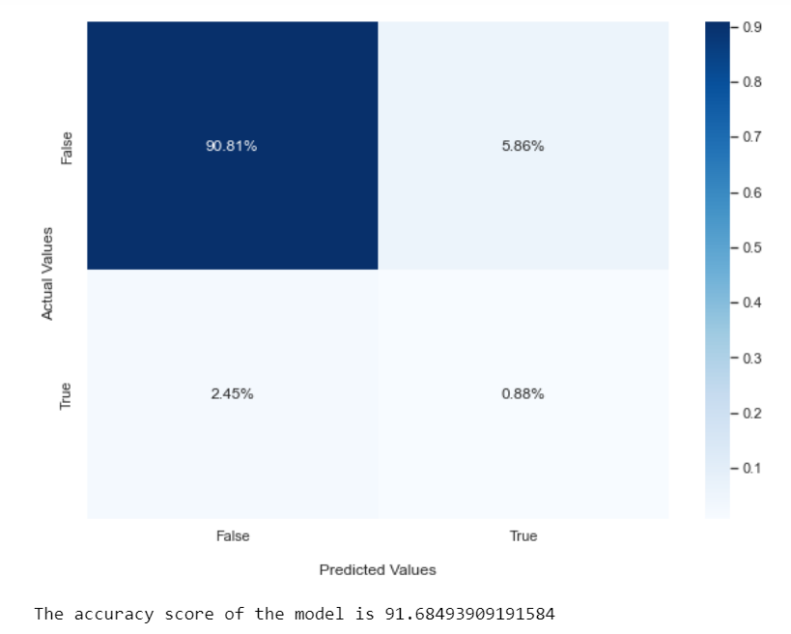
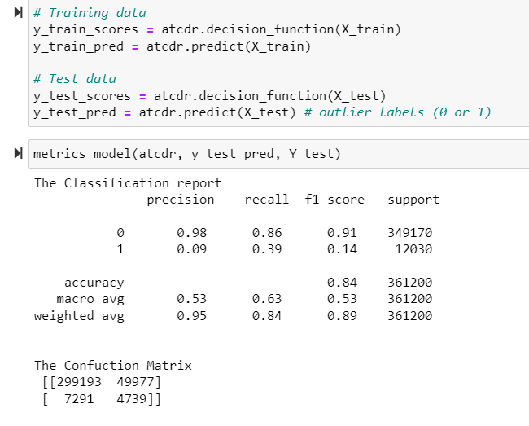
Autoencoder Results
It help us to identify anomalies in our data with the output predictions as either 0 or 1
Where 1 stands for anomalies and 0 stands for clean predictions of non attack determined by the decision function.

Slide 15
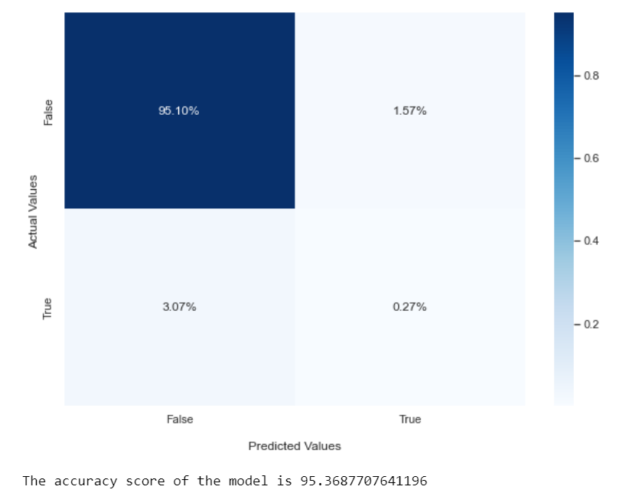
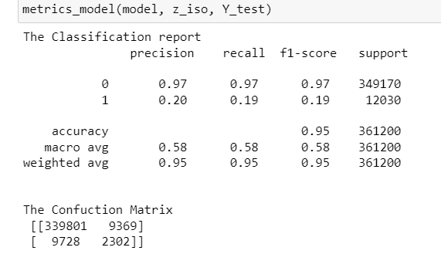
Isolation Forest Results
An ‘anomaly score’ is assigned to each of the data points based on the depth of the tree required to arrive at that point and is an aggregation of the depth obtained from each of the iTrees
An anomaly score of -1 is assigned to anomalies and 1 to normal points based on the contamination(percentage of anomalies present in the data) parameter provided.

Slide 16
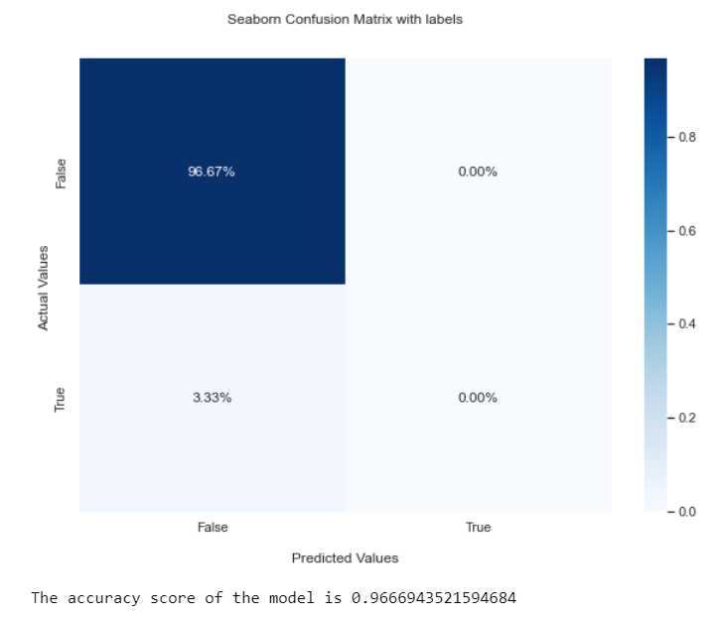
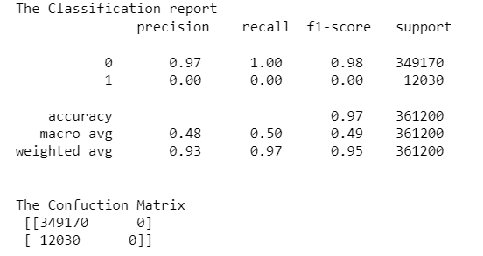
MLP Classifier Results
MLPClassifier trains iteratively since at each time step the partial derivatives of the loss function with respect to the model parameters are computed to update the parameters.
Where 1 stands for anomalies and 0 stands for clean predictions of non attack determined by the decision function

Slide 17
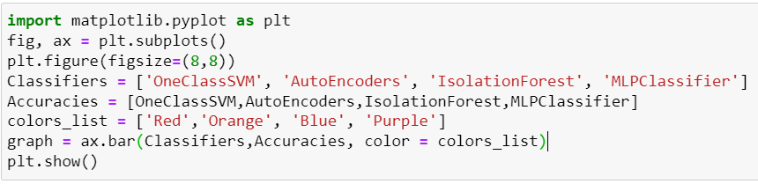
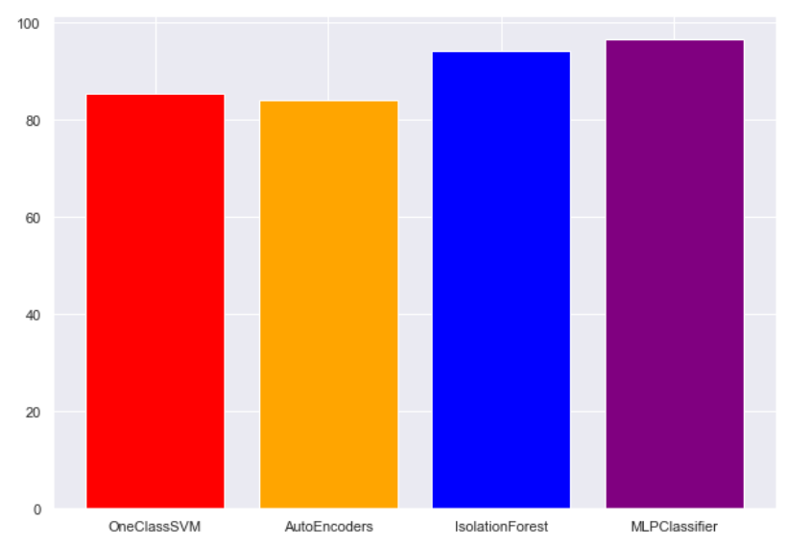
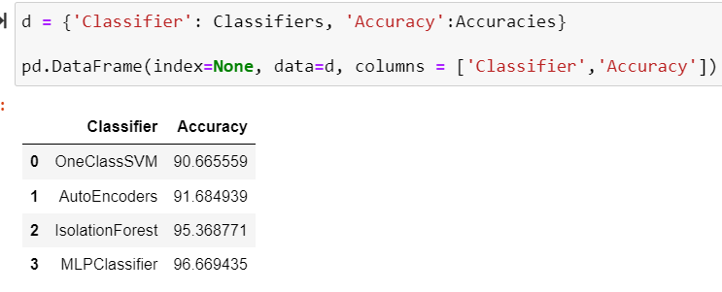
FINAL results

Slide 18
Thank You

