Slide 1
Artificial Intelligence

Slide 2
What is Artificial Intelligence? (John McCarthy, Stanford University, 1956)
AI is the study of ideas that enable computers to be intelligent & behave like human being
AI is the study of how to make computers do things at which at the moment people are better
It is the science and engineering of making intelligent machines, especially intelligent computer programs.
AI is concerned with the design of intelligence in an artificial device

Slide 3
What is Intelligence?
Intelligence:
“the capacity to learn and solve problems” (Websters dictionary)
Intelligence requires the possession of & access to knowledge and a characteristic of intelligent people is that they possess much knowledge.
in particular,
the ability to solve novel problems
the ability to act rationally
the ability to act like humans
the ability to behave in the best possible manner

Slide 4
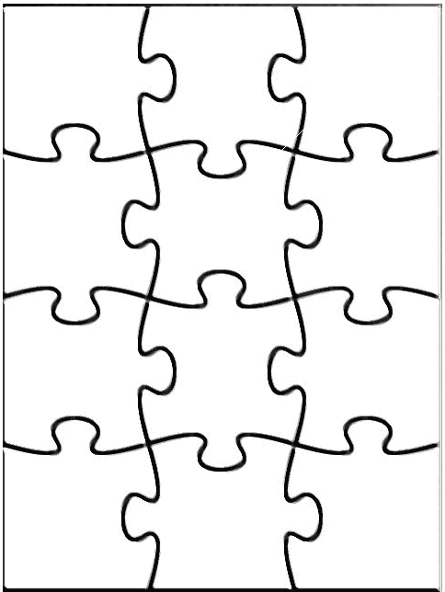
Main Areas of AI
Knowledge representation (including formal logic)
Search, especially heuristic search (puzzles, games)
Planning
Reasoning under uncertainty, including probabilistic reasoning
Learning
Agent architectures
Robotics and perception
Natural language processing
Agent
Perception
Robotics
Reasoning
Search
Learning
Knowledge rep.
Constraint satisfaction
Planning
Natural language
...
Expert
Systems

Slide 5
Can Machines Act/Think Intelligently?
“If there were machines which bore a resemblance to our bodies and imitated our actions as closely as possible for all practical purposes, we should still have two very certain means of recognizing that they were not real men. The first is that they could never use words, or put together signs, as we do in order to declare our thoughts to others… Secondly, even though some machines might do some things as well as we do them, or perhaps even better, they would inevitably fail in others, which would reveal that they are acting not from understanding, …”
Discourse on the Method, by Descartes (1598-1650)

Slide 6

Can Machines Act/Think Intelligently?
Turing Test:
Test proposed by Alan Turing in 1950
The proposed test is called as “The Imitation Game"
The computer is asked questions by a human interrogator. It passes the test if the interrogator cannot tell whether the responses come from a person
Required capabilities: natural language processing, knowledge representation, automated reasoning, learning,...
No physical interaction
Chinese Room (J. Searle)

Slide 7
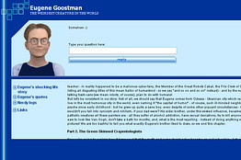
Was the Turing Test Passed?
It was told that a computer program called “Eugene Goostman” had passed the famous Turing Test
Vladimir Veselov, a software engineer from Russia, who led the team that created the program
Eugene posed as a 13-year-old from Odessa, Ukraine, for whom English was a second language
In a test on 1st week of June, 2014 sponsored by the University of Reading in the U.K., 10 of 30 people were not able to distinguish Eugene from a human while chatting by text.
Eugene’s claim is disputed.
Critics said Eugene had an unfair advantage by posing as a non-English-speaking teen, and said the program was narrowly tailored for the test, rather than a true “thinking machine.”

Slide 8
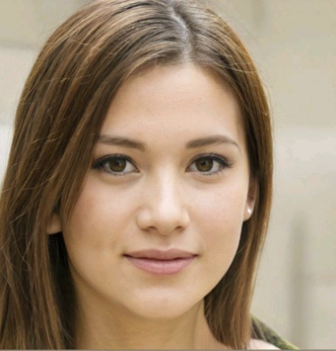
Recent Successes
AI generated paintings. These are auctioned by Cristie (October 25, 2018) and they earn $4,32,000 (approx.)
Alexa, Amazon’s voice-control system, lets you speak your wishes to an Echo smart speaker and see them fulfilled—at least simple ones, like dimming your lights or playing music tracks.
Honda’s human like robot, ASIMO, capable of recognizing moving objects, its surrounding environment, sounds, faces etc. It interprets voice commands, recognizes when handshake is offered.
Google’s DeepMind unit, which is working to develop super-intelligent computers, has created a system, called WaveNet, for machine-generated speech that it says outperforms existing technology by 50 percent.

Slide 9
More Recent Successes
ICICI Bank, India’s largest private sector bank, announced the deployment of ‘Software Robotics’ in over 200 business processes across various functions of the bank. The bank is the first in the country and among few, globally, to deploy ‘Software Robotics’ that emulates human actions to automate and perform repetitive, high volume and time consuming business tasks cutting across multiple applications. (September, 2016)
Google’s Self Driving Car

Slide 10
History of AI
1956: birth of AI
The name “Artificial Intelligence” is coined
1950s: initial promise
Early AI programs, including
Samuel's checkers program
Newell & Simon's Logic Theorist
1955-65: “great enthusiasm”
Newell and Simon: GPS, general problem solver
Gelertner: Geometry Theorem Prover
McCarthy: invention of LISP
1966—73: Reality dawns
Realization that many AI problems are intractable
Limitations of existing neural network methods identified
Neural network research almost disappears

Slide 11
History of AI (contd..)
1969—85: Adding domain knowledge
Development of knowledge-based systems
Success of rule-based expert systems,
E.g., DENDRAL, MYCIN
But were brittle and did not scale well in practice
1986-- Rise of machine learning
Neural networks return to popularity
Major advances in machine learning algorithms and applications
1990-- Role of uncertainty
Bayesian networks as a knowledge representation framework
1995-- AI as Science
Integration of learning, reasoning, knowledge representation
AI methods used in vision, language, data mining, etc

Slide 12
Success Stories
Deep Blue defeated the reigning world chess champion Garry Kasparov in 1997
AI program proved a mathematical conjecture (Robbins conjecture) unsolved for decades
During the 1991 Gulf War, US forces deployed an AI logistics planning and scheduling program that involved up to 50,000 vehicles, cargo, and people
NASA's on-board autonomous planning program controlled the scheduling of operations for a spacecraft
Proverb solves crossword puzzles better than most humans
Robot driving: DARPA grand challenge 2003-2007
2006: face recognition software available in consumer cameras

Slide 13
Example: DARPA Grand Challenge
Grand Challenge
Cash prizes ($1 to $2 million) offered to first robots to complete a long course completely unassisted
Stimulates research in vision, robotics, planning, machine learning, reasoning, etc
2004 Grand Challenge:
150 mile route in Nevada desert
Furthest any robot went was about 7 miles
… but hardest terrain was at the beginning of the course
2005 Grand Challenge:
132 mile race
Narrow tunnels, winding mountain passes, etc
Stanford 1st, CMU 2nd, both finished in about 6 hours
2007 Urban Grand Challenge
This November in Victorville, California

Slide 14
Importance of Knowledge
The meaning of knowledge is closely related to the meaning of intelligence.
a characteristic of intelligent people is that they possess much knowledge.
Knowledge may be declarative or procedural.
Heuristic, that is another special type of knowledge, used by humans to solve complex problems.
knowledge is defined as a set of rules & facts
A fact is always unconditionally true.
rule is true if some condition is satisfied. Rules have:
a) a condition part (right hand side)
b) a conclusion part (left hand side)
c) : - means if
d) a rule is read as if right hand side is true then left hand side is true, or left hand side is true if right hand side is true.
Example pam tom
fact: parent (tom, bob).
bob rule: offspring( X, Y):- parent (Y, X).
ann

Slide 15
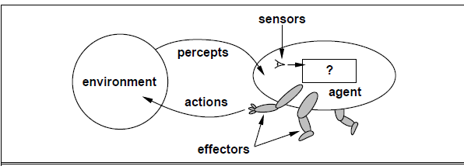

INTELLIGENT AGENTS
An agent is anything that can be viewed as perceiving its environment through sensors and acting upon that environment through effectors/actuators.
Rational Agent – is the one that does the right thing
Performance Measure - is the criteria that determine how successful an agent is.
Example: an agent that is supposed to vacuum a dirty floor.

Slide 16
HOW AGENTS SHOULD ACT
Ideal rational agent: For each possible percept sequence, an ideal rational agent should do whatever action is expected to maximize its performance measure, on the basis of the evidence provided by the percept sequence and whatever built-in knowledge the agent has.
What is rational at any given time depends on four things:
a) The performance measure that defines degree of success. (P)
b) What the agent knows about the environment (E)
c) The actions that the agent can perform (A)
d) Everything that the agent has perceived so far through sensors (S)

Slide 17
Ideal mapping from percept sequences to actions
If an agent’s behavior depends only on its percept sequence to date, then it’s better to describe any particular agent by making a table of the action it takes in response to each possible percept sequence.
Such a list is called a mapping from percept sequences to actions.
This does not mean, of course, that we have to create an explicit table with an entry
for every possible percept sequence
It is possible to define a specification of the mapping without exhaustively enumerating it.

Slide 18
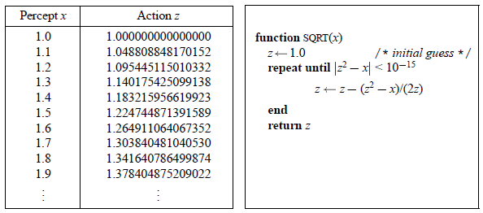
Example:
Consider a very simple agent: the square-root function on a calculator.
Whereas the table is very large, the agent is a nice, compact program.

Slide 19
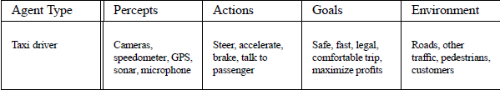
STRUCTURE OF INTELLIGENT AGENTS
agent program: a function that implements the agent mapping from percepts to actions.
Architecture: is the computing device on which this program will run
The relationship among agents, architectures, and programs can be summed up as follows:
agent = architecture + program
Example: The taxi driver agent type

Slide 20
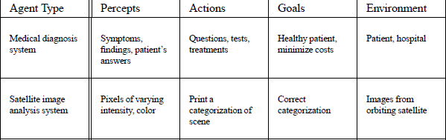

Examples of Agent types

Slide 21
ENVIRONMENTS
Accessible vs. inaccessible - If an agent’s sensory apparatus gives it access to the complete state of the environment, then we say that the environment is accessible to that agent
e.g. chess is accessible, whereas taxi driving is not accessible
Deterministic vs. nondeterministic - If the next state of the environment is completely determined by the current state and the actions selected by the agents, then we say the environment is deterministic
e.g. chess is deterministic, whereas taxi driving is nondeterministic
Static vs. dynamic - If the environment can change while an agent is deliberating, then we say the environment is dynamic for that agent; otherwise it is static.
e.g. chess is static, whereas taxi driving is dynamic
Discrete vs. continuous - If there are a limited number of distinct, clearly defined percepts and actions we say that the environment is discrete.
e.g. Chess is discrete, whereas Taxi driving is continuous

Slide 22
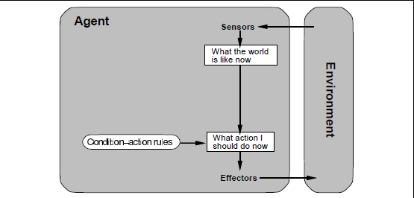
Different Types of Agent Programs
Simple reflex agents - respond immediately to percepts
For example, if the car in front brakes, and its brake lights come on, then the driver should notice this and initiate braking.

Slide 23
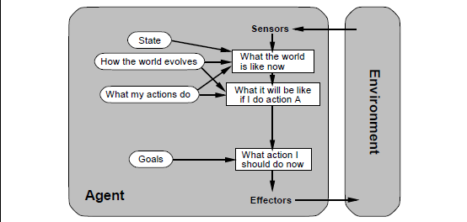
Different Types of Agent Programs contd....
Goal-based agents
Knowing about the current state of the environment is not always enough to decide what to do
Apart from current state description, the agent needs some sort of goal information, which describes situations that are desirable

Slide 24
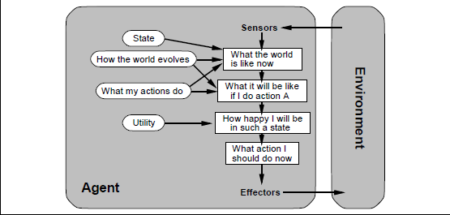
Different Types of Agent Programs contd....
Utility-based agents
Goals alone are not really enough to generate high-quality behavior
Utility is therefore a function that maps a state onto a real number, which describes the associated degree of happiness.

Slide 25
Problem Solving (State Space Search)
Problems can be characterized as a space consisting of a set of states (not necessarily finite) & a set of operators that map from one state to other states
Search methods are used to solve problems by searching a state-space to find a path (optimal) from a given initial state to a final state. The path found would indicate the steps or moves required to solve the given problem.
The problem may not naturally indicate a state-space representation. It may have to be reformulated in order to be suited for solving by search methods.
The state-space is basically a directed graph known as a search graph with a special node called a start node(s) & a set of goal nodes (r). If an arc is directed from node n_{i} to n_{j}, then n_{j} is said to be a successor of n_{i}. Given a node (state), the problem defines the operators which can be applied to the node to generate its successor nodes. There is a cost associated with generation of each successor. Hence each arc is generally labeled with an operator & a cost of applying the operator. Solving the problem, thus reduces to find the sequence of steps or moves required from start to goal state.

Slide 26
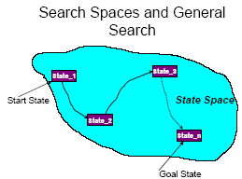
Problem Solving (State Space Search) contd…
In general the search graph is supplied implicitly to any search algorithm. The start node, the goal nodes & the operators are given as inputs. Any search algorithm starts by expanding the start node (i.e. by generating the successor of the start node with the help of operators) & adding its successors to the explicit graph. At any step, in general, a node in the explicit graph is chosen for expansion & the algorithm terminates when the goal node is chosen.
The implicit graph may have infinitely many nodes & arcs. In general the Assumption are:
a) Solution path is of finite cost.
b) Arc costs are +ve & greater than equal to ∆, a small +ve constant.
c) Finitely many successors of a node. The search algorithm tries to
restrict the search space by not generating all the nodes & arc of
implicit search graph.

Slide 27
Definition
Definition 1.
A state-space representation is a tuple 〈 A, k ,C ,O 〉 , where:
(1) A : is the set of states, A≠∅ ,
(2) k ∈A : is the initial state,
(3) C⊆A : is the set of goal states,
(4) O : is the set of the operators, O≠∅ .
Every o∈O operator is a function o : Dom(o)→A , where Dom(o)={a ∣ a∉C ∧ precondition_{o} (a)} ⊆A
Definition 2. Let 〈 A, k ,C ,O 〉 be a state-space representation, and a ,a' ∈A are two states. a ' is directly accessible from a if there is an operator o∈O where precondition_{o} (a) holds and o(a)=a' .
Definition 3. The problem 〈 A, k ,C ,O 〉 is solvable if , for any goal state c∈C . In this case, the operator sequence is referred as a solution to the problem.

Slide 28
State – Space Graph
The best tool to demonstrate the state-space representation of a problem is the state-space graph
Let 〈 A, k ,C ,O 〉 be the state-space representation of a problem. The problem's state-space graph is the graph 〈 A, E〉 , where (a ,a ‘)∈E and (a ,a ‘) is labelled with o if and only if
Therefore, the vertices of the state-space graph are the states themselves, and we draw an edge between two vertices if and only if one vertex (as a state) is directly accessible from another vertex (as a state). We label the edges with the operator that allows the direct accessibility.
It can be easily seen that a solution of a problem is nothing else but a path that leads from a vertex k (aka the initial vertex) to some vertex c∈C (aka the goal vertex). Precisely, the solution is the sequence of labels (operators) of the edges that formulate this path.

Slide 29
Examples
Water-Jug Problem
Description: You are given two jugs, a 4 gallon one & a 3 gallon one. Neither has any measuring marker on it. There is a pump that can be used to fill the jugs with water. How can you get exactly 2 gallons of water in to the 4 gallons jug?
State-Space Representation of the problem:
Start State: S (0, 0)
Goal State: S (2, n), for any value of n.

Slide 30
Examples
Water-Jug Problem
Statement:
We have 3 jugs of capacities 3, 5, and 8 litres, respectively. There is no scale on the jugs, so it's only their capacities that we certainly know. Initially, the 8-litre jug is full of water, the other two are empty. We can pour water from one jug to another, and the goal is to have exactly 4 litres of water in any of the jugs. The amount of water in the other two jugs at the end is irrelevant.

Slide 31
Examples
Water-Jug Problem
Description: Since there is no scale on the jugs and we don't have any other tools that would help, we can pour water from jug A to jug B in two different ways:
We pour all the water from jug A to jug B .
We fill up jug B (and it's possible that some water will remain in jug A ).

Slide 32
Examples
Water-Jug Problem
Set of states: In the states, we store the amount of water in the jugs. Let the state be an tuple, in which the i^{th} part tells about the jug denoted by i how many litres of water it is containing.
So, the set of states is defined as follows:
A={(a₁,a₂, a₃) ∣ 0≤a_{i}≤max_{i} }
Initial state: the initial state is: k=(0,0 ,max₃)= (0,0,8)
Set of goal states: We have several goal states, so we define the set of goal states with help of a goal condition:
C={(a₁ ,a₂ ,a₃)∈A ∣ ∃i a_{i}=4}

Slide 33
Examples
Set of operators: Our operators realize the pouring from one jug (denoted by i ) to another one (denoted by j ). We can also specify that the source jug ( i ) and the goal jug ( j ) can't be the same. Our operators are defined as follows:
O={ pour_{i , j} ∣ i , j∈{1,2,3} ∧ i≠ j }
Precondition of the operators: Let's define when an operator pour_{i , j} can be applied to a state (a₁ , a₂ , a₃) ! It's practical to specify the following conditions:
Jug i is not empty.
Jug j is not filled.
So, the precondition of the operator pour_{i , j} to the state (a1 , a2 , a3 ) is: a_{i}≠0 ∧ a_{j}≠max_{j}

Slide 34
Examples
Function of applying: Define what state (a'₁ , a'₂ , a’₃) does the operator pour_{i , j} create from the state (a₁ , a₂ , a₃) ! The question is how many litres of water can we pour from jug i to jug j . Since at most max_{j}−a_{j} litres of water can be poured to jug j , we can calculate the exact amount to be poured by calculating min(a_{i} , max_{j}−a_{j}). Denote this amount with T . Consequently:
pour_{i , j} (a1 , a2 , a3)=(a '1 , a '2 , a ‘3) , where
a '_{m}= a_{i}−T , if m=i
a_{j}+T , if m=j
a_{m} , otherwise
where m∈{1,2,3}

Slide 35
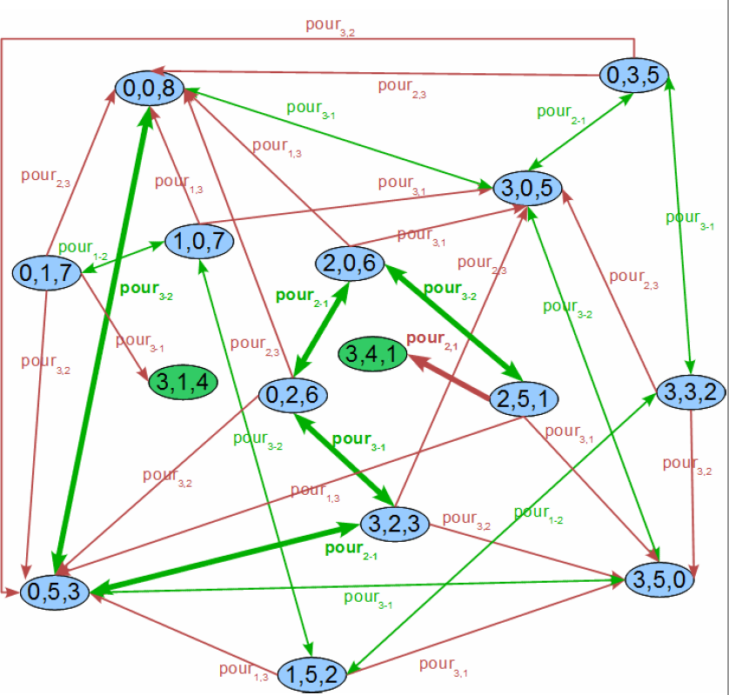
Examples
State-Space Graph

Slide 36
Examples
TOWERS OF HANOI
Statement: There are 3 discs with different diameters. We can slide these discs onto 3 perpendicular rods. It's important that if there is a disc under another one then it must be bigger in diameter. We denote the rods with „P”, „Q”, and „R”, respectively. The discs are denoted by „1”, „2”, and „3”, respectively, in ascending order of diameter. We can slide a disc onto another rod if the disc
is on the top of its current rod, and
the discs on the goal rod will be in ascending order by size after the replacing.
Our goal is to move all the discs to rod R.

Slide 37
Examples
TOWERS OF HANOI
Set of States: In the states, we store the information about the currently positions (i.e., rods) of the discs. So, a state is a vector (a₁ , a₂ , a₃) where ai is the position of disc i (i.e., either P, Q, or R). Namely: A=(a₁,a₂,a₃) ∣ a_{i}∈{P ,Q, R}}
Initial state: Initially, all the discs are on rod P, i. e. k=(P , P ,P)
Set of goal states: The goal is to move all the three discs to rod R. So, in this problem, we have only one goal state, namely: C={(R, R , R)}
Set of operators: Each operator includes two pieces of information:
▫ which disc to move
▫ to which rod?
O={move_{which , where} ∣ which∈{1,2,3} , where∈{P ,Q , R}}

Slide 38
Examples
TOWERS OF HANOI
Precondition of the operators:
Take an operator move_{which ,where} ! Let's examine when we can apply it to a state (a₁ , a₂ , a₃) ! We need to formalize the following two conditions:
The disc which is on the top of the rod a_{which} .
The disc which is getting moved to the top of the rod where .
Thus, the precondition of the operators is:
a_{which}≠where∧∀ i (i<which ⇒ a_{i}≠a_{which} ∧ a_{i}≠where)

Slide 39
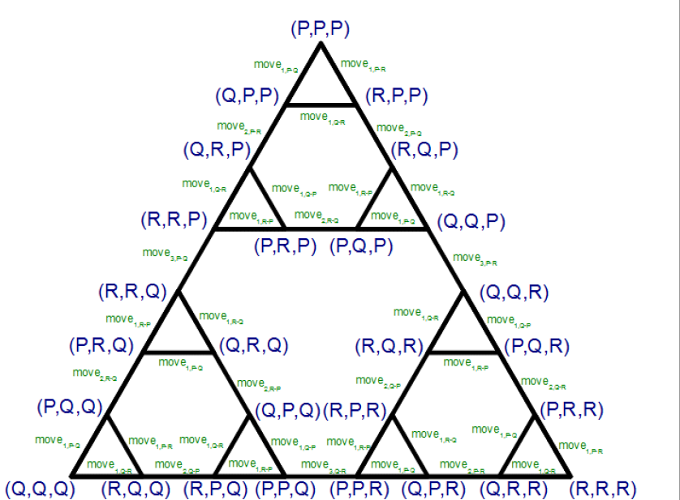
Examples
TOWERS OF HANOI: State-Space Graph

Slide 40
Examples
8-Queens Problem
Statement: Place 8 queens on a chessboard in a way that no two of them attack each other. Generalize the task to a N×N (N>=1) chessboard, on which we need to place N queens.
Description: The basic idea of the state-space representation is the following: since we will place exactly one queen to each row of the board, we can solve the task by placing the queens on the board row by row. So, we place one queen to the 1st row, then another one to the 2nd row in a way that they can't attack each other. In this way, in step i^{th} we place a queen to row i while checking that it does not attack any of the previously placed i−1 queens.

Slide 41
Examples
Set of states: In the states we store the positions of the placed queens within a row! Let's have a N -component vector in a state, in which component i tells us to which column in row i a queen has been previously placed. If we haven't placed a queen in the given row, then the vector should contain 0 there. In the state we also store the row in which the next queen will be placed.
So: A={(a1 ,a2 ,.., aN , s) ∣ 0<=ai<=N ,1<=s<=N+1}
As one of the possible value of s , N+1 is a non-existent row index, which is only permitted for testing the terminating conditions.
Initial state: Initially, the board is empty. Thus, the initial state is: k=(0,0 ,..,0 ,1)
Set of goal states: We have several goal states. If the value of s is a non-existent row index, then we have found a solution. So, the set of goal states is: C={(a1 ,..,aN , N +1)∈A}

Slide 42
Examples
Set of operators: Our operators will describe the placing of a queen to row s . The operators are expecting only one input data: the column index where we want to place the queen in row s . The set of our operators is: O={ placei ∣ 1<=i<=8}

Slide 43

Examples
Precondition of the operators: The preconditions of applying an operator place_{i} to a state (a1 ,..,a8 , s) are as follows:
It can be applied if the queen we are about to place is:
not in the same row as any queens we have placed before. So, we need to examine if the value of i was in the state before the s^{th} component. i. e., for all m<s : a_{m}≠i
not attacking any previously placed queens diagonally. The row index of the queen we are about to place is s , while the column-index is i . So: for all m<s : ∣s−m∣≠∣i−a_{m}∣
Function of applying:
Place_{i} (a1 ,.., a8 , s)=(a '1 ,.., a '8 , s ‘) , where

Slide 44
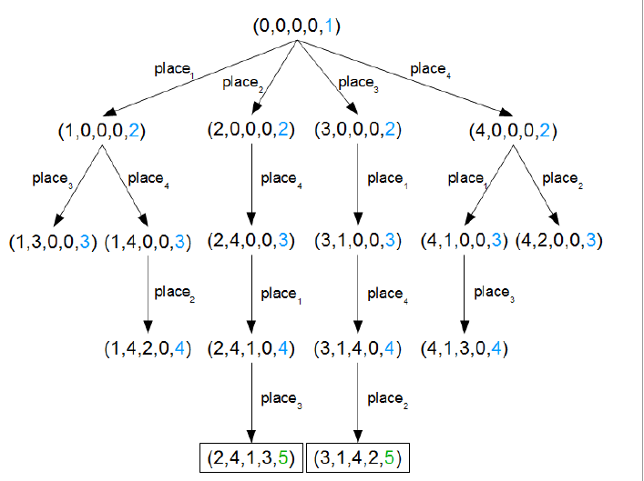
Examples
State-Space Graph: N Queens problem, when N = 4

Slide 45
Examples
The wolf-goat-cabbage problem
Description A farmer is on the left bank of a river with a boat, a cabbage, a goat, and a wolf. The task is to get everything to the right bank of the river.
Restrictions:
a) only the farmer can handle the boat
b) when he is in the boat, there is only space for one more item
c) The farmer can't leave the goat alone with the wolf, nor with the
cabbage (or something will be eaten)
State-Space Representation of the problem:
Initial State: S (L, [w, g, c], [])
Final State: S (R, [], [w, g, c])

Slide 46
Examples
Missionaries and Cannibals Problem
Description:
There are three missionaries and three cannibals on the left bank of a river. They wish to cross over to the right bank using a boat.
Restrictions:
a) The boat can carry two at a time.
b) The number of cannibals on either bank must never exceed the
number of missionaries on the same bank, otherwise the
missionaries will become the cannibals' dinner!
c) Plan a sequence of crossings that will take everyone safely across.
State-Space Representation of the problem:
Initial State: S (L, [3, 3], [0, 0])
Goal State: S (R, [0, 0], [3, 3])

Slide 47
Production System
It provides useful structures to AI programs that facilitates the search process
A production system consists of
a) a set of rules
b) One/ more knowledgebase that contain whatever information is
appropriate for the particular task
c) a control strategy that specifies the order in which the rules will be
applied
d) a rule applier

Slide 48
Control Strategies
It decides which rule to apply next during the process of searching for a solution to a problem
The first requirement of a good control strategy is that it cause motion
The second requirement is that it be systematic

Slide 49
Production System Characteristics
Monotonic system – is the one in which the application of a rule never prevents the later application of another rule that could also have been applied at the time first rule was selected
Non-monotonic system – is the one in which this is not true
Partially commutative system – is the one with the property that if the application of a particular seq of rules transforms state x into state y, then any permutation of those rules that is allowable also transforms state into state y
Commutative system – is one that is both monotonic & partially commutative

Slide 50
Search Methods
Search can be characterized as finding a path through a graph or tree structure
This requires moving from node to node after successively expanding & generating connected nodes.
The process of generating all of the children of a parent is also known as expanding the node
A search procedure is a strategy for selecting the order in which nodes are generated & a given path selected
Search problems can be classified by the information used to carry out a given strategy
blind or uninformed search
informed or directed search

Slide 51
Search Strategies
A strategy is defined by picking the order of node expansion
Strategies are evaluated along the following dimensions:
Completeness: does it always find a solution, if one exists?
Time complexity: number of nodes generated/expanded
Space complexity: maximum number of nodes in memory
Optimality: does it always find a least-cost solution?
Time and space complexity are measured in terms of
b - maximum branching factor of the search tree
d - depth of the least-cost solution
m - maximum depth of the state space (may be ∞)

Slide 52
Uninformed or Blind Search
Breadth-first search
Uniform-cost search
Depth-first search
Depth-limited search
Iterative deepening search

Slide 53
Breadth – first Search (BFS)
Algorithm
begin
put start node in OPEN, found = false;
while OPEN not empty & not(found) do
begin
remove top-most node n from OPEN & put n in CLOSED;
expand n generating all its successors;
put those successors (in no particular order) at the end of OPEN except the
successor already appearing in CLOSED; // also in OPEN for graphs
direct backward pointer to n for each successor n_{i};
if any of the successor is a goal node then
found = true;
else if any of n_{i} is a dead end then
remove it from OPEN ;
end
if OPEN is empty then
output failure message;
else
output solution path by tracing back thru pointers;
end

Slide 54
Breadth – first Search (BFS) Example
S
m1 m2
m3
m4 m5
m6 r m3 m6
m1 m4 r
S
m2 m5
OPEN | CLOSED
S
S | S
m1m2 | S m1
m2 m3 m4 | S m1 m2
m3 m4 m5 | S m1 m2 m3
m4 m5 | S m1 m2 m3 m4
m5 m6 r

Slide 55
Remarks
OPEN holds nodes generated in the explicit graph, but not yet expanded. CLOSED holds list of expanded nodes in the graph
Complete?? Yes (if b is finite)
Time?? 1 + b + b² + b³ + : : : + b^{d} = O(b^{d+1}),
Space?? O(b^{d+1}) (keeps every node in memory)
Optimal?? Yes (if cost = 1 per step); not optimal in general
Advantages
BFS guarantees to find goal node if one exist. But the solution may not be optimal in terms of cost.
BFS produces faster solution in certain graphs.
Disadvantages
Higher memory required.
More house-keeping work, more overhead & relatively difficult to implement.
Not suitable for human problem solving approach.

Slide 56
Uniform cost search
Uniform cost search modifies the breadth-first strategy by always expanding the lowest-cost node on the fringe (as measured by the path cost g(n)), rather than the lowest-depth node, where g(n): cost of currently known best path from start node s to n
It is easy to see that breadth-first search is just uniform cost search with g(n) = DEPTH(n)
When certain conditions are met, the first solution that is found is guaranteed to be the cheapest solution, because if there were a cheaper path that was a solution, it would have been expanded earlier, and thus would have been found first

Slide 57
Uniform cost search contd..
Algorithm
begin
g(s) = 0; put s in OPEN; found = false;
while OPEN not empty & not(found) do
begin
select a node n from OPEN with minimum g-value(resolve ties arbitrarily but in
favor of a goal node);
remove n from OPEN & put n in CLOSED;
if n is a goal node then found = true;
else begin
expand n generating all its immediate successors n_{i} (if any);
for each n_{i} do
begin
g = g(n) + c(n, n_{i});
if n_{i} is not already in OPEN or CLOSED then
begin
g(n_{i}) = g; put n_{i} in OPEN;
direct backward pointer from n_{i} to n;
end
else if n_{i} is in OPEN and g(n_{i}) > g then
begin
g(n_{i}) = g;
redirect backward pointer from n_{i} to n;
end
end
end
end
if (found) then output g(n) & solution path thru pointers;
else output failure message;
end

Slide 58
Remarks
Uniform cost works with g(n) values of node. It doesn’t use any information about the cost of the remaining path from a node to a goal node. So, in many problems the uniform cost method tends to expand too many nodes
It is possible to cut down the no. of node expansion by using the estimate of the cost of the remaining path from a node to a goal node
Complete?? Yes, if step cost ≥ ∈
Time?? # of nodes with g ≤ cost of optimal solution, O(b^{⌈C*/ ∈⌉})
where C* is the cost of the optimal solution
Space?? # of nodes with g ≤ cost of optimal solution, O(b^{⌈C*/ ∈⌉})
Optimal?? Yes - nodes expanded in increasing order of g(n)

Slide 59
Depth First Search (DFS)
Algorithm
begin
put start node s into OPEN;
found = false;
while OPEN not empty & not(found) do
begin
remove top most node n from OPEN & put it in CLOSED;
if depth of n = depth bound then // depth bound is set very high, say infinity
CLEAN-UP CLOSED;
else begin
expand n generating all its successors;
put these successors (in no particular order) on top of OPEN
except the successor already appearing in CLOSED;
Direct backward pointer to n for each succ. n_{i};
If any of n_{i} is a goal node then
Found = true;
Else if any n_{i} is a dead end then
Remove it from OPEN & CLEAN-UP CLOSED;
end
end
if OPEN is empty then
output “solution path not found”;
else
output the solution by tracing back thru pointers;
end { End of Algorithm }

Slide 60
Depth First Search (DFS) Example
S
m1 m2
m3
m4 m5
m4 m6
m6 r m3 r
m1 m5
S m4
m2
OPEN | CLOSED
S
S | S
m1m2 | S m1
m3m4m2 | S m1 m3
m4 m5 m4 m2 | S m1 m3 m4
m6 r m5 m4 m2

Slide 61
Depth First Search (DFS) Example
A
B F
C D G
E H
I
OPEN | CLOSED
A
B F | A
CDF | A B
DF | A B
EF | ABD Due to CLEAN-UP
F | A
G | AF
H | AFG
I | AFGH

Slide 62
Remarks
CLEAN-UP operation means removing of all the nodes from CLOSED that don’t have any child in OPEN
CLOSED will contain only the expanded nodes in the current path, reduces size of CLOSED & save memory.
CLOSED list forms a single path from the start node to the currently expanded node with CLEAN-UP operations. This restricts maximum storage which is: depth bound * branching factor
Complete?? No: fails in infinite-depth spaces, spaces with loops Modify to avoid repeated states along path
-→ complete in finite spaces
Time?? O(b^{m}): terrible if m is much larger than d
but if solutions are dense, may be much faster than breadth-first
Space?? O(bm), i.e., linear space!
Optimal?? No

Slide 63
Depth-limited Search
Depth-limited search is a depth-first search with depth limit l, i.e., nodes at depth l have no successors
The drawback of DFS is that it can make a wrong choice & get stuck going down a very long (or even infinite) path when a different choice would lead to a solution near the root of the search tree
The depth limit solves the infinite-path problem
The problem of unbounded trees can be alleviated by supplying depth-first search with a predetermined depth limit l, i.e. nodes at depth l are treated as if they have no successors
But, it also introduces an additional source of incompleteness if we choose l<d, i.e., the shallowest goal is beyond the depth limit
Time needed: O(b^{l}), Space needed: O(bl)
DFS can be viewed as a special case of depth-limited search with l = ∝

Slide 64
Iterative deepening depth-first search
This is a general strategy, often used in combination with depth-first search, that finds the best depth limit
It does this by gradually increasing the limit – first 0, then 1, then 2, & so on – until a goal is found
This will occur when the depth limit reaches d, the depth of the shallowest goal node
Iterative deepening combines the benefits of DFS & BFS

Slide 65
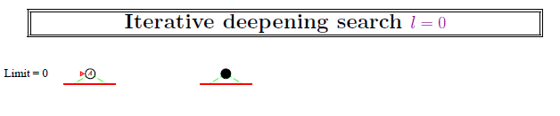

Slide 66
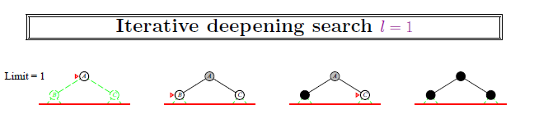

Slide 67
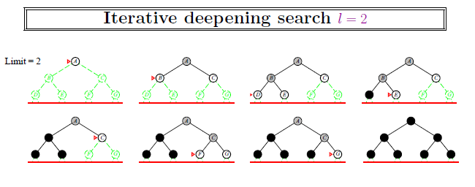

Slide 68
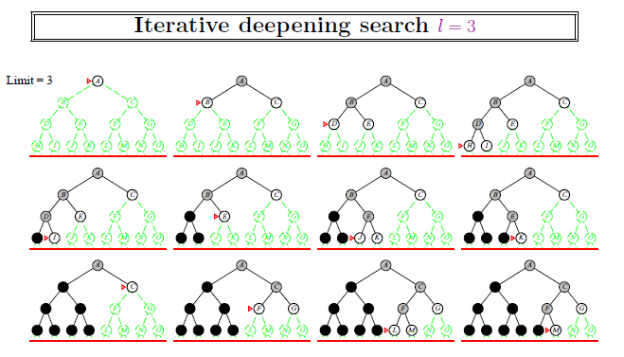

Slide 69
Remarks
Complete?? Yes
Time?? (d)b¹ + (d -1)b² + : : : + (1)b^{d} = O(b^{d})
Space?? O(bd)
Optimal?? Yes, if step cost = 1
Can be modified to explore uniform-cost tree
Numerical comparison for b = 10 and d = 5, solution at far right leaf:
N(IDS) = 50 + 400 + 3,000 + 20,000 + 100,000 = 123, 450
N(BFS) = 1+10 + 100 + 1, 000 + 10, 000 + 100, 000 = 1, 11,111
an iterative deepening search from depth 1 all the way down to depth d expands only about 11 % more nodes than a single breadth-first or depth-limited search to depth d, when b = 10

Slide 70
Informed Search
more information than the initial state, the operators, & the goal state is available
When this is the case, the better the information available, the more efficient the search process will be
They often depend on the use of heuristic information
A heuristic is a method that
a) might not always find the best solution
b) but is guaranteed to find a good solution in reasonable time.

Slide 71
A*
Algorithm
begin
g(s)=0; h(s)=0; put s in OPEN; found = false;
while OPEN not empty & not(found) do
begin
select a node from OPEN with minimum f-value(resolve ties
arbitrarily, but in favor of a goal node);
remove n from OPEN & put n in CLOSED;
if n is a goal node then
found = true;
else begin
expand n generating all its immediate successors n_{i} (if any);
for each successor n_{i} of n do
begin
g = g(n) + c(n, n_{i});
if n_{i} is not already in OPEN or CLOSED then
begin
g(n_{i}) = g;
f(n_{i}) = g+h(n_{i});
put n_{i} in OPEN;
direct backward pointer from n_{i} to n;
end
else if g(n_{i}) > g then
begin
g(n_{i}) = g; f(n_{i}) = g+h(n_{i});
redirect backward pointer from n_{i} to n;
if ni is in CLOSED then
remove it from CLOSED & put n_{i} in OPEN;
end
end
end
end
if (found) then output f(n) & solution path by tracing back through pointers;
Else output failure message;
end

Slide 72
A* Example (I)
S
2 3
m1⁽⁴⁾ m2⁽⁵⁾
3 m3⁽⁰⁾ 1
4 1
1 2
m4⁽⁵⁾ m5⁽³⁾
1 1 3
m6 ⁽²⁾ r
Solution Path: S m2 m5 r, cost = 7
Note: This is not the best solution
steps | S | m1 | m2 | m3 | m4 | m5 | m6 | r
1 | 0+0
2 | 0+0 | 2+4 | 3+5
3 |  | 2+4 | 3+5 | 5+0 | 6+5
4 |  |  | 3+5 | 5+0 | 6+5 | 7+3
5 |  |  | 3+5 | 4+0 | 6+5 | 4+3
6 |  |  |  | 4+0 | 5+5 | 4+3
7 |  |  |  |  | 5+5 | 4+3 |  | 7+0
8 |  |  |  |  |  |  |  | 7+0

Slide 73
A* Example (II)
S
m1⁽⁸⁾ 1 2 m2⁽⁸⁾
3 4 n2⁽⁵⁾ 2 1 3
n1⁽⁷⁾ n3⁽⁷⁾ n4⁽⁶⁾
3 1
r1 2
r2
Solution Path: S m2 n2 r1, Cost = 7
Note: Still not the best solution
steps | S | m1 | m2 | n1 | n2 | n3 | n4 | r1 | r2
1 | 0+0
2 | 0+0 | 1+8 | 2+8
3 |  | 1+8 | 2+8 | 4+7 | 5+5
4 |  |  | 2+8 | 4+7 | 4+5 | 3+7 | 5+6
5 |  |  |  | 4+7 | 4+5 | 3+7 | 5+6 | 7+0
6 |  |  |  |  |  |  |  | 7+0

Slide 74
A* Example (III)
S
m1⁽⁶⁾ 4 2
n2⁽³⁾ m2⁽²⁾
3 4 2 1 3
n1⁽⁷⁾ n3⁽⁷⁾ n4⁽¹⁾
3
r1 1 2
r2
Solution Path: S m2 n4 r1, Cost = 6
steps | S | m1 | m2 | n1 | n2 | n3 | n4 | r1 | r2
1 | 0+0
2 | 0+0 | 1+6 | 2+2
3 |  | 1+6 | 2+2 |  | 4+3 | 3+7 | 5+1
4 |  | 1+6 |  |  | 4+3 | 3+7 | 5+1 | 6+0 | 7+0
5 |  | 1+6 |  |  | 4+3 | 3+7 |  | 6+0 | 7+0
6

Slide 75
Heuristic Estimate
Non-negative heuristic estimate h(n) is associated with each node n in the graph where h(n) is the estimate of the cost of a minimum cost path from n to a goal node
f(n) = g(n) + h(n), where f(n) gives an estimate of the cost of a minimal cost path from s to a goal node, which is constrained to pass through n, where as
g(n): cost of currently known best path from s to n
g*(n): cost of best path from s to n such that g*(n)≤g(n)
f(s): cost of the optimal solution path
h*(n) is the actual cost of a minimal cost path from n to a goal node. It is infinite if no path exists
f*(n) = g*(n) + h*(n) is the actual cost of a minimal cost path from the start node to a goal node which is constrained to pass through n, such that f*(n) ≥ f(s)

Slide 76
Remarks
If h=0 for all nodes then A* reduces to Uniform Cost method & the optimal solution is guaranteed
A heuristic h is admissible if for each node n belonging to the graph 0 ≤ h(n) ≤ h*(n). Otherwise a heuristic is called as inadmissible
Algorithm A* finds optimal solution path if heuristic estimates are admissible, i.e., h(n) never overestimates the cost to reach the goal
A* never stores entire explicit graph. That’s why size of memory requirement is appreciable in contrast to DFS
A node may be expanded more than once by A*, i.e., there is a chance of expanding more nodes in A* than Uniform Cost method

Slide 77
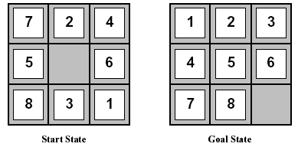
Heuristic Functions
Let’s consider the heuristics for the 8-puzzle problem, one of the earliest heuristic search problems
The two commonly used heuristic functions are:
h1 = the number of misplaced tiles. For the above figure, the start state would have h1=6. h1 is admissible heuristic, because it is clear that any tile that is out of place must be moved at least once.
h2 = the sum of the distances of the tiles from their goal positions. Because tiles can’t move along diagonals, the distance is the sum of the horizontal & vertical distances. This is sometimes called the city block distance or Manhattan distance. For the above figure, the start state gives a Manhattan distance of h2 = 4+0+3+3+1+0+2+1 = 14. h2 is also admissible, because all any move can do is to move one tile one step closer to the goal
It is easy to see from the definitions of the two heuristics that, for any node n, h2(n) ≥ h1(n), i.e., h2 dominates h1
It is always better to use a heuristic function with higher values, provided it does not overestimate & that the computation time for the heuristic is not too large

Slide 78
Important Results on A*
Consistent heuristic: for any node n and one of its children n’, h(n)≤ c(n, n’) + h(n’) & for any goal node G, h(G) = 0
a) If h is consistent, then p.t. h(n)≤ c(n, n’) + h(n’) is applicable for any descendant n’
of n.
Proof: n’’ – a grandchild of n by way of n’.
we know h(n)≤ c(n, n’) + h(n’) ------------------ (1)
we can write, h(n’)≤ c(n’, n’’) + h(n’’)
so from (1), h(n)≤ c(n, n’) + c(n’, n’’) + h(n’’)
≤ c(n, n’’) + h(n’’)
Thus the inequality holds for a grandchild n’’ of n as well as for a direct child n’ of n. By a similar argument, we can extend this to any descendant of n.

Slide 79
Important Results on A* contd..
b) If A* uses a consistent heuristic, then f(n) is non-decreasing along any path
Proof: we know that f(n) = g(n) + h(n) --------------- (1)
since A* uses consistent heuristic, so h(n)≤ c(n, n’) + h(n’)
so, from (1) we have,
f(n) ≤ g(n) + c(n, n’) + h(n’)
≤ g(n’) + h(n’) ≤ f(n’)
Thus we can say that a node’s f is never less than it’s parent’s f, so f is non-decreasing along any path
c) If h is consistent, then h is admissible also
Proof: since h is consistent heuristic, so h(n)≤ c(n, n’) + h(n’) ---------- (1)
now, for any node n, consider the best path from it to any goal node. This is h*(n) that an admissible heuristic must not overestimate. For the consistent heuristic, n’ can be any descendant of n. so let’s consider n’ be the node G, where G is that best reachable goal node.
so from (1) we get, h(n)≤ c(n, G) + h(G)
since h(G) = 0, so we have h(n)≤ c(n, G); h(n)≤ h*(n) which is the definition of admissible heuristic. Hence the proof.

Slide 80
Important Results on A* contd..
Prove that the heuristic ‘sum of manhattan distances’ for the 8-puzzle problem is an admissible heuristic
Proof: Let the sum of manhattan distances be denoted by totdist. We have to prove that totdist ≤ h* ∀ positions
this relation can be proved by the following argument:
if we relaxed the problem by allowing the tiles to climb on top of each other, then each tile could travel to its home square along a trajectory whose length is exactly the manhattan distance .
so the optimal solution in the relaxed puzzle would be exactly of length totdist.
In the original problem, however, there is interaction between the tiles and they are in each other’s way. This can prevent the tiles from moving along the shortest trajectories, which ensures our optimal solution’s length be equal to greater than totdist, i.e. h*≥ totdist.

