Slide 1
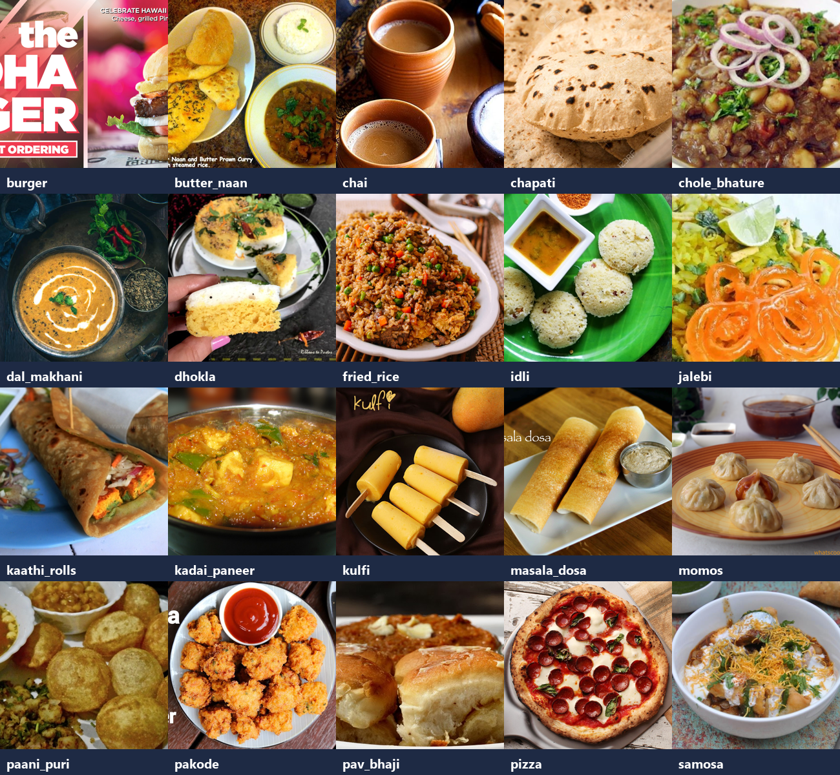
B.TECH AI & ML · 7TH SEMESTER · GROUP 4
PATTERN RECOGNITION PROJECT
Vegetarian Food Image Classification
using Transfer Learning
A two-stage fine-tuned ResNet-18 recognises 8 Indian vegetarian dishes from 2,000 REAL photographs — 88.49% test accuracy, trained on CPU.
one real photo per class
TEST ACCURACY 88.49%
Saswat Pattanaik · Ritesh Kumar Singh · Manoranjan Barik · Ankit Kumar Das
Guide: Mr. Rahul Rawat · Faculty of Engineering & Technology · Academic Year 2023 – 2027
Notes:
Introduce the rebuilt project: trained entirely on real photographs from the Indian Food Images dataset (no synthetic images). Two-stage fine-tuning on CPU. Headline: 88.49% test accuracy on 304 unseen photos.

Slide 2
THE PROBLEM
Real photos are messy — and that's the point
Why web-scraped food photography needs curation + transfer learning
A
B
C
Web photos are wild
Leakage ruins evaluation
Compute is scarce
Real scraped food images vary in framing, lighting, plating — and hide duplicates, menus and posters among genuine photographs.
Near-identical uploads straddling train and test inflate accuracy; deduplication must happen before splitting.
Training a CNN from scratch needs GPU-days; a semester project has a laptop CPU and a small labelled subset.
Goal: a 8-class vegetarian dish classifier trained purely on real photographs, with leakage-free splits and a measured fine-tuning gain — CPU only.
02 / 10
Notes:
Three pain points: messy real photos, leakage risk, compute budget. The goal box sets the bar: real photos only, deduplicated splits, measured gain.

Slide 3
THE IDEA
Borrow ImageNet's eyes, then let the late layers adapt
Two-stage transfer learning: frozen head training, then selective fine-tuning
Stage 1 — frozen backbone
WHY TWO STAGES
1
ImageNet ResNet-18 is frozen; a fresh 4,104-parameter head trains with Adam (lr 1e-3, cosine annealing) for 6 epochs.
Dish identity lives in mid-level textures — idli's steam pores, pakode's fried-batter granularity, dosa's lace. Generic ImageNet features under-represent those; fine-tuning layer3+layer4 retunes exactly them while early layers keep their general edge vocabulary.
Stage 2 — selective fine-tune
2
layer3 + layer4 unfreeze (10.5M parameters, 93.9% of the network) and fine-tune at lr 1e-4 — late features adapt, early features stay generic.
Honest evaluation
+8.4 pts
validation gain from fine-tuning
3
Deduplicated 70/15/15 split; the test split is touched exactly once — at the end.
03 / 10
Notes:
The design: stage 1 trains only the head; stage 2 adapts the late residual blocks. The payoff: +8.4 points validation accuracy.

Slide 4
THE DATA
2,000 real photographs, 8 verified classes
From the Indian Food Images corpus — validated, deduplicated, stratified
6,269
20 classes, all real
corpus photos
2,000
8 vegetarian classes × 250
curated subset
304
38 per class, balanced
unseen test photos
38
30 exact + 8 near (aHash)
Fig. 1 — one real photograph per class (validation grid)
duplicates removed
04 / 10
Notes:
Data story: 6,269-image real corpus validated (0 corrupted), eight vegetarian classes selected after verification, 38 duplicates removed, stratified 70/15/15 split. Vegetarian assumptions documented per dish; ambiguous kaathi_rolls excluded.

Slide 5
FROM DOWNLOAD TO DEPLOYMENT
Five-stage pipeline
prepare_data → build_subset → train → evaluate → predict
01
02
03
04
Download + validate
Curate subset
Two-stage training
Evaluate + serve
Parquet corpus extracted; every image decoded; corruption and flat-image scan; verification grid.
8 classes verified present; SHA-256 + perceptual-hash dedupe; stratified 70/15/15 split.
Frozen-head 6 epochs → layer3+4 fine-tune 6 epochs; best checkpoint on val accuracy.
Test-only metrics, confusion matrix, category analysis; upload interface runs the checkpoint.
prepare_data.py
build_subset.py
train.py
evaluate.py / app/
Reproducibility: five commands regenerate everything — dataset, subset, model, metrics, interface — from the raw shards.
05 / 10
Notes:
Walk the pipeline. Curation is a first-class stage, not an afterthought — that's what makes the evaluation honest.

Slide 6
THE MODEL
ResNet-18: frozen first, adaptive later
ImageNet1K_V1 backbone · 4,104-parameter head → 10.5M-parameter fine-tune
Input
TRAINING CONFIGURATION
224×224×3 · ImageNet-normalised
Backbone
ResNet-18, ImageNet1K_V1
ResNet-18 backbone
Stage 1
head only · Adam 1e-3 · 6 ep
stem + res2/res3 FROZEN · res4/res5 fine-tuned
Stage 2
layer3+4 · Adam 1e-4 · 6 ep
Scheduler
cosine annealing (both)
Global average pool
512-d feature vector
Batch size
32
Loss
cross-entropy (8-class)
fc head 512→8
Augment
crop .7–1.0, flip, ±10°, jitter
4,104 params (stage 1) + softmax
Best checkpoint
val 0.9122 (ep 8)
06 / 10
Notes:
Architecture and config. Key asymmetry: stage 1 trains 0.04% of the network, stage 2 93.9%. The 10x LR drop protects pretrained weights during fine-tuning.

Slide 7
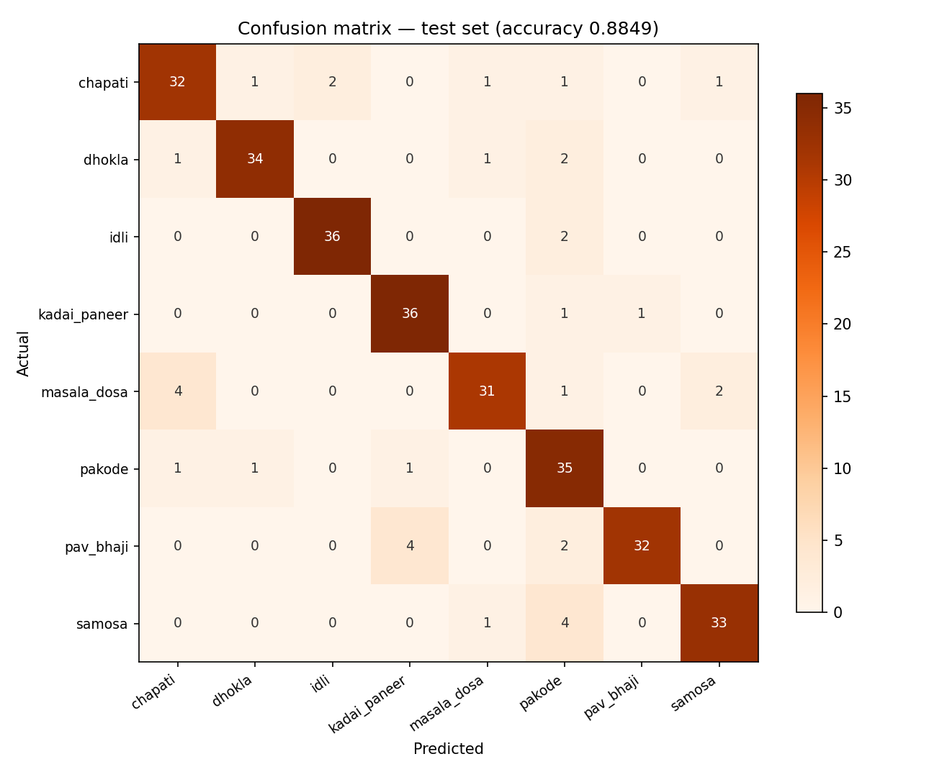
RESULTS
88.49% test accuracy on 304 unseen photos
Held-out real photographs · macro precision 0.8924 · macro F1 0.8860
Idli & Kadai Paneer
36/38 each (0.947)
Pakode
35/38 (0.921)
Masala Dosa (weakest)
31/38 (0.816)
WHERE THE 35 ERRORS LIVE
masala→chapati (4) · pav→kadai (4) · samosa→pakode (4) — visually plausible look-alikes: golden fried or gravy-dominant dishes. Every class stays above 0.82.
Fig. 2 — 8×8 confusion matrix, 304 test images
07 / 10
Notes:
Results: 269/304. Confusions are interpretable look-alike pairs. Balanced classes mean macro = weighted metrics (0.8860 F1).

Slide 8
BENCHMARK
Fine-tuning is worth +8.4 points
Same data, same schedule — only the trainable scope differs
Stage 1 — frozen backbone
MEAL-CATEGORY SCOREBOARD
82.77%
head only (4,104 params)
Breakfast
88.6%
101/114 test photos
OUR MODEL
Snack
89.5%
68/76 test photos
Stage 2 — fine-tuned layer3+4
91.22%
Main Meal
87.7%
10.5M params (93.9%)
100/114 test photos
No meal slot is systematically weak — a diet-tracking app can rely on all three categories nearly equally.
Δ = +8.4 pts and test accuracy 88.49% with macro F1 0.8860.
08 / 10
Notes:
The ablation: frozen backbone plateaus at 82.77%, fine-tuning reaches 91.22% — and test accuracy 88.49% confirms it generalises. Category scoreboard is balanced.

Slide 9
KEY INSIGHT
Curate first, fine-tune second
What training on real photographs taught us
Honest splits need dedupe
Late layers carry the cuisine
Real-data errors are legible
SHA-256 caught 30 byte-identical twins; perceptual hashing caught 8 more. Without them, near-duplicates would silently inflate test accuracy.
Frozen features plateau at 82.8%; adapting layer3+4 unlocks +8.4 points — dish identity lives in mid-level textures.
The 35 misses cluster into three plausible look-alike pairs. Legible errors make the next data investment obvious.
Takeaway: on real photographs, careful curation plus two-stage transfer learning delivers a dependable 8-dish classifier on a laptop CPU — no synthetic data, no GPU, no leakage.
09 / 10
Notes:
Three insights: dedupe before splitting, fine-tune the late layers, and read the errors — they point to the next data investment.

Slide 10
Thank You
TEST ACCURACY 88.49% · 8 CLASSES · 2,000 REAL PHOTOS
Notes:
Close: thank the panel. One-line summary: a two-stage fine-tuned ResNet-18 classifies eight vegetarian dishes at 88.49% test accuracy on 304 unseen real photographs — trained entirely on CPU.

