Slide 1
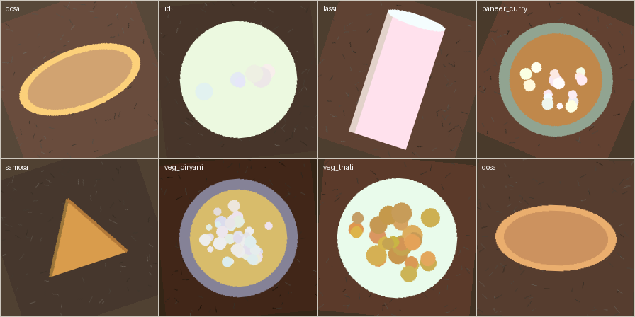
B.TECH AI & ML · 7TH SEMESTER · GROUP 4
PATTERN RECOGNITION PROJECT
Vegetarian Food Image Classification
using Transfer Learning
A frozen ResNet-18 backbone with a 3,591-parameter head recognises seven Indian vegetarian dishes from ordinary photos — 99.11% test accuracy, trained on CPU in minutes.
one sample per class · 224×224
TEST ACCURACY 99.11%
Saswat Pattanaik · Ritesh Kumar Singh · Manoranjan Barik · Ankit Kumar Das
Guide: Mr. Rahul Rawat · Faculty of Engineering & Technology · Academic Year 2023 – 2027
Notes:
Introduce the project: classify seven Indian vegetarian dishes from photos using transfer learning. Emphasise the constraint that shaped it: CPU-only training, one semester. Headline result: 99.11% on 112 unseen images.

Slide 2
THE PROBLEM
Same nutrition, wildly different pixels
Why food recognition needs learned features, not hand-tuned rules
A
B
C
Appearance is everything
Labels need scale
Compute is scarce
The same dal looks completely different across plates, angles and lighting. Colour thresholds break the moment the tablecloth changes.
Canteens, calorie trackers and recipe apps need to tag thousands of photos a day — manual labelling does not scale.
Training a CNN from scratch needs GPU-days; a semester project has a laptop CPU and six weeks.
Goal: a lightweight vegetarian-food classifier that reaches ≥95% test accuracy on seven dish categories while training end-to-end on a CPU in under ten minutes.
02 / 10
Notes:
Three pain points: visual variability, labelling scale, compute budget. The goal box sets the success criterion used later: 95%+ accuracy, CPU-trained.

Slide 3
THE IDEA
Borrow ImageNet's eyes, train only the last layer
Transfer learning turns a six-week problem into a six-minute one
Frozen ResNet-18
WHY IT WORKS
1
ImageNet-pretrained convolutional backbone converts each 224×224 photo into a 512-d visual feature vector. No pixel-level rules, ever.
ImageNet's 1.2M photos already teach edges, textures and shapes. Food photos reuse exactly those features — a dosa's crisp gradient, a lassi's glass rim, a thali's multi-bowl layout are ordinary visual patterns to the backbone.
Tiny trainable head
2
A single 512→7 linear layer + softmax (3,591 trainable parameters) maps features to dishes.
CPU-friendly training
3591
trainable parameters — 0.16% of the network
3
Cross-entropy + Adam at lr 1e-3 for 6 epochs — the head converges in minutes because the features are already good.
03 / 10
Notes:
Explain transfer learning simply: reuse the pretrained backbone as a fixed feature extractor, train only the 3,591-parameter head. This is what makes CPU training viable.

Slide 4
THE DATA
1,120 mobile-style food photos, 7 balanced classes
Synthetic-but-learnable plates with real-world camera noise
1,120
160 per class
images
7
4 meal categories
classes
896 / 112 / 112
80 / 10 / 10
train / val / test
±25°
plus blur, brightness
Fig. 1 — one generated sample per dish class (dataset_samples.png)
rotation jitter
04 / 10
Notes:
Data: 1,120 seeded, procedurally generated 'mobile food photos' — plate-shape and palette signatures per dish, with rotation, blur and brightness simulating real phone cameras. Balanced classes; 80/10/10 split.

Slide 5
FROM PIXELS TO FEATURES
Four-stage pipeline
prepare_dataset.py → train.py → evaluate.py → export_predictions.py
01
02
03
04
Dataset builder
Camera augmentation
Frozen backbone + head
Evaluation & export
PIL-generated plates with per-class shape/palette signatures on textured table backgrounds.
±25° rotation, brightness jitter, Gaussian blur (σ 0.4–1.3) — mobile-photo realism.
RandomResizedCrop, flip, jitter → ResNet-18 → 512-d features → 7-way softmax head.
Confusion matrix, per-class precision/recall, per-image top-3 softmax export.
prepare_dataset.py
prepare_dataset.py
train.py
evaluate.py
Reproducibility: python run_all.py → data → train → evaluate → figures, one command, seeded and CPU-only.
05 / 10
Notes:
Walk the four stages and the one-command reproducibility. Augmentation choice matters: it bakes camera variance into training data so the frozen backbone generalises.

Slide 6
THE MODEL
ResNet-18, frozen and re-headed
Backbone: 11.7M frozen parameters · Head: 3,591 trainable parameters
Input
TRAINING CONFIGURATION
224×224×3 · ImageNet-normalised
Backbone
ResNet-18, ImageNet1K_V1
ResNet-18 backbone
Frozen layers
all conv + bn
4 stage blocks · 512 channels · FROZEN
Head
nn.Linear(512, 7)
Loss / optim
CrossEntropy · Adam
Global average pool
512-d feature vector
Learning rate
1e-3 (head only)
Epochs / batch
6 · 32
fc head 512→7
Augment (train)
crop, flip, jitter
3,591 trainable params + softmax
Best val accuracy
1.000 (epoch 4)
06 / 10
Notes:
Architecture walk-through. Stress the asymmetry: 11.7M frozen vs 3,591 trained. Validation hit 1.000 accuracy by epoch 4 — the head converges almost immediately.

Slide 7
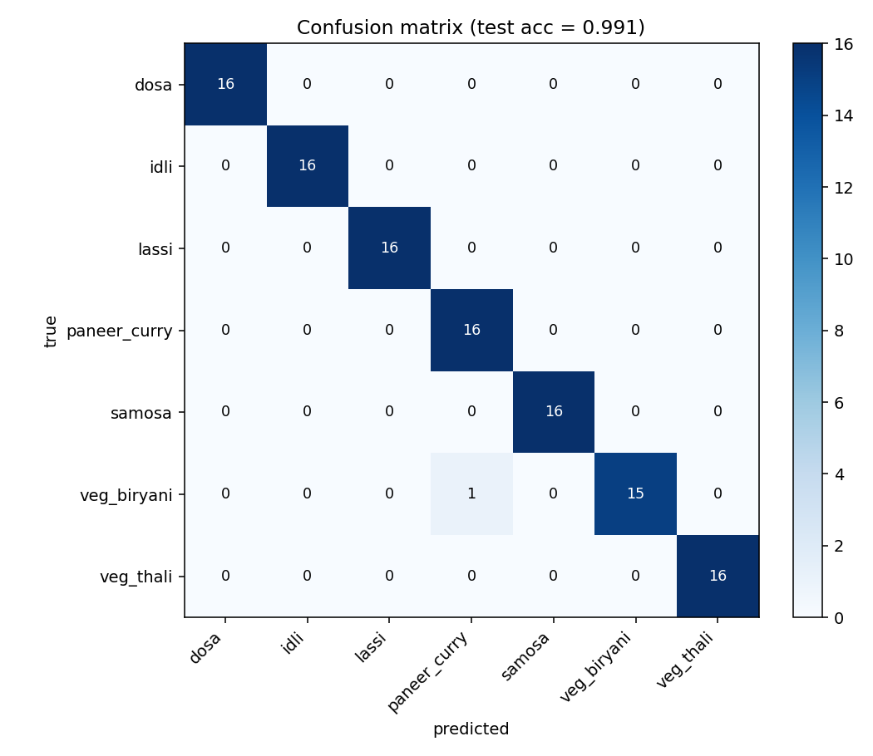
RESULTS
99.11% test accuracy — 111 of 112 correct
Held-out test set · per-class scores from classification_report.txt
Dosa · Idli · Lassi · Samosa · Veg Thali
100% precision, recall and F1
Paneer Curry
1.00 recall · 0.94 precision
Veg Biryani
0.94 recall · 1.00 precision
THE ONE MISS
veg_biryani_155.png: a veg biryani bowl read as paneer curry at 50.6% confidence — both Main-Course bowls share warm palettes and grain textures.
Fig. 2 — 7×7 confusion matrix, 112 test images
07 / 10
Notes:
Results: 111/112. Five classes perfect; the single error is biryani→paneer_curry, an intra-category confusion (both main-course bowls). Macro precision 0.9916, F1 0.9911.

Slide 8
BENCHMARK
Transfer learning is worth +16.1 points
Identical protocol: same data, split, epochs and optimizer — only the init differs
OUR MODEL
Transfer (ImageNet init)
RANDOM-INIT BASELINE
99.11%
ResNet-18 frozen · head-only
test accuracy
83.04%
macro precision
0.8556
macro recall
0.8304
Random-init baseline
macro F1
0.8274
83.04%
same protocol, no pretraining
best val accuracy
85.71%
epochs to converge
6
Control experiment in baseline_experiment.py: identical train.py protocol, only the ImageNet weights removed.
Δ = +16.07 pts macro F1 0.9911 vs 0.8274 — pretraining supplies features six epochs cannot.
08 / 10
Notes:
The control experiment: same everything, random init. 83.04% vs 99.11% — the +16.07-point gap is the measured value of ImageNet pretraining on this task.

Slide 9
KEY INSIGHT
Tiny heads on big features beat big training runs
What the numbers say about solving vision problems cheaply
3,591 params trained
Features transfer, labels don't
Know the failure mode
0.16% of the network trained end-to-end; 99.11% accuracy. Task knowledge lives in the features, not the head.
The random-init control shows the same architecture without pretraining stalls 16 points lower — pretraining is the algorithm, not a bonus.
The only error is an intra-category confusion (biryani vs paneer curry). Hard negatives within a meal category are the next data investment.
Takeaway: for small labelled datasets, frozen-pretrained-backbone + tiny-head is the highest-accuracy-per-watt recipe — CPU training is enough when the backbone already knows how to see.
09 / 10
Notes:
Three insights, one takeaway. If asked about deployment: the whole pipeline is CPU-class; ONNX export of the head is a trivial next step.

Slide 10
Thank You
Vegetarian Food Image Classification using Transfer Learning
Questions & discussion welcome
TEST ACCURACY 99.11% · 7 CLASSES · CPU-TRAINED
Notes:
Close: thank the panel, invite questions. One-line summary if asked: frozen ResNet-18 features plus a 3,591-parameter head classify seven vegetarian dishes at 99.11% test accuracy, trained on CPU in minutes.

