Slide 1

Project Title
SOA Project Review-1
18 August 2026
 | Under the Guidance of Dr.XXXXXX XXXXXX Professor, Department of Computer Science and Engineering, KLH CSE Bowrampet Campus
Team Members Name Roll Number K.Bhavya - 2420030394 S.Saswitha - 2420090067 M.Pranavi - 2420090110

Slide 2
Outline of Project Work
Focus
Introduction
Literature Survey
Challenges
Research Objectives
Conclusion & Future Work
References
Publications Details

Slide 3
Problem Statement
Traditional lost-and-found portals have several problems:
Manual Searching: Owners have to search through many lost-and-found items.
Time Consuming: Users must continuously scroll through static listings.
Fraudulent Claims: Public photos can allow unauthorized users to claim items.
No Automatic Matching: Users have to find possible matching items by themselves.
No Private Verification: Important hidden details of the item are not used to verify the real owner.
No Automatic Alerts: Owners do not automatically get a notification when a possible match is found.
Need for Secure Recovery: A proper verification process is needed before the item is handed over.
FindEase-SOA aims to solve these problems using AI-based matching, zero-knowledge verification and automatic notifications.

Slide 4
Objectives
To develop a full-stack Spring Boot web application that allows users to quickly report, track, and recover lost and found belongings anywhere.
To integrate an intelligent matching system that automatically pairs lost and found entries based on selected item categories, text details, and location data.
To create an automated blind verification workflow where AI generates targeted questions based on hidden traits to test whether the claimant is genuine.
To notify owners instantly on their personal dashboard with candidate match badges whenever a matching category and description are identified.
To provide a secure verification portal for authorities to authorize physical handovers, drastically cutting down manual search effort and preventing fraudulent claims.

Slide 5
Literature Survey
Authors | Title of the Paper | Methodology | Inferences | Limitation/Future work
Zhou et al. [1] (2024) | LostNet: A Smart Way for Lost and Find | • Uses MobileNetV2 and CBAM for image matching. • Uses Perceptual Hashing. • Uses Spring Boot for the online system. | • Images of lost and found items can be matched automatically. • Helps reduce manual searching. | • Mainly focuses on image matching. • Does not provide your zero-knowledge verification, AI agents, text matching and event-based notification.
Jitesh T. et al. [2] (2026) | SmartFind: AI Based Lost Item Finder in College/Office Campuses | • Uses image-based similarity matching. • Uses text-based similarity matching. • Designed for college and office campuses. | • Image and text together can help find lost items. • AI can reduce manual searching. | • Mainly focuses on image and text matching. • Does not include your blind challenge-response verification and multi-agent workflow.
Chinchmalatpure et al. [3] (2026) | Automated Lost & Found Retrieval System Using Deep Learning and Geospatial Analysis | • Uses CLIP embeddings for image similarity. • Uses location search. • Uses image hashing for similarity search. | • AI image matching and location information can improve lost-item retrieval. • Similar ideas are useful for FindEase-SOA. | • Does not provide the complete zero-knowledge verification and event-driven recovery workflow proposed in FindEase-SOA.

Slide 6
Problem Gap Identification
Manual Search and Inefficiency: Traditional lost and found systems rely heavily on manual cataloging, physical notice boards, or scrolling through unfiltered lists, which is time-consuming and leads to low recovery rates.
Lack of Smart Categorization Matching: Most standard portals require exact keyword matches, failing to connect items when users describe the same object with slightly different wording or broad categories.
Public Exposure of Item Details: Existing platforms display all submitted item details publicly, making it easy for dishonest individuals to view identifying features and submit fraudulent ownership claims.
Absence of Blind Ownership Verification: Current systems lack an automated mechanism to verify ownership before physical contact, forcing administrators to manually interrogate claimants without standardized proof.
Lack of Real-Time Workflow Automation: Most existing solutions do not provide automated lifecycle tracking or instant dashboard alerts, leaving users unaware when a candidate match is reported.
Administrative Burden on Handover Authorities: Custodians and authorities face significant overhead and fraud risk when physically validating and handing over items without a pre-verified audit trail.

Slide 7
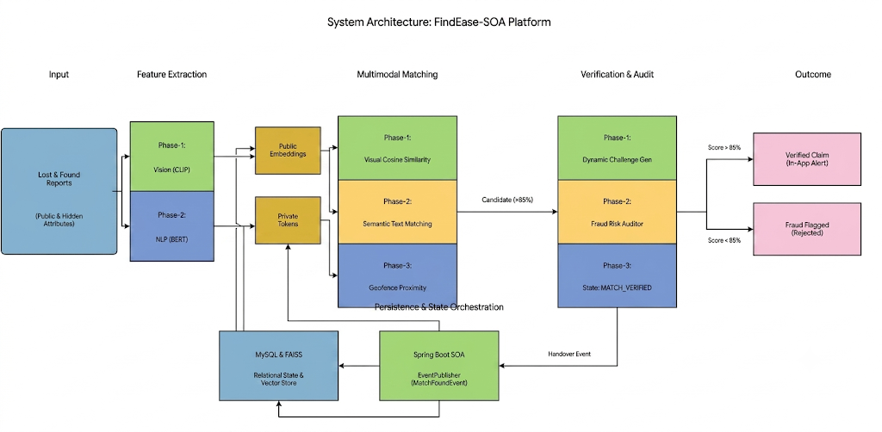
Innovation, Creativity, and Novelty
Novelty (Blind Verification): Keeps unique item traits hidden from the public to prevent fake claims, using them only as secret ground truth for verification.
Innovation (AI Agent Verification): Uses AI to automatically generate challenge questions and evaluate claimant answers, eliminating manual admin questioning.
Creativity (Smart Categorical Matching): Matches items instantly using structured categories, descriptions, and location data without exposing sensitive item photos.

Slide 8
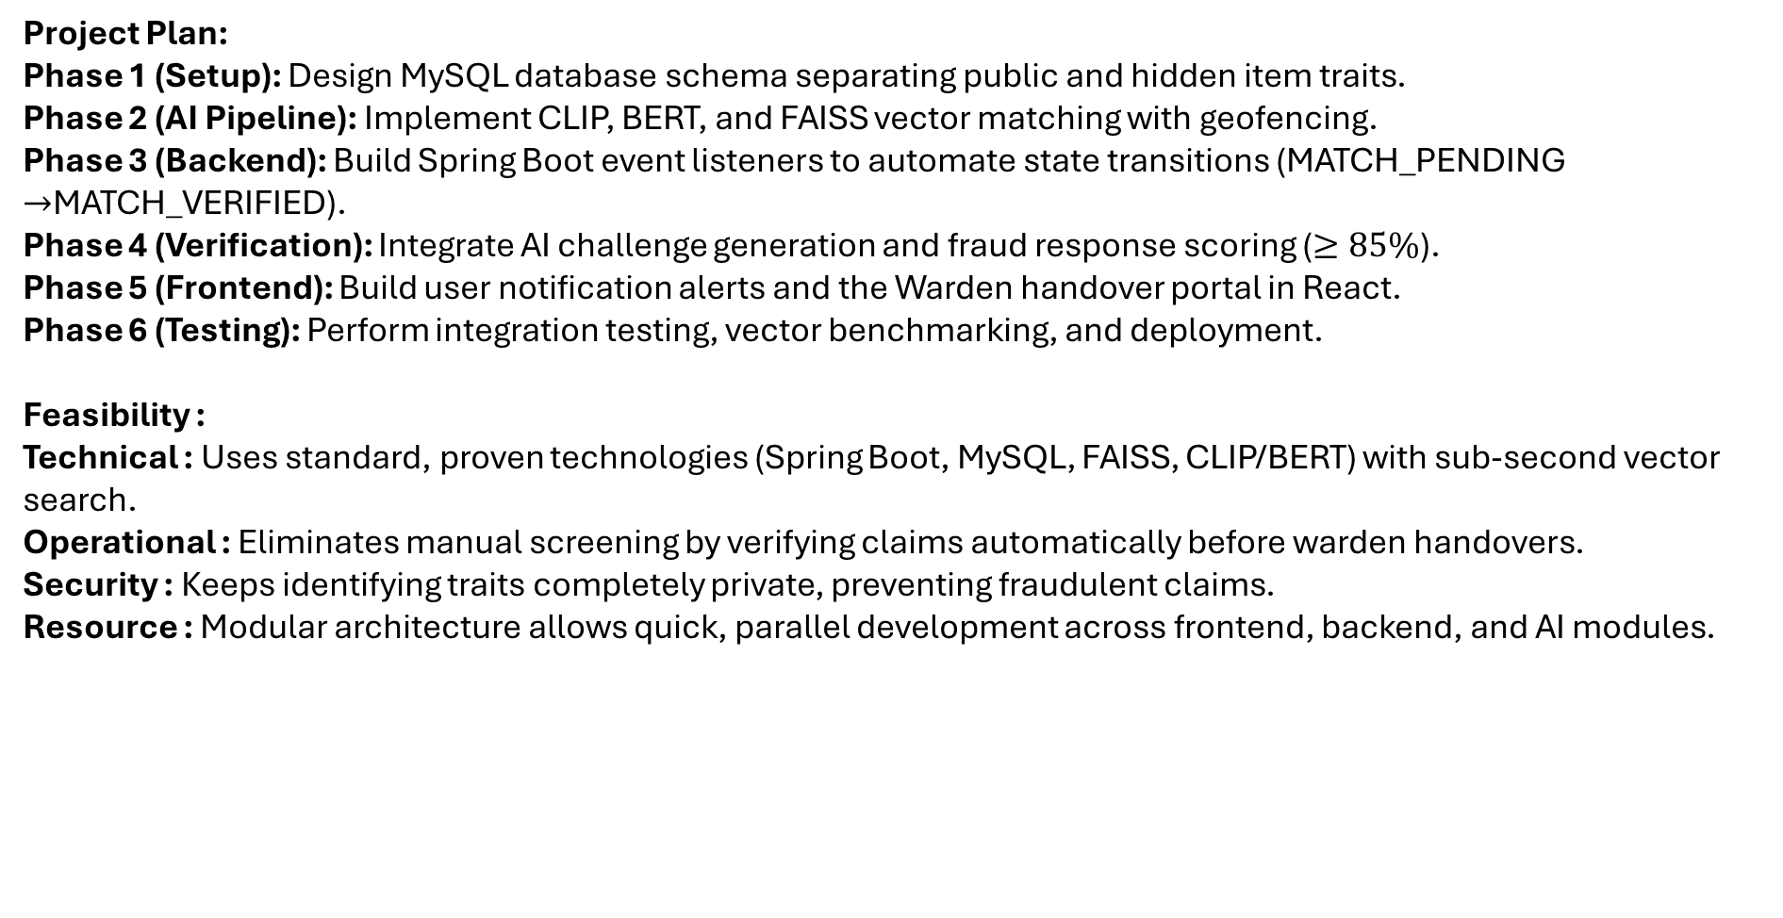
Feasibility and Project Plan
Project Plan:
Phase 1 (Setup): Design MySQL database schema separating public and hidden item traits.
Phase 2 (AI Pipeline): Implement CLIP, BERT, and FAISS vector matching with geofencing.
Phase 3 (Backend): Build Spring Boot event listeners to automate state transitions (MATCH_PENDING $→$MATCH_VERIFIED).
Phase 4 (Verification): Integrate AI challenge generation and fraud response scoring ($≥85\%$).
Phase 5 (Frontend): Build user notification alerts and the Warden handover portal in React.
Phase 6 (Testing): Perform integration testing, vector benchmarking, and deployment.
Feasibility :
Technical : Uses standard, proven technologies (Spring Boot, MySQL, FAISS, CLIP/BERT) with sub-second vector search.
Operational : Eliminates manual screening by verifying claims automatically before warden handovers.
Security : Keeps identifying traits completely private, preventing fraudulent claims.
Resource : Modular architecture allows quick, parallel development across frontend, backend, and AI modules.

Slide 9
Existing System VS Proposed System
Existing system | Proposed System
Manual Searching | Automatic Item matching
Public Ownership claims | Secret trait verification
Admin manually checks and hands over the item | Claim is verified → Item is handed over
Item photos/details may be publicly visible | Sensitive item details are kept private

Slide 10
Services :
Service | Responsibility
User Service | Registration and login
Item Service | Report lost/found items
Matching Service | Automatically find possible matches
Verification Service | Verify ownership using secret traits
Notification Service | Notify users about matches/claims

Slide 11
Technical Implementation
Frontend: HTML, CSS and JavaScript for the user interface.
Backend: Python with Flask for handling users, items, claims and requests.
Database: SQLite for storing user, lost/found item and claim details.
Matching: Python-based matching using item category, name, description, color and location.
Verification: Secret-trait questions are used to verify the actual owner.
Authentication: User login and session-based access control.
Claim Management: Potential matches generate claims that can be verified and approved/rejected.
Notifications: Users are informed about relevant matches and claim updates.

Slide 12
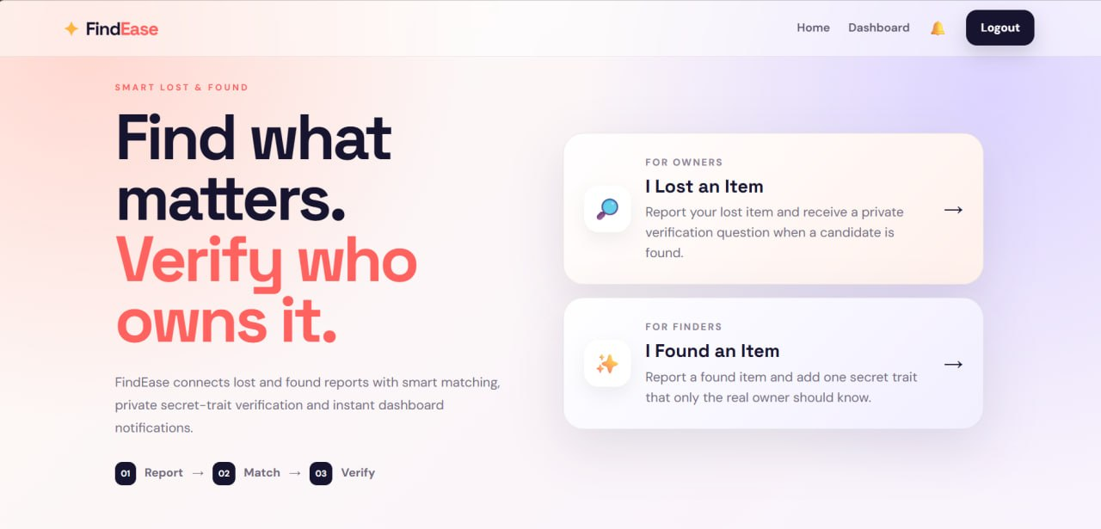
Project Outputs :

Slide 13
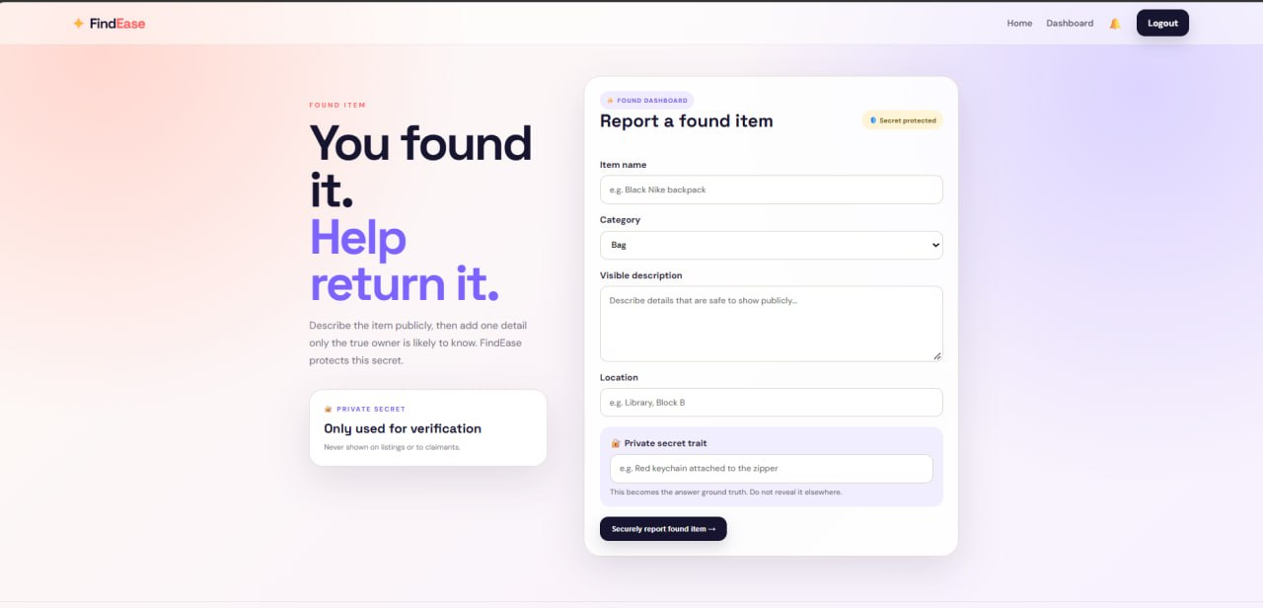

Slide 14
