Slide 1
Enhancing Network Security with Machine Learning Based Intrusion Detection System
CS 389-INNOVATION LAB PROJECT

Slide 2
INTRODUCTION:
The rapid evolution of cyber threats poses significant challenges for safeguarding data and network integrity. Fortunately, advancements in Artificial Intelligence (AI) are transforming cybersecurity, particularly in the realm of Intrusion Detection Systems (IDS). This presentation explores the use of AI in IDS, highlighting its benefits and the challenges it addresses. We will delve into the limitations of existing models and introduce a novel approach that utilizes efficient feature selection and machine learning to enhance intrusion detection accuracy, efficiency, and scalability.

Slide 3
Literature Review:
METHODOLOGY | Description | Dataset | Future scope | Drawbacks
OGBDTs-IDs | Gradient Boosting Decision Trees for intrusion detection. | UNBS-NB 15 | Enhance with advanced feature selection and ensemble methods. | •Cannot find the type of cyber- attack.
Fusion of feature selection and security model based on ML | Combines feature selection techniques with ML models. | UNSW-NB 15 | Integrate feature selection with deep learning. | • Used low- dimensional security data.
M-MultiSVM | •An efficient feature selection assisted network intrusion detection system using ML | UNSW-NB 15 | Implement attention mechanisms and test across various networks. | high computational cost, and limited attack classification

Slide 4
Research Gap:
Limitations of Existing IDS:
High computational time and delays
Inability to handle large-scale networks
Inaccurate attack classification
Limited security data

Slide 5
Need for Improvement:
Develop efficient algorithms for fast data processing
Design scalable algorithms for large networks
Implement advanced classification methods
Integrate diverse, high-dimensional security data

Slide 6
MOTIVATION:
Existing intrusion detection models struggle with high detection time, limited scalability, and low-dimensional data. The proposed Efficient Feature Selection-Assisted System uses machine learning to enhance accuracy and security in networks.

Slide 7
Problem Statement:
Enhancing the Classification Performance for Cybersecurity Intrusion Detection Using the UNSW-NB15 Dataset
Objectives:
Improve Classification Accuracy: Develop and optimize machine learning models to achieve higher classification accuracy for detecting malicious and normal network traffic.
Reduce False Positives and False Negatives: Minimize the rate of false alarms and missed detections to improve the reliability of the intrusion detection system (IDS).

Slide 8
METHODOLOGY:
AEMNSC Algorithm (Advanced Ensemble Model for Network Security Classification)
Initialize:
• Feature transformation matrices Φ
• Model weight vector W = {ω1, ω2, ω3}
• Establish feature space F and label space L
Feature Engineering: G(F) =
• Z-score normalization: (x - μ)/σ
• Pairwise ratio: R(i,j)
• Yeo-Johnson transformation: P(λ)

Slide 9
Preprocessing: Ψ(x) =
• Median imputation: M(x)
• Categorical encoding: E(x)
• Standardization: S(x)
• Output: Enhanced space F'
Model Training:
• CatBoost: L1 = ∑(yi - ŷi)² + λ||w||²
• XGBoost: L2 = ∑l(yi,ŷi) + γT + 1/2λ||w||²
• TabNet: Minimizes L3 with attention masks A
Ensemble Integration:
• I(x) = ω1P1(x) + ω2P2(x) + ω3P3(x)
• Decision function: D(x) = argmax(I(x))

Slide 10
Output:
• Transform via O = T⁻¹(y’)
• Return security state C*
Constraints:
• ∑ωi = 1
• 0 ≤ ωi ≤ 1
• d ≥ 1 (tree depth)
• S ≥ 1 (decision steps)

Slide 11
Key Parameters:
• Φ: Feature transformation matrix
• W: Weight vector (0.4, 0.3, 0.3)
• λ: Regularization coefficient
• γ: Tree complexity
• B(x): Bayesian bootstrap
• A: Attention mask matrix
Optimization:
minimize L(x) = α₁L1 + α₂L2 + α₃L3 subject to model constraints

Slide 12
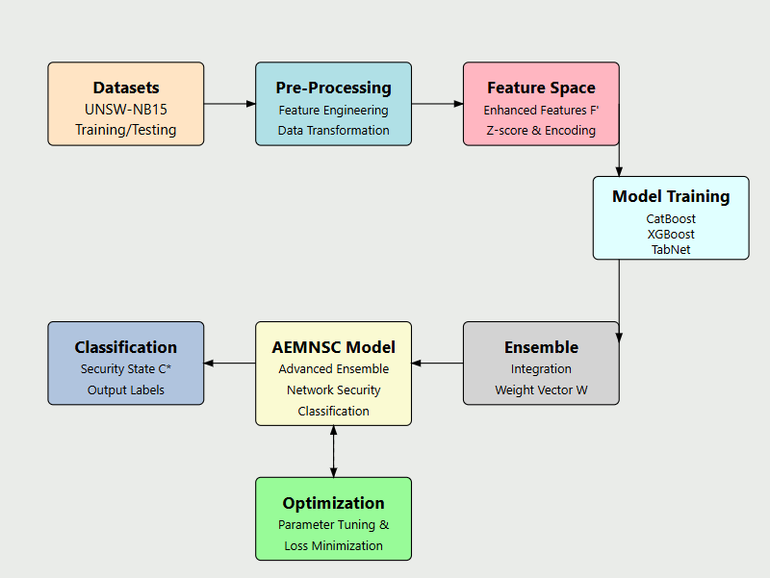
Conceptual diagram of work done

Slide 13
Classification of attacks:

Slide 14
Results & Analysis:
Algorithm | Precision (%) | Recall (%) | F1 Score (%) | Support | Accuracy (%)
Proposed (AEMNSC) | 86.89% | 85.95% | 84.13% | 82,332 | 85.95%
M-MultiSVM | 80.22% | 76.51% | 75.25% | 82,332 | 76.57%

Slide 15
Conclusion :
The proposed intrusion detection system leverages efficient feature selection and advanced machine learning models to enhance classification performance significantly. By optimizing hyperparameters, reducing false positives/negatives, and improving feature relevance, the system ensures high reliability and scalability. With an accuracy of 85.95% and robust performance across key metrics, the model addresses the limitations of existing approaches while demonstrating improved detection efficiency and adaptability.

Slide 16
Future Scope:
The proposed system can be extended to real-time intrusion detection in large-scale networks. Integrating deep learning for dynamic feature extraction and improving adaptability to new attack patterns can further enhance its robustness. Scalability for cloud and IoT environments is another promising direction. For effective monitoring, tracking individual model performance, monitoring feature stability, implementing prediction confidence metrics, and incorporating model drift detection are essential.

Slide 17
References:
Mishra, S., 2022. An optimized gradient boost decision tree using enhanced African buffalo optimization method for cyber security intrusion detection. Appl. Sci. 12 (24), 12591.
Sarker, I.H., 2021. Cyber Learning: effectiveness analysis of machine learning security modeling to detect cyber-anomalies and multi-attacks. Internet Things 14, 100393.
Turukmane , A.V., Devendiran , R., 2024. M-MultiSVM : An efficient feature selection assisted network intrusion detection system using machine learning. Computers & Security 137, 103587.

Slide 18
THANK YOU
Pannala Kankshitha Reddy(2201CS51)
Parepally Sasya Sri Harshitha(2201CS52)

