Slide 1
Multitask Neural Networks and SHAP
- by Sateesh Sivakoti (ML Scientist at PayPal)

Slide 2
Table of Contents
Agenda
Introduction to the topic <Indicative>
Agenda #2
Sub-agenda #2a
Sub-agenda #2b
Conclusion <Indicative>
Q & A <Indicative>

Slide 3

Brief about me..
My name is Sateesh Sivakoti
Machine Learning Scientist @ PayPal
~3.5 years of work experience
Experienced in building predictive models for use cases around marketing, customer lifecycle etc.

Slide 4
Neural Networks

Slide 5
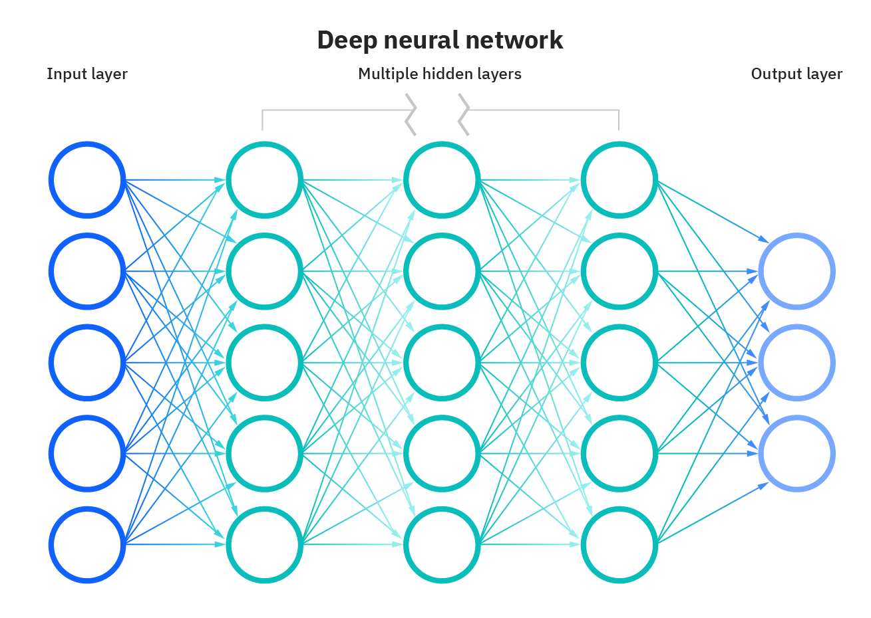
Neural Networks
Brief about me..
“Universal Function Approximators”
Due to their ability to represent complex non-linear relationships, an appropriate neural network can represent any function
Architecture
An Input Layer, An output layer, a series of hidden layers which run computations on the input and perform nonlinear transformations
More complex networks like RNNs, CNNs, transformers etc. build on these
Training
The output on passing the data to the network is compared against the training label and a loss is computed
The Loss is backpropagated to get the gradient for each weight in the network
The optimizer uses the gradients to update the weights

Slide 6
Multitask Neural Networks
Brief about me..
Multitask Neural Networks (MTNN) are a type of neural network architecture that can perform multiple tasks simultaneously.
They are designed to learn multiple related tasks jointly by sharing hidden layers across tasks.
Benefits of Multitask Neural Networks:
Improved Performance: MTNN can improve the performance of a model on all tasks by allowing it to leverage shared information between tasks.
Better Generalization: By learning multiple related tasks simultaneously, MTNN can help a model generalize better to new tasks.
Efficiency: Training a single MTNN model to perform multiple tasks can be more efficient than training separate models for each task.

Slide 7
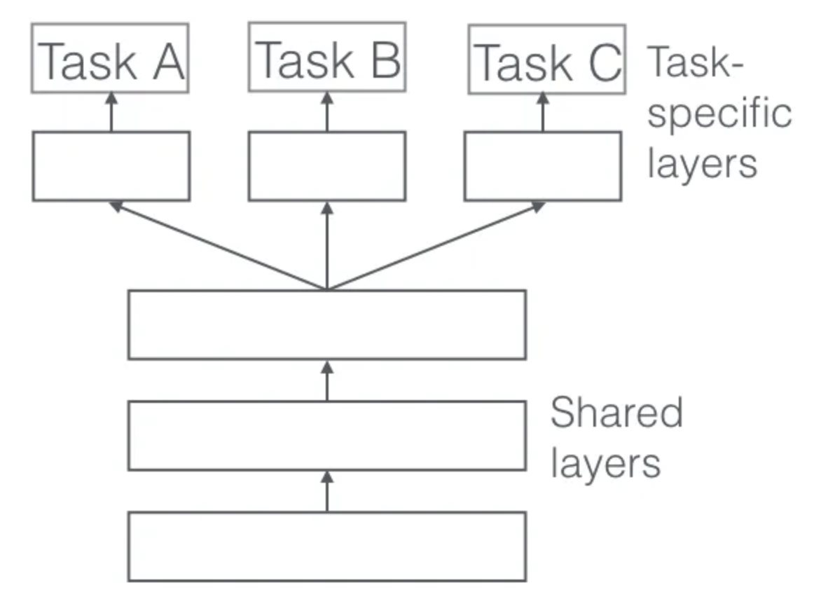
Multitask Neural Networks – Hard Parameter Sharing
Brief about me..
Shared Layers: MTNN have shared layers that are common to all tasks, allowing them to learn representations that are useful for all tasks.
Task-Specific Layers: In addition to shared layers, MTNN have task-specific layers that are specific to each task. These layers allow the model to learn task-specific features and output.
Each task specific head has it’s own loss function. The overall loss is computed to adjust the weights of the model during training

Slide 8
SHAP Explanations

Slide 9
Shapley Values
Brief about me..
Shapley value is a concept from game theory which answers how to distribute the outcome to members of a group
If we have a coalition C that collaborates to produce a value V, how much did each individual member contribute to V?
A coalition is a group of members

Slide 10
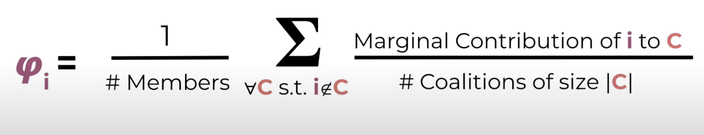
Shapley Values
Brief about me..
V₁₂₃
V₂₃
V₁₂₃ – V₂₃ = Marginal Contribution of Member 1 to C₂₃
1
2
3
2
3
V₁₃
V₃
V₁₃ – V₃ = Marginal Contribution of Member 1 to C₃
1
3
3
V₁₂
V₂
V₁₂ – V₂ = Marginal Contribution of Member 1 to C₂
1
2
2
V₁
V⏀
V₁ – V⏀ = Marginal Contribution of Member 1 to C⏀
1
Get the Shapley value of member 1 by averaging out marginal contributions from all possible coalitions of the given members
The same process can be repeated for all members to get their Shapley values

Slide 11

SHAP - SHapley Additive ExPlanations
Brief about me..
“Given that without any features, we would just predict an average value, once we bring the feature in how much would our prediction change?”
For a sample
g is the explanation model
z’ is the coalition vector. It is a vector of 1’s and 0’s representing whether the feature in position j is present in the coalition
⏀ represents the Shapley value for each feature value

Slide 12
SHAP - Questions
Brief about me..
How do we estimate g(z’)? We need all features for our trained model to make a prediction
For estimating Shapley value of each feature for a sample, we need to make 2^M coalitions, which needs us to make 2^M predictions for each sample in the data – Really expensive

Slide 13


Kernel SHAP
Brief about me..
For each sample:
Sample a few coalitions
For predictions on coalitions which have missing features, sample possible values from a background dataset, get all predictions and average them
Calculate weight for each coalition using SHAP kernel
Fit a linear model on this training dataset
The coefficients of this linear model are the SHAP values

Slide 14
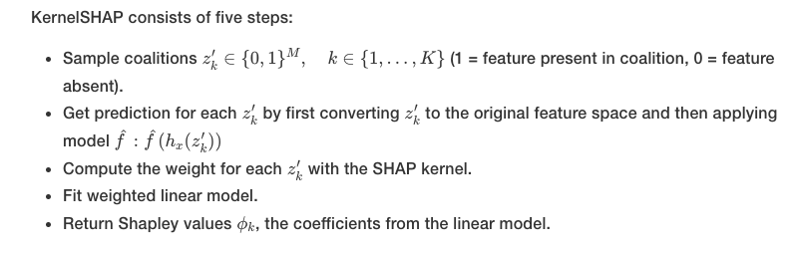
Kernel SHAP
Brief about me..

Slide 15
DataHour : Q&A

Slide 16
Thank you!

