Slide 1

ZOMATO DATASET ANALYSIS AND VISUALIZATION
EDA
SUBMITED BY:
D.BHAVANA(19B21A0413)
S.TEJASWI(19B21A0422)
V.KAVYA(19B21A0410)
Y.JOSHNA(19B21A0401)
P.SATISH(19B21A0440)
SUBMITED TO:
KRISH NAIK
SUBMISSION DATE: 11TH NOVEMBER ,2021

Slide 2
TABLE OF CONTENTS
ABSTRACT:
PICTURE
INTRODUCTION:
PRODUCT OF ZOMATO
OPERATIONAL MODEL
FUND ALLOCATION AND UTILIZATION
SWOT ANALYSIS OF ZOMATO
BUSINESS TIME LINE
BUSINESS GROWTH
FINANCIAL GROWTH
EMPLOYEE GROWTH
CONCLUSION…

Slide 3


Slide 4
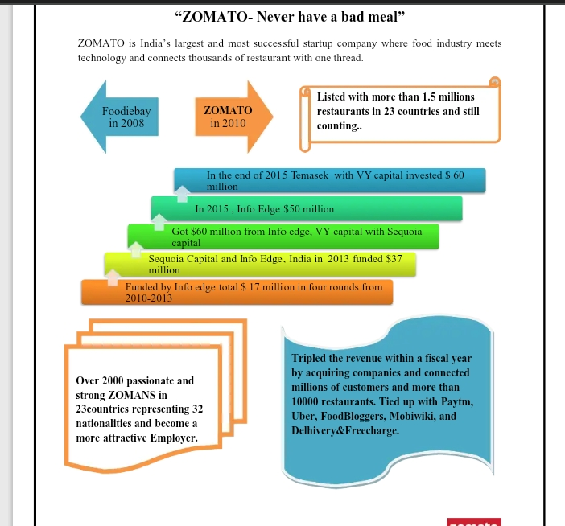
INTRODUCTION

Slide 5
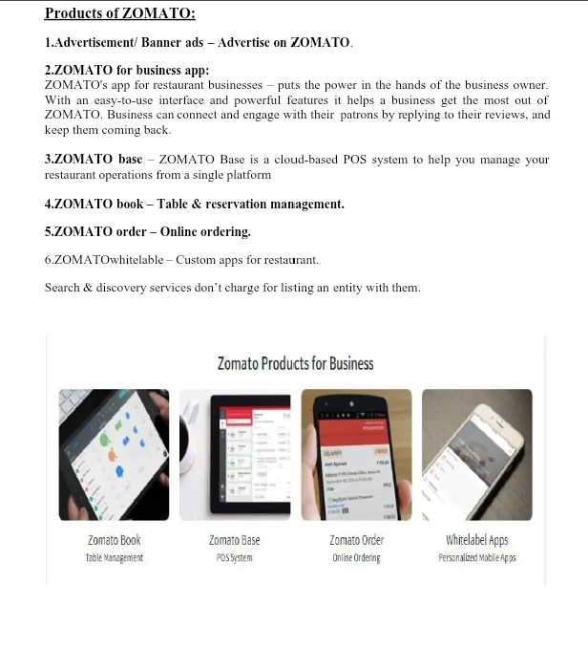

Slide 6
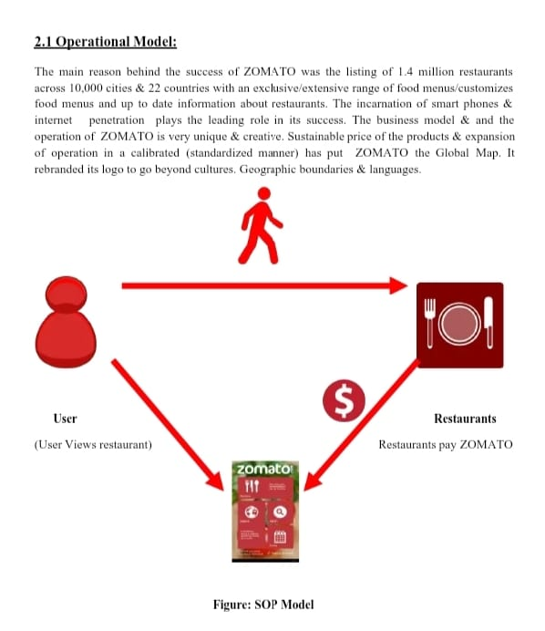

Slide 7
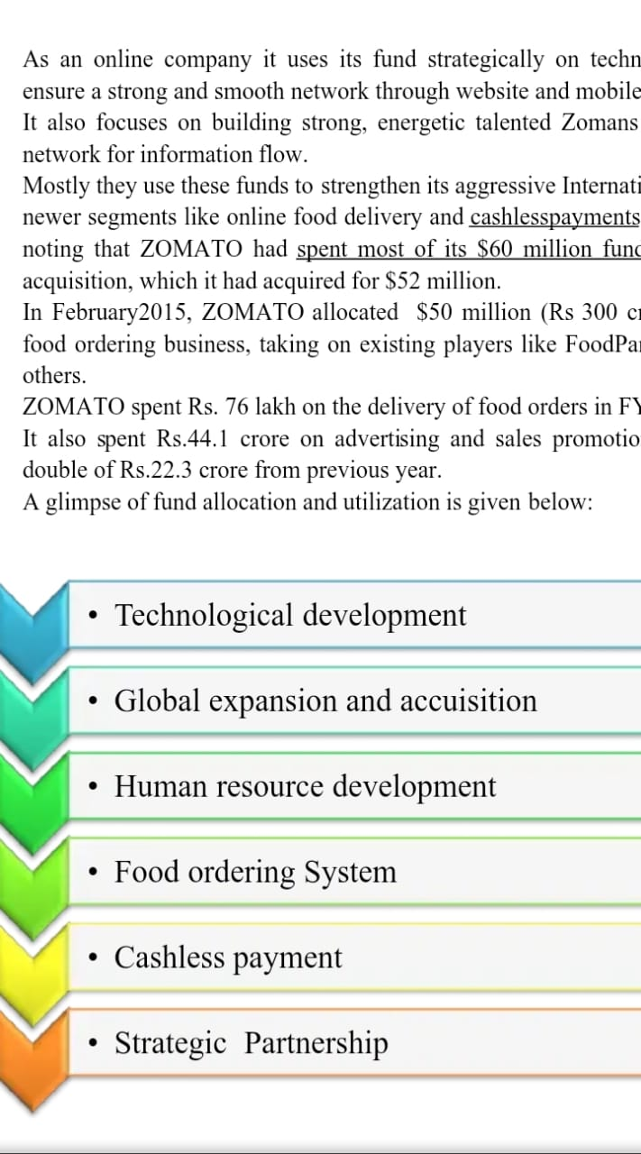
FUND ALLOCATION AND UTILIZATION

Slide 8
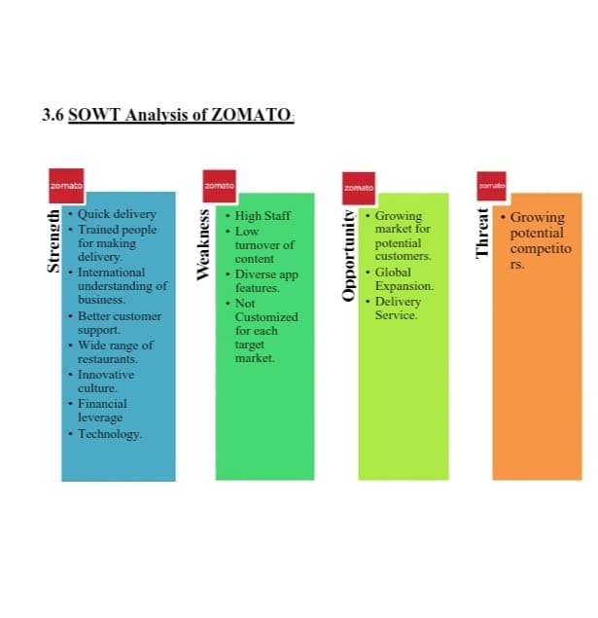

Slide 9
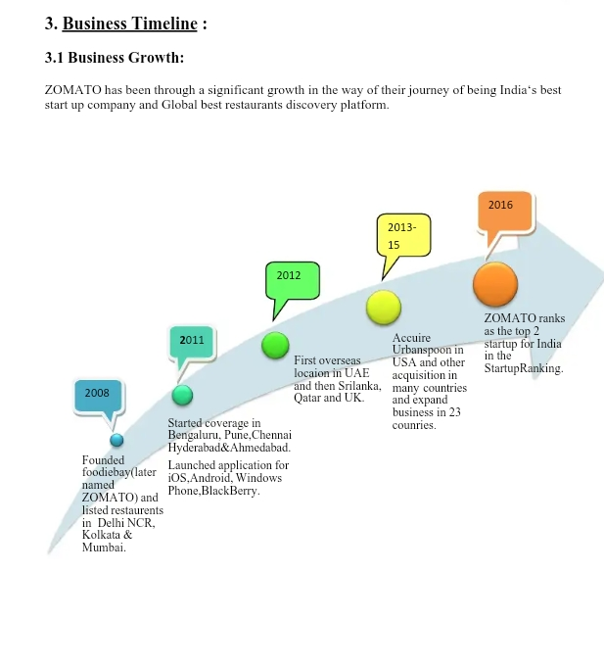

Slide 10
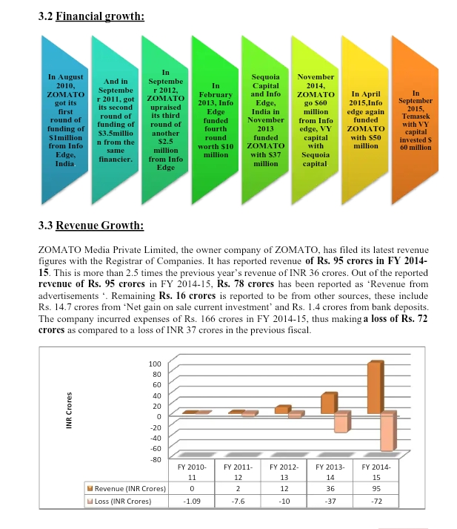

Slide 11
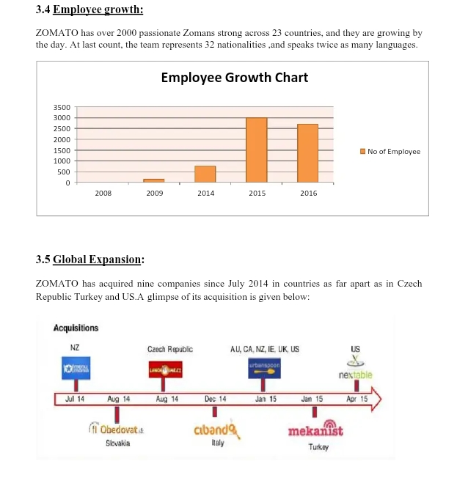

Slide 12
