Slide 1
Harmonic Search Based Algorithm For Mobile Robot Localization
EE698G- Dr. Gaurav Pandey
Presented By,
Satyam Dwivedi 13629
Lokendra Choudhary 14356

Slide 2
Introduction
The problem that we were working on was to localize a vehicle fitted only with range sensor like Lidar .
This type of problems can be solved using scan matching
Two new algorithms are implemented in this project for fast and efficient scan matching.
Using the results from the above algorithms an efficient localization algorithm is implemented.

Slide 3
Iterative Closest Point
In ICP as the problem is characterized by local minima, convergence is not guaranteed
For guaranteed optimal solution, correspondence between the points is required

Slide 4
Harmony Search Algorithm
A new meta-heuristic optimization method imitating the music improvisation process.
Musicians improvise their instrument’s pitches searching for a perfect state of harmony.
Very successful in a wide variety of optimization problems.

Slide 5
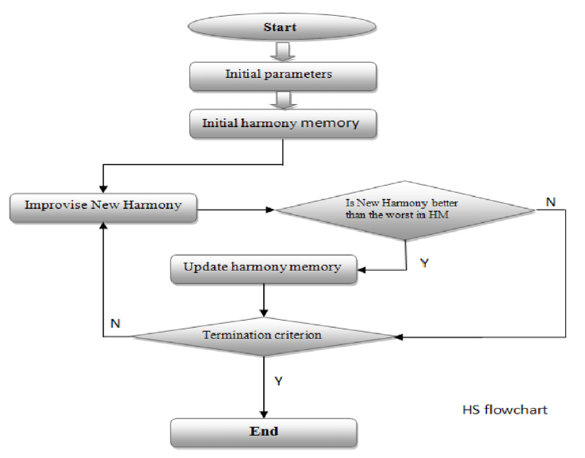

Slide 6
Harmony Search Algorithm
Harmonic Memory:
The harmony memory (HM) that is a memory location where all the solution vectors (sets of decision variables) are stored in.
Parameters:
The harmony memory size (HMS)
The harmony memory consideration rate (HMCR)
The probability of pitch adjusting (PAR).
The number of improvisations (NI)

Slide 7




Harmony Search Algorithm
Initialization:
Improvising new harmony memory:
Update harmony memory
Improved Harmony Search (IHS):

Slide 8
Harmony Search Algorithm
Fitting Function:
The quality of the solutions, produced by HS, relies on the stochastic nature of the technique and the way in which the objective function is converted to a fitness function that can guide the algorithm to the desired region of the search space.
f(x) = ∑exp(-dist)

Slide 9
Harmony Search algorithm generally have slow convergence rate.
To improve upon this limitation, another algorithm is implemented that uses Differential Evolution step along with HS.

Slide 10
Differential Evolution
Let X be a solution set and suppose that x_{i}(k) is a solution vector that should be updated in iteration (k+1). A trial update of x_{i}(k), is as follows:
If x′_{i} (k+1) yields a better fitness than x_{i}(k) then replace it otherwise x_{i}(k) is retained for the new generation.

Slide 11

HIDE Algorithm
Initializing the parameters of DE and HS.
Initializing the solution vectors (HM).
Performing HS and generating HRT new solutions and replacing them if they satisfy the replacement criterion.
Performing DE and updating HM according to below given equation
Finishing the program if the termination condition is met otherwise going to step 3.

Slide 12
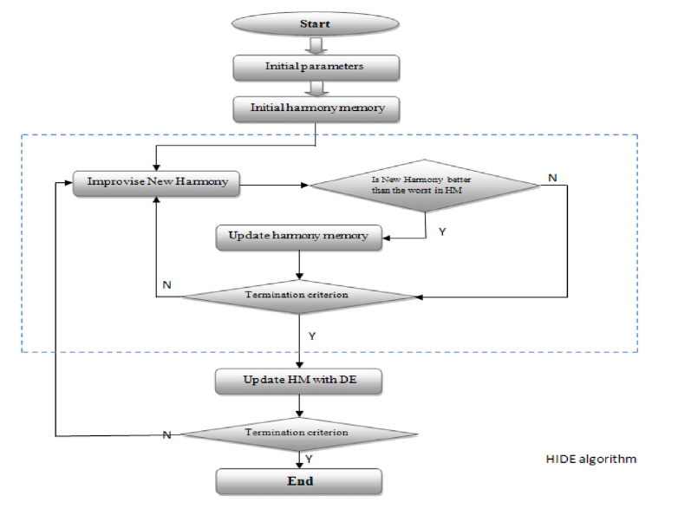

Slide 13
Dataset
For scan matching algorithm we used dataset given by sir for assignment 5.
For localization problem, we again used EKF simulation environment sir provided us in assignment 4 and included with it the scan matching data to get the required environment.

Slide 14
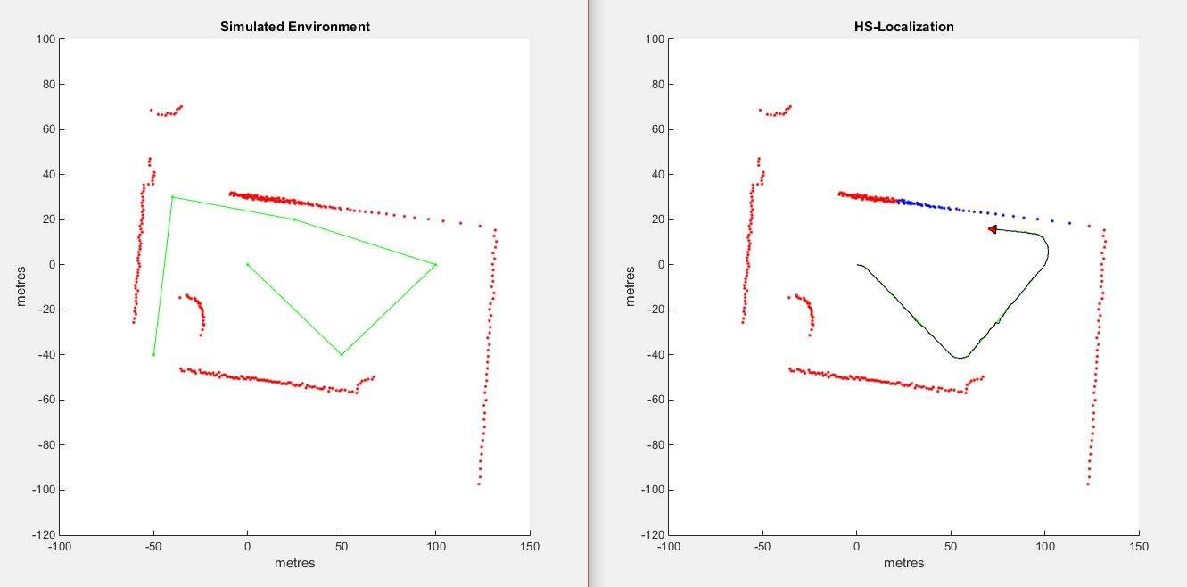
Dataset

Slide 15
Implementation
We used HS algorithm to do scan-matching of the two scan in dataset.
We used Proposed HIDE algorithm to do scan-matching of the two scan in dataset.
We implemented localization using HS algorithm in the given environment dataset.
We implemented localization using Proposed HIDE algorithm in the given environment dataset.
We implemented SLAM using HS algorithm in the given environment dataset.
We implemented SLAM using HIDE algorithm in the given environment dataset.

Slide 16
Results

Slide 17
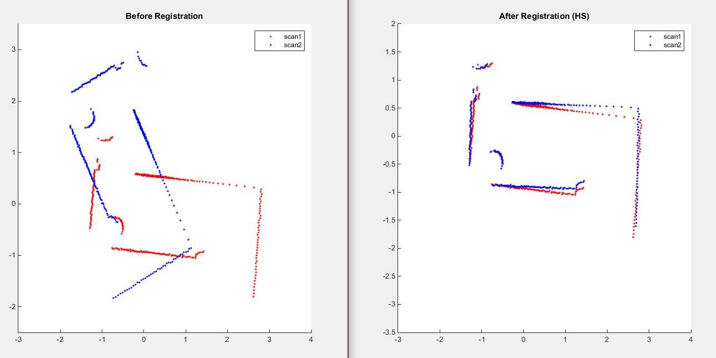
Scan Matching with HS

Slide 18
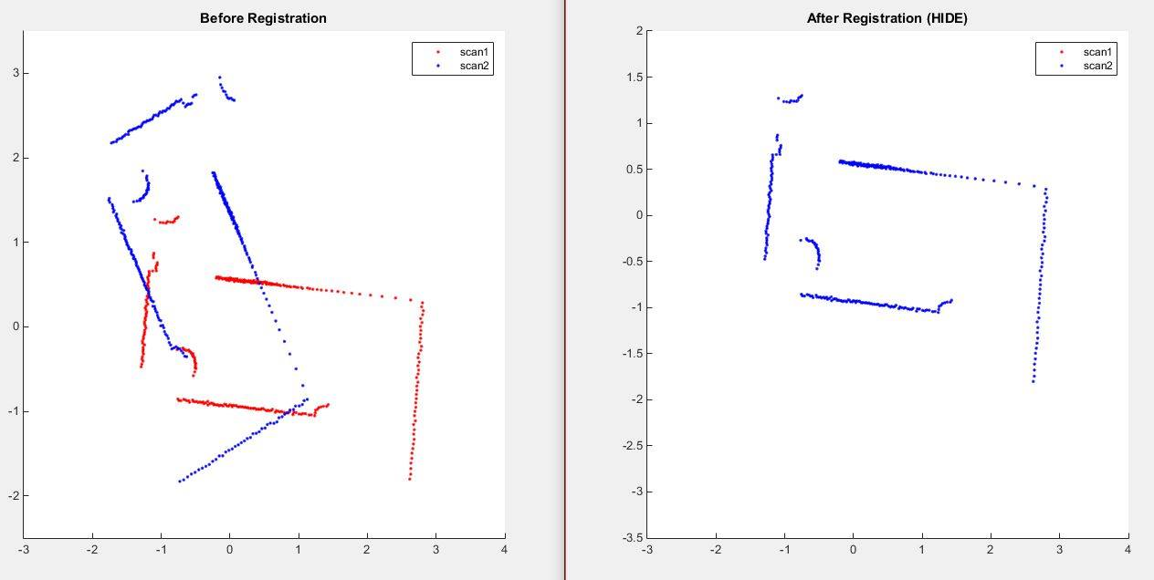
Scan Matching with HIDE

Slide 19
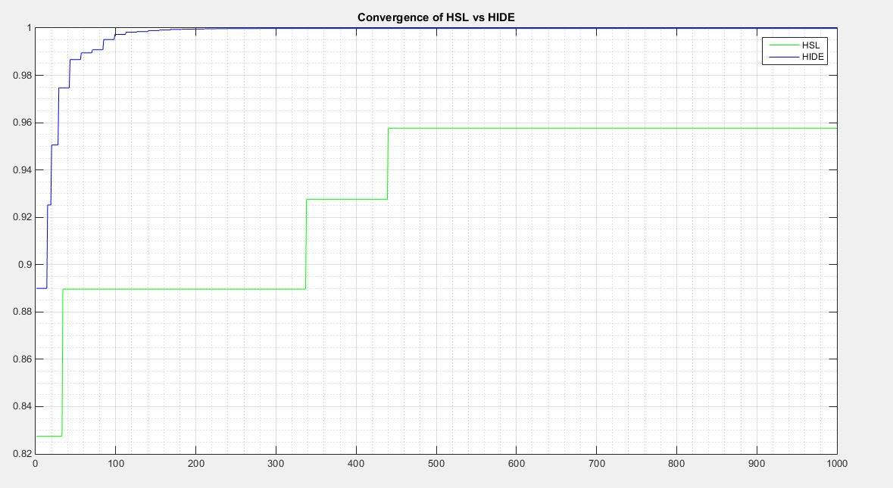
Convergence of HS vs HIDE

Slide 20
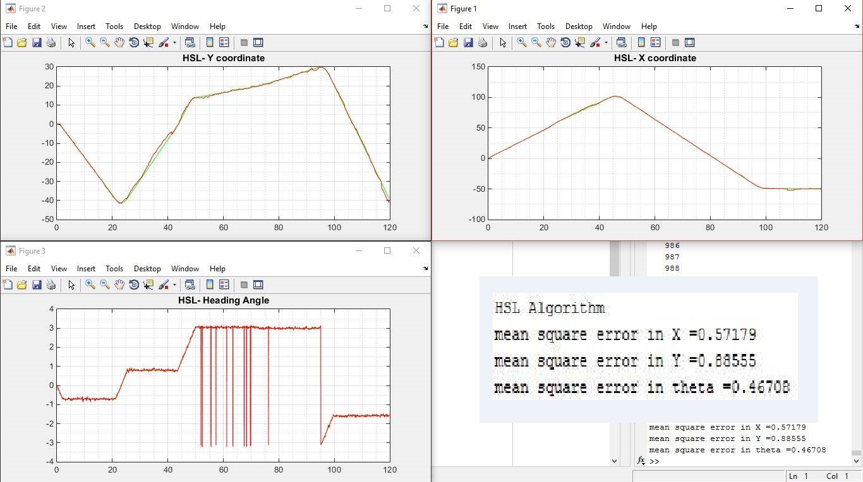
Localization using HS

Slide 21
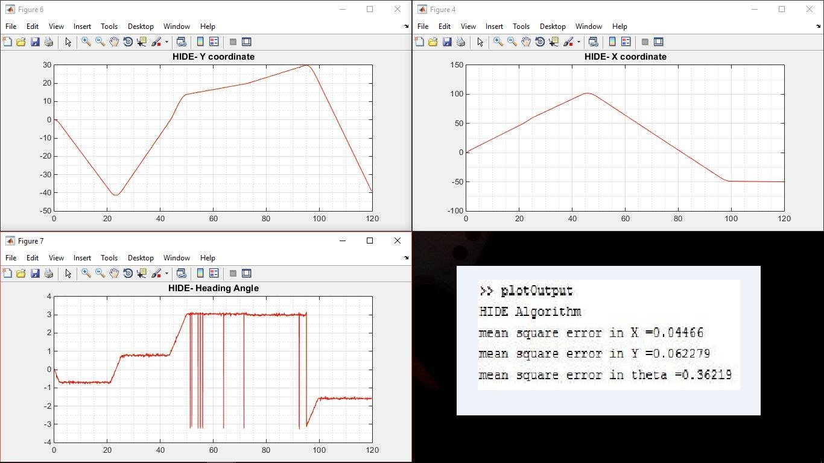
Localization using HIDE

Slide 22
References
Mirkhani, Mohsen, et al. "A novel efficient algorithm for mobile robot localization." Robotics and Autonomous Systems 61.9 (2013): 920-931.

Slide 23

Thank You

