Slide 1
Modelling Semi Autonomous Vehicle Driving
Course Project for CS637A
GROUP 6
Avinash Chambhare, 13212
Satyam Dwivedi, 13629
Utsav Gupta, 13757

Slide 2
Problem Statement
Indian traffic environment consist of various sub-environment ranging from narrow roads with unpredictable traffic to normal highways or lane with smooth traffic.
To design an autonomous system for such environment we need an agile model to detect and prevent obstacle in a smooth manner.

Slide 3
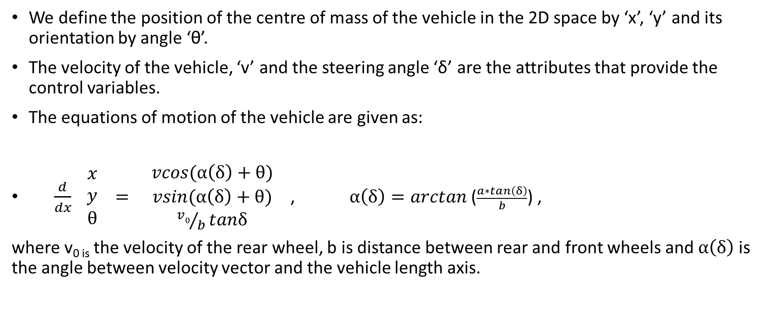
Vehicle Model
We define the position of the centre of mass of the vehicle in the 2D space by ‘x’, ‘y’ and its orientation by angle ‘θ’.
The velocity of the vehicle, ‘v’ and the steering angle ‘δ’ are the attributes that provide the control variables.
The equations of motion of the vehicle are given as:
$\frac{d}{dx} \begin{matrix}x \\ y \\ θ\end{matrix} = \begin{matrix}vcos(α\left(δ\right)+θ) \\ vsin(α\left(δ\right)+θ) \\ {v0}/btanδ\end{matrix}$ , $α\left(δ\right)=arctan$($\frac{a∗tan\left(δ\right)}{b}$) ,
where v_{0 is} the velocity of the rear wheel, b is distance between rear and front wheels and $α\left(δ\right)$ is the angle between velocity vector and the vehicle length axis.

Slide 4
Proposed Safety Constraints
The overall aim of the safety system proposed is to keep the vehicle on a collision free path within the lane while maintaining a stable vehicle motion.
We introduce padding around the obstacles to maintain sufficient clearance distance between vehicle and obstacle.
Speed regulation is done for safe maneuvering in tight corners.

Slide 5
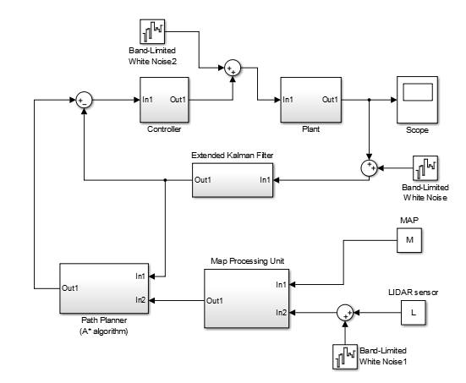
Block Diagram

Slide 6
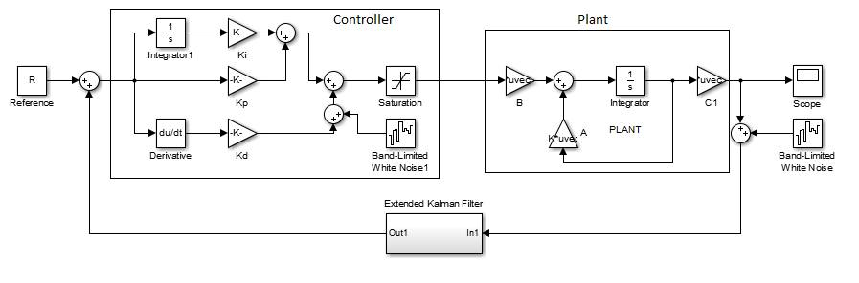
Plant Controller Model

Slide 7
Noise Generator
We simulate the noise in data received by the sensors as a White Gaussian Noise.
Adding the noise helps us simulate the data that is actually received from IMU and GPS.

Slide 8
EKF (Extended Kalman Filter)
The Extended Kalman Filter provides a fairly accurate estimate of the actual data given an input to which noise is added.
The Extended Kalman Filter is the de facto standard for navigation systems and GPS data.
EKF processes the data to which WGN is added to generate an estimate that is close to the actual input.

Slide 9
Path Finder
We use the A* path finding algorithm to trace out a route of traversal for the vehicle.
The A* algorithm provides an optimal path in a time that is computationally feasible.
A map of the environment at each quantum is provided as input to the algorithm which then provides a safe path to follow till the next quantum.

Slide 10
Controller
The input to the controller are the control variables ‘v’, the velocity of the vehicle and ‘δ’, the steering angle.
The position of the vehicle is denoted by (x, y, θ). We then use the transform matrix shown next to get a representation of the vehicle along the axis which lies at angle θ from the x-axis.
Doing this, the aim of the controller becomes to move the bot along the x-axis which is comparatively easy.

Slide 11

(x₂, y₂)
θ , θ = tan⁻($\frac{\text{y}\text{2}\text{ – }\text{y}\text{1}}{\text{x}\text{2}\text{ – }\text{x}\text{1}}$)
(x₁, y₁)
T = $\begin{matrix}cos\text{θ} & −sin\text{θ} \\ sin\text{θ} & cos\text{θ}\end{matrix} \begin{matrix}0 & x1 \\ 0 & y1\end{matrix}$ ,
$\begin{matrix}0 & 0 \\ 0 & 0\end{matrix} \begin{matrix}1 & 0 \\ 0 & 1\end{matrix}$
X’ = T⁻¹X , X = $\begin{matrix}x \\ \begin{aligned}y \\ \text{θ} \\ 1\end{aligned}\end{matrix}$

Slide 12
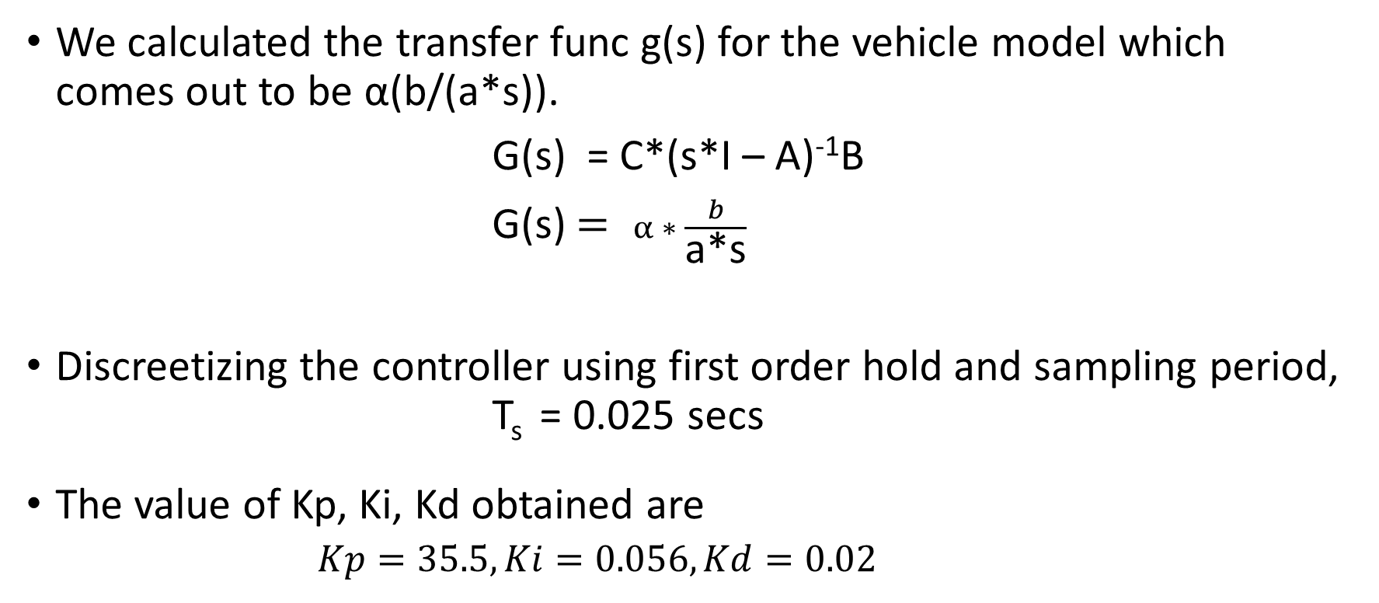
We calculated the transfer func g(s) for the vehicle model which comes out to be α(b/(a*s)).
G(s) = C*(s*I – A)⁻¹B
G(s) $= α ∗ \frac{b}{\text{a}\text{*}\text{s}}$
Discreetizing the controller using first order hold and sampling period, T_{s} = 0.025 secs
The value of Kp, Ki, Kd obtained are
$$Kp=35.5, Ki=0.056, Kd=0.02$$

Slide 13
Demonstration

Slide 14
Future Action Plans
Try to model an accurate traffic model that incorporates dynamic obstacles.
Try to develop driver models to account for attentive and distracted driving.
Enhance the capability of the autonomous mode that enables it to take corrective measures in case of distracted driving and/or suggest optimal paths along which to drive in attentive driving.
To come up with appropriate actions that the model can take in the case when the safety constraints fail.
Implement the model on a miniature scale to test its feasibility for real life application.

Slide 15
THANK YOU!!!

