Slide 1


Matching Customer Requests with Supply in Smava’s personal loan marketplace

Slide 2

Table of contents
01
04
Smava business in a nutshell
Production environment
02
05
Why application engine?
Deploying to AWS
03
06
How we built it
Summary

Slide 3

01
Smava business model

Slide 4






smava Business Model
smava enables borrowers to get the best deal for consumer loans, by pooling offers from a few dozen banks in a single website
Notes:
Kreditprivat weg?

Slide 5
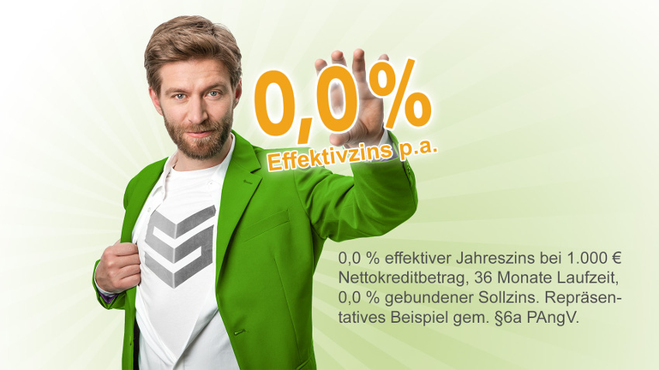

Market Pioneer
0.0% Loans
Negative Interest Rate Loans
Pioneered a 0.0% installment loan in Germany in Nov-2015
Pioneered a -0.4% installment loan in Germany in Jul-2017
‹#›

Slide 6
Customer journey
www.smava.de - fill in the details online. ~3-5 mins
Get some online offers. ~60 seconds
Provide proof of income and other details. ~few days
Get the loan from the bank.

Slide 7
02
Why application engine?

Slide 8
Problem statement
For each individual customer find an attractive, realisable set of loan offers.

Slide 9
Why application engine?
Simple solution - request all banks for each customer, but
Banks don’t like waste
Banks pass the costs of waste to Smava when negotiating commissions

Slide 10
How much do we know about each side?
Banks
Customers
We see them interact with many different types of customers : we know banks preferences
But, banks actively manage their risk exposure - bank’s preferences are regularly changing
Unlike Facebook, we don’t observe the same customer choices over and over again.
But we know customer preferences by observing similar customers.

Slide 11
smava Master Presentation Template - Introduction
Smava marketplace
Efficient matching
Customer mostly care about the interest rate
Banks care about number of requests they receive vs the number of payouts they provide. Banks do not like waste
smava’s mission is to assist the customer find the best deal on the marketplace
smava is concerned both with the interest rate of the offer AND the realisability of the offer (measured by probability to get the offer)
smava gets paid commission by the bank and is free for customers to use

Slide 12
Application engine - objectives
Efficient matching
Get the best offers for the customer
Reduce waste for banks
Fast response

Slide 13
03
How?

Slide 14
How?
Machine learning: use historical data to learn “applied probability” and interest rate of all potential offers.
Predict applied probability and interest rate for each individual customer
Combine these predictions to find the optimal offer portfolio
Output
An ordered list of banks to request
exact timing of each request
when to stop requesting

Slide 15
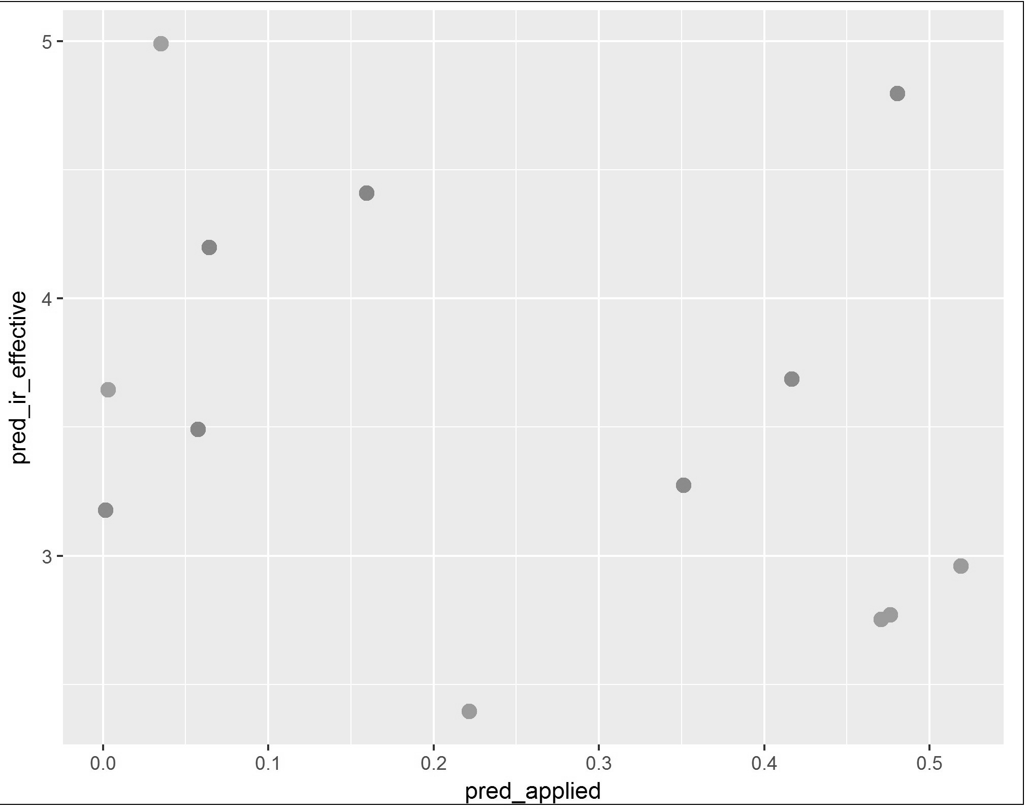

Interest rate - predicted applied probability space
Set of which offers constitutes the optimal customer portfolio?

Slide 16
Smava engineering infrastructure
Bank_1
Data collection, processing saving
(Smava website,
databases etc.)
Predictions, portfolio creation, execution schema
(“Application engine” - Machine Learning component)
request execution schema
Bank API connectivity
offer request - response
customer data
Bank_2
offer request - response
Bank_N
~3-5 mins
~1 sec
~60 sec
t

Slide 17
ML component within Smava architecture
Provides an execution schema that is used by the Bank API connectivity component
Fast - currently below 1 second
Affects each customer

Slide 18
04
Production environment

Slide 19
Design principles
End to end vs predictive models only
Extensive tests (unit and statistical) - testthat
Automatic retraining - weekly/daily
Live monitoring (input data, output data , effect on the world) - Shiny

Slide 20
Automatic retraining (build script)
Get data from all sources (cloud,DB)
Clean data and prepare it for modelling
Train models (learn from what happened last week)
Run tests
Compute predictive accuracy on unseen data
Return a training report - Rmarkdown

Slide 21
Monitoring
Hourly real time model predictive performance monitoring - Shiny
Daily input monitoring

Slide 22
Unit testing
“Test that” - formal testing of your code functionality
Essential to keep production environment stable.
Automatically performed at each retraining
test_that("str_length of factor is length of level", {
expect_equal(str_length(factor("a")), 1)
expect_equal(str_length(factor("ab")), 2)
expect_equal(str_length(factor("abc")), 3)
})

Slide 23
Package version control
Necessary to ensure package versions on training and production environment are identical or compatible
“Packrat” - dependency management system for R
Isolated: separate package directory per project
Portable: transport from one platform to another
Reproducible: records package versions and reproduces them
Integrates with Rstudio
We were not satisfied - breaks when R versions differ
Mac running R 3.5.0, Ubuntu server running R 3.4.4,Packrat not able to install the needed packages
Using docker containers instead

Slide 24
Production monitoring
“Shiny” - real time monitoring of key metrics
AUC, Logloss,MAE
KPI monitoring
Market changes
“Rmarkdown” - post retraining report
Can new models be pushed to production?
Freshly retrained model performance - out of sample AUC, Logloss, MAE
Per bank statistics

Slide 25
Integrating ML components into smava’s engineering architecture
ML component encapsulated within a JAVA system that is able to execute R code with multiple execution nodes
IT ops assistance required for R configuration
Engineering assistance required to put retrained models into production
Failure prone when updating R packages
Can not use python

Slide 26
05
Model hosting with AWS Sagemaker

Slide 27
Model deployment
Many tools to deploy ML model in cloud
AWS Sagemaker, Azure AI, Google Cloud AI
Fully managed
load balancing, autoscaling
Sagemaker is flexible
any docker image containing trained model

Slide 28
Model deployment
Dockerized REST API (FLASK) deployed on sagemaker
“Blue/Green deployment” to reduce risk and downtime
Create a new REST API for a re-trained model
No more package clashes and can also use Python

Slide 29
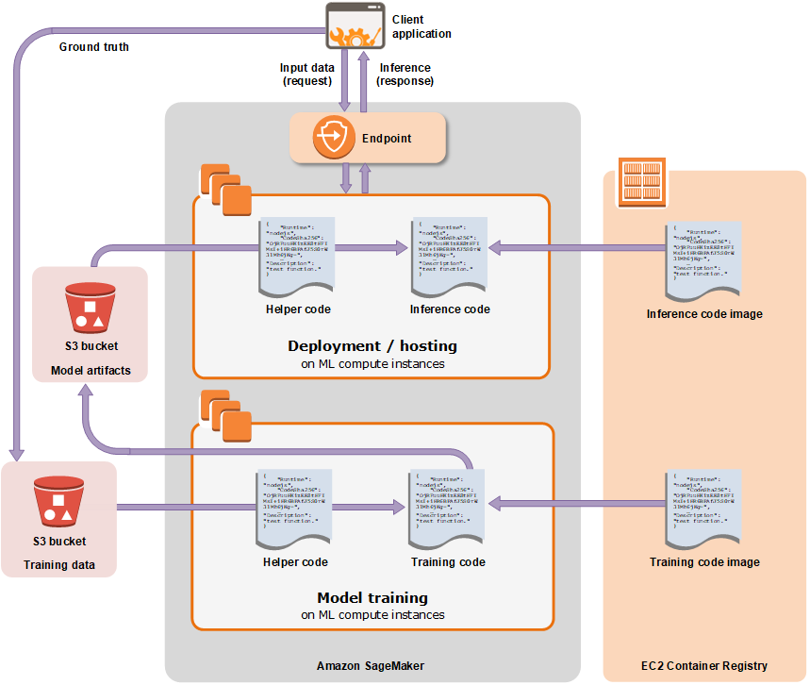

Slide 30
Application Engine microservice
DS team fully owns the Application Engine microservice
Complete ownership of infrastructure - no IT ops/engineering involvement required
DS outputs are provided via a REST api

Slide 31
06
Summary

Slide 32
Summary
ML component within smava is the very core of the production system
Opportunities and desire to significantly impact the business in real time
Additional challenges
Fitting into the overall engineering architecture - end to end design
Changing bank and customer preferences - regularly retraining the models
Stability - retraining report and monitoring, unit testing
Speed - monitoring script execution time
Solid software engineering practices

Slide 33
We’re hiring
Interesting challenges + real business impact + great team = fun
We’re hiring at a mid - senior level. Send an email

Slide 34
Thank you for your attention
Evgeny Savin
Senior data scientist
evgeny.savin@smava.de

