Slide 1
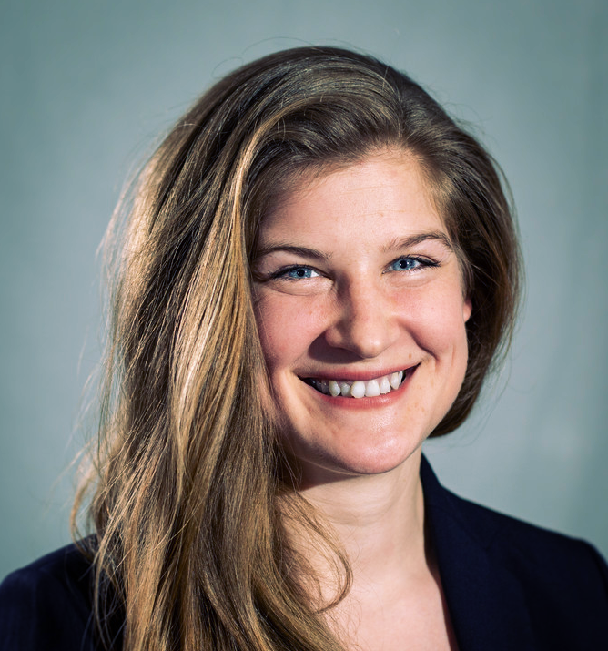
Hello!
library(dplyr)
rladies_global %>%
filter(city == 'Berlin')

Slide 2
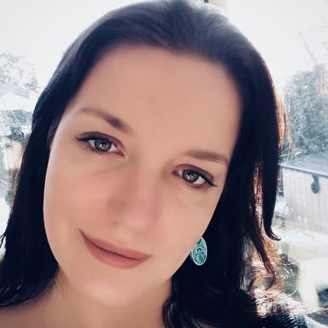
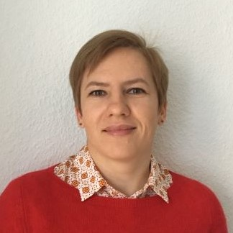

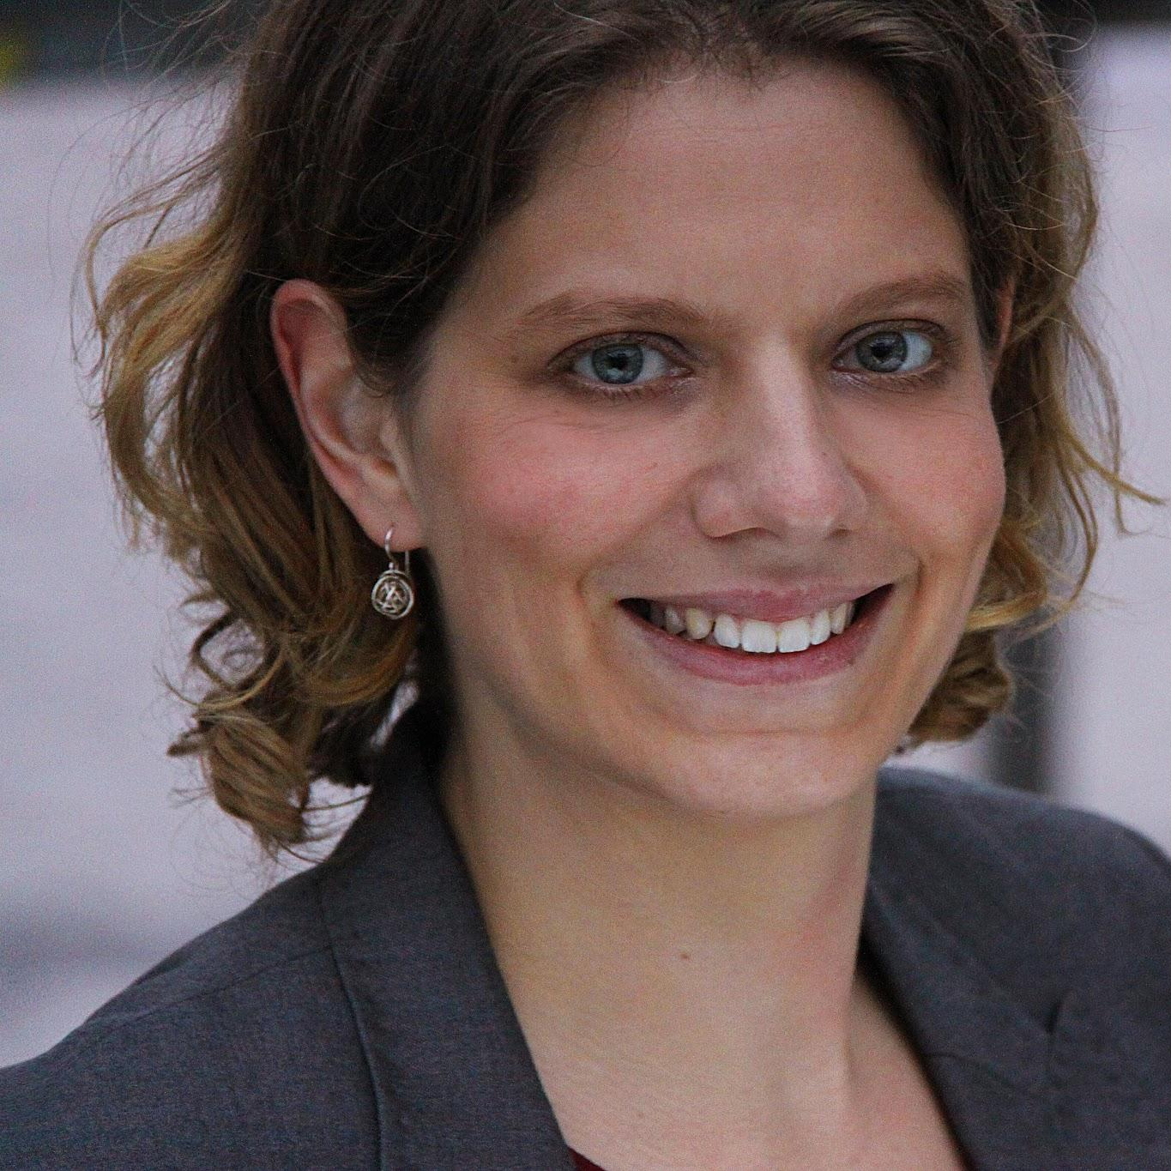
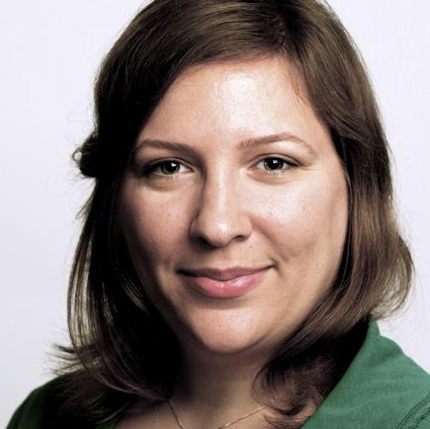


R-Ladies Berlin
library(dplyr)
rladies_global %>%
filter(city == 'Berlin')
@RLadiesBerlin rladies-berlin mail: berlin@rladies.org

Slide 3
Save the date - our next session
Ciera Martinez, R-Ladies San Francisco
When: 24th June 2019
Where: Babbel, Berlin-Mitte
Stay tuned! Updates soon online on meetup.com/rladies-berlin/
Notes:
We’re in discussion with some interesting external speakers who will be in Berlin for PyData that week.

Slide 4
(All) Meetup resources:
https://github.com/rladies/meetup-presentations_berlin
Notes:
Let’s start!

Slide 5
R-Ladies Berlin
library(dplyr)
rladies_global %>%
filter(city == 'Berlin')
@RLadiesBerlin rladies-berlin mail: berlin@rladies.org

