Slide 1


Integrating R & Google Drive
for Collaborative Research
H. Rempel, K. Bodwin, B. Ruttenberg

Slide 2


Challenges: Collaborators vary in knowledge of data management practices, R and/or Git literacy
> df %>% function
Tidy-whaaat???

Slide 3




Challenges: Consistent data entry
!=

Slide 4

Google Drive for Project Management
Free, familiar & user-friendly
→ Not everyone is comfortable making the initial commit to Git

Slide 5
Google Drive for Project Management
Free, familiar & user-friendly, with version control
Version control, file backup & simultaneous editing
Google sheets tools save time cleaning data in R

Slide 6
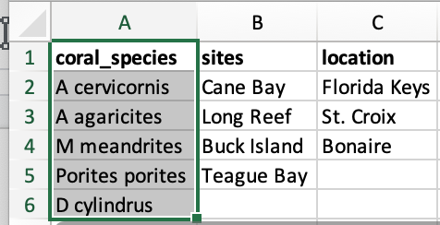
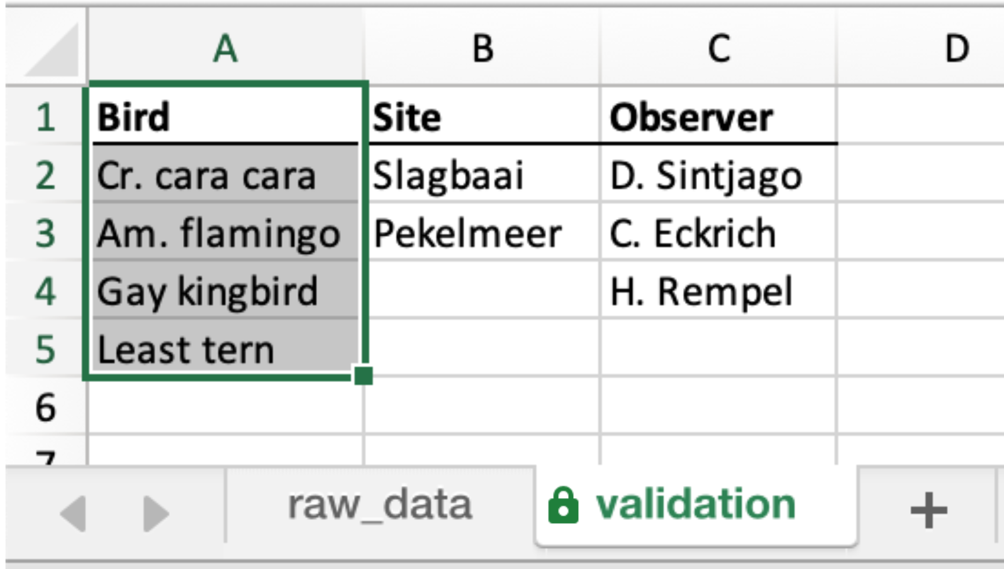
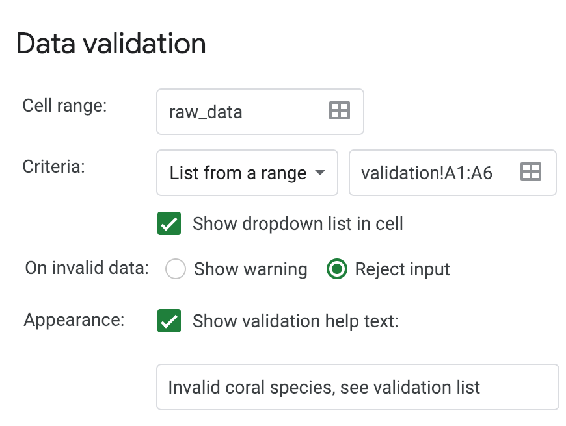
Tools: Data validation– work smarter, not harder

Slide 7
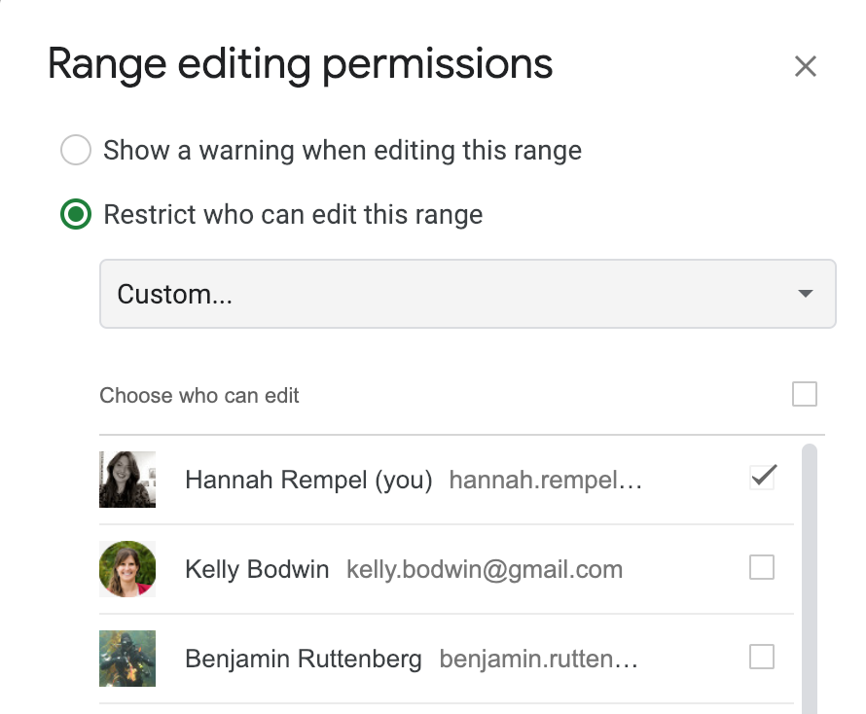
Tools: Restricting User Access to Data Editing

Slide 8
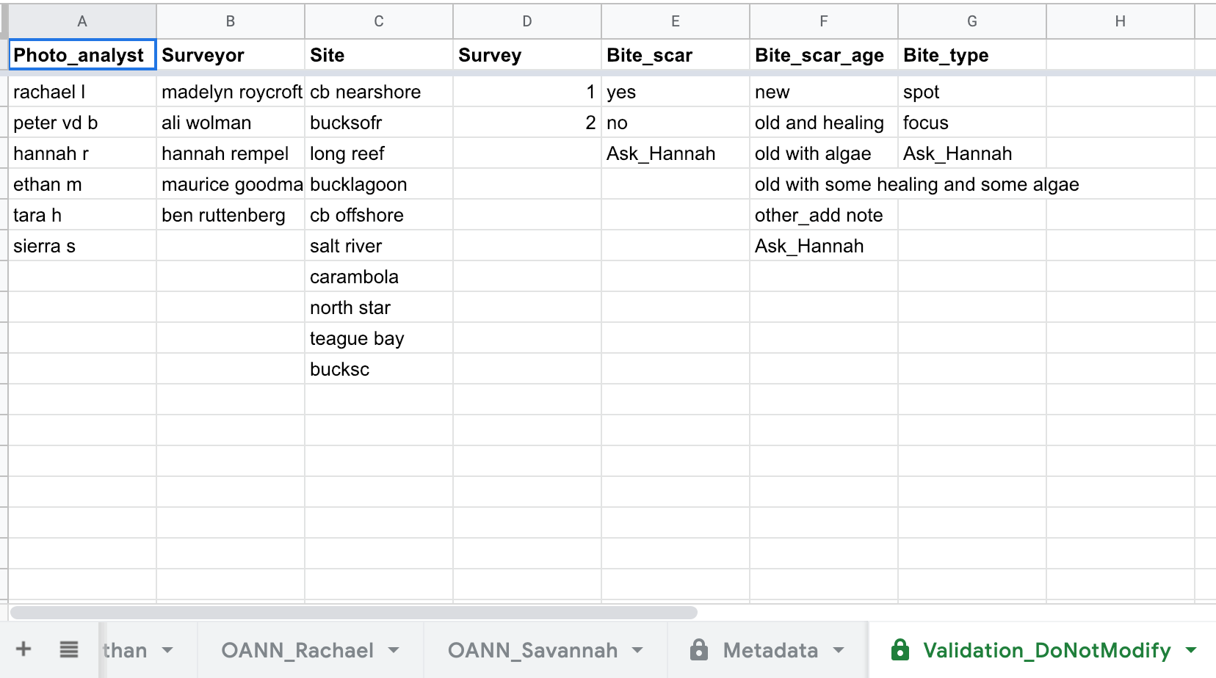
Tools: Restricting User Access to Data Editing

Slide 9
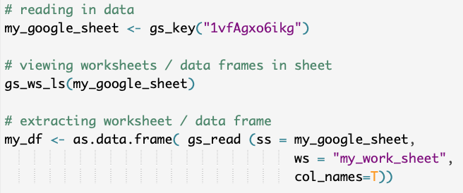
Easy Drive to R workflow: ‘googlesheets’ package

Slide 10
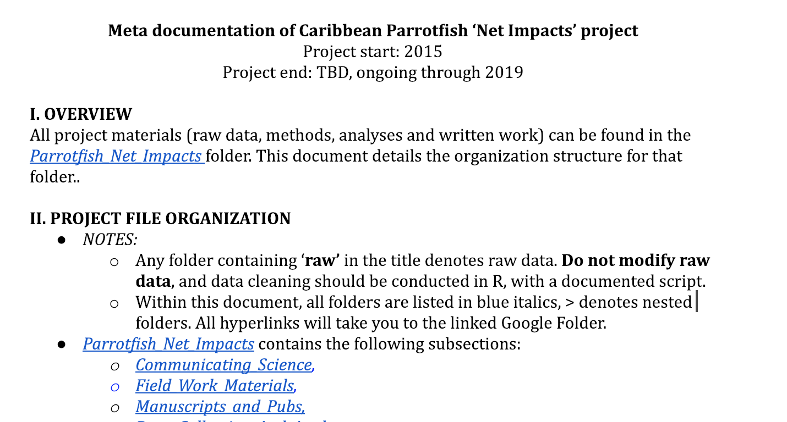
Easy Documentation

Slide 11
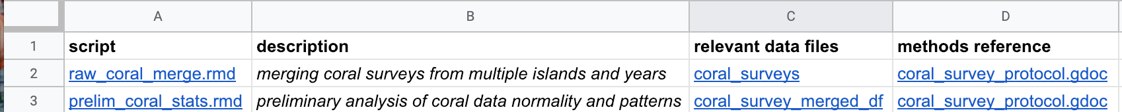
Easy Documentation

Slide 12
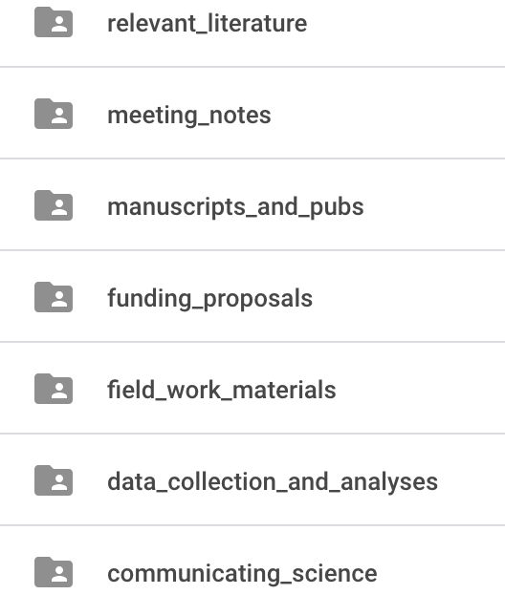

Drive to Git Interface
→ You can still store scripts on GitHub

Slide 13
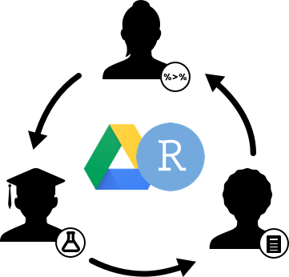
Summary
Data management is difficult– especially with collaborators of varying data science literacy
Google Drive is free, familiar and user-friendly
Sheets has useful tools for upstream data management
Data science doesn’t need to be rocket science

Slide 14
Questions?

