Slide 1
THE WEATHER CONDITIONS, INCLUDING TEMPERATURE, HUMIDITY, WIND SPEED, AND PRESSURE
Submitted by:
Satabdi Biswas
Batch No: 43
Roll: 01-043-19
Submitted to:
Md. Erfan
Assistant Professor & Chairman
Dept. of Computer Science & Engineering
University of Barishal

Slide 2
Key Insights
Foggy conditions persisted throughout the day.
Humidity remained high (mostly above 88%).
Temperature ranged between 59°F and 66°F.
Wind was mostly calm, with occasional NE or ESE breezes.

Slide 3
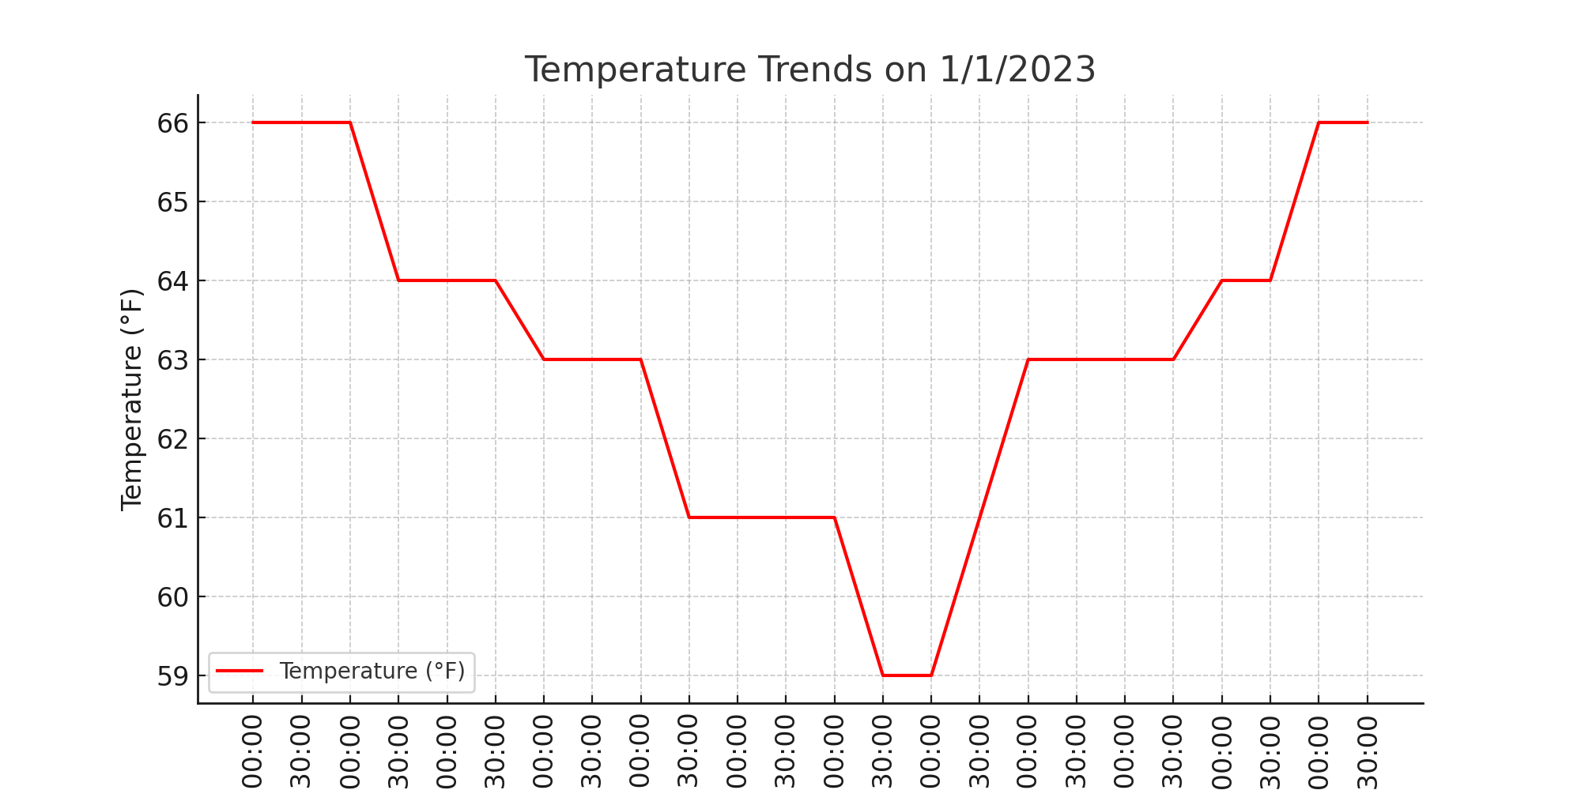
Temperature Trends

Slide 4
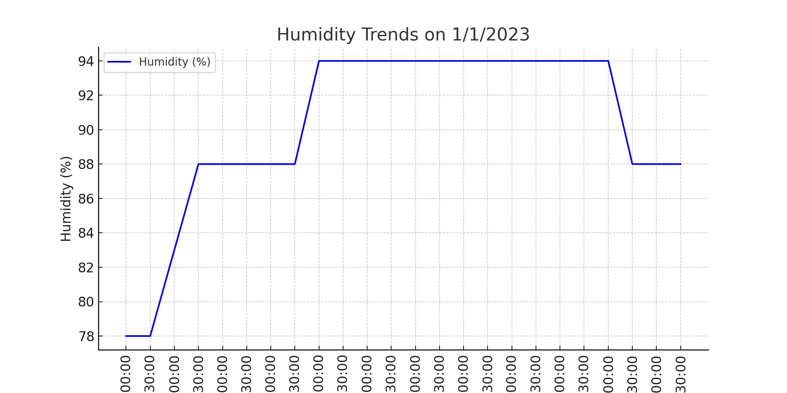
Humidity Trends

Slide 5
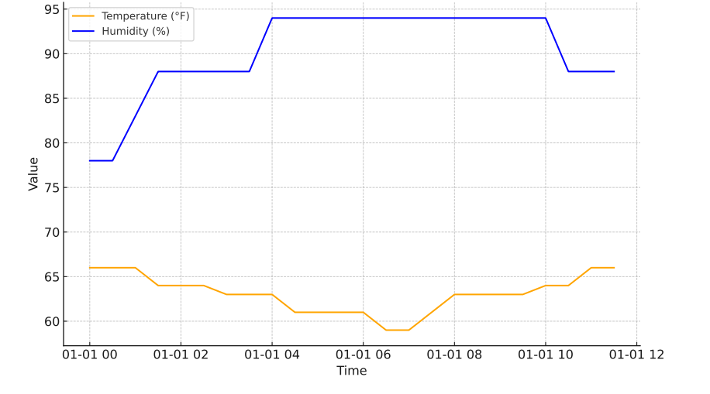
Temperature & Humidity Trends

Slide 6
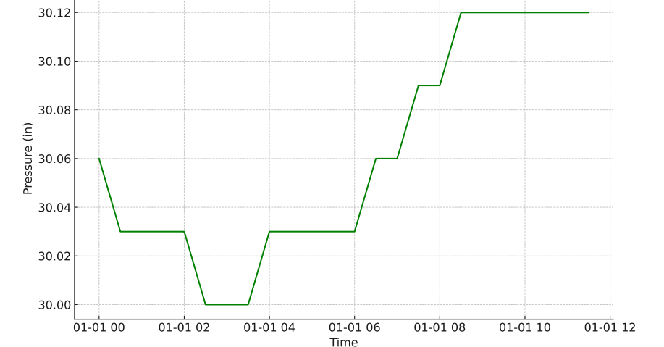
Pressure Variation Throughout the Day

Slide 7
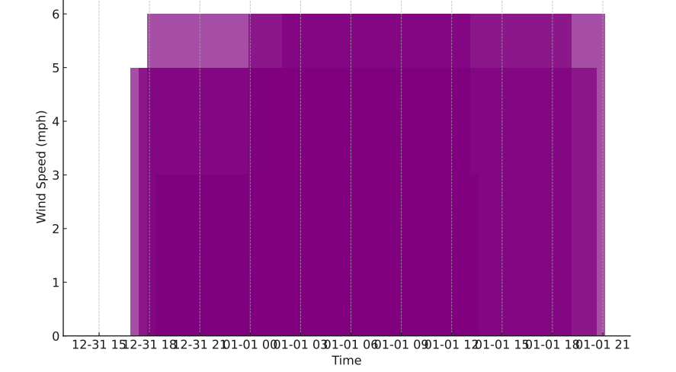
Wind Speed Variation

Slide 8
Conclusion
High humidity (near or at 94%) coupled with temperatures near the dew point promoted sustained fog.
Calm winds or very light breezes contributed to fog persistence, as stronger winds typically disperse moisture-laden air.
Minimal fluctuations in pressure ensured stability conducive to fog retention.

Slide 9
Thank You

